Slide 1
Creating a Sudoku Solver: A Comparison Study
Artificial Intelligence final project
Lewis University
March 6, 2019
Group 3: Stewart Galloway, Jason Overgard,
Phung Hong Vu, and Johannah Cushing

Slide 2
Outline
Background information, related research
Project/problem description
Methodology- the dataset and solver descriptions
Results and Discussion
Conclusion
References

Slide 3
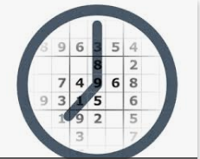
Project Description and Goal
Goals:
Algorithms that can guarantee solutions to sudoku problems.
Algorithms with least amount of time
Solve “The world’s hardest Sudoku”
Descriptions:
10,000 Sudoku puzzles used from Kaggle
Algorithms use:
Solver 1 = Python-Constraint
Solver 2 = Constraint, naked twins, & search
Solver 3 = constraint, search
Solver 4 = Backtracking
Compare the solving time
Notes:
We will evaluate our solvers based on solving speed and compare them based on how well they work for sudokus of various difficulty.

Slide 4
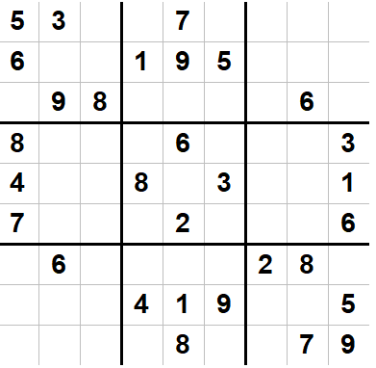
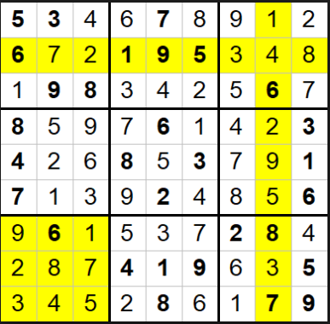
Background - What is Sudoku?
“Suji wa dokushin ni kagiru” meaning “ the digits are limited to one occurrence.”
Notes:
Sudoku is a game requiring no math, just logic
Numbers 1-9 can only appear once in each 3 x 3 box, each row, and each column
Single unique solution

Slide 5
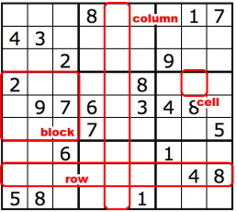
Constraint Satisfaction Problem
Definition:
CSP = (V,D,C)
V = {V_{rc}} a set of n variables
D = {1…,9} is set of domain, one domain per variable
C is a set of constraints apply to the variables
Notes:
V = cell w/ row r and column c
D = {1..,9} for 9x9 grid

Slide 6
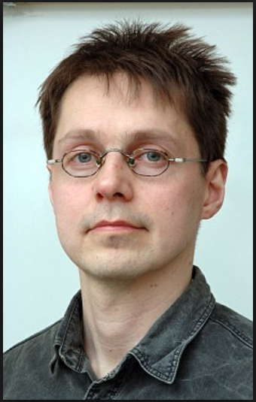
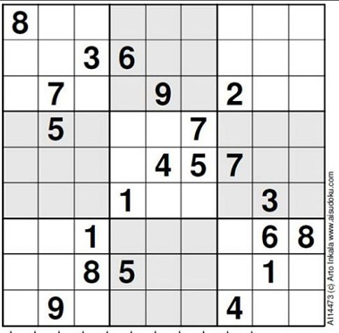
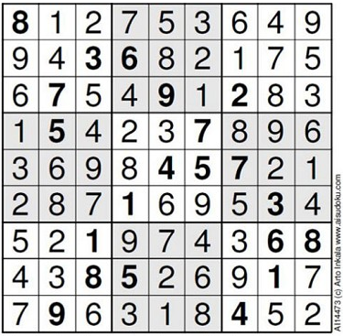
The “World’s Hardest Sudoku”
Everest
Arto Inkala
Solution
Notes:
Developed by Arto Inkala, a Finish mathematician in 2012
Would be an 11 on a normal 1-5 scale of difficulty
Requires a person to think 10 moves ahead
Difficulty of sudokus could be assessed by size of search space

Slide 7
Algorithms used
Python-constraint
Constraint propagation
Naked twins
Search
Backtracking

Slide 8

Python-Constraint
Part of python package to solve CSP

Slide 9
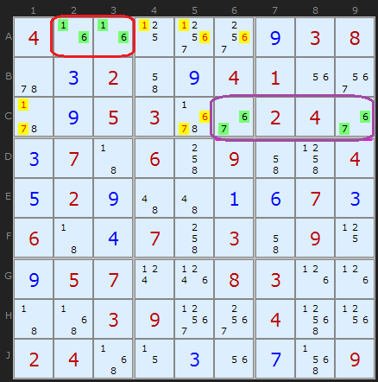
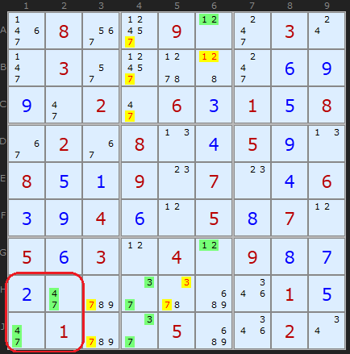
Naked Twins
Also known as Conjugate Pair
Notes:
Also known as Conjugate Pair
A set of 2 numbers
sighted in 2 cells
belong to at least 1 unit in common
Unit: row, column, and box
candidate numbers from other cells in the same unit are removed

Slide 10
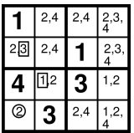
Constraint Propagation
Hidden single technique
Hidden single technique
Naked Single technique
Notes:
Naked single technique: only a single value is in the cell. The remaining cells with the number is omitted
Hidden single technique (also called naked value, inclusion principle): For a given unit (row, column or sub-grid) there exists only one cell which can contain a given value (all other placements would lead to a direct violation of rules).

Slide 11
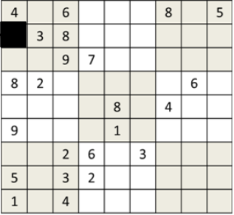
Search Algorithm
Possibility = {7,2}
7
2
Notes:
Try all possibilities until it works

Slide 12
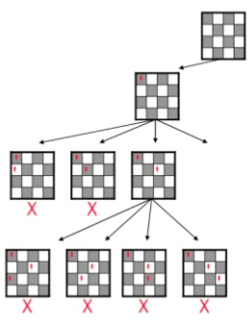
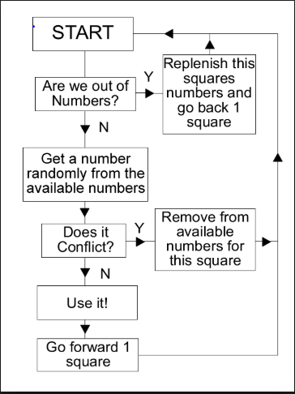
Backtracking
Flowchart
https://www.codeproject.com/Articles/23206/Sudoku-Algorithm-Generates-a-Valid-Sudoku-in-0-018
Notes:
A brute-force approach
Assume exactly one solution, a fully filled grid
Input is a partially filled grid (solution won’t change any of the values already given)
Consider a depth-first search through a solution tree
Each internal node is a partially completed sudoku grid.
Each leaf is a completed sudoku grid.
In the tree, there are solution paths, or sequences of choices of children that lead to to a correct, solved grid.
If A node has m empty cells in A sudoku grid. Then, it will have n ∗ m distinct children, (each empty cell could have n possible values)
If we are on a solution path, THEN exactly one of the n children in each N * m cluster is also on the solution path. I.E., for each cell in the Sudoku grid, there is exactly one correct digit I can write.
DEPTH OF THE TREE FROM HERE IS M
At each node, before looking at its children, we check to make sure the populated grid cells comply with the Sudoku constraints. We reduce the amount of time traversing the tree.
When we try writing a number down in a cell, or make a choice on a solution path, we’ve effectively reduced our problem size.

Slide 13
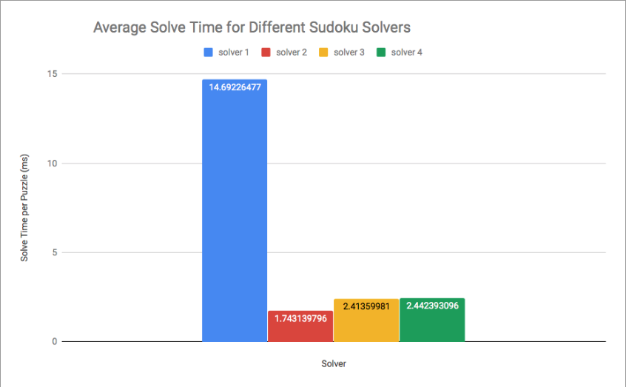
Observations
Notes:
Solver 1 = Python- Constraint
Solver 2 = Constraint, naked, & search
Solver 3 = constraint, search
Solver 4 = Backtracking

Slide 14
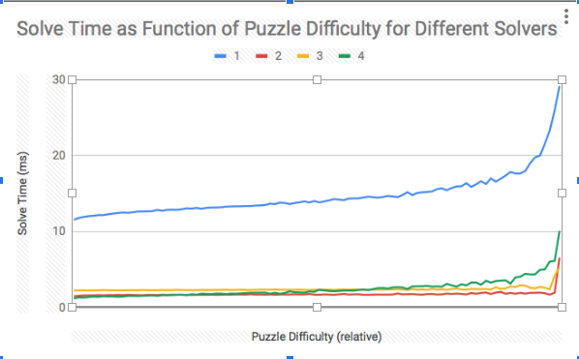
Notes:
Note: To obtain a gauge of difficulty, all the solve times were added up for each puzzle and then the puzzles were sorted by that total
Solver 1 = Constraint
Solver 2 = Constraint, naked, & search
Solver 3 = constraint, search
Solver 4 = Backtracking

Slide 15
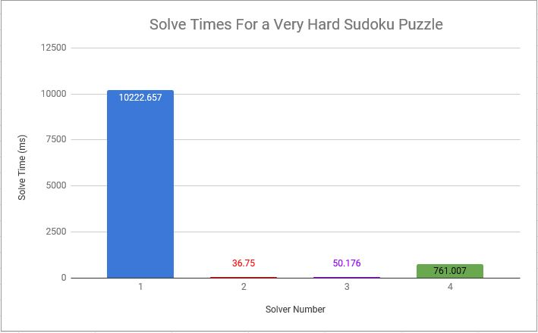
constraint
naked twins
stochastic search
backtracking

Slide 16
Results Analysis
Average time for 10,000 puzzles
Solver 1, Python-Constraint: 14.69ms
Solver 2, Naked Twins: 1.74ms
(Shortest solution time)
Solver 3, Constraint & Search: 2.41ms
Solver 4, Backtracking: 2.44ms
World’s hardest Sudoku-Everest puzzle
Solver 1, Python- Constraint: 10,223ms
640x longer than average puzzle solution time
Solver 2, Naked Twins: 37ms (Shortest solution time)
21x longer
Solver 3, Constraint &Search: 50ms
22x longer
Solver 4, Backtracking: 761ms
317x longer

Slide 17
Conclusion Analysis
Python-Constraint is the slowest
Solver 2 is faster than 3 but has a larger standard deviation (.495 vs. .367)
Solvers 2 and 3 have very flat graphs until the 90th percentile of difficulty
Python-constraint and backtracking solve time gradually increase with difficulty
Backtracking is the fastest for the easiest puzzles but loses in the more difficult half

Slide 18
There are several algorithms which can be used for solving sudokus
Of the methods we used, naked twins was fastest
The best are specifically designed for solving sudokus or are a combination of algorithms
Conclusions

Slide 19
References
Coelho, Leandro C. and Laporte, Gilbert. A comparison of several enumerative algorithms for Sudoku. The Journal of the Operational Research Society, 10/2014, Volume 65, Issue 10.
Collins, Nick (28 June 2012). The world’s hardest sudoku: Can you crack it? The Telegraph. Retrieved from https://www.telegraph.co.uk/news/science/science-news/9359579/Worlds-hardest-sudoku-can-you-crack-it.html
Park, Kyubyong (2017). One Million Sudoku Puzzles (csv file). Retrieved form www.kaggle.com
Simple API. (2019). Python-constraint and sudoku. [online] Available at: https://simplapi.wordpress.com/2012/11/02/python-constraint-and-sudoku/ [Accessed 6 Mar. 2019].
https://slideplayer.com/slide/6171129/

Slide 20
Questions?
Thank you

