Slide 1
AWS CLI
Joseph Cutrono
Ultimate Software

Slide 2
Terminology
EC2 – Amazon Virtual Servers
S3 - Amazon Unlimited FTP Server
IAM - Users, Keys and Certs
* https://www.expeditedssl.com/aws-in-plain-english
AWS-CLI – Command Line Interface for issuing AWS service requests
Dokku - The smallest PaaS implementation you've ever seen

Slide 3
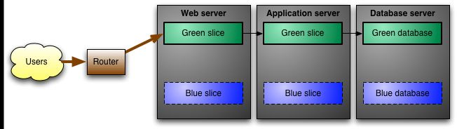
Blue Green Deployments

Slide 4
Steps in deployment
Create new EC2 instance
Install PaaS
Deploy code
Backup and Migrate data
Setup URLs / DNS
Tear down old instance
Drink

Slide 5
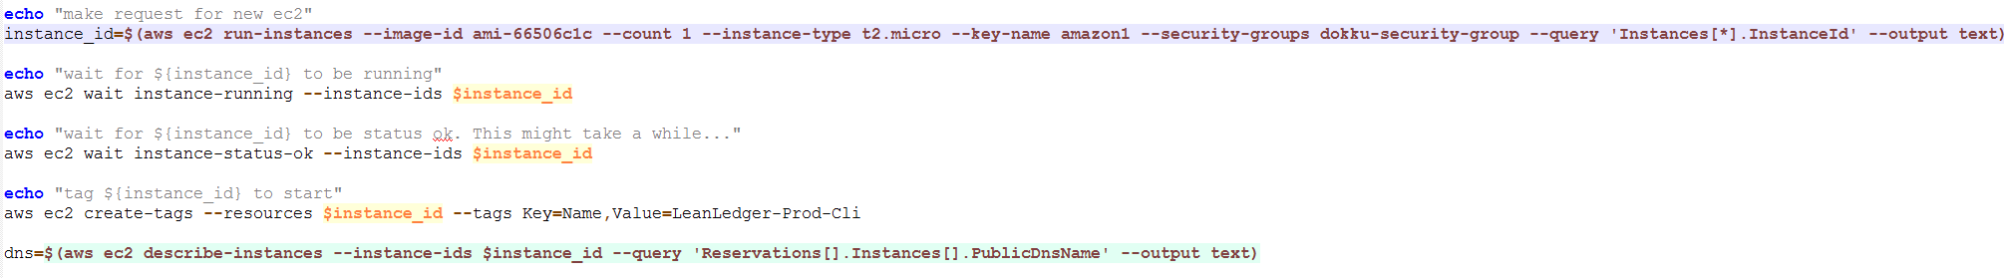
Create new EC2 instance

Slide 6
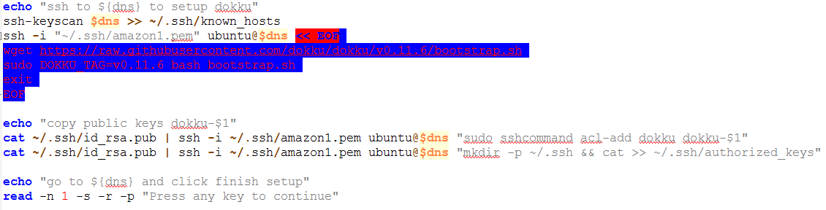
Install PaaS

Slide 7

Deploy code

Slide 8
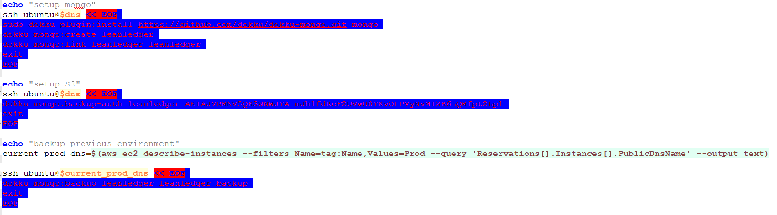
Backup (and Migrate data)

Slide 9
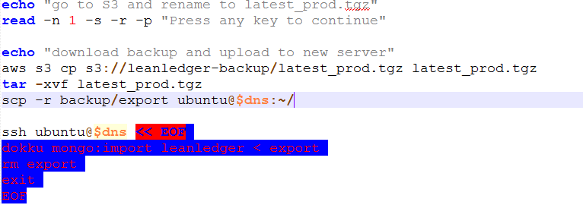
(Backup) and Migrate data

Slide 10
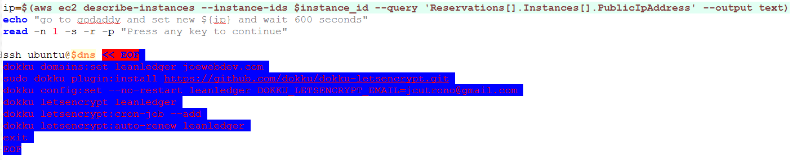
Setup URLs / DNS

Slide 11
Tear down old instance

Slide 12

3…2…1…ACTION

Slide 13
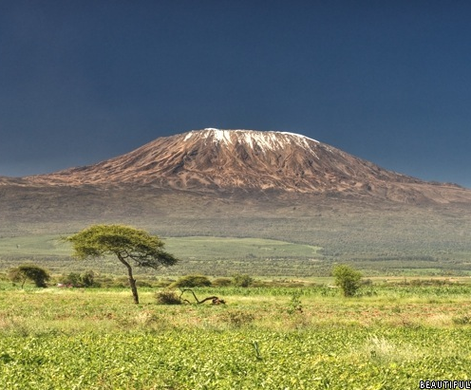
Questions…
https://github.com/jcutrono/leanledger

