Slide 1


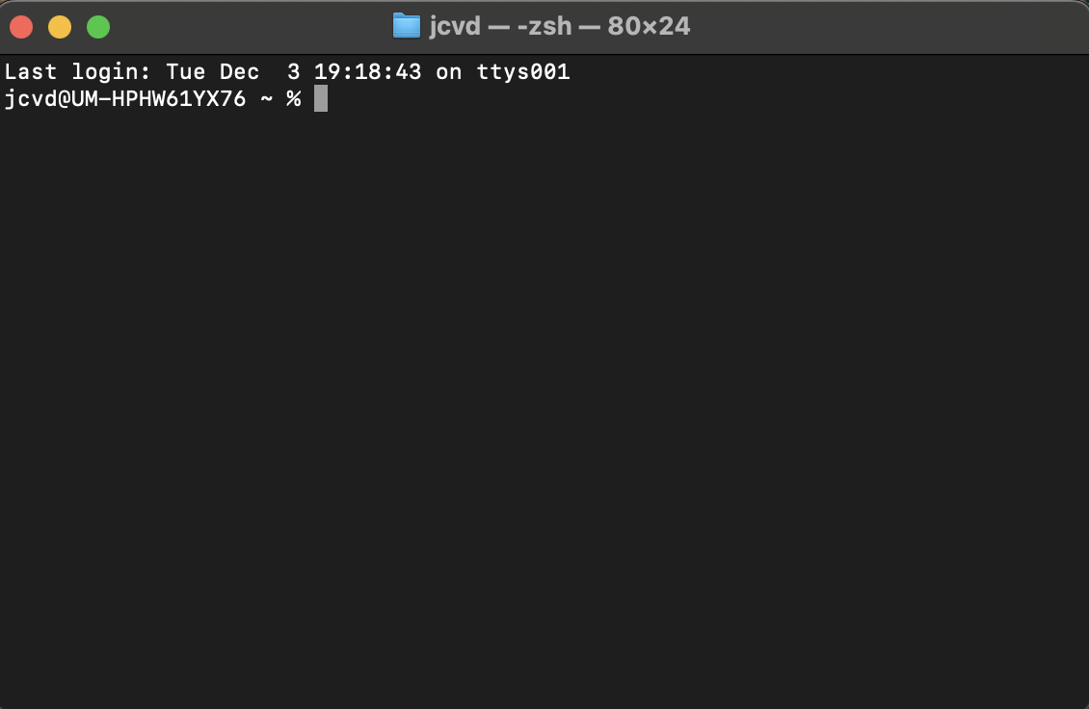


More
Flexibility
Less
The terminal
Scripting languages
Point-and-click
Less
Ease of use
More

