Slide 1
Item Description Standardization 物料描述標準化 (v2)
Group #2 May 4, 2026
鐘惠英
張冠倫
黃乃香
嚴秀惠
朱永彰
范三偉
Best View In Slideshow Mode

Slide 2
Context
We are in a 30+ years company; major product is “cables”.
Due to various reasons, the item master data is not standardized.
Here we focus on item description standardization.
That will help to streamline the direct understanding of this item.
The mission here, is to use AI to standardize historical item descriptions.

Slide 3
Input & Output
Input
We will provide about 4,500 descriptions with 95% confidence level. (Good.xlsx)
We will provide another 5,000 descriptions might need to be standardized. (No_Good.xlsx)
All item descriptions will be provided in Microsoft Excel (.xlsx) format.
To simplify this task, all items are single core cables.
PLS use any AI technology to standardize all the descriptions provided.
Output
PLS generate an Excel file with before/after the change.
PLS generate an AI-learned standard description rule.

Slide 4
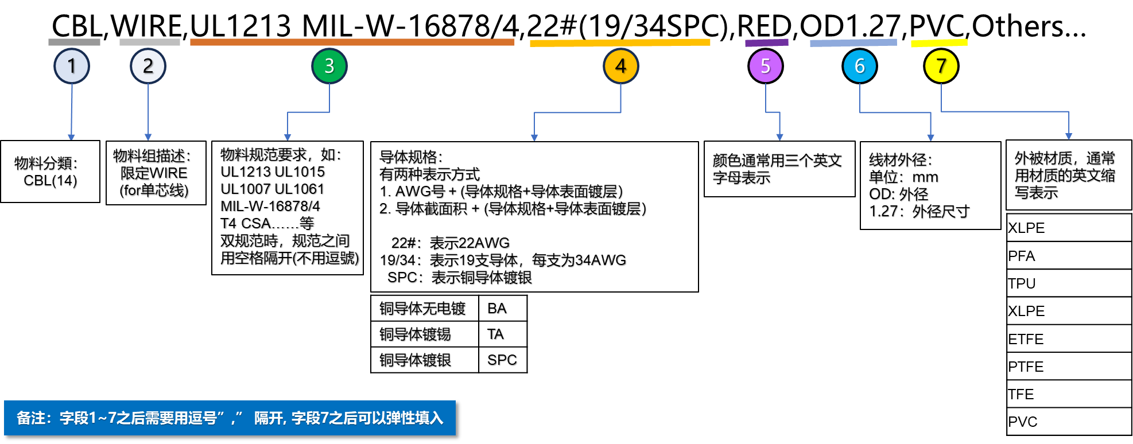
Rule for reference only
Good = 1 ~ 4 fit to the rule
No_Good = not fit, even a comma

Slide 5
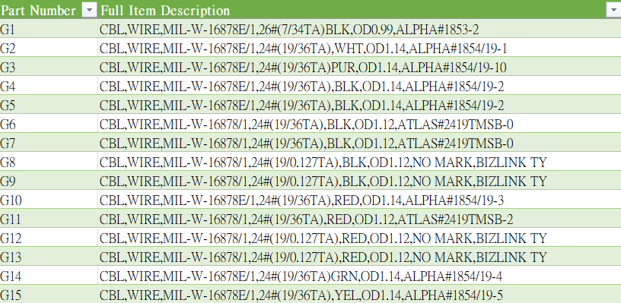
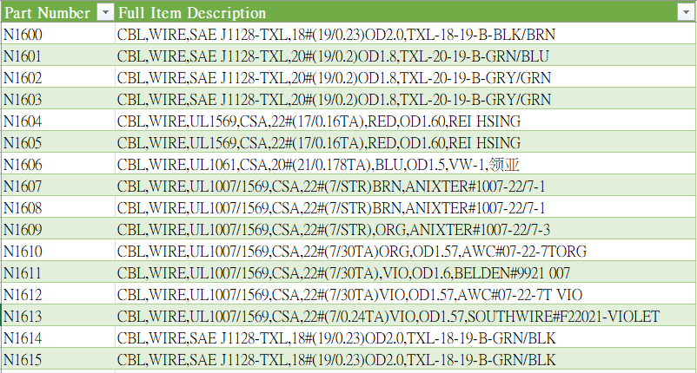
Good
No Good

Slide 6
Example (of inconsistency)
Spec
CBL,WIRE,MIL-W-16878E/1,22#(19/34),BLK,OD1.32,ALPHA#1855/19-2
CBL,WIRE,MIL-16878/1,22#(19/34TA),BLK,OD1.3,ATLAS#2219TMSB-0
CBL,WIRE,M16878/5,8#(133/29SPC),WHT,OD5.3,ANIXTER#M16878/5-BNL-9
Coating
CBL,WIRE,UL10086,6#(133/27)SPC,BRN,OD6.5,150°C,600V,AWC#10086-6-133-BRN
CBL,WIRE,M16878/5,8#(133/29SPC),WHT,OD5.3,ANIXTER#M16878/5-BNL-9
CBL,WIRE,MIL-W-16878E/1,22#(19/34),BLK,OD1.32,ALPHA#1855/19-2
Color
CBL,WIRE,UL1007/1569,CSA,18#(16/30TA)GRN,OD2.0,ALPHA#3055-4
CBL,WIRE,UL1007/1569,CSA,18#(16/30TA),GRN,OD2.0,ANIXTER#UL1007-18/16-5
CBL,WIRE,SAE J1128-TXL,22#(7/0.26A),或(7/0.254BA),OD1.6,TXL-22-7-B-YEL
Misc (separator)
CBL,WIRE,UL10530,CUL,18#(41/0.16BA),BLK,OD2.0,TPE,VW-1,-40~105℃,日新

Slide 7
Thank you
Welcome Feedback to gilzhang@yahoo.com.tw

