Slide 1
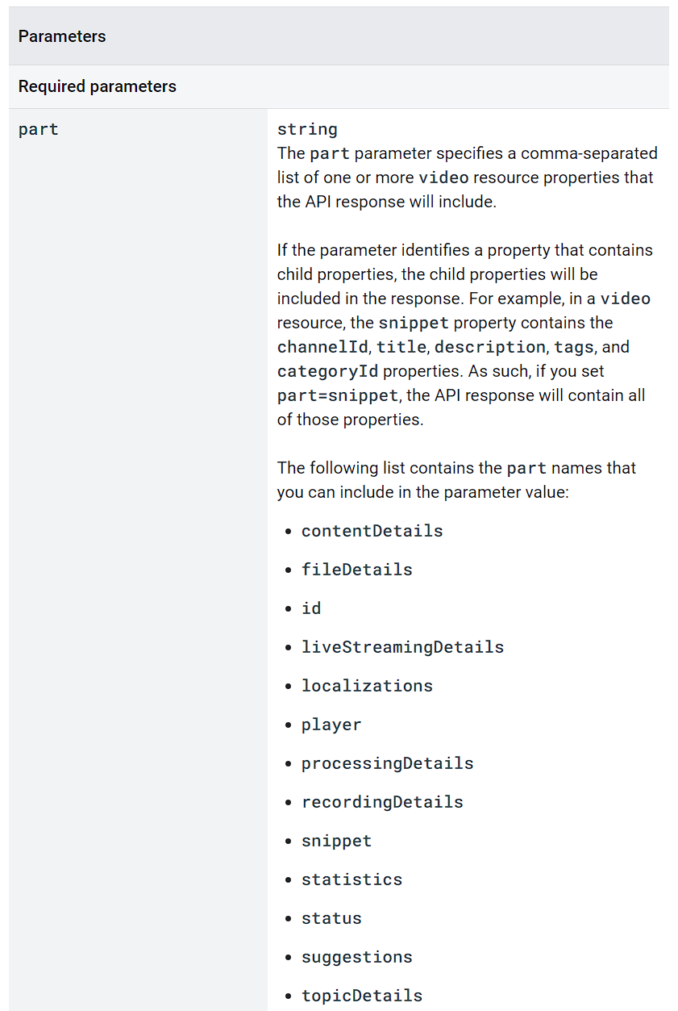
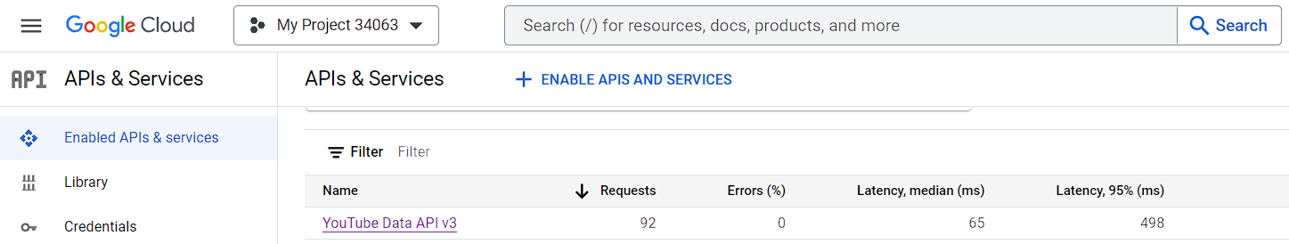
Web Scraping
YouTube API available in Google Cloud
youtube_api <- "https://www.googleapis.com/youtube/v3/search"
query string
request_url <- paste(youtube_api , "?part=snippet&maxResults=1&q=", URLencode(search_query), "&key=", api_key, sep="")
part=snippet
maxResults=1
q=URLencode(search_query)
key=“your_api_key”
https://developers.google.com/youtube/v3/docs/videos/list
Notes:
query string. It contains parameters that define what information you're asking for from the API.
encode the search query to be included in the URL URL encoding is necessary because URLs can only be sent over the Internet using the ASCII character-set.

Slide 2
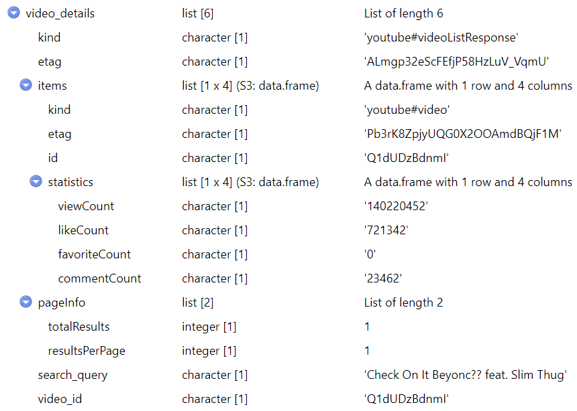
Libraries Used in Web Scraping – httr, jsonlite
GET() - httr
# Make the API request
response <- GET(request_url)
status_code() - httr
# Check the HTTP status code of the response
if (status_code(response) == 200) {}
200 – OK; 404 – Not Found; 500 – Internal Server Error
content() - httr
# Extract content from the response
content <- content(response, "text")
fromJSON() - jsonlite
# Parse JSON content
video_details <- fromJSON(content)
write_json() - jsonlite
# Write json file
write_json(json, “data.json", pretty = TRUE, auto_unbox = TRUE)
Notes:
when you make a request to a web API (like the YouTube API you were working with), the response is often in JSON format.

Slide 3
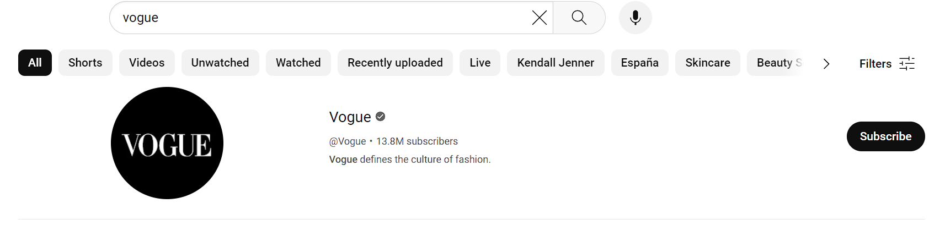
Web Scraping Tips
Sometimes, the first search result is not a video but an advertisement.
Special symbols do not work and can cause errors in search queries, for example, when searching for a song named 'Neighborhood #1 (Tunnels)’.
The problem was then solved by using a combined query with both the song name and the singer's name. This approach makes sense, as some song names can refer to other things.
Notes:
The "#" symbol might be used for other purposes in web contexts.

