Slide 1
What makes a song “classic”: an analysis of lyrics from top songs from 1960 to 2005?
Kuan-Jung Huang¹, Jiacheng Wang², Zhangqi Duan³
¹ Psychological and Brain Sciences ² Chemical Engineering ³ Computer Science
STATS 535 Group 2 Final Project Presentation

Slide 2
Outline
Introduction (Research Question & Dataset)
Textual processing/analysis
Webscraping
Nonparametric analysis
Power analysis
Parametric analysis
Conclusion

Slide 3

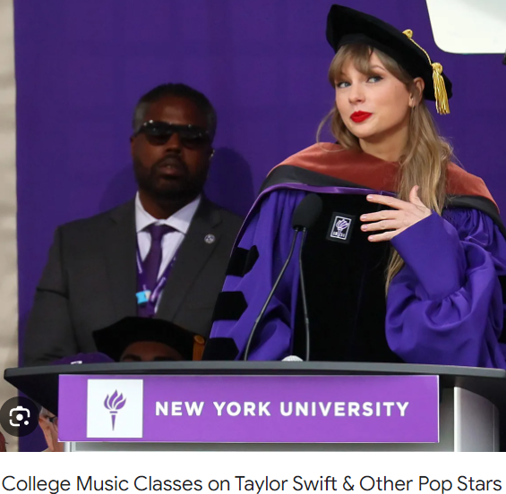

Background (motivation)
Notes:
Why do some songs last longer than others

Slide 4
Research Question
Does the times of repetition of the song title explain how popular a song is?
Hypothesis: the song title repeats ↑ memorability & catchiness ↑, hence popularity ↑
Popularity (YouTube Viewcount) ~ song title repetition times

Slide 5
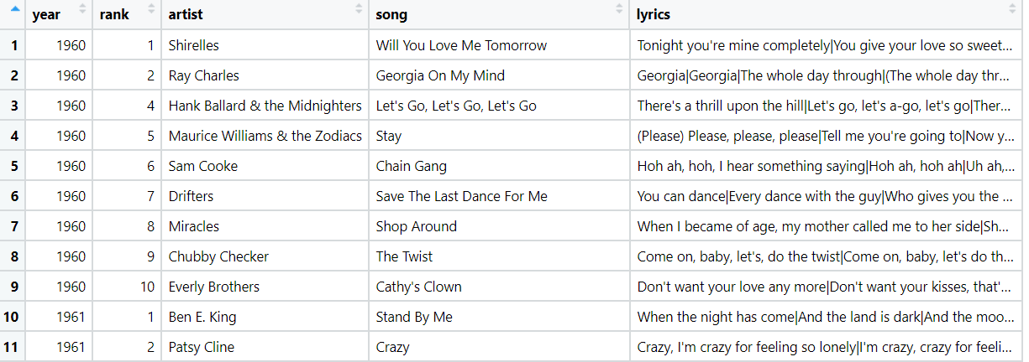
Original dataset
https://www.kaggle.com/datasets/stefancomanita/top-us-songs-from-1950-to-2019-w-lyrics
5 columns and 700 rows (10 top songs per year, for 70 years)
Lines of lyrics are segmented with |
Augmented with data scraped from

Slide 6
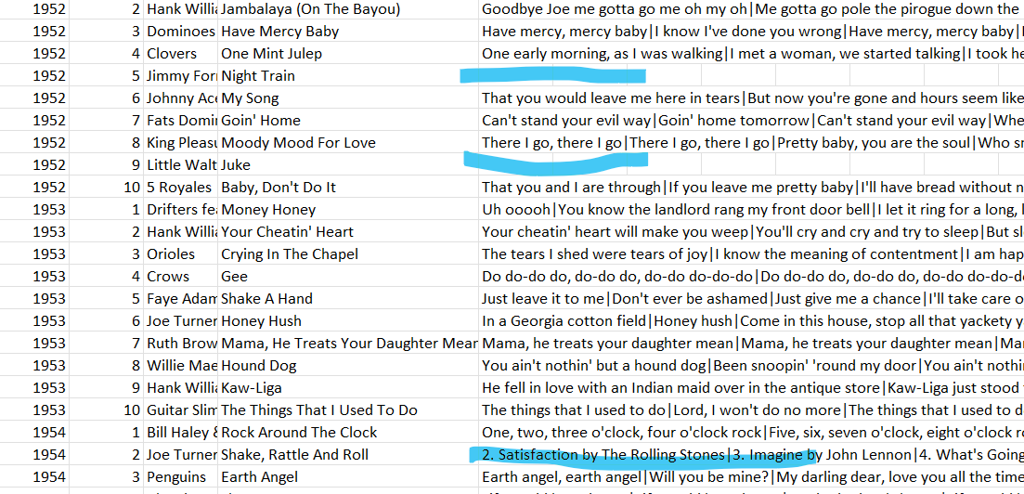

Trimming
YouTube came out in the end of 2005.
Used only songs from 1960-2005 (remove too-old or too-new songs)
A few songs’ lyrics are incorrectly provided
Notes:
All the songs exist by the time Youtube came out

Slide 7
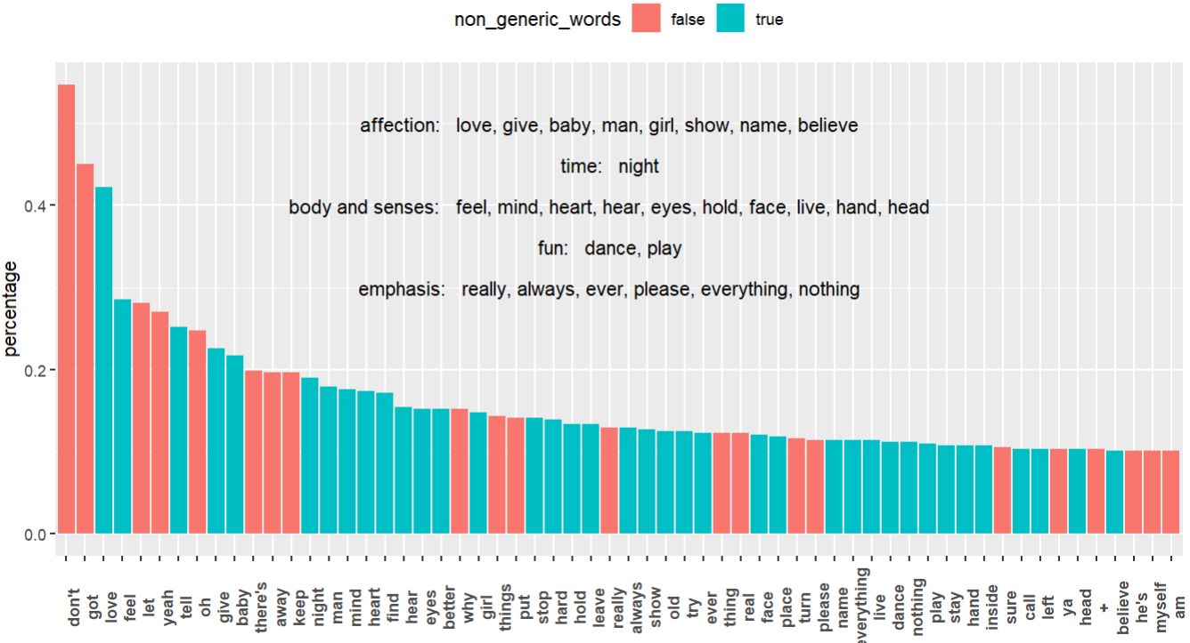
Lyrics analysis
The most common content words in top-song lyrics
str_replace_all
str_split
for-loop + unique
nested for-loop + str_detect
Notes:
str_replace_all (| and other punctuations)
str_split (whole lyrics -> words)
For-loop + unique (find all words ever used and build a dictionary)
Nested for-loop + str_detect
(for every entry in the dictionary, check if it appears in a song)

Slide 8
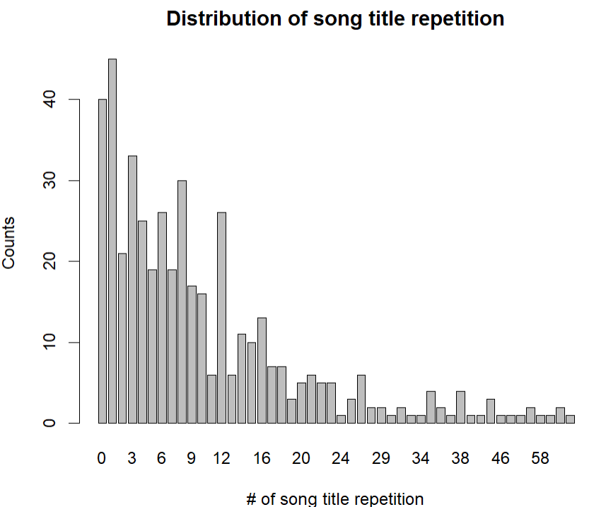
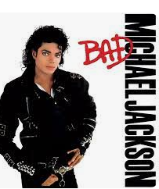
# of times song title repeats
str_replace_all
tolower
str_detect
str_count
Notes:
Remove line segmenters

Slide 9
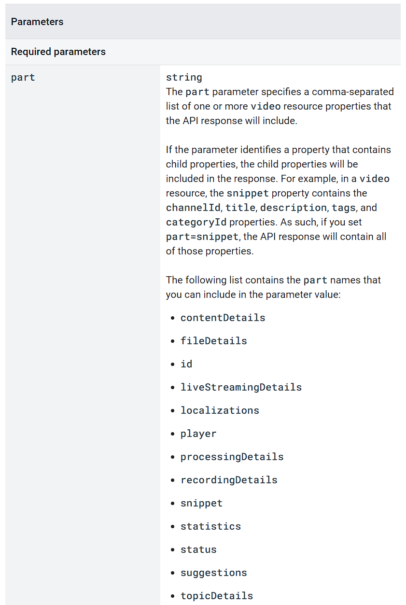
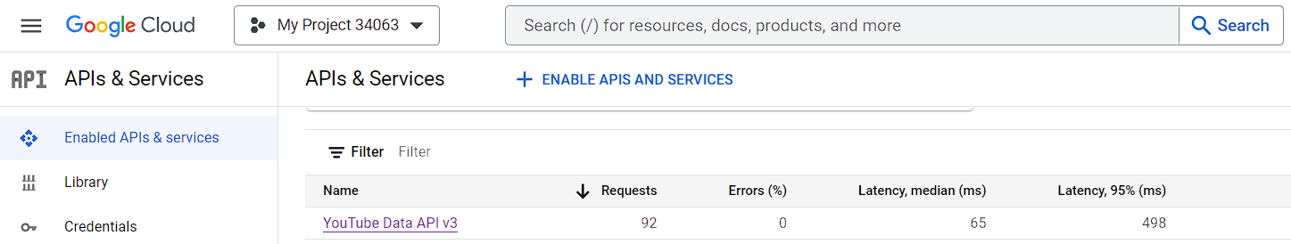
Web Scraping
YouTube API available in Google Cloud
youtube_api <- "https://www.googleapis.com/youtube/v3/search"
query string
request_url <- paste(youtube_api , "?part=snippet&maxResults=1&q=", URLencode(search_query), "&key=", api_key, sep="")
part=snippet
maxResults=1
q=URLencode(search_query)
key=“your_api_key”
https://developers.google.com/youtube/v3/docs/videos/list

Slide 10
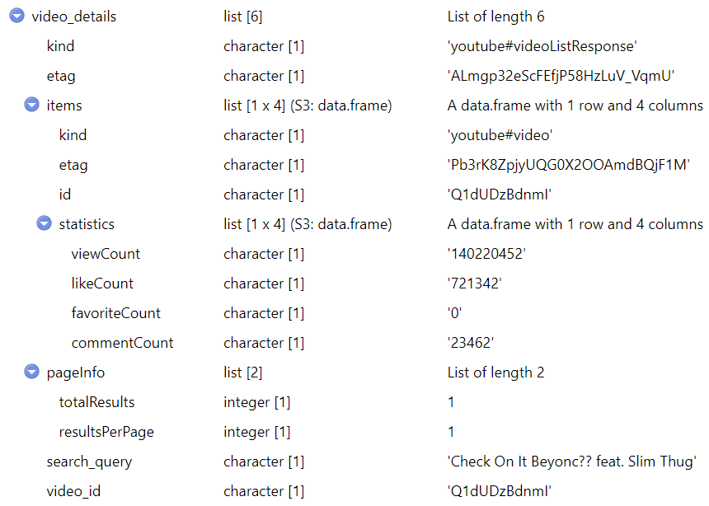
Libraries Used in Web Scraping – httr, jsonlite
GET() - httr
# Make the API request
response <- GET(request_url)
status_code() - httr
# Check the HTTP status code of the response
if (status_code(response) == 200) {}
200 – OK; 404 – Not Found; 500 – Internal Server Error
content() - httr
# Extract content from the response
content <- content(response, "text")
fromJSON() - jsonlite
# Parse JSON content
video_details <- fromJSON(content)
write_json() - jsonlite
# Write json file
write_json(json, “data.json", pretty = TRUE, auto_unbox = TRUE)
Notes:
when you make a request to a web API (like the YouTube API you were working with), the response is often in JSON format.

Slide 11
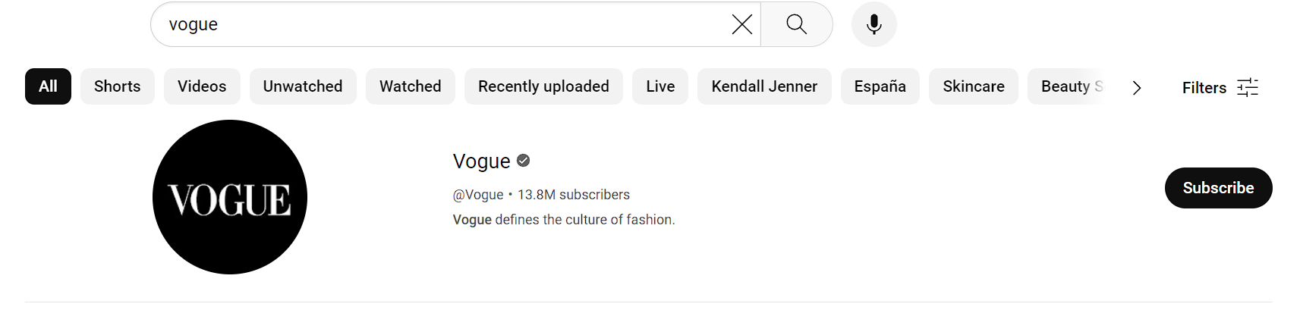
Web Scraping Tips
Sometimes, the first search result is not a video but an advertisement.
Special symbols do not work and can cause errors in search queries, for example, when searching for a song named 'Neighborhood #1 (Tunnels)’.
The problem was then solved by using a combined query with both the song name and the singer's name. This approach makes sense, as some song names can refer to other things.
Notes:
The "#" symbol might be used for other purposes in web contexts.

Slide 12
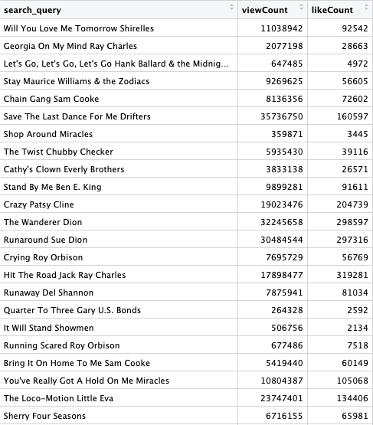
Regular Expression in Handling Json
We created the regular expression pattern for the features we want, including (song_name, view_count, like_ count)
The function we used is str_extract_all() to find all matching pairs.

Slide 13
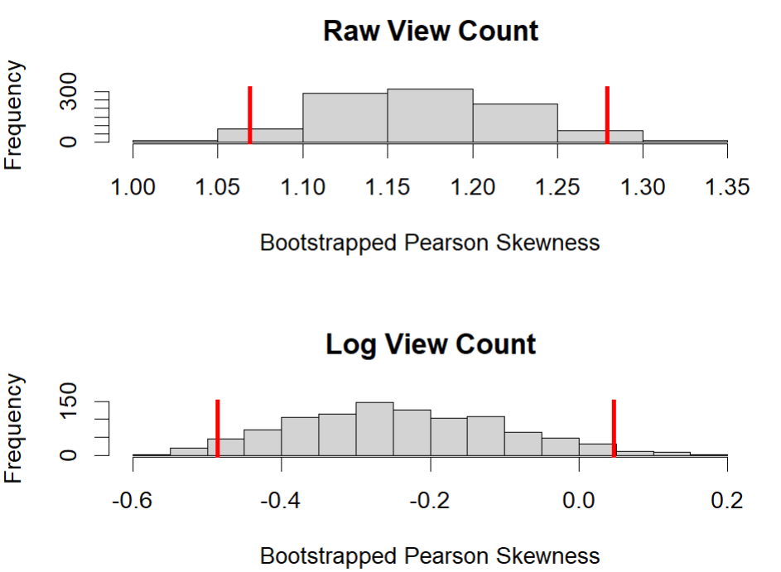
Skewness of the Data Distribution Using Bootstrap
Perform a bootstrap analysis to estimate the distribution of the Pearson's median skewness coefficient for the view_count variable.
This histogram has values around 1.05 to 1.3, indicating a positive skew in the view_count data.
The skewness values after the log transformation range from about -0.5 to 0.05. The distribution is more centered around zero, suggesting that log transformation can help reduce the skewness of the data, leading to a more symmetric distribution.

Slide 14
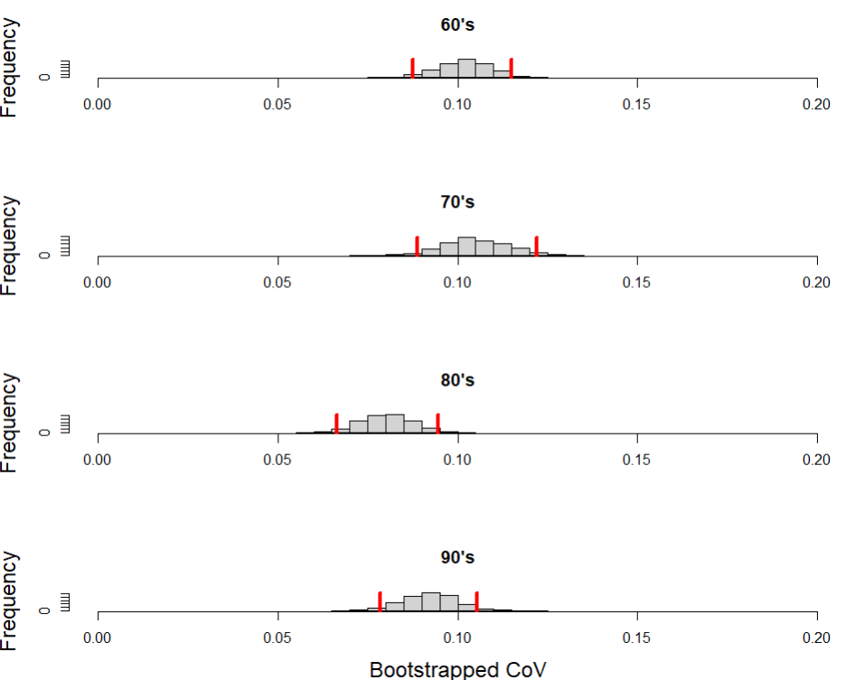
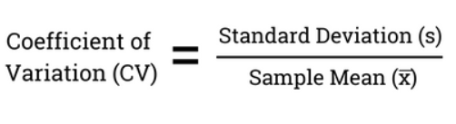
Analysis on Coefficient of Variation
We used bootstrap to get an interval for each decade.
The CV for 80's is comparatively small, which indicates greater consistency and less variability in the view counts of songs from the 80’s.
Notes:
The CV for 80 is comparatively small, which indicates greater consistency and less variability in the view counts of songs from that decade.

Slide 15
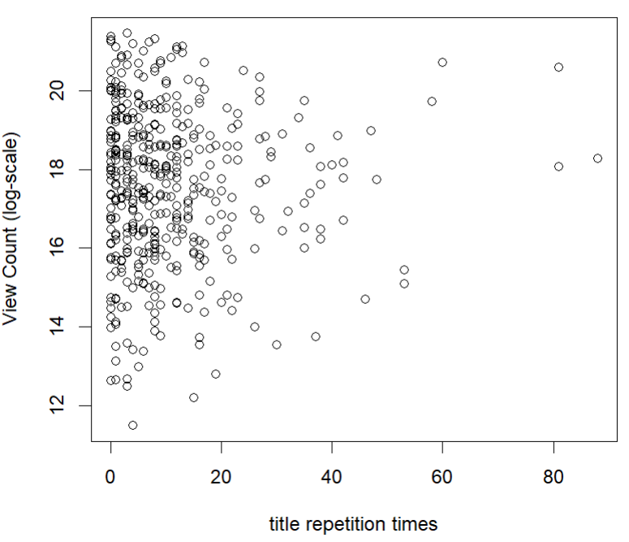
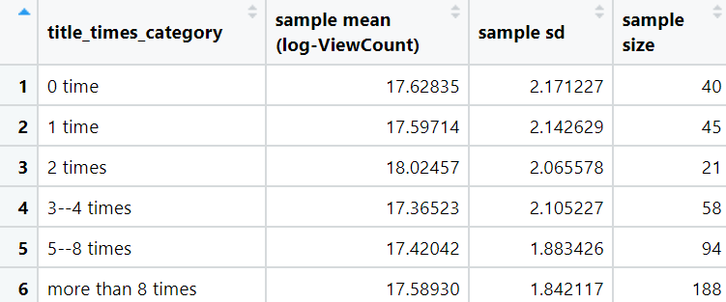
View Count ~ title repetition times Choice of predictor (continuous or categorical?)

Slide 16
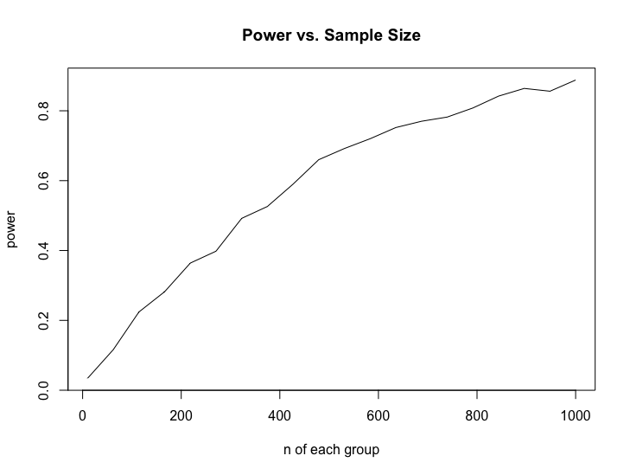
Monte Carlo Power Study
We applied Monte Carlo method for the Power Study
Assumptions:
In each group (by repetition times), the sample size n is the same
The true distribution has mean and standard deviation same as our sample mean and standard deviation
F test: aov()
Power becomes high when sample size is at least 800

Slide 17
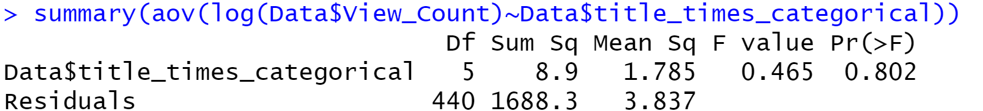
Parametric F test(AOV)
Null hypothesis(H₀): The means of each group are the same
Alternative hypothesis(H_{𝛼}): At least one sample mean differs from the others.
Result: 0.802>0.05, fail to reject the null hypothesis
Notes:
or the different categories of title_times_categorical do not have significantly different effects on view count

Slide 18
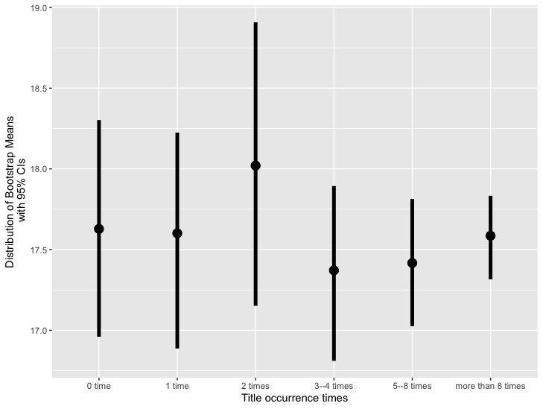
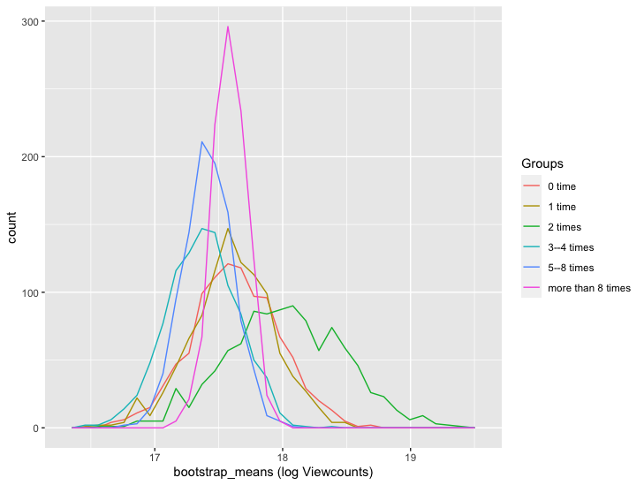
Further Validation
Bootstrap for creating confidence interval for mean of each group
From the graph, it shows that there is no big differences among all groups, which aligns with our F test and Power study (we might be underpowered).

Slide 19
Conclusion
There is no linear relationship between the occurrence of song title in lyrics and the popularity of songs
Our analysis shows with a slight evidence that maybe having occurrence of 2 times might be the better option in song.

