Slide 1


Accelerating PolyFEM Triangular Mesh
Impact Simulation with
Machine Learning Surrogates
Jiacheng Zhao
Supervisor: Dr. Teseo Schneider
University of Victoria
Notes:
Good [morning/afternoon]. My thesis is about making PolyFEM impact simulation practical for design search by replacing each FEM solve with a machine learning surrogate. ~20 min talk, then ~20 min questions on the thesis and the code. (Target ~1 min here.)

Slide 2

Background
Notes:
Section divider. One-line transition, then move on. (~20 s.)

Slide 3

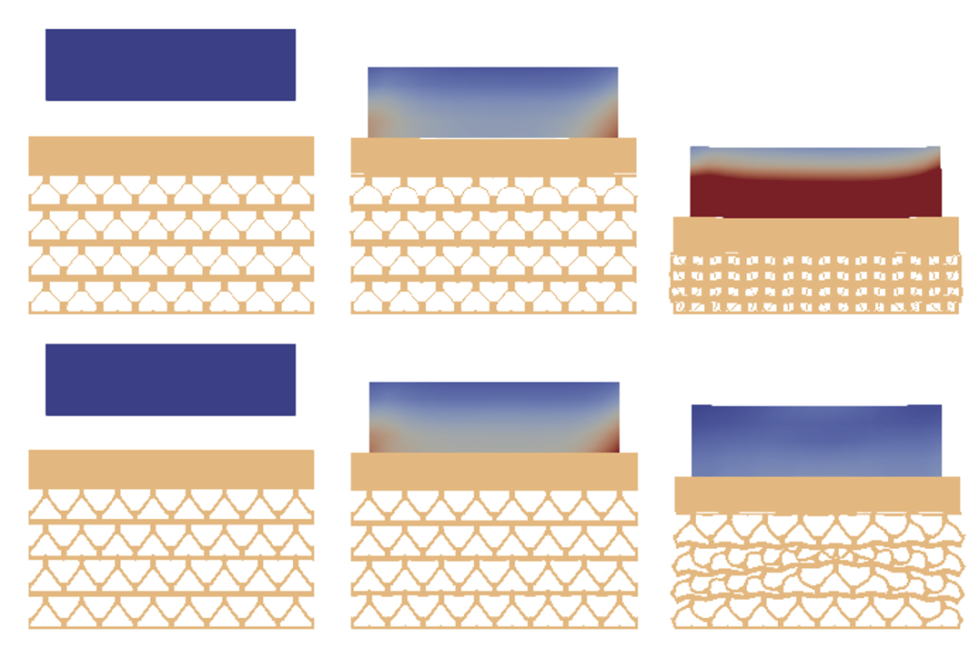
Problem A mesh cushioning the impact from block
apex angle θ, wall thickness h, material stiffness E.
INPUT
3 params (θ, h, E) of Body 1 Mesh
OUTPUT
Peak Stress of Body 2 Block
FEM simulation
Body 2 Block
Accurate, because it solves full physics
50-100 simulations for each scenario
Gradient even longer (~30 mins per)
Time-consuming
Body 1 Mesh
block falls → lattice squashes → soaks it up (color = stress building up)
Jiacheng Zhao · MSc Defense · University of Victoria
3
Notes:
Frame it for a non-specialist. The goal: design a lattice structure that cushions an impact, like a helmet liner or packaging. We describe that lattice with three parameters: its apex angle theta, its wall thickness h, and its material stiffness E. That is the input. Feed it to one FEM simulation, the physics solver, and out comes a score: the peak stress on the upper block, how hard the cargo on top gets hit. The picture shows one such run: a block falls, the lattice squashes and soaks up the hit, color is stress building up. The catch: one run is accurate but takes minutes, and finding a good design means searching thousands to millions of them. Too slow to do directly. (~1.5 min.)

Slide 4
Problem Stress and Gradient Both Slow
3 params: apex angle θ, wall thickness h, material stiffness E.
Stress · Forward
Gradient · Backward
(θ, h, E) → σ_peak (upper block)
(θ, h, E) → ∇L = (∂L/∂θ, ∂L/∂h, ∂L/∂E)
Minutes per
Measures the block on top: how hard it gets hit.
30 mins per
Measures the lattice below: how to reshape it to absorb better.
Body 2 Block
Body 1 Mesh
Jiacheng Zhao · MSc Defense · University of Victoria
4
Notes:
An optimizer needs two things from the simulation, and both are slow. One: a score, how good is a design, that is sigma-peak, the peak stress on the upper block, from one forward simulation, minutes. Two: a direction, which way to move the three parameters to improve, that is the gradient grad-L, the three partial derivatives dL by d-theta, d-h, d-E, and it comes from a heavier adjoint solve, about 30 minutes. Note they measure different bodies on purpose: the score watches the block on top (how hard the cargo gets hit), the direction watches the lattice below (how to reshape it). Both are far too slow for a search of millions, so I fit a fast predictor to each, taking every query from minutes to sub-millisecond. Bottom line, the thread of the whole talk: the physics sets the limit, not the size of the model. (~1.5 min.)

Slide 5
Methodology
Notes:
Divider. (~20 s.)

Slide 6
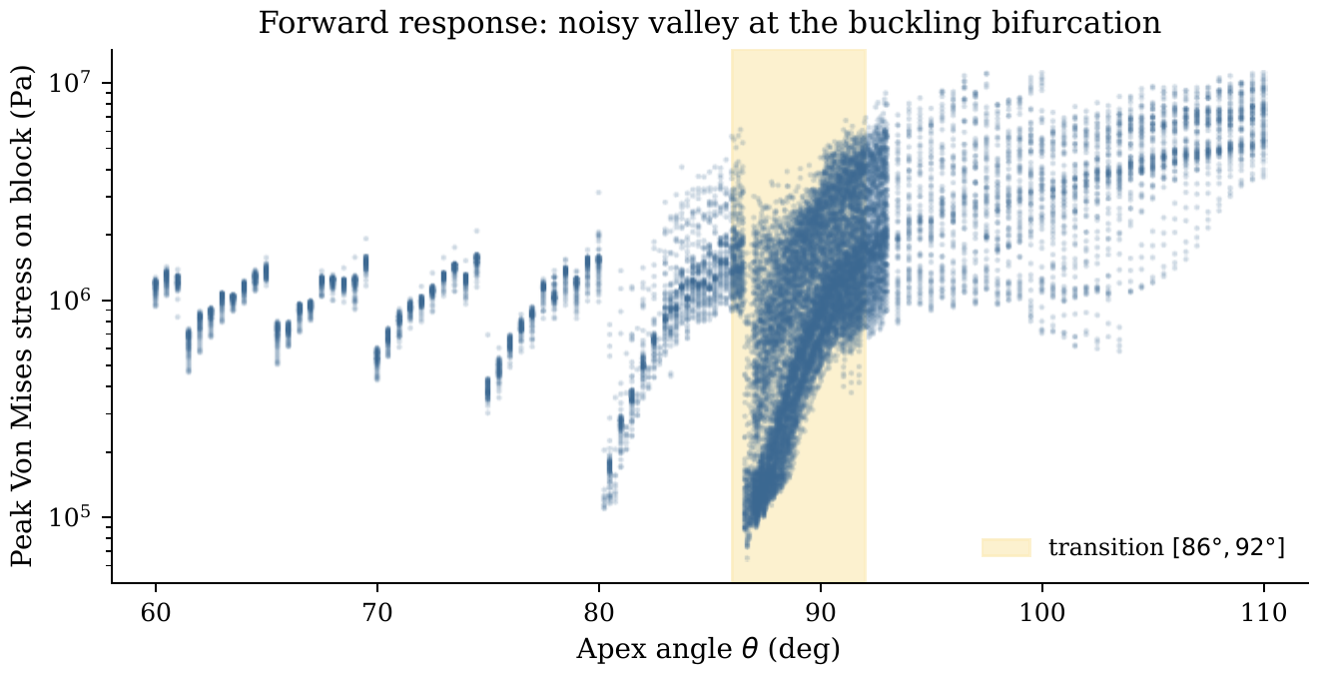
Challenge for Forward (Stress Prediction):
Rapid Variation near θ 88°
Small angle: lattice just squashes, stress steady
Sharp angle: the walls fold over
At the switch (~88°) it goes wild
Each dot is one real simulation. The shaded band is the switch.
Jiacheng Zhao · MSc Defense · University of Victoria
7
Notes:
Why predictor 1 is hard, read straight off the data, each dot is one real simulation. Shallow slope, gentle angle: the lattice just squashes, stress is steady, easy. Sharp angle: the walls fold over, that is buckling, a different way of collapsing. Right at the switch near 88 degrees, a tiny change in the design flips which way it fails, so the stress scatters wildly in that band. That is real physics, not a glitch, so every model struggles here. (~1.5 min.)

Slide 7
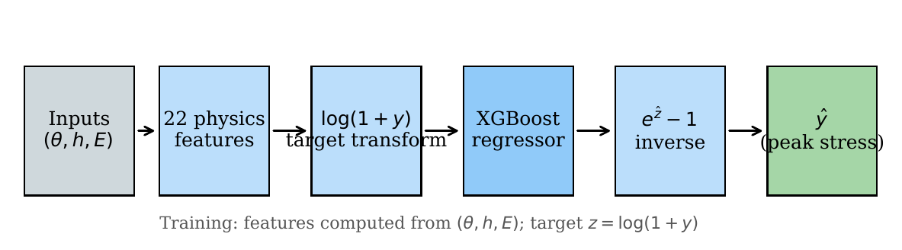
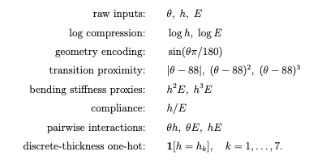
Solution for Forward (Stress Prediction):
Feature Enginnering
Turn 3 params into 22 physics features, hint from physics clues
3 raw params + 12 engineered + 7 one-hot
Learn stress on a log scale
Jiacheng Zhao · MSc Defense · University of Victoria
8
Notes:
Progressive: what we did, then why. First, turn the 3 raw knobs into 22 physics clues, the most useful being how far the design sits from the 88-degree switch, which the model cannot infer on its own. Second, learn stress on a log scale so small and large designs count equally. Third, use tree models, not a big neural net, because this is a small table of numbers where trees win. Backup: dropping the clues costs 31 points, the log trick alone only 3.7, so the clues do the work. (~1.5 min.)

Slide 8
Methods Forward (Stress Prediction)
2 routes
Method 1 (Time-series → Peak Stress Value):
  MLP (Fully connected neural network),
  DeepONet (predict a time series)
Method 2 (Directly predict Peak Stress Value):
  XGBoost (Gradient Boostied Decision Tree), Random Forest
  GBR(Gradient Boosting Regressor), SVR (support vector regression), MLP
Jiacheng Zhao · MSc Defense · University of Victoria
8
Notes:
Progressive: what we did, then why. First, turn the 3 raw knobs into 22 physics clues, the most useful being how far the design sits from the 88-degree switch, which the model cannot infer on its own. Second, learn stress on a log scale so small and large designs count equally. Third, use tree models, not a big neural net, because this is a small table of numbers where trees win. Backup: dropping the clues costs 31 points, the log trick alone only 3.7, so the clues do the work. (~1.5 min.)

Slide 9
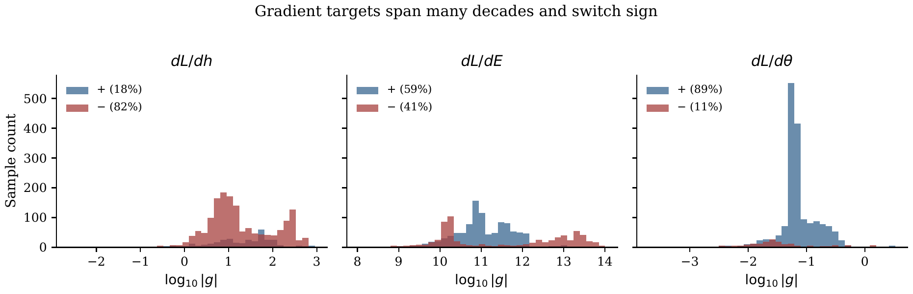
Challenge for Gradients: Span unevenly
Real data: each bar counts simulations of a given size. Left = tiny, right = huge. Blue = push up, red = push down.
Gradients span a billion in size and flip sign
Plain model chases only the bigges
Jiacheng Zhao · MSc Defense · University of Victoria
9
Notes:
Predictor 2 is hard for a different reason, and the histogram shows it, this is real data. The size of the improvement signal ranges from tiny to a billion times bigger, so for one design a nudge barely matters and for another it matters enormously. It also flips direction, improve means thicker for some designs, thinner for others, the two colors. Train the normal way and the model only chases the huge values and gives most designs a useless answer. The next slide fixes exactly this. (~1.5 min.)

Slide 10
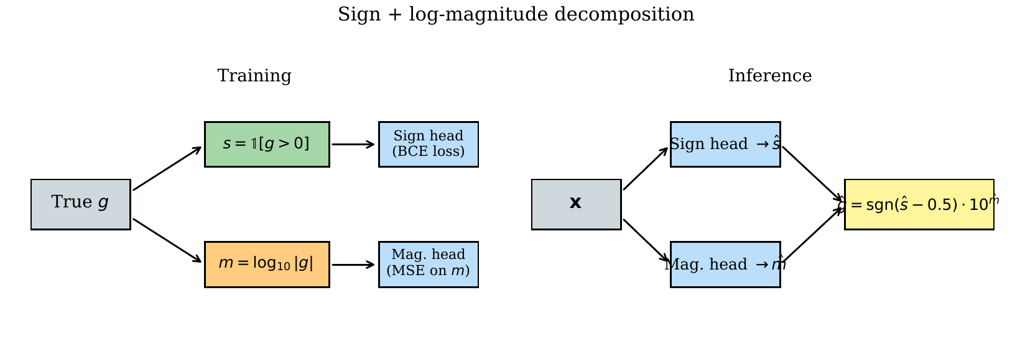
Solution for Gradient: Sign + log-magnitude
1 hard number = Sign + log-magnitude
Predict sign and magnitude separately
Jiacheng Zhao · MSc Defense · University of Victoria
10
Notes:
MONEY SLIDE. Rehearse until fluent. Instead of predicting one hard number, predict two easy things: the direction, a simple yes/no, up or down, and the size, just how many zeros. Predicting them separately means tiny and huge designs are treated fairly, because size is on a log scale. It is only a smarter way to frame the target, so it works for any model, simple trees or a neural net. This one idea added 30 points. (~2.5 min.)

Slide 11
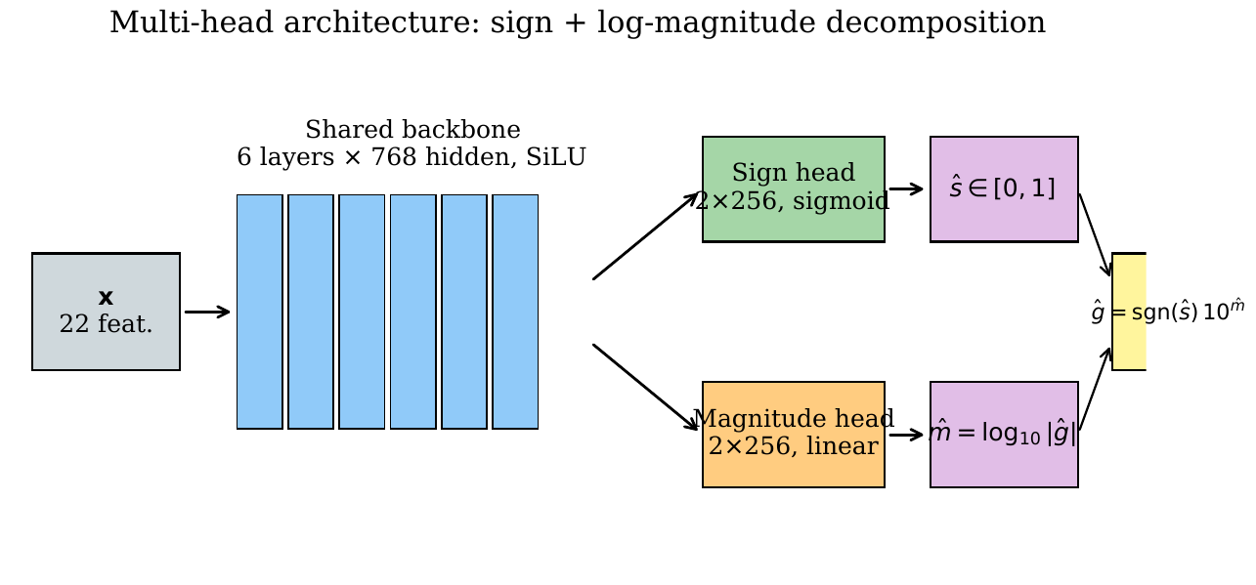
Method for Gradient: Multihead Neural Network, XGBoost
4 Methods
  Autograd baseline (Pytorch, when forwarding)
  Sobolev training (Joint supervised learning of values + gradients together)
  XGBoost w/ decomp
  Multihead NN w/ decomp
3 raw params + 12 engineered = 15 for XGBoost
Multi NN only 3 params input
Jiacheng Zhao · MSc Defense · University of Victoria
11
Notes:
How predictor 2 is built, and why you can trust the numbers. One shared network with two outputs, one for direction and one for size, learning together. The honesty point matters for the committee: I never peek at the test data while tuning, otherwise the scores would look about 5 points better than they really are. And I score by a practical yes/no, is the answer close enough to use, which is fairer than a single summary number like R-squared. (~1.5 min.)

Slide 12
Experiments
Notes:
Divider. (~20 s.)

Slide 13
Dataset
3 params: apex angle θ, wall thickness h, material stiffness E.
18887
8606
9653
Stress Samples
material directions (dL/dE)
shape directions (dL/dh, dL/dθ)
All data is from PolyFEM (simulator) w/ same setup
Forward Stress Prediction, 18887 samples + 80/10/10 split
Gradient Prediction, 8606 (material) + 9653 (shape), 5 fold CV
Sampling NOT evenly, denser around buckling bifurcation (rapid change)
e.g Near the 88° switch (Δθ = 0.05°)
Jiacheng Zhao · MSc Defense · University of Victoria
5
Notes:
Where the data comes from, briefly. Every sample is one PolyFEM run of the same scenario, a block hitting a lattice, with only the three knobs changed and everything else fixed, so the designs are comparable. Counts: about 19 thousand designs scored for the forward task, and 8-to-10 thousand gradient samples. Key detail: I did not sample the knobs evenly, I sampled by the physics, densely around the 88-degree switch and coarsely where the response is smooth. Why: if you leave that band out of training, accuracy drops from 73 to 50 percent, because the model leans on nearby designs, so the tricky region has to be well covered. The simulations were generated on a CPU cluster and given to me; my work is the machine learning on top. (~1 min.)

Slide 14
Training loss, optimizer, model size, cost
Forward peak stress σ
XGBoost · 22 physics features · log1p target
L = (1/N) Σ ( log(1+y) − ẑ )²
invert: σ = exp(ẑ) − 1 (relative error, matches Acc@10%)
SETUP
Size 5000 trees, depth 8, lr 0.01
Cost train ~12 s (5-fold CV) · infer <0.1 ms
Gradient dL/dE, dL/dh, dL/dθ
Multihead net · 6-layer SiLU + per-target heads
split g into v = log(1+L), m = log₁₀(|g|+1), s = 1[g>0]
L = MSE(v) + λ(t)·[ 3·MSE(m) + 1.5·BCE(s) ]
h+θ variant: 2·MSE+1·BCE (h), 3·MSE+1.5·BCE (θ) · λ(t)=clip((t−30)/40,0,1)
recombine: ĝ = sign(ŝ−0.5)·(10^m̂ − 1)
SETUP
Optimizer AdamW lr 5e-4, 400 epoch, batch size 512, clip 1
Size ~2.1M params (dL/dE) to ~2.6M (h+θ)
Cost ensemble ×5, train ~45 min · infer <0.1 ms
Jiacheng Zhao · MSc Defense · University of Victoria
6

Slide 15
Training Losses
Forward peak stress σ
Squared error on a log target
L = (1/N) Σ ( log(1+y) − ẑ )²
y = true peak stress ẑ = model output (log space)
invert at inference: σ = exp(ẑ) − 1
Gradient dL/dE, dL/dh, dL/dθ
Split each gradient g into three easy parts:
v = log(1+L) m = log₁₀(|g|+1) s = 1[g>0]
L = MSE(v) + λ(t) · [ 3·MSE(m) + 1.5·BCE(s) ]
λ(t) = clip( (t − 30) / 40, 0, 1 ) ramp warmup
recombine: ĝ = sign(ŝ − 0.5) · (10^m̂ − 1)
Jiacheng Zhao · MSc Defense · University of Victoria
6

Slide 16

Metrics
Model | Training loss | Evaluation | Diagnostic
Forward | MSE on log(1+y) target | Acc@10% | R², MAPE
Gradient | BCE(sign) + MSE(log₁₀-magnitude) + MSE(aux valu | Acc@20%, Sign% | R²_log, R², MAPE
Acc@K% within ±K% of truth Sign% correct gradient direction
MAPE mean absolute % error R² variance explained R²_log variance explained in log space (order of magnitude)
MSE mean squared error BCE Binary Cross Entropy
Acc@10% (forward) and Acc@20% + Sign% (gradient): is each prediction close enough to actually use
Acc
Jiacheng Zhao · MSc Defense · University of Victoria
5

Slide 17
Results
Notes:
Divider. (~20 s.)

Slide 18
Performance
Forward: peak stress (Acc@10% = within 10%)
Gradient: Acc@20% per component
Forward model | R² | Acc@10% | Acc@20%
XGBoost (chosen) | 0.97 | 74.1% | 86.9%
Random Forest | 0.97 | 73.3% | 87.5%
Grad. Boosting | 0.97 | 72.9% | 86.4%
SVR | 0.84 | 27.2% | 49.0%
MLP (neural net) | 0.75 | 14.6% | 31.2%
Gradient method | dL/dE | dL/dh | dL/dθ
Multihead NN (chosen) | 68.7% | 80.5% | 56.8%
XGBoost split | 66.9% | 75.8% | 57.4%
Sobolev / value-MLP | ~37% | -- | --
RECAP
Apex Angle θ,
Wall Thickaness h
Material Stiffness E.
70% around
Jiacheng Zhao · MSc Defense · University of Victoria
2

Slide 19
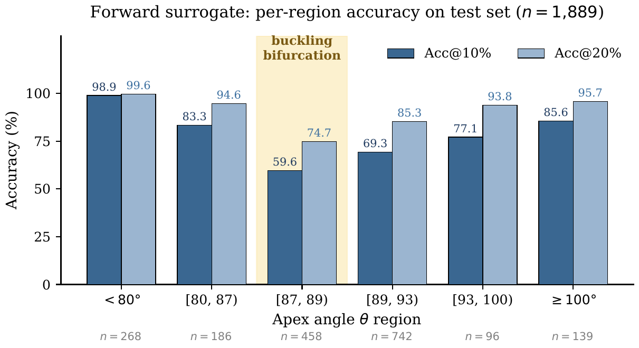
Forward: Peak Stress Analyze angle region
74% overall in XGBoost
99%
60%
away from the switch
right at the switch
Other scope is good enough, around buckling bifurcation is still hard
Jiacheng Zhao · MSc Defense · University of Victoria
13
Notes:
KEY SLIDE, the committee will push here. Overall it looks great, 74% correct, and the usual summary score is 0.97, near perfect. But split by region: away from the switch it is nearly perfect, 99%; right at the switch it falls to about 60%. The summary score looks great because the big values dominate it. That is why I report region by region, one average would have hidden this. Practice this pivot. (~2.5 min.)

Slide 20
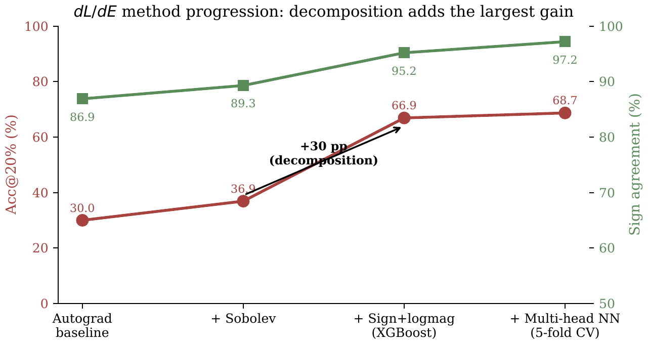
Gradient Methods Comparison
Plain approach on raw numbers: ~30% correct
XGBoost w/ decomposition jumps to 67%, +30% improved
Then a bigger neural net: 69%, only 2% improved
Sign-magnitude decomposition works
Jiacheng Zhao · MSc Defense · University of Victoria
14
Notes:
The story in one chart, built up step by step. Start with the plain approach, about 30%, most designs wrong. Add the split idea and it jumps to 67%, that is plus 30 points, and that is with simple trees. Then add a big neural net on top and it only reaches 69%, all that model power buys just 2 more points. The idea did the work, not a bigger model. (~2 min.)

Slide 21
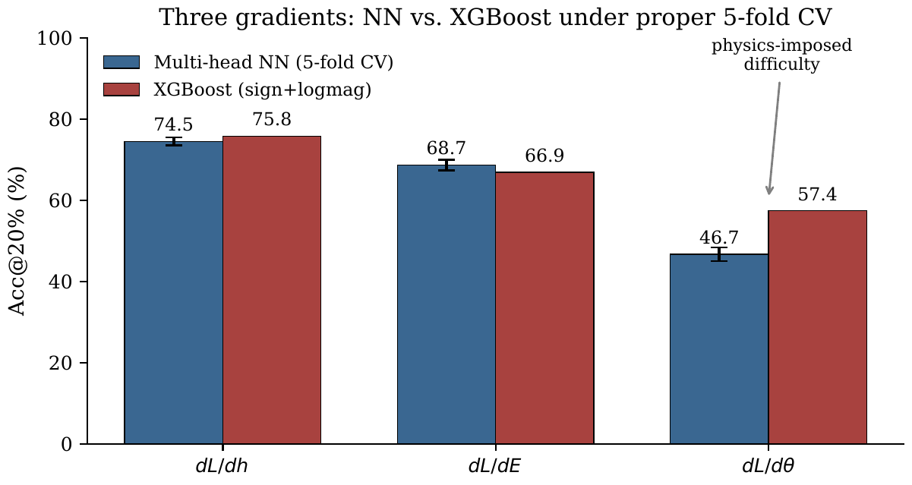
Gradient 3 Predictions Performance Comparison
Thickness dL/dh, ~75%
Angle dL/dθ, ~47%, hard to predict
RECAP
Apex Angle θ,
Wall Thickaness h
Material Stiffness E
Each knob’s accuracy tracks how rough its physics is.
Jiacheng Zhao · MSc Defense · University of Victoria
15
Notes:
Three knobs, three difficulties, all tracking the physics. The smooth knob, thickness, is easy, about 75%. The rough knob, angle, carries the buckling switch, so it collapses to about 47%. The key: trees and a neural net fail the exact same way on the hard knob. If this were about model size, a bigger model would break through, but it does not. Same failure from two very different models means it is a physical limit, not a modeling gap. (~2 min.)

Slide 22
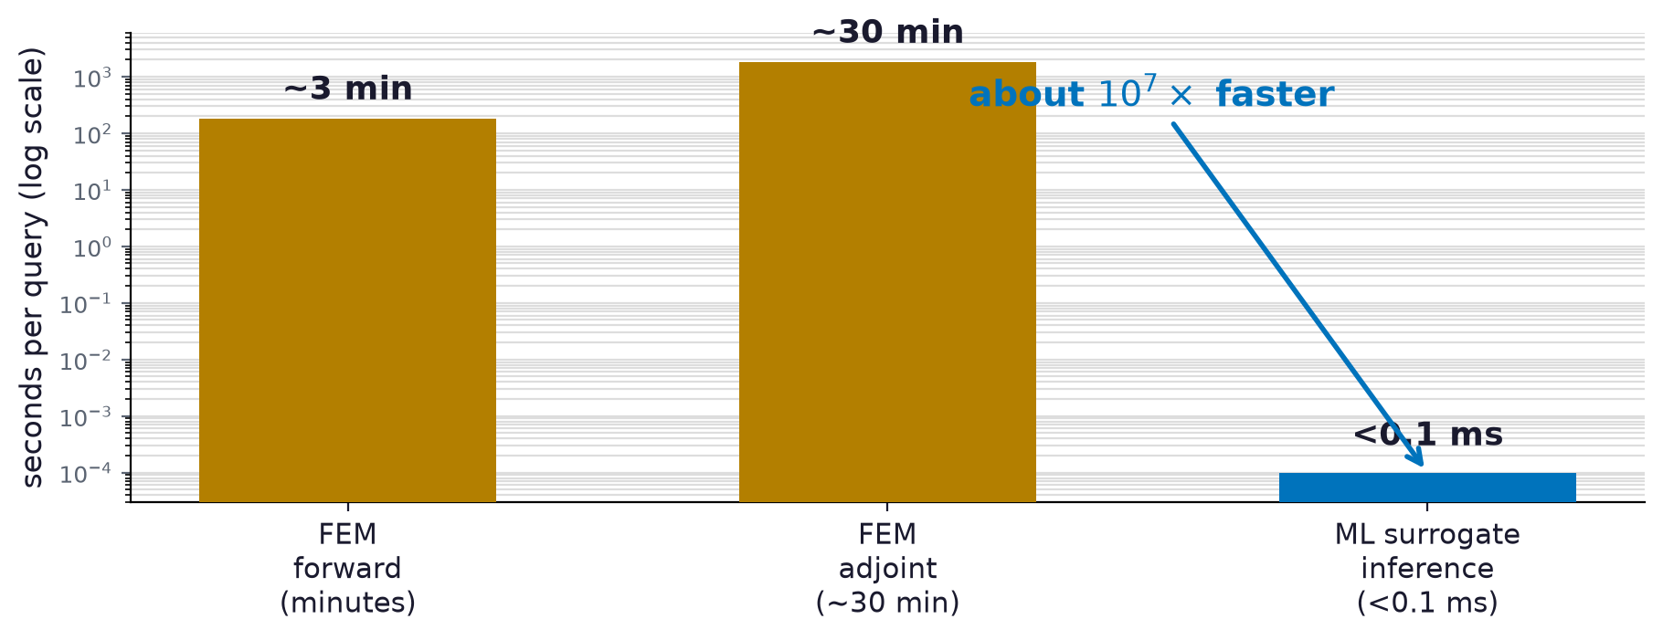
Speeding
~10⁷x faster than FEM. Make a million-design search affordable
Jiacheng Zhao · MSc Defense · University of Victoria
4

Slide 23
Incorporation Fast predictor first, simulator to confirm
Predictor is ~10 million times faster
Predictor explores, simulator confirms
Do not compete
When | Confidence | What to do
Away from the buckling zone | High | Predictor alone
Near the buckling zone | Medium | Best to confirm with Simulator
Buckling bifurcation zone | Low | Use only for ranking; let simulator decide
Jiacheng Zhao · MSc Defense · University of Victoria
16
Notes:
The closer. The rule comes straight from the regional results. Away from the buckling zone, trust the predictor. Near it, shortlist with the predictor and confirm with FEM. For the hardest knob, use it only to rank. The predictor is 10 million times faster, so it explores millions while FEM confirms the few finalists. They work together, they do not compete. Pause, then take questions. (~2.5 min.)

Slide 24

Thank you
Questions welcome.
Jiacheng Zhao
Supervisor: Dr. Teseo Schneider · University of Victoria
Notes:
Thank the committee, hold on this slide for Q&A. Q&A prep: why not neural operators for forward; why not Bayesian/GP; why NeoHookean not plasticity; uncertainty quantification; how physics-ceiling is proven (both model families fail identically).

