Slide 1
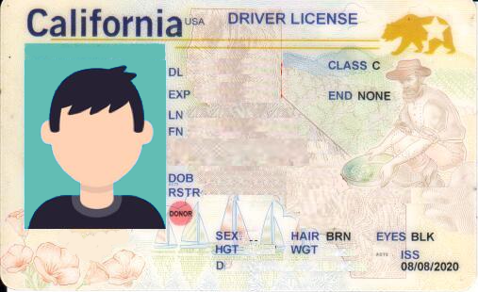
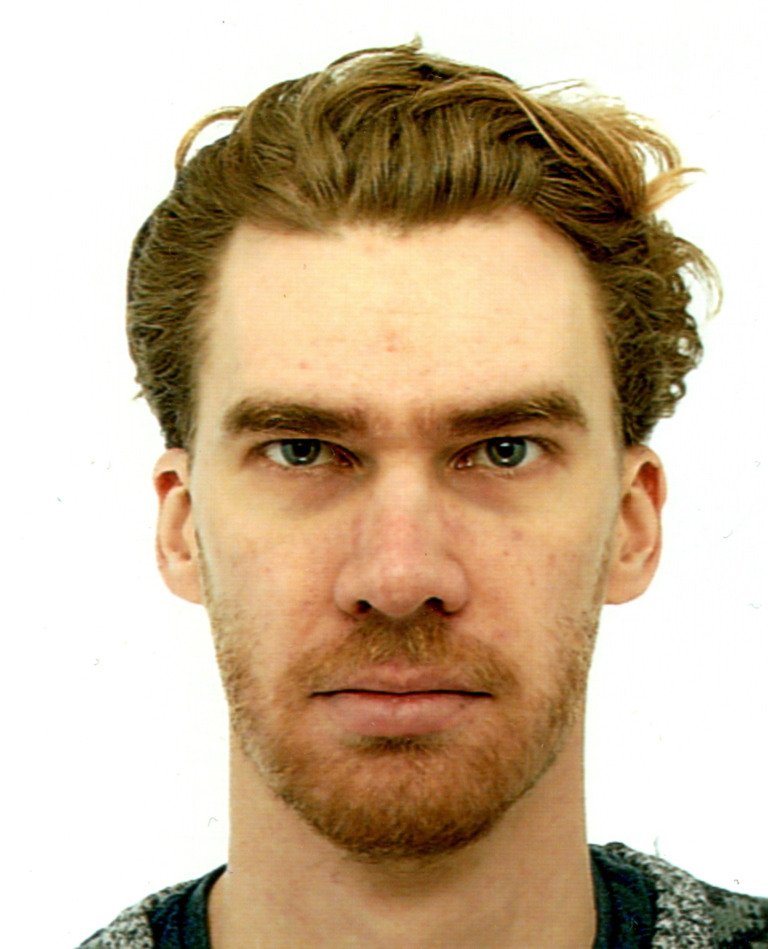
D1234567
02/26/2027
Czylwik
Johannes
09/05/1989
M

