Slide 1
IT314 : SOFTWARE ENGINEERING
End Term Presentation
Topic: Hotel Automation System
Group: 54
Professor : Dr. JayPrakash Lalchandani
Mentor TA : Mahir

Slide 2
Hotel Bliss
Where Love resides, Memories are created

Slide 3
Team Members
Name | ID
Shreyas Sakariya | 201901075
Ankit Rathod | 201901108
Kishan Gajnotar | 201901116
Hiten Padaliya | 201901401
Deep Tank | 201901410
Jenish Rathod (Team Leader) | 201901435

Slide 4
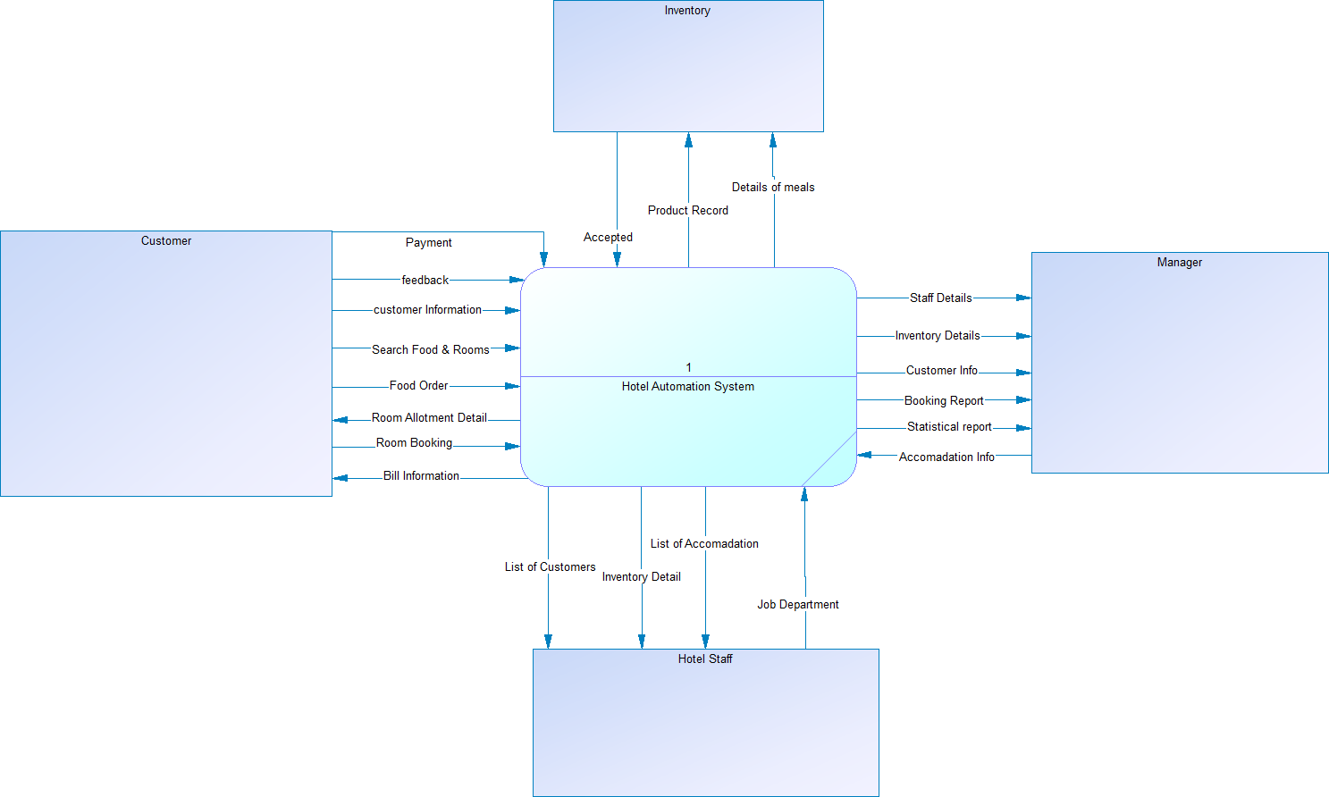
Context Diagram

Slide 5
Functional Summary (User Stories)
User login: The user can create a new account or log in to an existing one using their email address and password, or their phone number and OTP.
Change user detail: user can change his/her detail like phone number, address, email address, etc.
Searching: Users can filter foods/rooms by different genres like Punjabi, Chinese, Gujarati, non a/c rooms,a/c rooms, etc.

Slide 6
Functional Summary (User Stories)
Food Order: We use a filtering technique that tracks user history and shows certain types of foods to each user based on their previous choices. so users can order food based on this or users can search food according to different food types.
Reservation: user can reserve their room according to their preference Like a/c room, non a/c room, according to room facilities, for users can filter according to prices or according to facilities which they required.
Favorite list: Users can add their favorite foods/room types to a list that they can find them again without searching for them.

Slide 7
Functional Summary (User Stories)
Payment: The user will receive an automatic bill when checking out and can choose to pay online with a credit card or Razorpay using a secure payment method.
Cancellation: Users can cancel their reservation through this page but according to the policy they will get some penalty charges they have to Pay. A policy like premium users can cancel without any penalty charge and non-premium users will not need to pay penalty charges if they cancel their booking before 24 hours.
Room Availability: Management can view a complete list of available and reserved rooms at the hotel.

Slide 8
Functional Summary (User Stories)
Booking for Event/ Party: Customers can register for special events (such as parties, meetings, and functions) in advance. The hotel will confirm his/her registration based on his requirements and available space.
Inventory Management: The hotel management can change the price of any item in the hotel, like room prizes and food prices.
Rating system: Users can submit ratings and feedback on hotel services and hotel facilities they have used.

Slide 9
Top Level Use Case Model

Slide 10
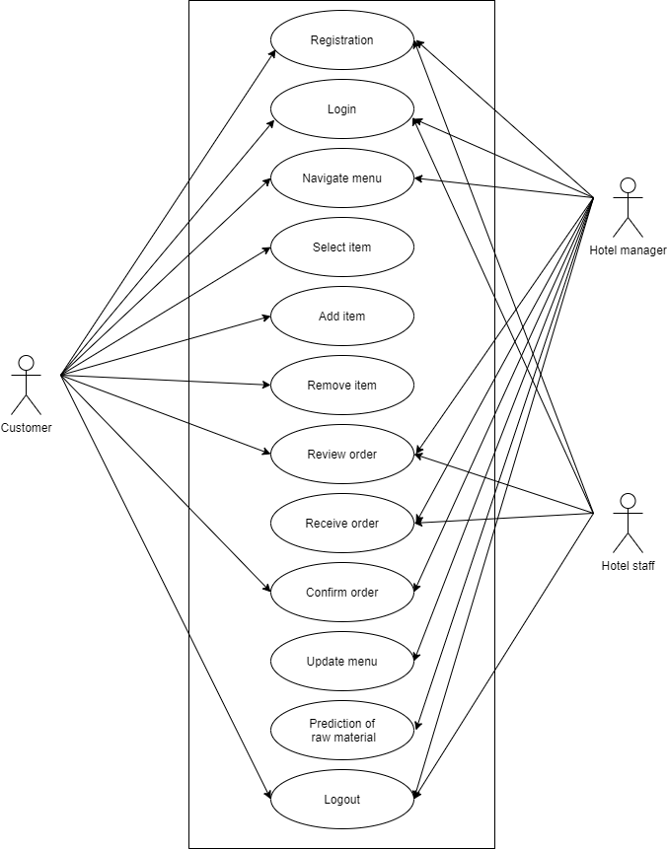

Slide 11
Activity Diagram

Slide 12
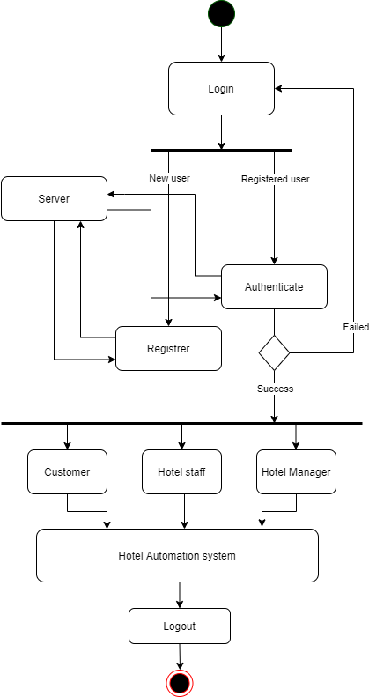

Slide 13
Login Diagram

Slide 14
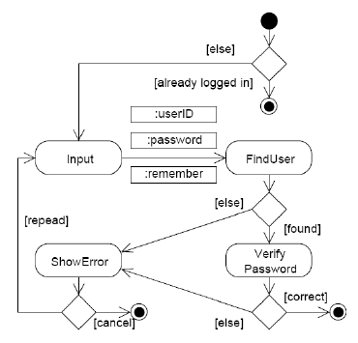

Slide 15
Customer Activity Diagram

Slide 16
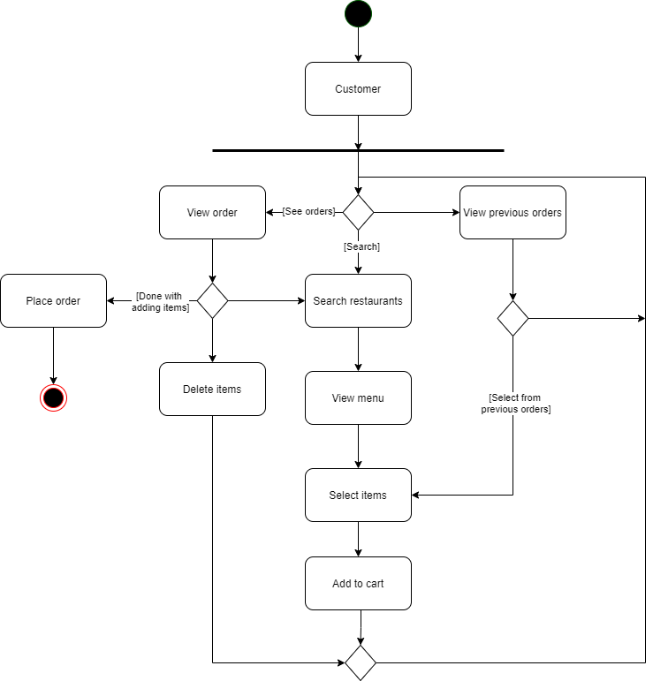

Slide 17
Manager Activity Diagram

Slide 18
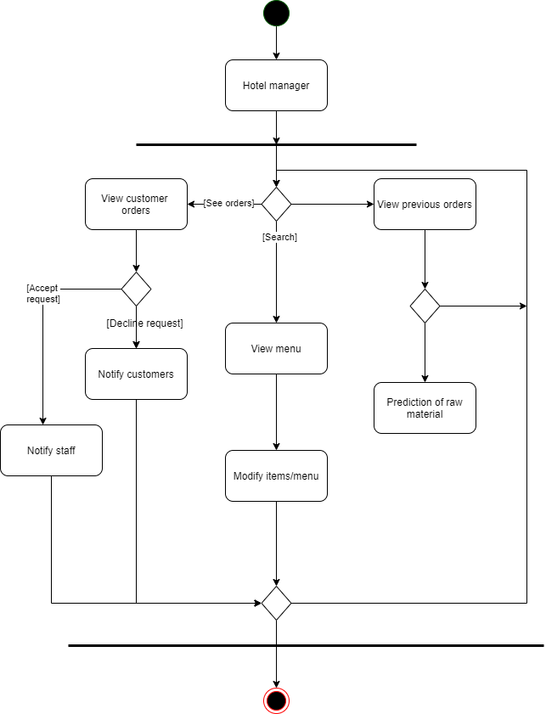

Slide 19
Staff Activity Diagram

Slide 20
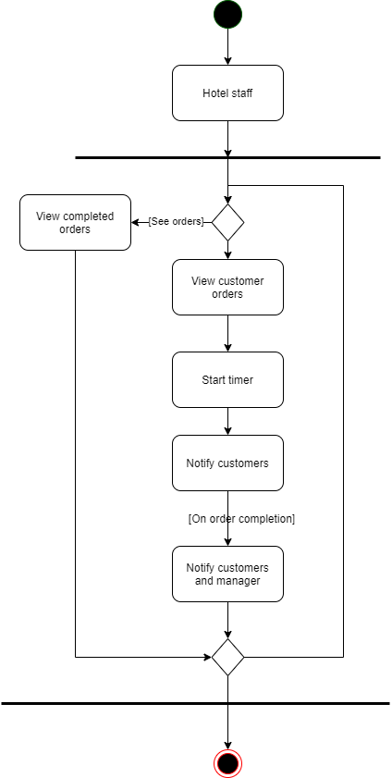

Slide 21
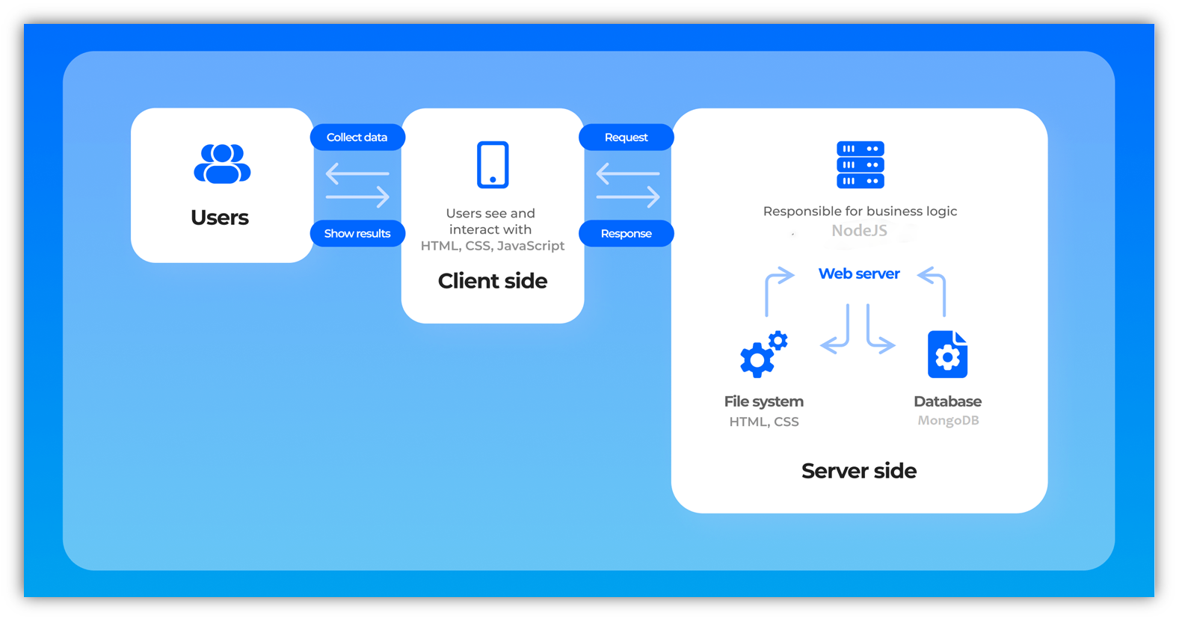
Application Architecture

Slide 22
Technologies/Tools and libraries
Languages Used: HTML, javascript
Frameworks Used: CSS , Node Js, React
Technologies used: Firebase Authentication
Database design: MySQL

Slide 23
Detailed Class Diagram

Slide 24
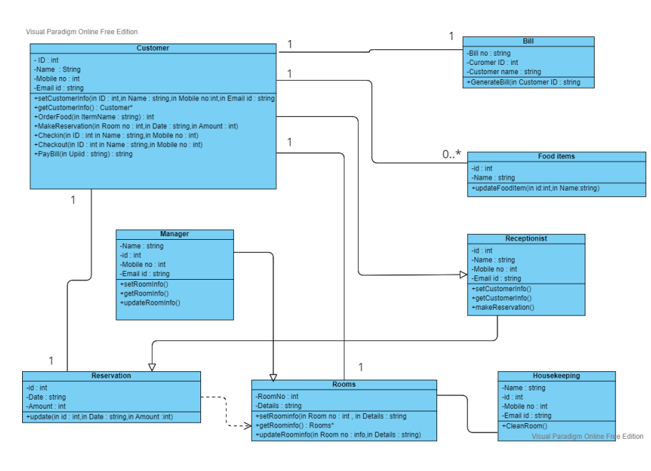

Slide 25
Summary of Implementation
Implemented Login & Register Page with Firebase Authentication.
Implemented Logout feature
Implemented home page which shows the photos of hotel rooms and user review.
Implemented Room Booking page
Implemented User Profile page
Implemented User Booking Details page
Implemented Responsive UI.
Implemented Admin page where he can view the booking details of user.
Implemented Admin Page where he can add new facilities.

Slide 26
Deployment Diagram

Slide 27
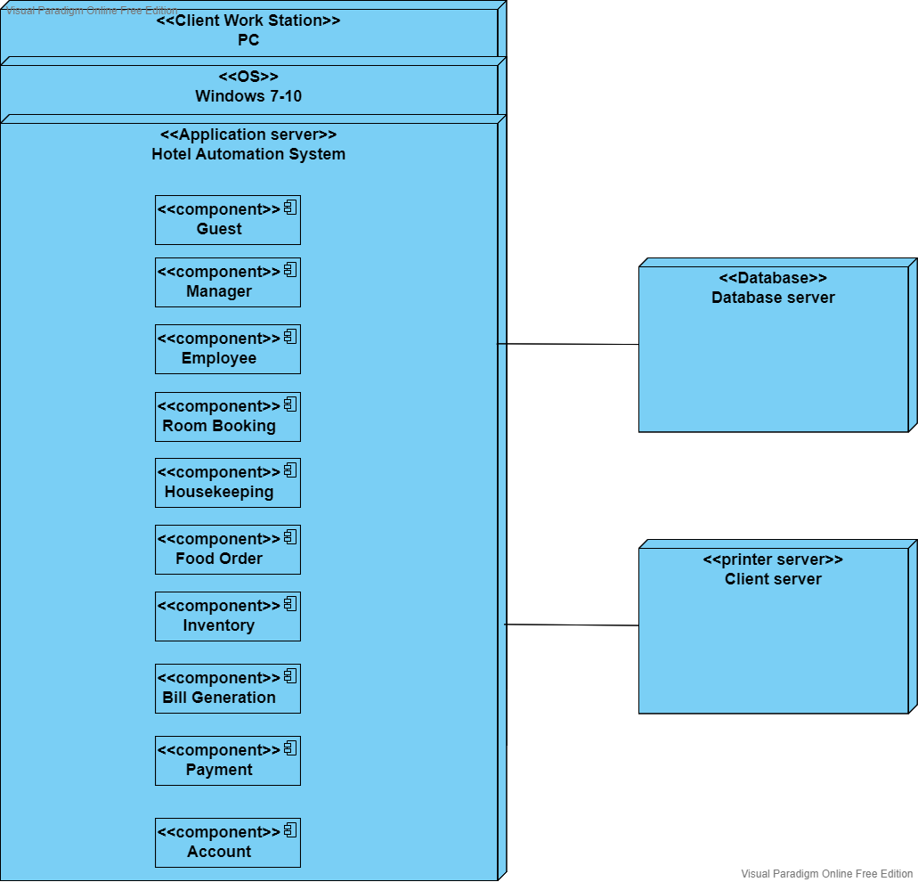

Slide 28
Individual Contribution
Shreyas Sakariya - Homepage Design, User profile Page, Responsive UI
Ankit Rathod - Login Page, Firebase Authentication, Room Booking Page
Kishan Gajnotar - Register Page, User Profile Page, Home page
Hiten Padaliya - Login Page, User Booking Details Page, Responsive UI
Deep Tank - Homepage Design, Admin Pages, Room Booking Page
Jenish Rathod - Homepage Design, Admin Pages, Firebase Authentication

Slide 29
Gantt Chart for entire Project

Slide 30
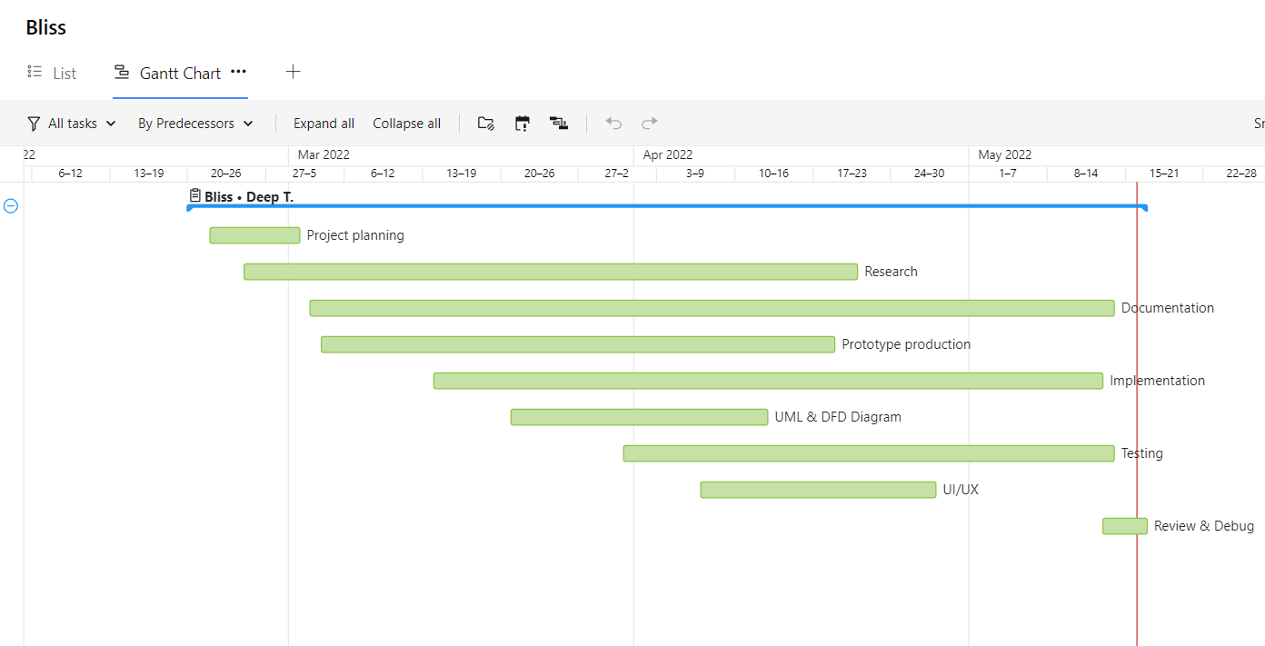

Slide 31
Application Navigation Using UI/UX Design

Slide 32
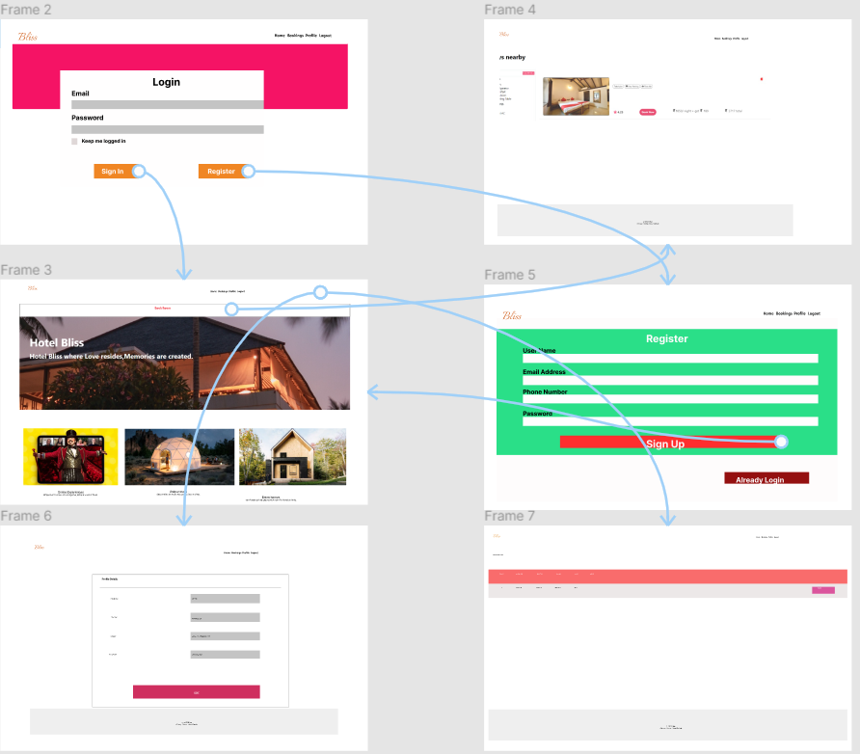

Slide 33
Summary of Test Plan
Functionality | Related Use Case
Registration | New user can register himself on the site
Login | After successful login each user will be directed to its related homepage
Update Profile | User can update profile anytime
Search | User can search particular room and food he/she like
Room Booking | User can book a room according to his/her choices

Slide 34
Functionality | Related Use Case
Password & Verification | Password should be minimum 8 characters long and have no numeric values and also confirm password text have to match with password text.
Report generation for manager | Software should generate the report which gives all relevant data to the hotel manager
Online Payment | Users should be able to pay bills using Razorpay, Eazypay, Paytm, Gpay , etc..

Slide 35
Thank You

Slide 36
Github Link
Document Link:
https://github.com/jd-rathod-120/Hotel-Automation-System-
Code Link:
https://github.com/jd-rathod-120/HAS_Bliss_Code

