Slide 1
Predicting Weekly Walmart Sales
ANDREW GOODING
JIA LI DONG
KATHLEEN CALLAGHAN

Slide 2
Introduction

Slide 3


Overview
What predicts Walmart’s weekly sales?
We were given 2010-2013 Weekly Sales data for 45 Walmart stores
Originally a Kaggle competition

Slide 4
Predictor Variables
Temperature: the temperature in degrees Fahrenheit, as measured at the store location.
Fuel_Price: the average price in USD of one gallon of gasoline, as measured at the store location.
CPI: the US Consumer Price Index, an index which measures the price of a defined basket of goods used to measure inflation.
Unemployment: the US Unemployment rate as measured by the Federal Reserve
IsHoliday: a boolean variable denoting whether or not the week contained a holiday, as defined by Walmart.
MarkDown1-MarkDown5: an anonymized variable provided by Walmart which relates to discount promotions that the store was running
Type: a categorical variable denoting the type of Walmart each store was. This variable takes values “A”,“B”, or “C”.
Size: the square footage of each store
Dept: a categorical variable denoting the department
Store: a categorical variable denoting the store ID

Slide 5
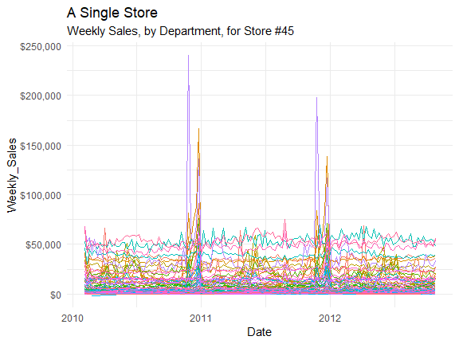
Example Store

Slide 6
What We Thought Would Work
Time-Sensitivity: the data was highly seasonal, our model would have to account for that
Holidays: we expected there to be higher sales during holiday periods
MarkDowns: we expected higher markdowns to lead to higher sales
Macroeconomics: we expected that a stronger macroeconomic environment would lead to higher sales

Slide 7
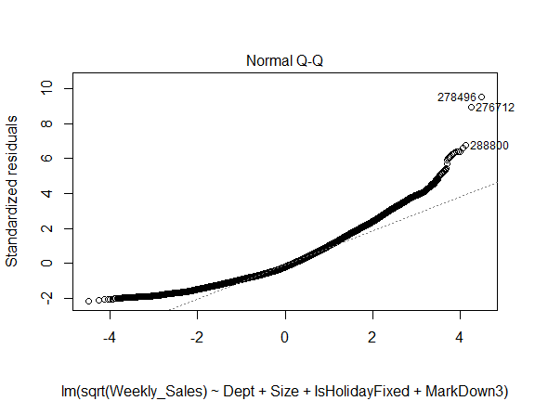
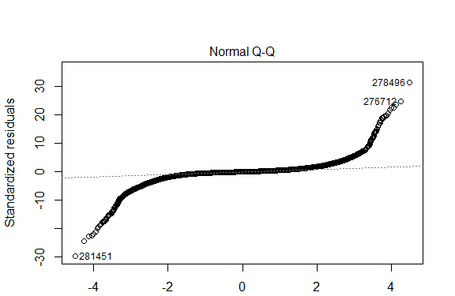
What Didn’t Work (Part 1)
At the department-level, we could not find a linear model with normal residuals.
We tried:
Transformations (log, sqrt)
Weighted-Least-Squares
Different Models for Different Stores
“Reverse Engineering”: using our prediction for store-level sales to predict department-level sales.
But we kept getting residuals that looked like this:

Slide 8
What Didn’t Work (Part 2)
The promotional MarkDown data had less predictive value than we expected.
The MarkDown data was:
Extremely Sparse: only available for 1/3 of observations
Uninterpretable: anonymized by Walmart. How could we interpret findings?
Store-Level: store-level variable which didn’t affect all departments in the same way.

Slide 9
“The Cheating Model”
If you were on a desert island, and you could only have one variable to predict weekly sales…
…use last week’s sales.
Which works!
Prediction vs Insight
In the end, we decided against it. While this model is excellent at prediction, it offers no insight as to why sales change.

Slide 10
Methods

Slide 11
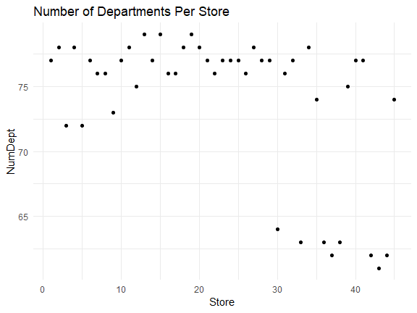
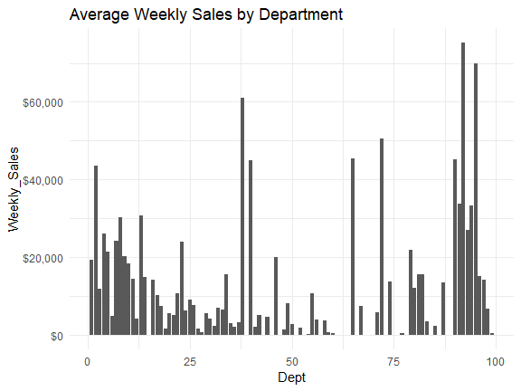
Aggregating to Store Level
Issues with Department-Level data:
Different departments for each store
Non-normal residuals
Difficulty predicting tails of the distribution (the most important to predict)
High Variance (and “noise”) in department-level sale

Slide 12
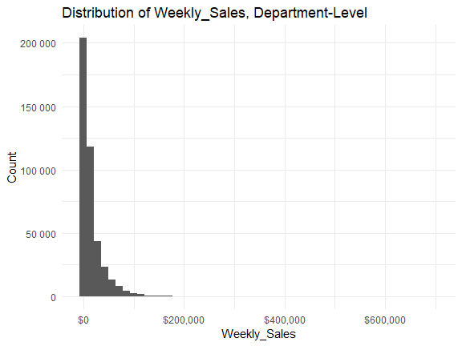
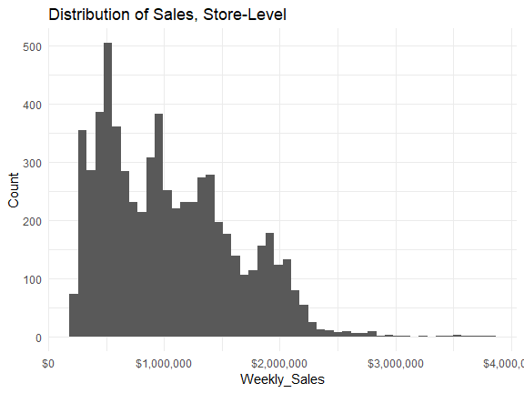
A Key Transformation
Original Data
Aggregated Data

Slide 13
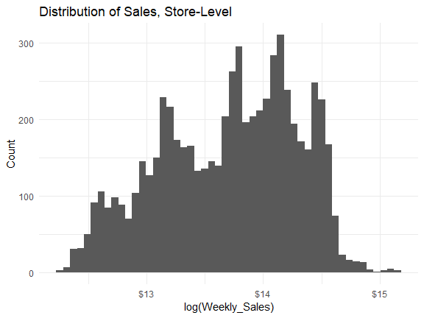
A Key Transformation
Aggregated Data, With Log Transform

Slide 14
Best Subsets
We narrowed the range of possible models using a Best Subsets procedure:
IsHoliday | Temp | Fuel Price | CPI | Unemp. | Type | Size | Week | IsHoliday (Fixed) | Number | Cp
0 | 0 | 0 | 1 | 1 | 1 | 1 | 1 | 1 | 7 | 42.63
0 | 1 | 0 | 1 | 1 | 1 | 1 | 0 | 1 | 7 | 48.70
0 | 1 | 0 | 1 | 1 | 1 | 1 | 1 | 1 | 8 | 11.53
0 | 1 | 1 | 1 | 1 | 1 | 1 | 0 | 1 | 8 | 43.35
1 | 0 | 0 | 1 | 1 | 1 | 1 | 1 | 1 | 8 | 43.45
0 | 0 | 1 | 1 | 1 | 1 | 1 | 1 | 1 | 8 | 43.52
0 | 1 | 1 | 1 | 1 | 1 | 1 | 1 | 1 | 9 | 8.51
1 | 1 | 0 | 1 | 1 | 1 | 1 | 1 | 1 | 9 | 13.08
1 | 0 | 1 | 1 | 1 | 1 | 1 | 1 | 1 | 9 | 44.25
1 | 1 | 1 | 1 | 1 | 1 | 1 | 0 | 1 | 9 | 45.25
1 | 1 | 1 | 1 | 1 | 1 | 1 | 1 | 1 | 10 | 10.00

Slide 15
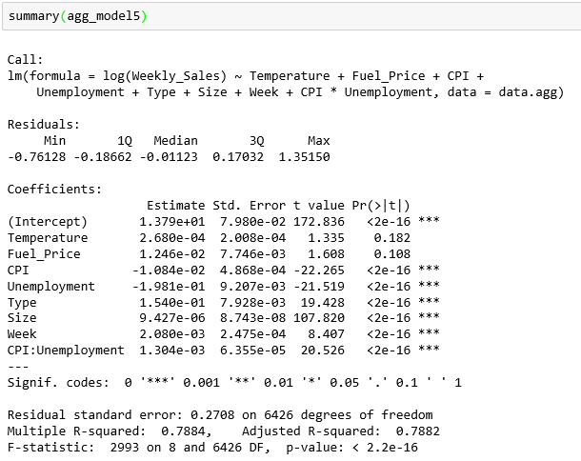
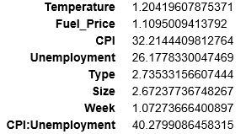
Exploring Influential Cases
VIF

Slide 16
Outlying Observations Table
Observation | DFBETA | DFFITS | Cook’s Distance | Bonferroni Critical Value | Direct Leverage Calculation (for hidden extrapolation)
2080 |  | X |  | X
4420 | X | X |  | X
4433 | X | X |  | X
2093 | X | X |  | X
1900 |  | X |  | X
Observation Number | Model Number | Percentage of Influence
2080 | Best | 0.00283482759777784%
4420 | Best | 0.00261453118084852%
4433 | Best | 0.0031262645405175%
2093 | Best | 0.0031977954395883%
1900 | Best | 0.00232895005016511%

Slide 17
Results

Slide 18
Our Final Model
Log(WeeklySales (in $1000)) = 12.88 + (0.00063 * Temperature) - (.0012 * CPI)
- (.0094 * Unemployment) + (.000008* Size) + (.08793* IsHolidayFixedTrue)
Summary of Linear Model
ANOVA
Term | Coef | Std. Error | t-stat | P-Value
(Intercept) | 12879.77 | 0.04 | 302.49 | 0.00
Temperature | 0.63 | 0.00 | 2.99 | 0.00
CPI | -1.22 | 0.00 | -12.07 | 0.00
Unemployment | -9.43 | 0.00 | -4.57 | 0.00
Size | 0.01 | 0.00 | 140.37 | 0.00
IsHolidayFixedTRUE | 87.93 | 0.01 | 10.19 | 0.00
Term | DF | Sum. Sq. | Mean. Sq. | Statistic | P-Value
Temperature | 1 | 19.06 | 19.06 | 229.24 | 0.00
CPI | 1 | 8.59 | 8.59 | 103.26 | 0.00
Unemployment | 1 | 20.69 | 20.69 | 248.86 | 0.00
Size | 1 | 1635.22 | 1635.22 | 19665.97 | 0.00
IsHolidayFixed | 1 | 8.67 | 8.67 | 104.31 | 0.00
Residuals | 6429 | 534.57 | 0.08

Slide 19
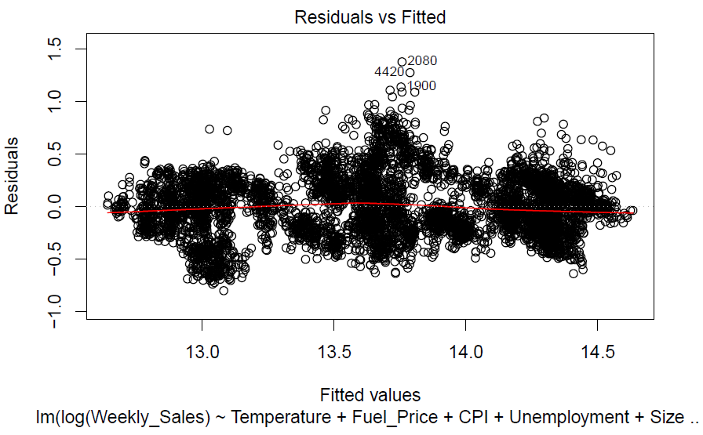
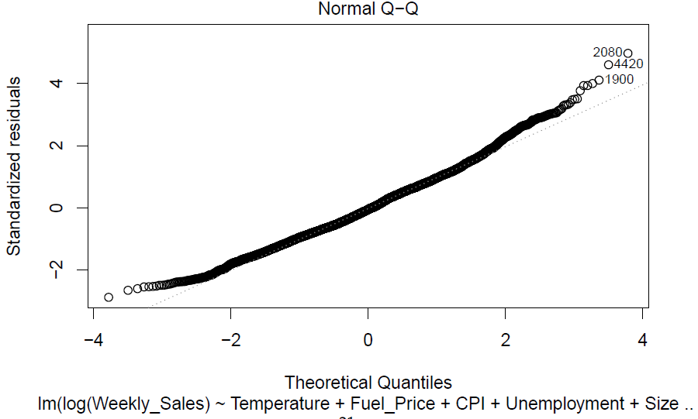
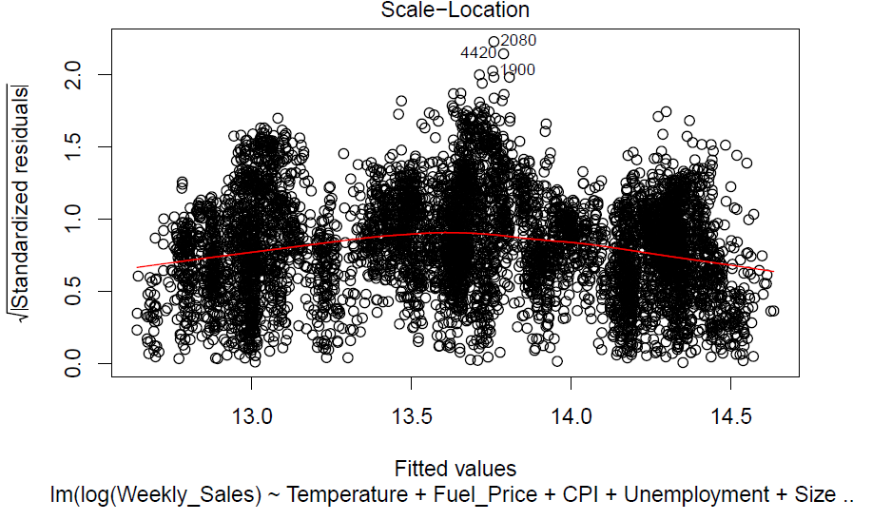
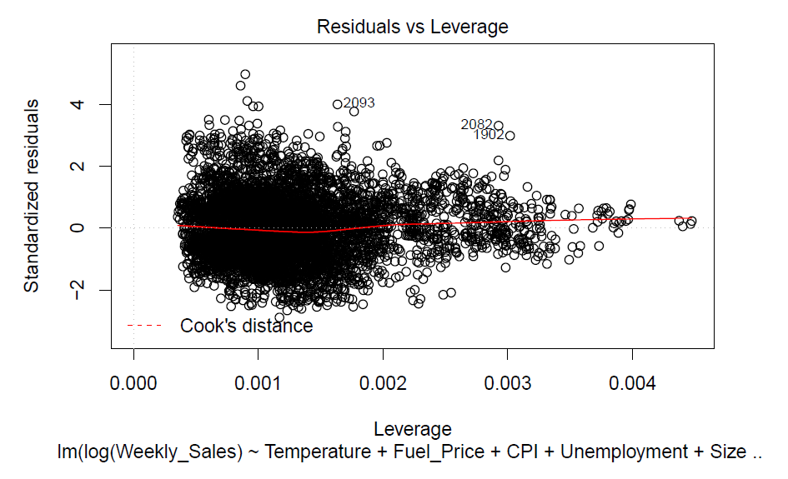
Diagnostics

Slide 20
Results
Large Increase in Sales
Larger Stores
Holidays
Small Increase in Sales
Higher Temperature
Low Fuel Prices
Low Unemployment
Low Inflation
Summary of Linear Model
Term | Coef | Std. Error | t-stat | P-Value
(Intercept) | 12.88 | 0.04 | 441.56 | 0.00
Temperature | 0.00063 | 0.00 | 3.02 | 0.00
CPI | -.00122 | 0.00 | -12.37 | 0.00
Unemployment | -.00943 | 0.00 | -4.59 | 0.00
Size | 0.00001 | 0.00 | 140.40 | 0.00
IsHolidayFixedTRUE | .08788 | 0.01 | 10.21 | 0.00

Slide 21
Discussion

Slide 22
Practical Applications
Determine staffing levels
Optimize inventory supply-chains
Revenue forecasting and capital budgeting
Development planning: where should stores be located? What kind of stores sell the most?

Slide 23
Questions?

