Slide 1
Blinky Proj
“Blinky Project”

Slide 2
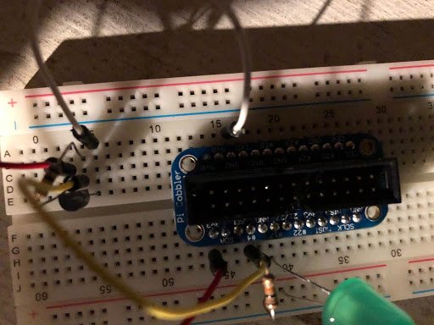
Hardware needs setup

Slide 3
Prereqs
Command: sudo git clone https://github.com/jd4rider/blinkyproj.git
Install G++ Compiler

Slide 4
Installing
Command: cd blinkyproj
Command: sudo g++ -Wall –o blinky blink.cpp –lwiringPi
Command: sudo cp blinky website/blinky
Command: sudo cp –r website /var/www/html/website
Command: sudo chmod 4755 /var/www/html/website/blink

Slide 5
Running the tests
Run with different flags example: ./blinky s
S – light status
O – turn on light
F – turn light off
B – blink light twice
T – check temperature
.blinky without flags results in menu selection
Navigate to IP of raspberry pi for web portal (IP = x.x.x.x)
http://x.x.x.x/website

