Slide 1


The Cutting Edge
This Photo by Unknown Author is licensed under CC BY-SA-NC
An appointment scheduling service for a small one person hair salon

Slide 2
Designers
Allison Smith
Terahje Gratkowski
Jennifer Schlierman

Slide 3

Elevator Pitch
This Photo by Unknown Author is licensed under CC BY-SA

Slide 4

Concept
Description
Motivation for development
User story

Slide 5
Description of the project
Appointment scheduling app for a busy hair stylist
Allows customers:
To book appointments
To see future appointments
Allows stylist to:
See what appointments are coming up
See which customers are actively scheduling appointments

Slide 6
Motivation for Development
Met a hair stylist who is currently having difficulty tracking the appointments of her customers
She needs a system that will help her streamline and manage the process better

Slide 7
As a User I would like to:
I want to see what I have scheduled on a daily basis
I want to offer a menu of services to my clients
I want my clients to be able to log in to choose services and schedule appointments
I want to be able to edit my schedule
I want to be able to have basic contact information for my clients

Slide 8
Process
Technologies Used
Breakdown of tasks and roles
Challenges
Successes

Slide 9
Technologies Used
NodeJs
Sequelize
MySQL
Nodemon
Handlebars
Sweet Alerts
ExpressJs

Slide 10
Tasks and Roles
Allison
Backend development
SQL relationships
Front end design
Terahje
Backend development
Express routes
SQL relationships
Git Repo
Jennifer
New technology finding, incorporating and troubleshooting
Front end design
Coordinating product development to meet user needs

Slide 11
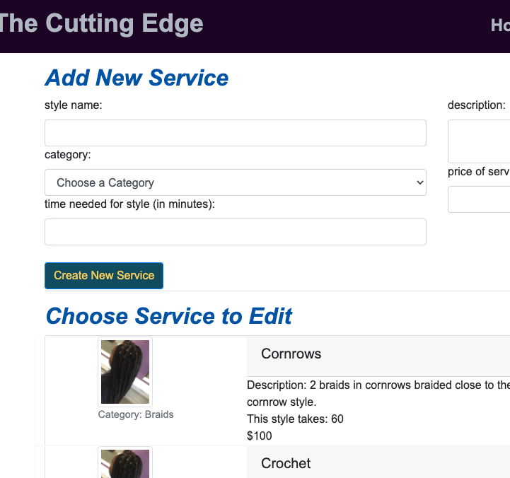
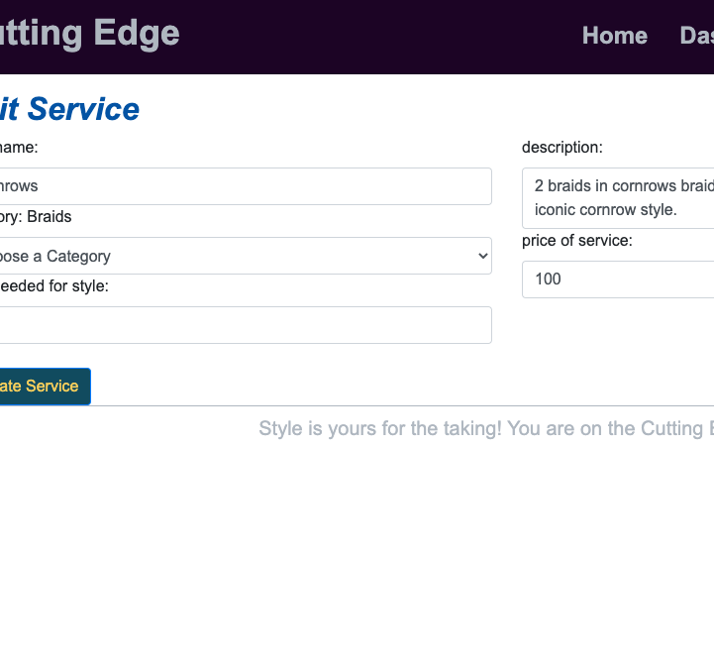
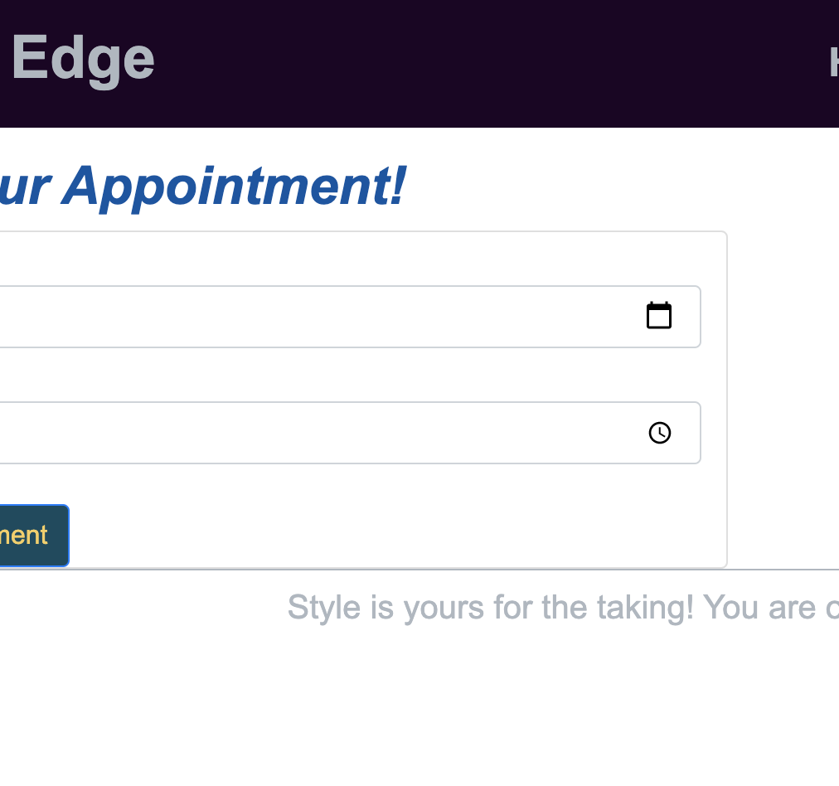
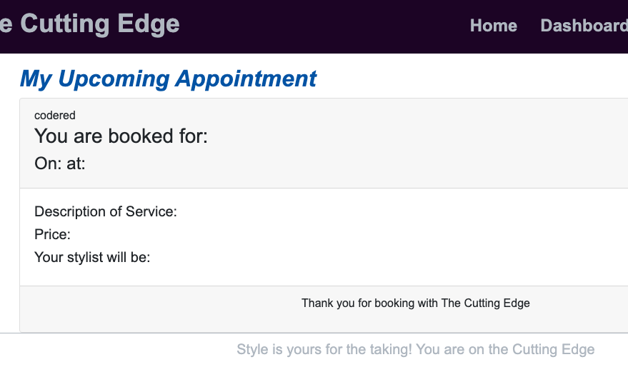
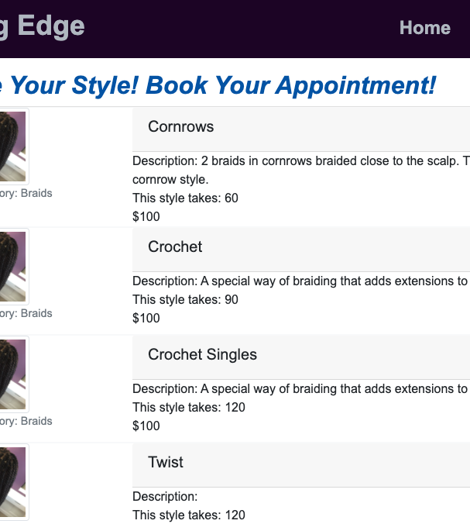
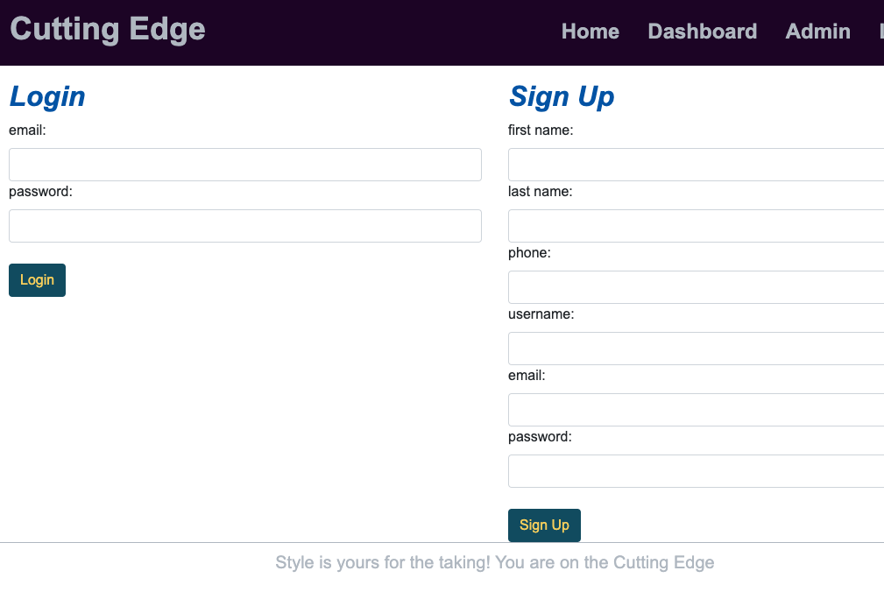
Product Demo
Herokuapp Deployment!
https://cutting-edge-2020.herokuapp.com/

Slide 12
Challenges
Finding a new technology that will fit into the scheduling app
Incorporating the library into the system
Library has some issues
Making all the parts and pieces work together in a coherent whole
AUTHENTICATION!

Slide 13


Success
Working together as a team
Stumbling upon a user who needs a product was happenstance
Being able to capitalize on our strengths as a team
Communication goes very well
Using github in a completely new way

Slide 14
Moving forward we want to….
Add functionality to the calendar (be able to add/edit/delete appointments)
Deploy to webhosting service and allow it to be used by multiple small hair salons

Slide 15

Links
Deployed to Heroku
https://cutting-edge-2020.herokuapp.com/
GitHub Repo
https://github.com/terahje/cutting-edge

