Slide 1
Virtual Reality Therapy
By: Joshua Amora

Slide 2

Notes:
Virtual Reality Scene of Alice in Wonderland
Main object is to do mundane tasks
Mundane for most people
Great step in healing for patients in hand rehabilitation
Improves hand arm coordination
The simulation scores the patient
Example of virtual reality therapy

Slide 3

Position
Virtual Reality therapy
Utilize tech to help
Growing
Multiple paths
Notes:
Encourage VR therapy and tech to improve
Demonstrates the best of technology
Helps users to heal (Engage in exercise)
Will continually evolve
Pushes Creativity as different ideas are used (Alice in Wonderland only one example)

Slide 4
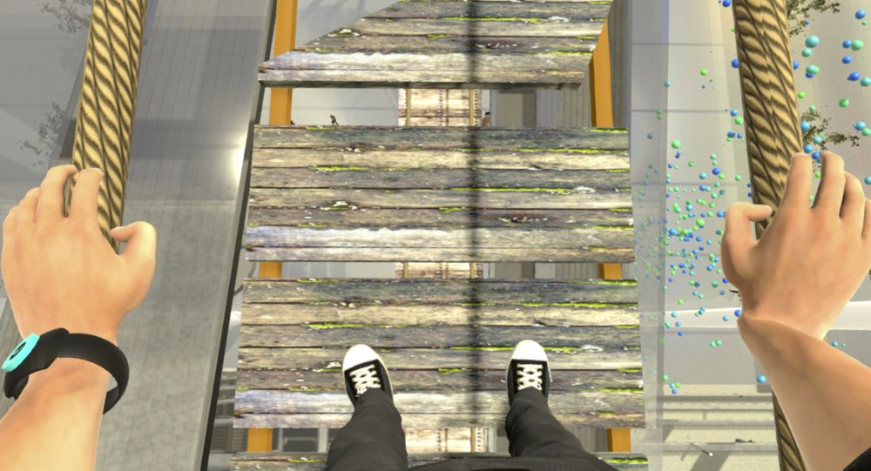
Support
Controllable
Easier exposure
Scalable
Imagination
Notes:
One of greatest strengths is that is controllable
Customizable environment (Change based on necessity)
Give the appropriate amount of exposure at a time (Incremental increases in fear)
Easier to imagine while staying safe
Putting everything together is not easy

Slide 5
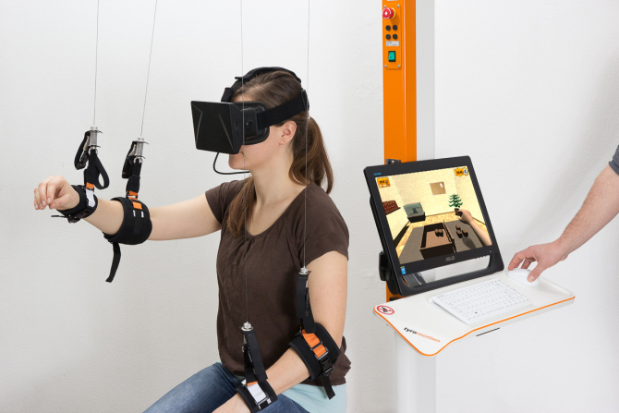
Disadvantages
Expensive
Difficult to Set up
Unstable Software
Notes:
Biggest disadvantage is expensive
VR was expensive first starting out as tech was young
Advanced equipment to get full benefits
Expensive when first started out
Software has good chance for glitches
Not widely and easily implemented
Large risk

Slide 6
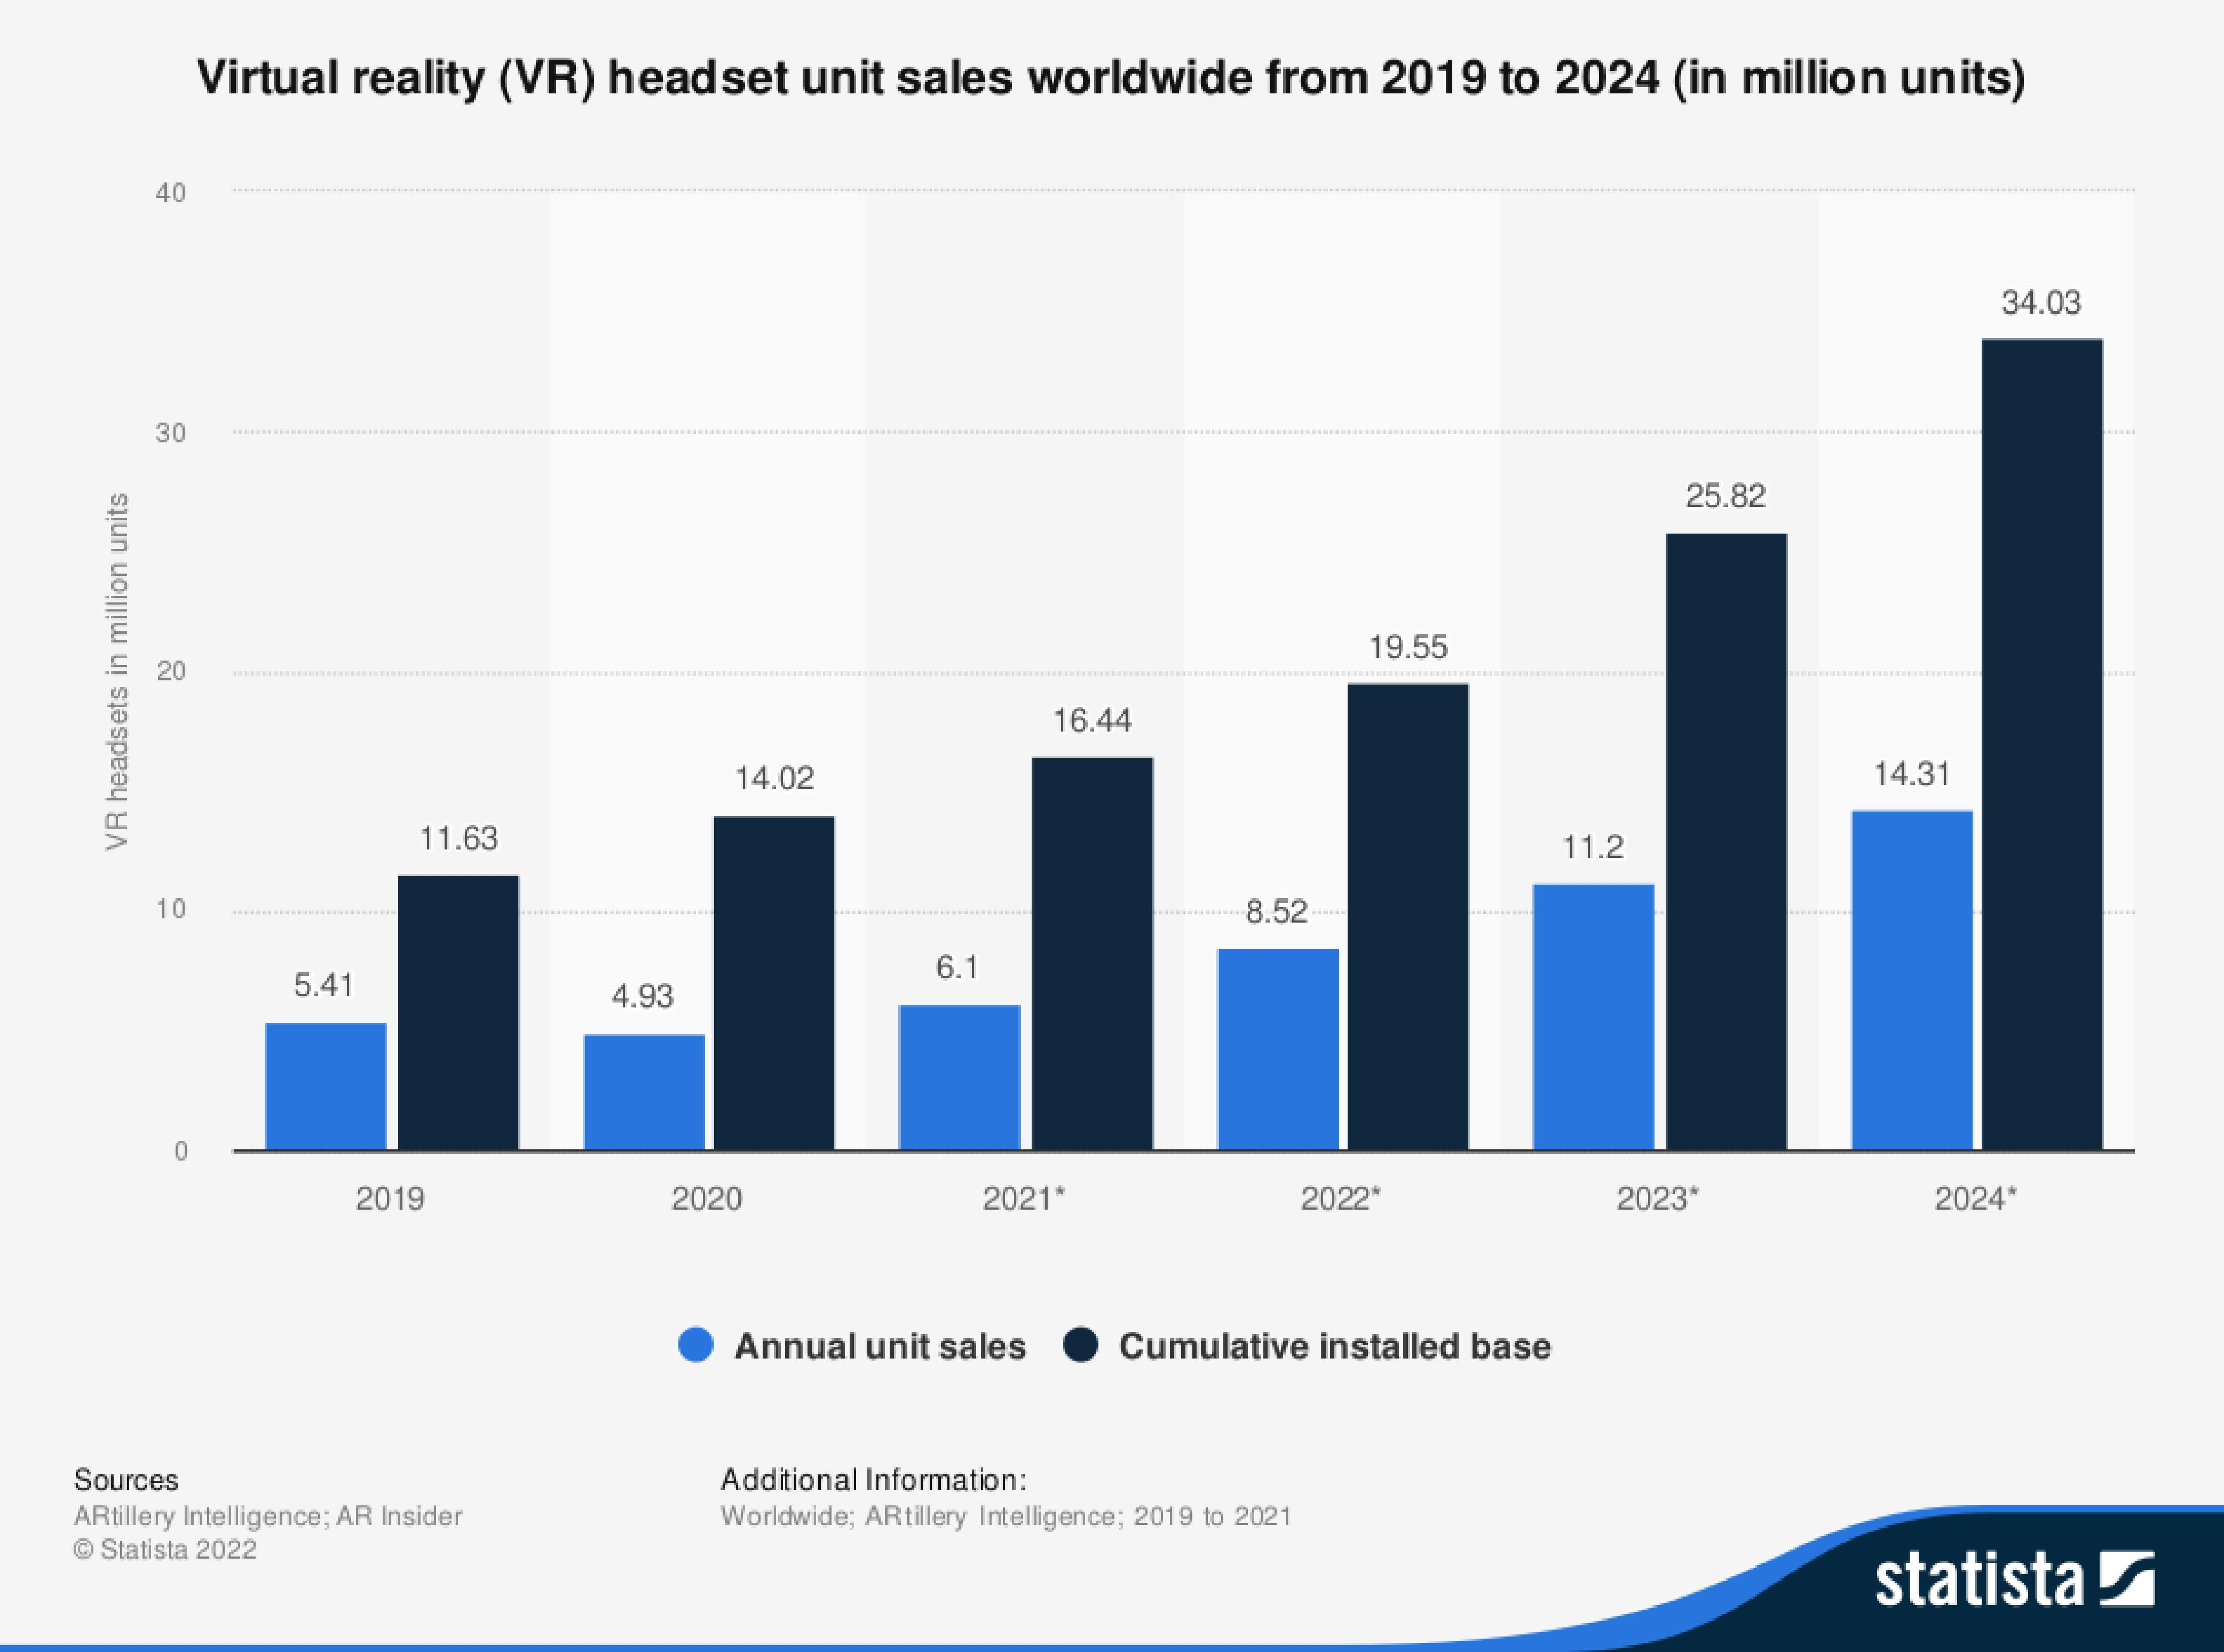
Rebuttal
More affordable
Simpler Set-ups
More training and testing
Notes:
Headsets more affordable overtime
Becoming more widespread in households as seen on chart
Simpler therapy methods can just use phone set-ups
Proper training and testing needs to be implemented
The therapy will not be as effective without quality assurance

Slide 7
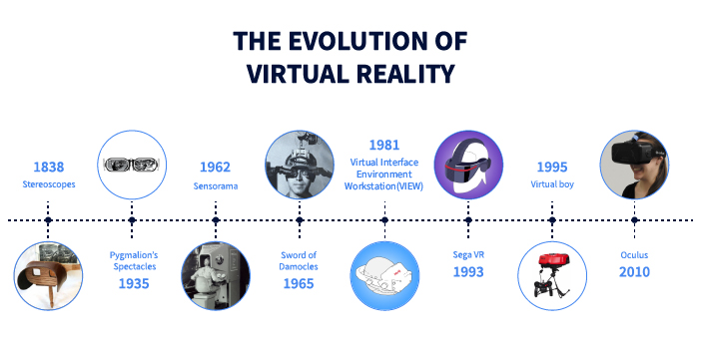
Conclusion
Technology is:
Evolving
Multi-purpose
Helpful
Notes:
VR therapy needs to be researched more
Advantage is controllability
Disadvantage- not easy to implement in the first place
Cost and quality will improve overtime
VR therapy is one of the best uses of technology

Slide 8
Works Cited
Hoffman, Hunter G et al. “Virtual reality hand therapy: A new tool for nonopioid
analgesia for acute procedural pain, hand rehabilitation, and VR embodiment therapy for phantom limb pain.” Journal of hand therapy : official journal of the American Society of Hand Therapists vol. 33,2 (2020): 254-262. doi:10.1016/j.jht.2020.04.001
Rothbaum, B O et al. “Virtual reality exposure therapy for PTSD Vietnam Veterans: a
case study.” Journal of traumatic stress vol. 12,2 (1999): 263-71. doi:10.1023/A:1024772308758
Tsoupikova, Daria et al. “Virtual Reality Environment Assisting Post Stroke Hand
Rehabilitation: Case Report.” Studies in health technology and informatics 184 (2013): 458-64 .

Slide 9
Pictures
Alsop, Thomas. “VR Headset Unit Sales Worldwide 2024.” Statista, 25 Jan. 2022,
https://www.statista.com/statistics/677096/vr-headsets-worldwide/.
Johnson, Carla K. “New Era in Virtual Reality Therapy for Common Phobias.” AP
NEWS, Associated Press, 18 Sept. 2018, https://apnews.com/article/health-
science-technology-us-news-ap-top-news-35ba06aa00784732969b5ad161e43a3c.
“Virtual Reality in Healthcare: A New Solution for Rehabilitation?” Program Ace, 28
Feb. 2018, https://program-ace.com/blog/virtual-reality-in-healthcare-a-new-solution-for-
rehabilitation/.
“VR Therapy May Be Effective in Treating Schizophrenia, Autism, Parkinson's.” The
Week, The Week, 29 Mar. 2019, https://www.theweek.in/news/health/2019/03/29/Virtual-reality-therapy-may-be-effective-in-treating-autism-Parkinsons.html.
“The Story of Virtual Reality.” Ib.cricket, 4 Dec. 2019, https://ib.cricket/the-story-of-
virtual-reality/.

