Slide 1
Creating Dashboard with Plotly
Presented by:
Group: 5
Romiya, Sasmita, Simmi,
Sonu & Sufie

Slide 2
Learning Objectives
Discover Dash and its two components
Identify different web-based dashboarding tools available in Python
Use Plotly graph objects and Plotly express to create charts
Explore Plotly and its two sub-modules
Identify different types of Plotly Libraries

Slide 3
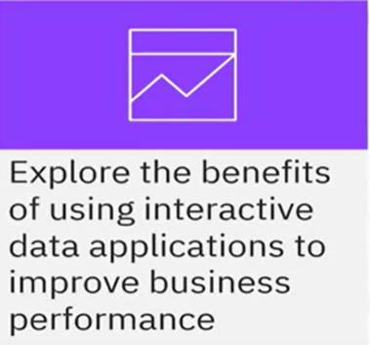
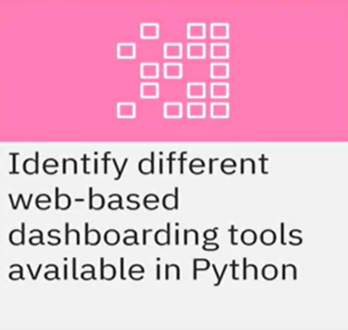
Dashboarding Overview
Dashboards and interactive data applications are crucial tools for data visualization and analysis because they provide a consolidated view of key data and metrics in a visually appealing and understandable format.
In this module, we will explore the

Slide 4
Dashboard
Real-time visuals simplify business moving parts.
Display Key performance Indicators(KPI) for analysis.
Help business by providing the big picture.
Best dashboards answer important business questions.
Scenarios : Review flight performance of US flights
Yearly Report items:
Top 10 airline carriers in 2019 (in terms of number of flights)
Number of flights in 2019 (split by months)
Number of travelers from California (to other state split by distance group)

Slide 5
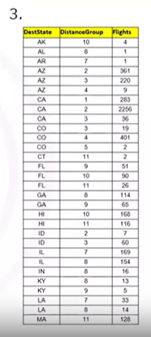
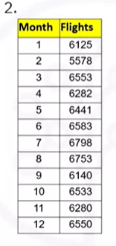
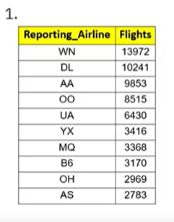
Type One : Without Dashboard

Slide 6
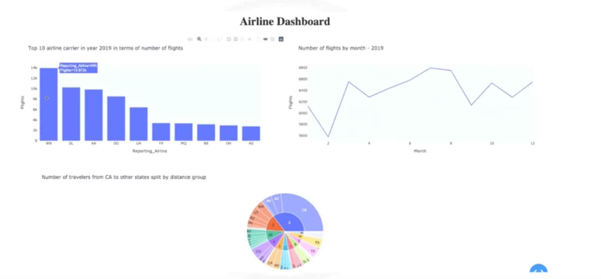
Type Two : With Dashboard

Slide 7

Web-based Dashboarding

Slide 8
Web-based Dashboarding
Dash : Dash is a Python framework for building web analytic applications. It runs on top of flask plotly.js and react.js. Dash is well suited for building data visualization apps with highly customized user interfaces.
Panel : Panel works with visualizations from Bokeh, Matplotlib, HoloViews, and many other Python plotting libraries, making them instantly viewable, either individually or when combined with interactive widgets that control them. Panel works equally well in Jupyter Notebooks for creating quick data exploration tools or as a standalone deployed app in dashboards and allows you to easily switch between those contexts as needed.
Voila : Voila turns Jupyter notebooks into standalone web applications. It's compatible with separate layout tools like Jupyter-flex or templates like voila-vuetify.
StreamKit : Streamlit can easily turn data scripts into shareable web apps with three main principles: embrace Python scripting, treat widgets as variables, and reuse data and computation.

Slide 9

Dashboard Tools

Slide 10
There are other tools that can be used for dashboarding.
Bokeh is a plotting library, widget, and app library. It acts as a server for both plots and dashboards. Panel, which is one of the web-based dashboarding tools, is built on Bokeh.
Ipywidgets provides a wide array of Jupyter compatible widgets and an interface supported by many Python libraries. But sharing as a dashboard requires a separate deployable server like voila.
Matplotlib is a comprehensive library for creating static, animated, and interactive visualizations in Python.
Bowtie allows users to build dashboards in pure Python.
Flask is a Python-backed web server that builds arbitrary websites,including those with Python plots that then function as Flask dashboards.

Slide 11
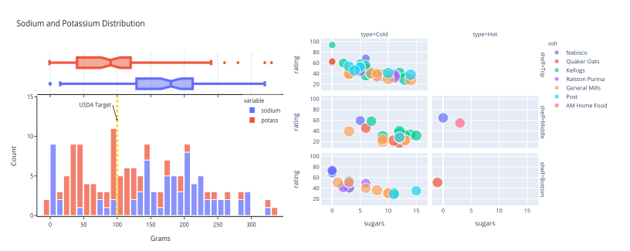
Introduction to Plotly
What is Plotly?
Plotly is an interactive, open-source plotting library that supports over 40 unique chart types.

Slide 12
Introduction to Plotly
Plotly Python is an extension of Plotly JavaScript Library and includes chart types like statistical, financial, maps, scientific, and three-dimensional data.
The web-based visualizations created using Plotly Python can be displayed in Jupyter Notebook, saved to standalone HTML files, or served as part of pure Python build web applications using dash.

Slide 13
Sub-Modules Plotly
1. Plotly Graph Objects : It is a low-level interface to figures, traces and layout.
Plotly.graph_objects.Figure
2. Plotly Express. : Plotly Express is a high level wrapper for Plotly.
simple syntax,
it uses graph objects internally.

Slide 14
Plotly graph objects and Plotly express
import plotly.graph_objects as go
import plotly.express as px
import numpy as np # we need numpy to generate sample data
np.random.seed(10) #Generate sample data
x=np.arange(12) # create an array of 12 elements
y=np.random.randint (50, 500, size=12). # create random y values by using random module
# The plotly.graph contains the JSON object, which has a dictionary structure. Then go will be the JSON object.
fig = go.Figure( data=go.Scatter( x=x, y=y)).
fig.update_layout( title= 'Simple Line Plot', xaxis_title= 'Month', yaxis_title= 'Sales').
fig.show().

Slide 15

Plotly Library
It's time to play with the Plotly library. We'll use the airline reporting dataset from the data asset exchange to demonstrate how to use Plotly Graph Objects and express to create charts.
Information on approximately 200 million
domestic US flights reported to the United States Bureau of
Transportation Statistics.( date, time, departure airport, and
arrival airport, and if applicable, the length of time the flight
was delayed and information about the reason for the delay.)

Slide 16
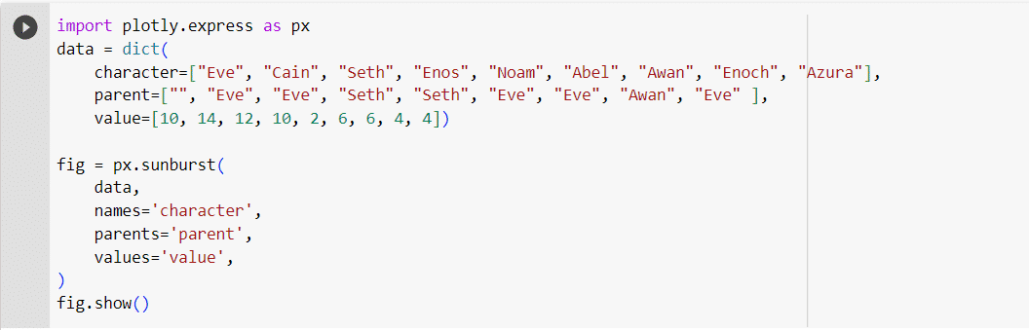
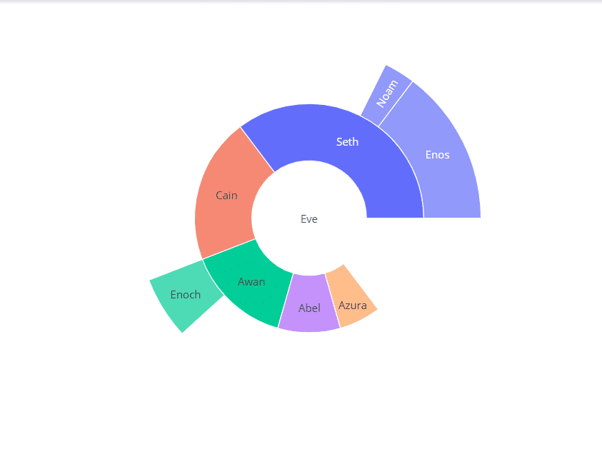
Sunburst

Slide 17
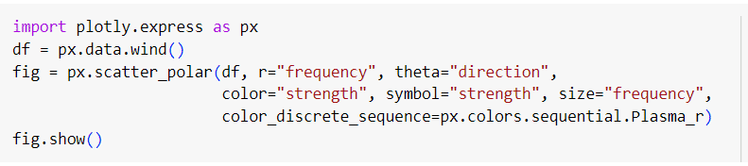
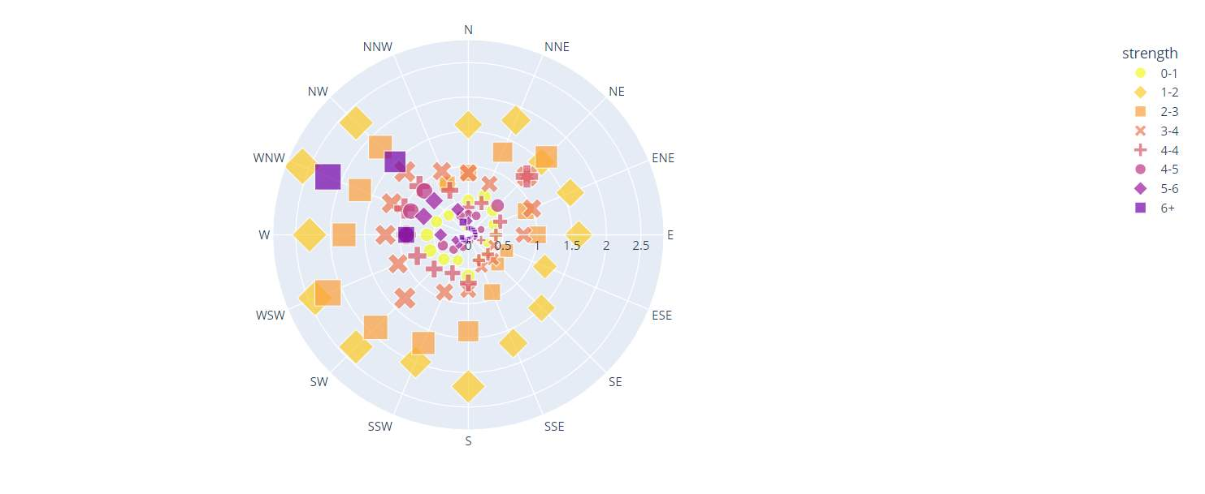
Scatter_polar

Slide 18
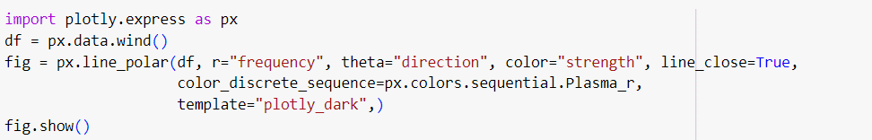
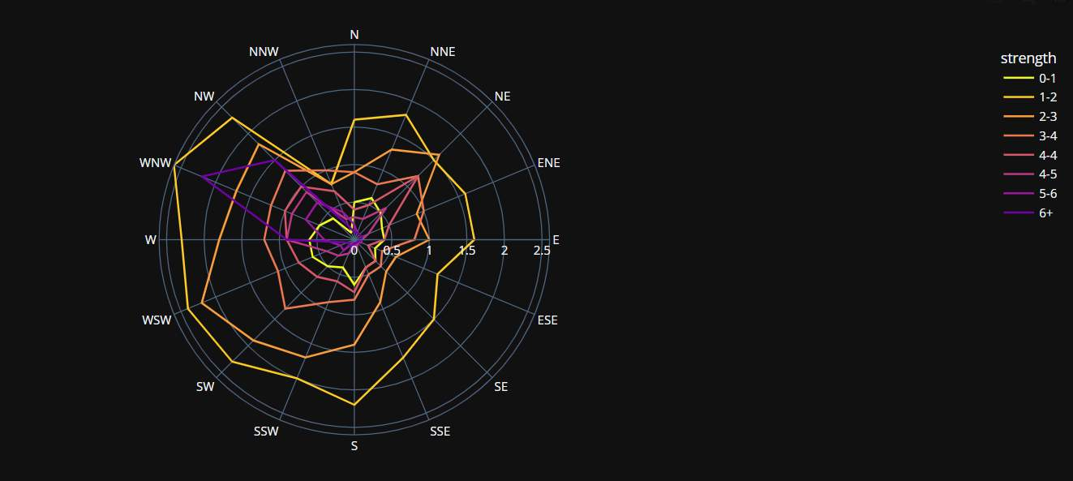
Line_polar

Slide 19
THANK YOU!

