Slide 1
This Employer Webinar Series program is presented by Spencer Fane Britt & Browne LLP in conjunction with United Benefit Advisors

Slide 2
Social Media 2.0
Lessons Learned and Applied
to the Workplace
---------------
Dave Kight & Eric Kelly
Copyright 2010

Slide 3
Social Media
A great way to connect or . . .
A great way to goof off, harass people and create liability for employers when you aren’t using so much bandwith that you shut the network down.
Copyright 2010

Slide 4
It’s Simple … Sort Of
Social media networks are simply the latest media of communications.
  E-mail is “so yesterday.”
It gets complicated when one considers the pace at which the popularity of such networks has grown and is already changing, and what this means for human interaction.
  i.e., It’s not just Facebook.
The line between personal and professional communications has been blurred.
Copyright 2010

Slide 5





What’s Out There?
The “Big Six” of social media:
Copyright 2010

Slide 6
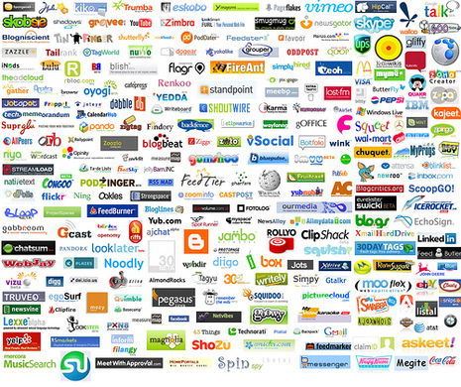
But Wait! There’s More!
Copyright 2010

Slide 7
Social Sharing
“Social media has led to ‘social sharing,’ the broadcasting of our thoughts and activities. It’s not a fad. It’s a sociological phenomenon, accelerating at light speed.”
  “What are you doing? Where are you doing it? Who are you doing it with? What do you like? These used to be things we kept to ourselves or shared with our friends and family. Now we’re willing to broadcast them to whoever is willing to listen.”
“Social sharing is a major behavioral shift, the most important so far of the 21st century. And the information we choose to share with friends, co-workers and even strangers, is re-defining the idea of what's private and public before our very eyes.”
David Armano, Harvard Business Review (Apr. 28, 2010)
Copyright 2010

Slide 8
Workplace Impact
Copyright 2010

Slide 9
Social Media Policies
  According to the Deloitte study, 24% of employees do not know if their company even has a policy about using social networking media.
  15% of employees would comment about something their employer did that they didn’t agree with.
Copyright 2010

Slide 10
Protecting Your Data
A recent survey found that nearly 60% of employees who lost or left jobs in 2008 admitted stealing company data.
The survey polled 945 adults from several industries who were laid off, fired, or changed jobs in 2008.
  - Wall Street Journal, April 30, 2009.
Copyright 2010

Slide 11
A recent news item
An employer defending a sexual harassment claim is entitled to see all Facebook or MySpace posts of a person claiming harassment and severe emotional injury:
  “It is reasonable to expect severe emotional or mental injury to manifest itself in some [social network] conyent, [including when the distress occurred and the degree of distress].” E.E.O.C. v. Simply Storage Management, LLC
  --- F.R.D. ----, 2010 WL 3446105 (S.D. Ind. 2010)
It is a Tsunami of change. . .
Copyright 2010

Slide 12
Spencer Fane Social Media Survey
In 2009, Spencer Fane started an annual Social Media Survey. We survey human resources executives on their use of social media along with its impact in their organizations.
Trends:
  Personal use of social media by individuals in Human Resources departments is trending down.
  The number of companies who permit social media in the workplace is down.
  However, the instances of issues relating to social media is increasing significantly.
Copyright 2010

Slide 13
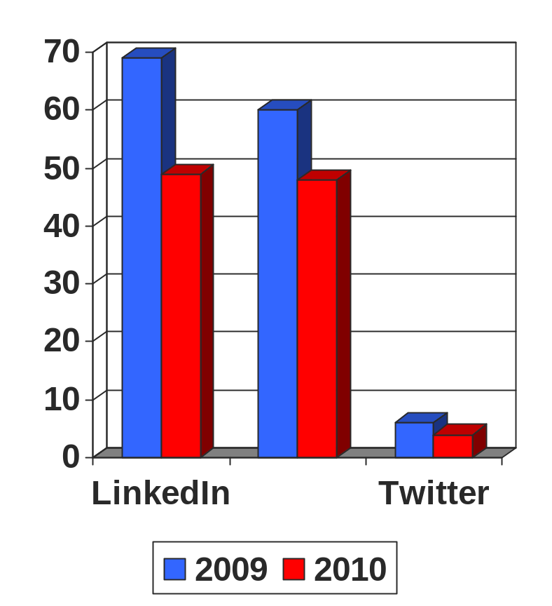
Usage by HR Officers
Do you personally use Linked In, Facebook, Twitter, MySpace?
Answers are % of those who responded yes.
Copyright 2010

Slide 14
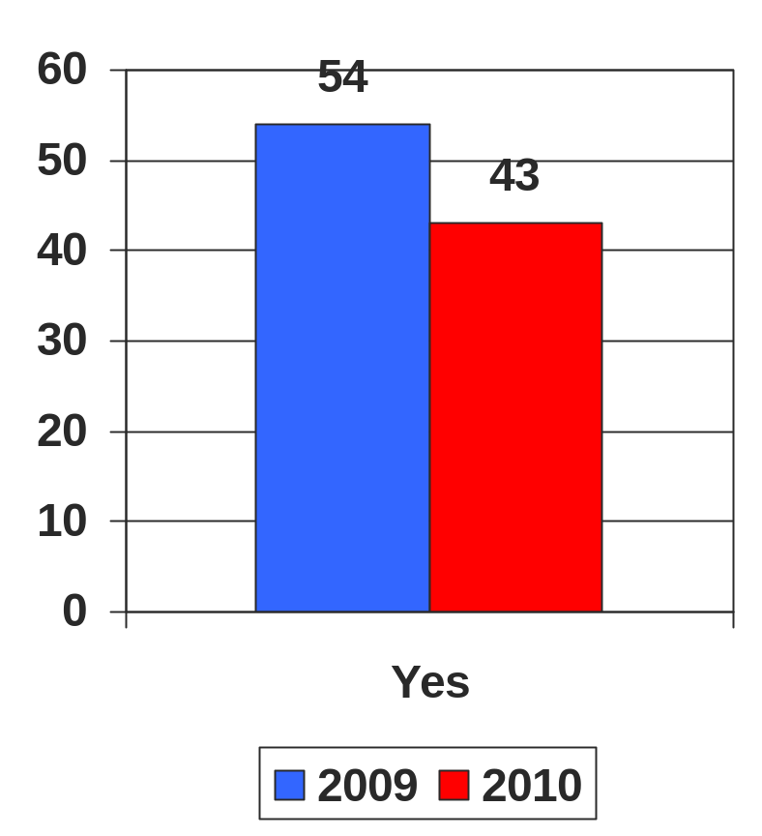
Organizations Tightening Use?
Does your organization permit employees to access online social media networks from a company computer or issued device?
Copyright 2010

Slide 15
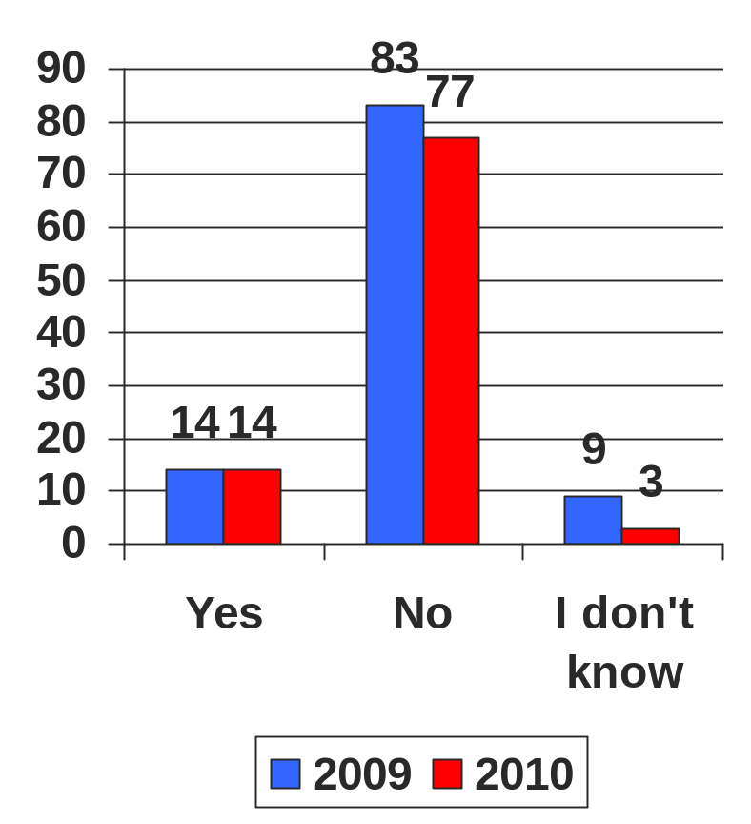
Organizations Tightening Use?
Does your organization encourage employees to access online social media networks from a company computer or issued device?
Copyright 2010

Slide 16
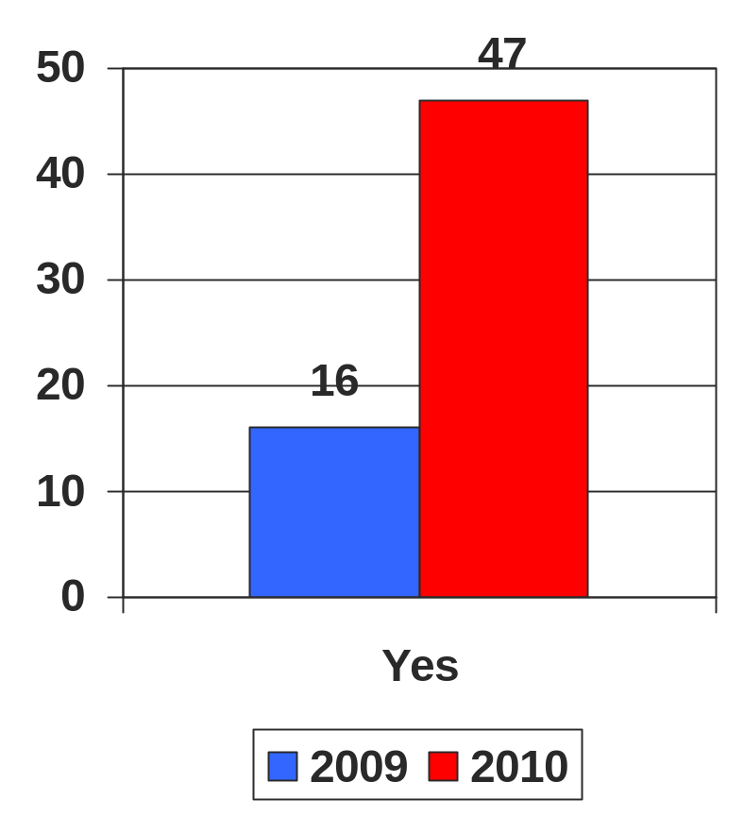
Increasing Instances
Has your organization encountered an issue involving an employee’s use of social media in the workplace?
Copyright 2010

Slide 17
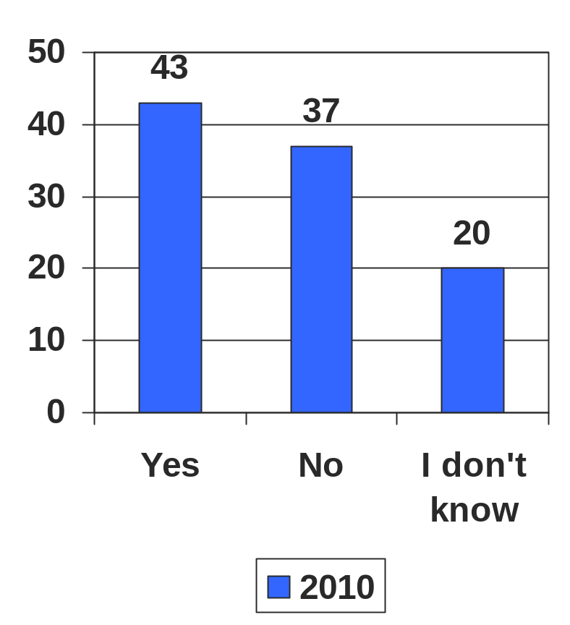
Issues other than Excessive Use
If you encountered a problem with an employee and social media in the workplace was it for something other than excessive use?
Copyright 2010

Slide 18
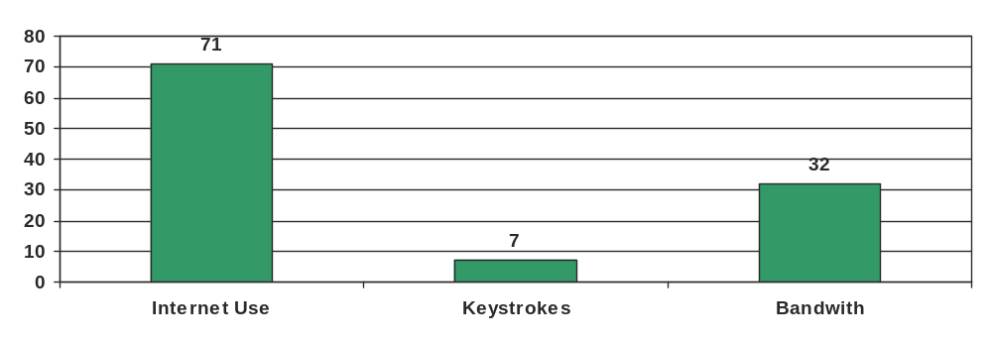
New in 2010 - Monitoring
Does your organization monitor internet usage, keystrokes or bandwith usage?
  We believe that these numbers will increase as technology makes them less expensive to implement.
Copyright 2010

Slide 19
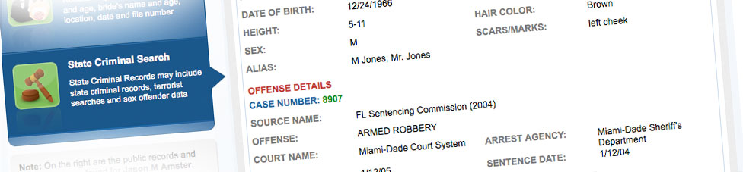

The latest issue? - Apps
Applications (apps) for the iPhone and other smartphones (Blackberry).
The app is free to download and users are allowed three comprehensive background checks per week for free.
Copyright 2010

Slide 20
Another new iTunes app…
Tiger Text
  You have the ability to send a text message and then control its deletion.
  Could permit an employee to send an explicit text to a co-worker which the co-worker could not save and report.
  Could permit an employee to share confidential or trade secret information outside the company and it would not be traceable.
Copyright 2010

Slide 21
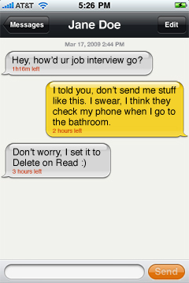
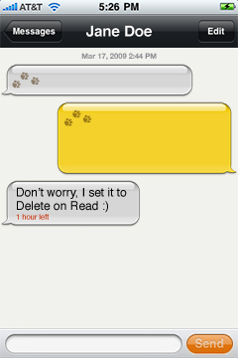
Tiger Text
Before After
Copyright 2010

Slide 22
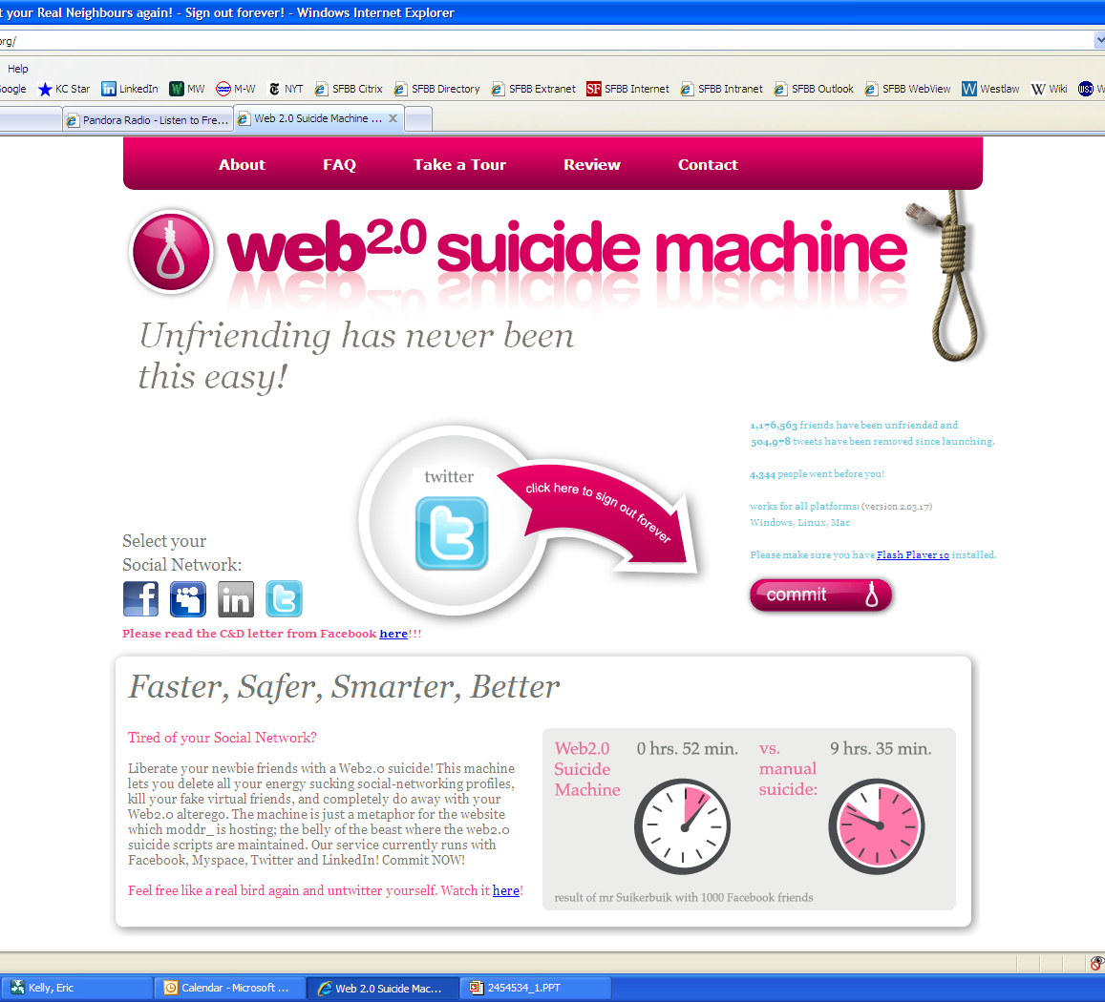
Social Media Backlash?
“Liberate your newbie friends with a Web2.0 suicide! This machine lets you delete all your energy sucking social-networking profiles, kill your fake virtual friends, and completely do away with your Web2.0 alterego. The machine is just a metaphor for the website which moddr_ is hosting; the belly of the beast where the web2.0 suicide scripts are maintained. Our service currently runs with Facebook, Myspace, Twitter and LinkedIn! Commit NOW!”
4,344 people went before you!
Copyright 2010

Slide 23
Can You Spot It?
Millenials are become adept at developing their own language on the net, on their pdas and elsewhere. Can you decipher these?
143
420
5FS
Copyright 2010

Slide 24
Workplace Planning
Copyright 2010

Slide 25
Initial Questions
Do you block access to any social media networks?
Do you block instant messaging?
Do you block Pandora?
Do you have any policies that address whether or not employees may provide recommendations and if so, does that apply to LinkedIn?
Copyright 2010

Slide 26
Additional Questions
What would your employees be comfortable doing at the security of their desks?
If managers are tweeting or instant messaging each other, is that discoverable in litigation?
Can you stop this?
Copyright 2010

Slide 27
Still More Questions
Should I use online social media networks?
Should I permit employees to use online social media networks?
Should I have a formal policy regarding the use of online social media networks?
Should I “friend” a subordinate?
Should I “friend” a boss?
Copyright 2010

Slide 28
The Law Has Not Kept Pace
Unlike social media networks, the law does not develop at “breakneck speed.”
Congress is watching, however.
  On April 27, 2010, four members of Congress sent a letter to Facebook’s CEO expressing concern about changes to Facebook’s privacy policy and “instant personalization” function.
  On July 22, 2010, the U.S. House of Representatives Subcommittee on Commerce, Trade, and Consumer Protection held a hearing regarding how online service providers handle user information.
Social Media Privacy Protection Act?
Copyright 2010

Slide 29
City of Ontario v. Quon
In April 2010, the United States Supreme Court heard arguments about the privacy claims of a police officer who claimed that his explicit texts on department issued pagers to his wife and mistress were private speech.
  Chief Justice John Roberts asked during oral arguments what the difference was “between email and a pager?”
On Jun 17, 2010, the Supreme Court found in favor of the City of Ontario.
Copyright 2010

Slide 30
Quon: The Facts
The Ontario, CA, police department issued pagers to its SWAT team members
Officers were initially informed there was a no-privacy rule and messages would be read
Management later told officers that personal messages would be considered private providing the officers paid for personal use
Excessive use caused yet another reconsideration of the policy, and messages of certain users were reviewed
Copyright 2010

Slide 31
Quon: The Issues
Issues for the Supreme Court
  The primary issue presented to the Supremes was a Fourth Amendment search and seizure question
  Broader issue was privacy rights in general when it relates to e-communication in the workplace
What did many expect?
  Although framed in the context of government employers, many expected that the Court’s opinion could have repercussions in the private sector.
Copyright 2010

Slide 32
Quon: The Decision
Expectation of Privacy
  The Court declined to take up this question, preferring instead to "dispose of this case on narrower grounds."
    The Court presumed for purposes of the opinion the Quon had an expectation of privacy in his pager messages.
    i.e., The long-waited guidance employers had hoped for was punted to another day.
Copyright 2010

Slide 33
Quon: The Decision (cont’d)
Some Guidance
  Justice Kennedy observed that while Quon's expectation of privacy was not decided in this case, some factors that might be considered in the event such an inquiry were made would be:
    (1) whether the employer has a policy in place regarding the expectation of privacy in such devices;
    (2) whether the policy specifically covers the device in question, keeping in mind that devices channeled through the employer's data servers are not necessarily the same as devices through third party networks; and
    (3) whether the employer has some legitimate work-related purpose for monitoring employees' communications.
Copyright 2010

Slide 34
Social Media & Labor Laws
Union organizers clearly recognize the importance of social media in organizing campaigns
  Union sponsored web sites offer the Union the opportunity to easily reach employees without fear of employer interference.
  Blogs and online chat forums offer employees the ability to converse about issues freely with one another in a relatively anonymous environment.
At the heart of the question is the NLRA’s prohibition on improper surveillance of union organizing activities
  Generally, an employer does not engage in improper surveillance by observing open union activity.
  However, if access is restricted in some fashion, management’s covert monitoring will likely be found to be per se improper.
Copyright 2010

Slide 35
Employer Surveillance
Even if observation of online activity is not improper in and of itself, where the employer informs an employee it is aware of the employee’s online activity, the conduct will likely be found to be improper
  Such conduct by the employer creates an impression of surveillance which could have a tendency to chill protected activities
Magna International, Inc. (2001)
  The administrative law judge found the employer violated the Act during an organizing campaign when a supervisor commented to an employee that he liked her picture on the UAW website
PPG Aerospace Industries, Inc. (2010)
  The NLRB found the employer violated the Act when a supervisor made it clear to an employee that he had seen the employee’s picture on the Union’s website
Copyright 2010

Slide 36
Recent Litigation
Company externally promotes an employee as a spokesman for the company. Company also requires the spokesman to create a blog linked to the company under the employee’s name. The employee blogs under their name on issues related to the company. The employee develops followers to her blog. Employee is fired.
Copyright 2010

Slide 37
Recent Litigation – II
Employee changes the password and username of the blog.
Employee scrubs the blog of references to the company and deletes the link in the blog to the company’s website.
Employee refuses the company’s requests to provide the username and password and stop using the blog.
Employee refuses to give the “followers of the blog” to the company.
Copyright 2010

Slide 38
Recent Litigation – III
Company had an employment agreement with a provision with an intellectual property provision.
Company sued the former employee for breach of contract and conversion.
Company sought and received a TRO.
Employee returned the property and the case was resolved.
Copyright 2010

Slide 39
You Make the Call
Some Example Issues That You Could be Faced With In This Brave New World
Copyright 2010

Slide 40
You Make the Call - 1
Your human resources officer asks whether or not you have the right to order employees not to use their cell phones for social networking on their own time such as breaks and lunch.
Copyright 2010

Slide 41
You Make the Call – 2
Company is an ambulance service. An employee posts a picture from their camera phone of a particularly gruesome injury on their Facebook account but does not indentify who the patient is or where it occurred. Employee’s status update says, “Saw this today. Whoah. I see injuries all day long, but this one is gnarly.”
  You have been notified of this. What if anything should you do?
Copyright 2010

Slide 42
You Make the Call - 3
An employee in human resources reports to you that the department has been using the three free searches they get on been verified to do checks on applicants for a position in sales. Two of the three applicants had clean reports but one indicates a prior arrest and conviction for theft. What, if anything, should you do now?
Copyright 2010

Slide 43
You Make the Call - 4
A supervisor in the department comes to you to discuss disciplining an employee for poor performance. You decide to meet with the employee about the concerns. The employee indicates that they are surprised and provides you a LinkedIn positive comment by the supervisor.
  What bearing, if any, does the LinkedIn comment have?
Copyright 2010

Slide 44
You Make the Call - 5
You receive several e-mailed applications. One e-mail contains the links to the applicant’s Facebook page, Linkedin account and Twitter page. Your hiring manager is curious and checks them out. By looking at the page you can learn the sex, gender, age, religious preference and family status of the applicant. You also search the applicant’s name on Google. You find out that the applicant sued her former employer for race discrimination. You cannot find whether the applicant “won or lost” her lawsuit. You do not want to hire someone that you believe might later sue you.
  Can you refuse to hire them?
Copyright 2010

Slide 45
You Make the Call - 6
A former employee has approached a current employee and asked for a Linkedin recommendation and a written recommendation in the hopes that they will find a job.
  The current employee asks you about this and whether they can do it.
Copyright 2010

Slide 46
You Make the Call - 7
An employee who is a fan of Kansas basketball has a personal blog about the team. When Nebraska announces that it is leaving the Big 12 conference, Kansas fans become enraged that this decision will hurt Kansas. The employee posts a blog that is derogatory to Nebraska and makes very derogatory comments about the alumni of Nebraska.
The President of the Company and his wife are very strong Nebraska alumni, and the Nebraska basketball arena is named after them. The President feels that these comments are highly offensive and cannot get past his anger. He demands that you fire the employee immediately.
Can you terminate an employee for off-duty comments made about non-work related issues?
Copyright 2010

Slide 47
You Make the Call - 8
John employs students for summer work at parks. A parent complains about an employee, Kate, who uses foul language in front of a child. John suspends Kate and warns her to “knock it off or you are fired.” Kate believes this is unfair and posts an entry on her blog that John is unfair and that the employees need to get together and demand fairer treatment. She creates a Facebook group called “John is the worst boss ever” and invites other students to post and they do. John’s daughter sees this and reports it to her father who fires Kate for insubordination.
John employs Kate in a right to work state. Does Kate have any claims that John should be concerned?
Copyright 2010

Slide 48
You Make the Call - 9
Your company’s salesman has both Linkedin and Facebook pages. Other employees are friends. Salesman is fired.
Salesman goes on to Linked in and Facebook to complain about how unfair the company is and how it mistreats people.
Company president find out about it and wants a cease and desist letter to be sent to the salesman.
Copyright 2010

Slide 49
Policies
Should you nip it in the bud?
Copyright 2010

Slide 50
Do …
Have a policy which covers internet usage, but is broad enough to cover electronic media of all types.
Have a policy on security of electronic data.
  USB drives, camera phones, blackberry devices, etc.
Regularly evaluate your policies to see if they are addressing new trends.
Consider intellectual property.
Copyright 2010

Slide 51
Don’t …
Assume that you can have a policy for every situation. Social media is expanding exponentially.
Forget e-mail in your policy. It has become so routine we forget about it.
Forget to make sure everyone signs an acknowledgment of the policy.
Copyright 2010

Slide 52
Internet Policy - Keys
No privacy on company computers.
Employees are responsible for what they do on the internet while at work.
Internet usage is for legitimate business activity only. "Surfing the Net" is not a legitimate business activity.
Prior approval is required before employees can post information to commercial on-line systems or the internet.
Copyright 2010

Slide 53
E-mail Policy
E-mail system is the property of the company and to be used for company purposes only.
E-mails are company records.
Employees have no right of privacy in their e-mail.
The company has the right to monitor, access, retrieve and delete any e-mail for any reason.
Company policies on discrimination and harassment apply to e-mail.
E-mail is not to be used for solicitation of any kind.
Copyright 2010

Slide 54
Blogging Policy
No blogging or “tweeting” during the work day unless on non-work time.
Work-time blogging or tweeting only if given pre-approval by the company.
No employee may have a blog or tweet on behalf of the company unless there is pre-approval.
Company reserves the right to discipline employees for blog entries or tweets.
Copyright 2010

Slide 55
Social Media Policies
What are they?
  A social media policy outlines for employees the corporate guidelines or principles of communicating in the online world.
  Do you have any existing communications, privacy and ethics policies? If so, you may be half-way there already.
Copyright 2010

Slide 56
Social Media Policies
Questions to Consider:
  If someone at your offices blogs, tweets or posts for the company, what happens when they leave the company?
  Who owns the “friends” or “followers”?
  Can I load up the company’s client list to LinkedIn?
  What am I permitted to post anonymously?
Copyright 2010

Slide 57
Social Media Policies
Employees should know that they have no right to privacy with respect to social networking.
  “Employer reserves the right to monitor employee use of social media regardless of location (i.e. at work on a company computer or on personal time with a home computer).”
Copyright 2010

Slide 58
Social Media Policies
Employees should be reminded that company policies on anti-harassment, ethics and company loyalty extend to all forms of communication (including social media) both inside and outside the workplace.
Copyright 2010

Slide 59
THANK YOU !
If we can ever assist your organization, on social media or any other legal concerns, please give us a call.
Dave Kight & Eric Kelly
(816) 474-8100
Copyright 2010

Slide 60
Thank you for your participation in the Employer Webinar Series.
To obtain a recording of this presentation, or to register for future presentations, contact your local UBA Member Firm.

