Slide 1



iBody: Reclaiming our Body Image in
Social Media

Slide 2
Links you will need for this presentation:
Facebook http://www.facebook.com/NewDawnTreatmentCenters
Twitter https://twitter.com/NewDawnCtr @newdawnctr
Pinterest http://pinterest.com/newdawncenter/
Youtube access

Slide 3
Tweet us your definition of Body Image
@newdawnctr
Quickest post gets a prize!

Slide 4
Don’t forget: You can copy-paste this slide into other presentations, and move or resize the poll.
Poll: Have you ever sucked in your stomach/fle...
Notes:
Poll: Have you ever sucked in your stomach/fle... Press F5 or enter presentation mode to view the poll In an emergency during your presentation, if the poll isn't showing, navigate to this link in your web browser: http://www.polleverywhere.com/multiple_choice_polls/LTIwNjE3MTg5OTM
If you like, you can use this slide as a template for your own voting slides. You might use a slide like this if you feel your audience would benefit from the picture showing a text message on a phone.

Slide 5
Don’t forget: You can copy-paste this slide into other presentations, and move or resize the poll.
Poll: Have you ever checked yourself out in a ...
Notes:
Poll: Have you ever checked yourself out in a ... Press F5 or enter presentation mode to view the poll In an emergency during your presentation, if the poll isn't showing, navigate to this link in your web browser: http://www.polleverywhere.com/multiple_choice_polls/MTQ3NjQxNDk0MQ
If you like, you can use this slide as a template for your own voting slides. You might use a slide like this if you feel your audience would benefit from the picture showing a text message on a phone.

Slide 6
Don’t forget: You can copy-paste this slide into other presentations, and move or resize the poll.
Poll: Have you ever lied about your height/wei...
Notes:
Poll: Have you ever lied about your height/wei... Press F5 or enter presentation mode to view the poll In an emergency during your presentation, if the poll isn't showing, navigate to this link in your web browser: http://www.polleverywhere.com/multiple_choice_polls/LTQwNTU0ODExMw
If you like, you can use this slide as a template for your own voting slides. You might use a slide like this if you feel your audience would benefit from the picture showing a text message on a phone.

Slide 7
Don’t forget: You can copy-paste this slide into other presentations, and move or resize the poll.
Poll: Have you ever worn an uncomfortable outf...
Notes:
Poll: Have you ever worn an uncomfortable outf... Press F5 or enter presentation mode to view the poll In an emergency during your presentation, if the poll isn't showing, navigate to this link in your web browser: http://www.polleverywhere.com/multiple_choice_polls/LTEwMzU5OTIyMzg
If you like, you can use this slide as a template for your own voting slides. You might use a slide like this if you feel your audience would benefit from the picture showing a text message on a phone.

Slide 9

When I look at other people's photo albums, the
comparing is automatic. I end up feeling like
crap. I went to Photoshop a picture of myself on
Facebook. I was changing a lot of things, then I
saw the picture and I stopped myself, thinking,
'this is not who I am. I want to be who I am.' "
-Kirby

Slide 10
Don’t forget: You can copy-paste this slide into other presentations, and move or resize the poll.
Poll: Do you have over 354 facebook friends?
Notes:
Poll: Do you have over 354 facebook friends? Press F5 or enter presentation mode to view the poll In an emergency during your presentation, if the poll isn't showing, navigate to this link in your web browser: http://www.polleverywhere.com/multiple_choice_polls/LTE5MjkyNzkzMzU
If you like, you can use this slide as a template for your own voting slides. You might use a slide like this if you feel your audience would benefit from the picture showing a text message on a phone.

Slide 11
Don’t forget: You can copy-paste this slide into other presentations, and move or resize the poll.
Poll: Do you have any "frenemies" on your FB f...
Notes:
Poll: Do you have any "frenemies" on your FB f... Press F5 or enter presentation mode to view the poll In an emergency during your presentation, if the poll isn't showing, navigate to this link in your web browser: http://www.polleverywhere.com/multiple_choice_polls/NTM4NTA3NjM3
If you like, you can use this slide as a template for your own voting slides. You might use a slide like this if you feel your audience would benefit from the picture showing a text message on a phone.

Slide 12
Don’t forget: You can copy-paste this slide into other presentations, and move or resize the poll.
Poll: What do you do if someone repeatedly mak...
Notes:
Poll: What do you do if someone repeatedly mak... Press F5 or enter presentation mode to view the poll In an emergency during your presentation, if the poll isn't showing, navigate to this link in your web browser: http://www.polleverywhere.com/multiple_choice_polls/LTE1ODM1MDU4NzU
If you like, you can use this slide as a template for your own voting slides. You might use a slide like this if you feel your audience would benefit from the picture showing a text message on a phone.

Slide 14
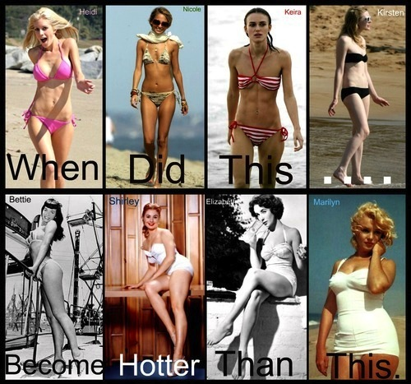

Using Social Media for Good
Be the positive voice in your friend’s head
Question the information being thrown at you

Slide 15

Does Instagram Promote Positive Body Image?
Each individual becomes the photographer, eliminating “created” images that would saturate a newsfeed.
We get a sense of those things that make the everyday extraordinary – the things that inspire us, pique our curiosity, deeply touch us, and make us smile.

Slide 16
Does Instagram Promote Positive Body Image?
Instagram has also taken a progressive stance on discouraging negative body image by urging users to not promote or glorify self-harm(including anorexia, bulimia, or other eating disorders). Hashtags that promote eating disorders, such as #thinspiration #proanorexia and #probulimia, for example, are unsearchable.

Slide 17


Make a board that is encouraging and promotes positive body image.
If you need inspiration on where to start,
try our boards at http://pinterest.com/newdawncenter/

Slide 18

If a picture speaks a thousand words, how much is a video worth?
YouTube videos have the ability to go viral so quickly, we need to make sure it is the message we want people to hear!
Prize to the first 3 body positive YouTube videos
posted to our facebook page!
http://www.facebook.com/NewDawnTreatmentCenters

Slide 19
Linking Your Social Media
If you haven’t already considered linking your
Twitter, Pinterest, Instagram or
YouTube Account and you would like to be that
positive voice: Do It!

Slide 20
Links from this presentation:
Facebook http://www.facebook.com/NewDawnTreatmentCenters
Twitter https://twitter.com/NewDawnCtr @newdawnctr
Pinterest http://pinterest.com/newdawncenter/
Youtube access

