Slide 1
Grant Writing Exercise
Josh D’Aeth
EECID
jd2117@ic.ac.uk

Slide 2
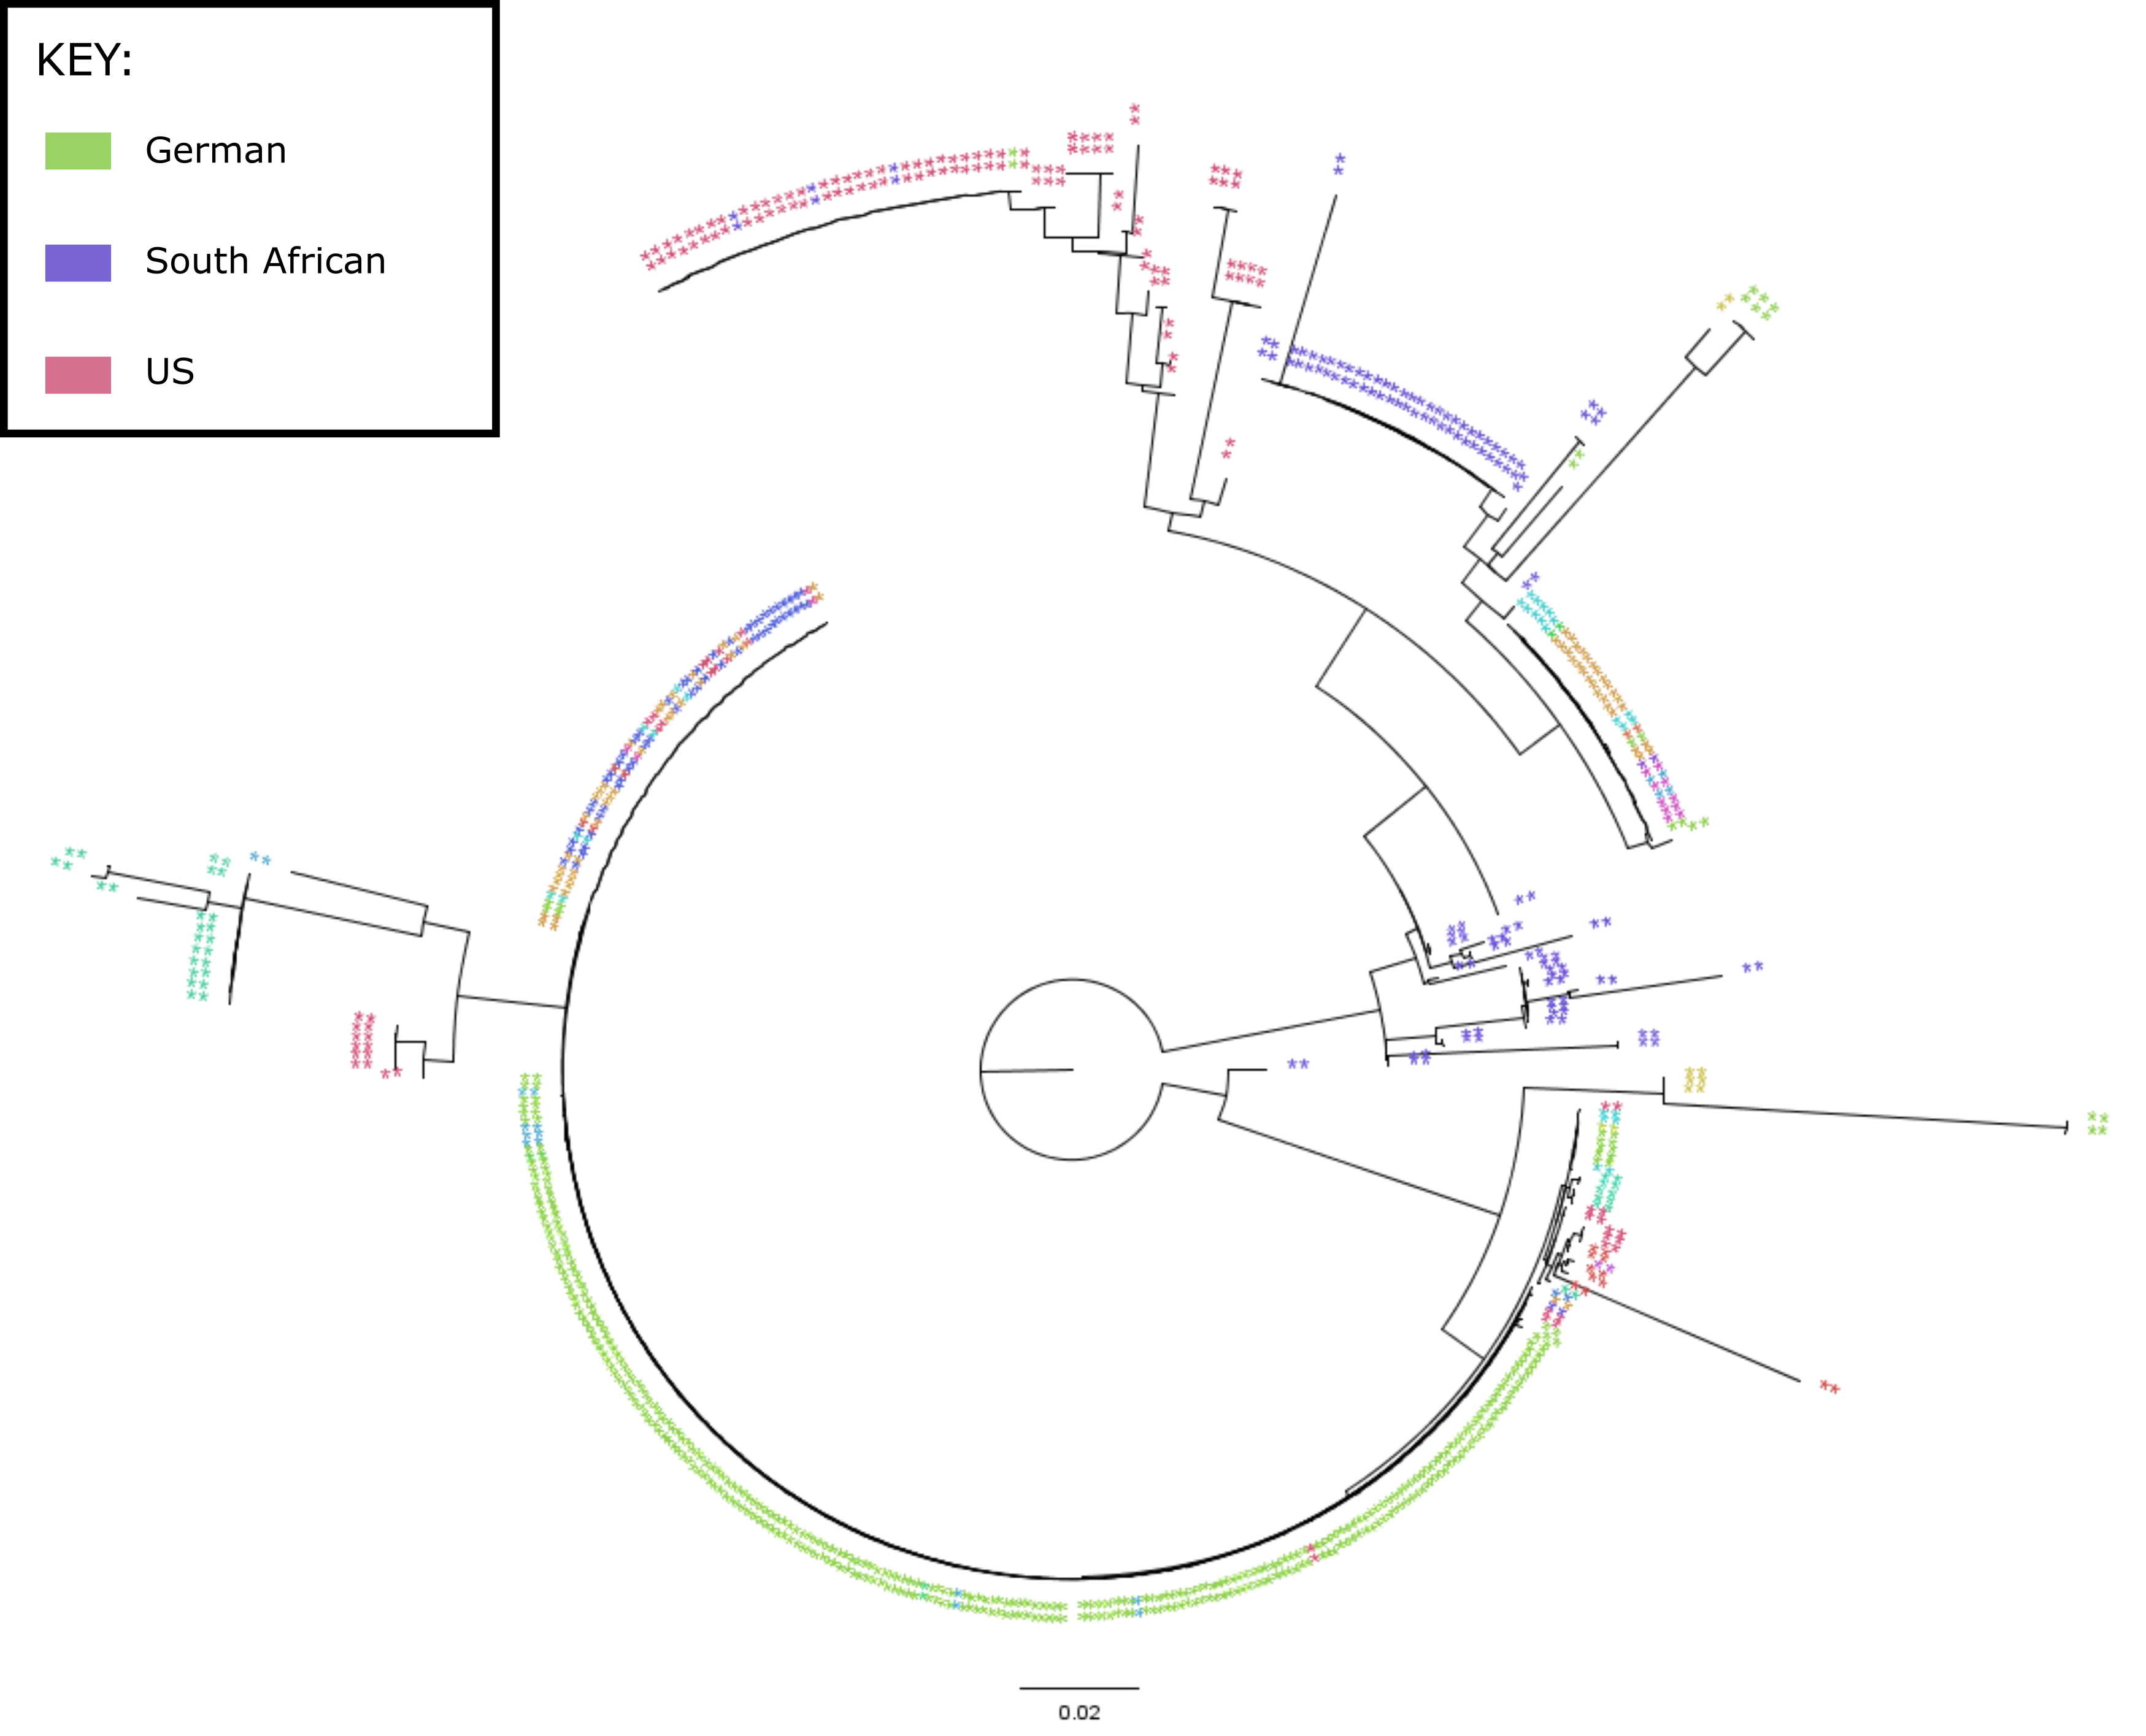
Project 1: Population Genomics of Multidrug resistance in Streptococcus pneumoniae
Background:
Antibiotic resistance is an increasing problem in the important human pathogen Streptococcus pneumoniae.
Sought to better understand how multidrug resistance evolves
Methods:
I analyzed WGS of isolates in two large international collections of Multidrug resistant S. pneumoniae.
I also mined large public sequence databases to assess the spread of two common antibiotic resistance elements among bacterial taxa.
Results:
Penicillin resistance was gained multiple times independently by S. pneumoniae, while resistance to other classes of antibiotics was more labile.
Perhaps there is a more nuanced relationship between antibiotic consumption and resistance levels
A greater diversity of insertion loci allows antibiotic resistance elements to more easily spread across bacterial species.

Slide 3
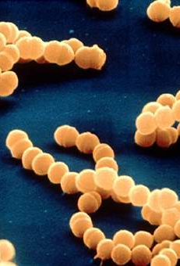
Grant proposal 1: An investigation of Commensal Nasopharyngeal bacteria
Background:
Commensal species such as Streptococcus oralis and Streptococcus mitis have in the past been identified as the source of penicillin resistance genes acquired by the pathogenic S.pneumoniae
These species are underrepresented in terms of WGS data.
Proposal:
Conduct a cohort study to sequence commensal Nasopharynegeal bacteria from the UK population
Analyse their genome content for precursors to resistance genes among these bacteria.

Slide 4
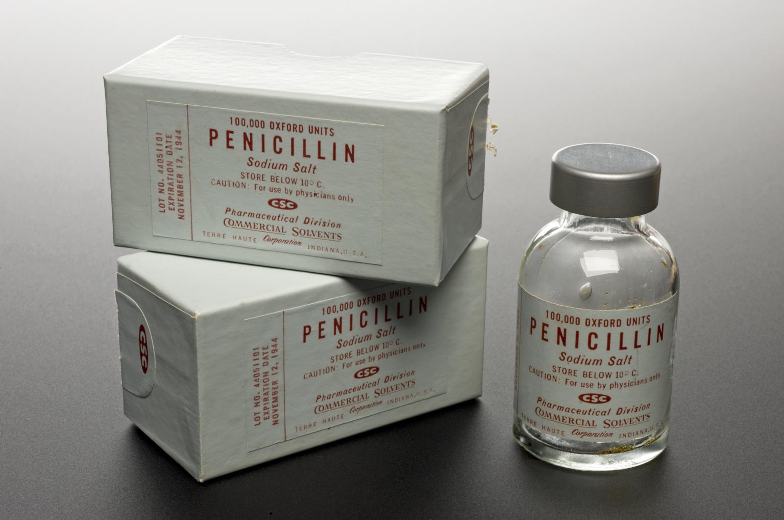
Grant proposal II: Characterization of the relationship between antibiotic consumption and resistance among Recombinogenic bacteria
Background:
Despite increasing antibiotic consumption within Europe, rates of resistance among S. pneumoniae have remained relatively stable
In my previous study we saw no relationship between the expansion of a macrolide resistant S. pneumoniae lineage and macrolide consumption in Germany.
Proposal:
Design a new statistical technique to infer the population dynamics of highly recombinogenic lineages of S. pneumoniae
Collect higher resolution data on antibiotic consumption in Germany and expand collection of resistant isolates
Test for any association between increasing N_{e} of a lineage and antibiotic consumption within Germany.

Slide 5
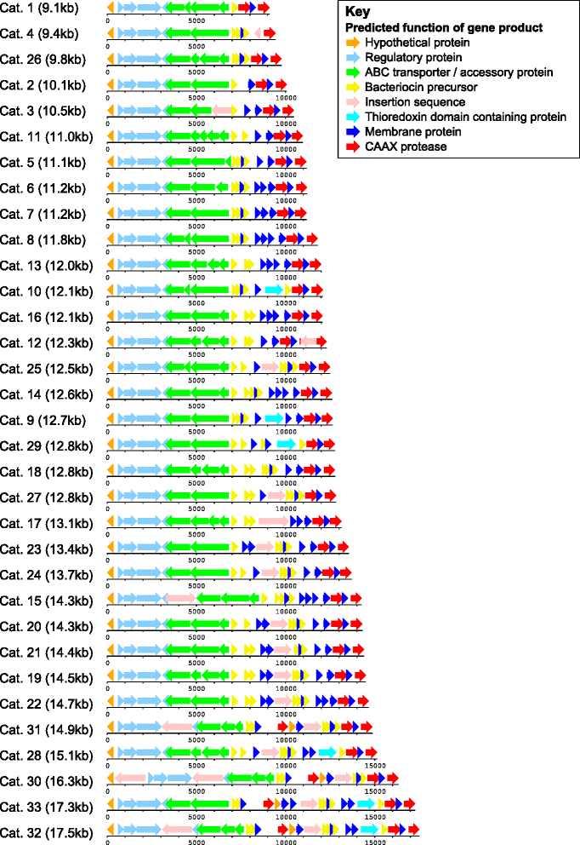
Grant Proposal III: investigation INTO THE Streptococcus Bacteriocin system.
Background:
Bacteria compete amongst each other within the human nasopharynx for limiting resources.
Streptococcus species can release antimicrobial peptides, bacteriocins, in order to kill off other competing strains.
The diversity of this system has only recently been looked into.
Proposal:
Further WGS analysis of the diversity of this bacteriocin system.
Testing of the different interactions between these antimicrobial peptides
Perhaps further work looking into possible clinical applications of these peptides.
Figure from Bogaardt et al 2015

Slide 6
What I CAN Offer as a co-I:
Experience in:
Evolutionary and epidemiological modelling.
Programming experience in R, Perl and C++ including package development experience in R
Phylogenetic analysis and population dynamic reconstruction of WGS Data.
Mining large public sequence databases.
Statistical model fitting.

Slide 7
What I would like in a Co-I:
Experience in sequencing bacteria.
Experience in culturing bacteria.
Experience in collecting data from large cohort studies.

