Slide 1

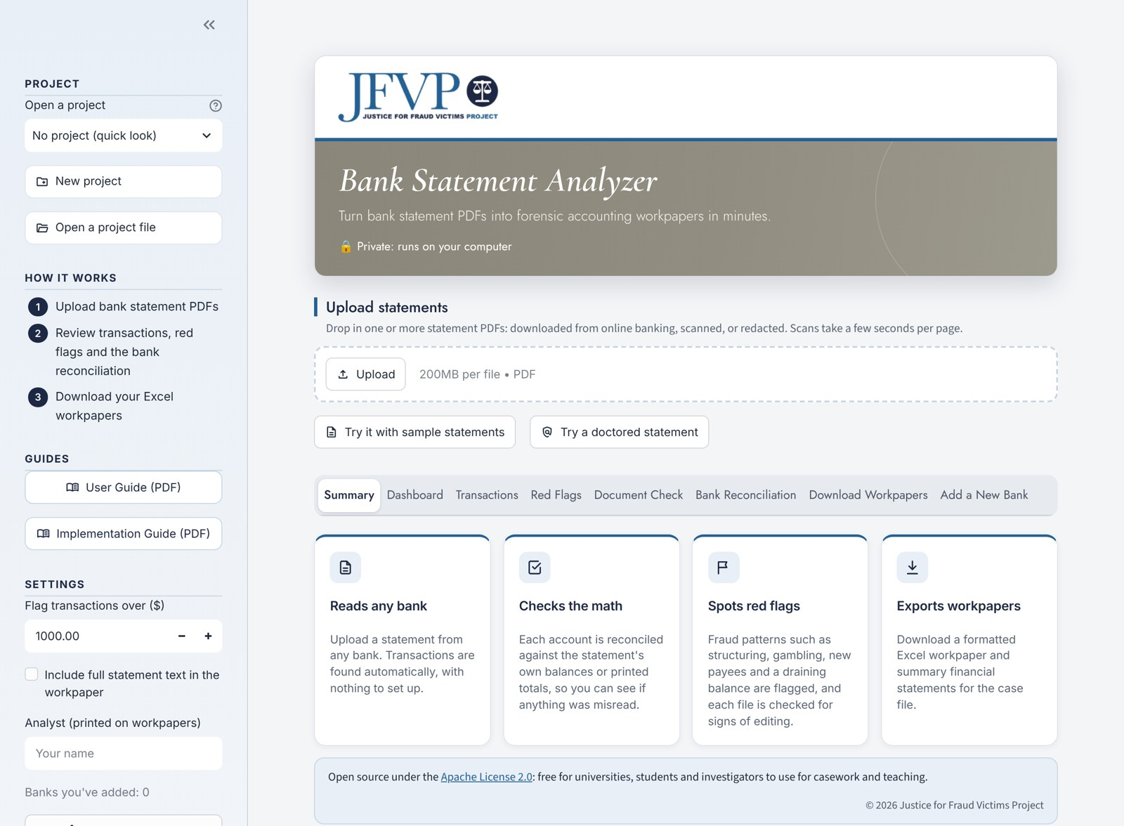
Bank Statement Analyzer
From bank statement PDFs to forensic workpapers in minutes
Webinar for accounting students
November 6, 2026 · Justice for Fraud Victims Project
Notes:
Welcome everyone. I'm with the Justice for Fraud Victims Project, and today I'll show you the Bank Statement Analyzer: a free, open-source tool that turns bank statement PDFs into forensic accounting workpapers.
Plan for about 45 minutes of talk and live demo, then questions. Everything you'll see in the demo is fictional: the bank, the customer and every transaction.
Before you start: have the app open in a browser tab with no project selected, so the home screen and "Try it with sample statements" button are visible.

Slide 2





Today's agenda
01
02
03
04
05
The problem
Why reading statements by hand slows fraud work down
What the analyzer does
Read, check, flag and export, for any bank
Live demo
The Hartwell accounts, a fictional exploitation case
Privacy and evidence
Where statements go, and how findings hold up
Getting started
Using it in class and hosting it at your school
Notes:
Five parts. The live demo in the middle is the heart of the session; the parts around it explain why the tool exists and how you can use it after today.

Slide 3



Reading statements by hand is slow, and fraud hides in the volume
Re-keying by hand
Hours spent typing transactions into spreadsheets, where one typo breaks the trail.
Every bank looks different
Different layouts, scanned pages, redactions, checking and credit cards in one case.
Fraud spreads across months
Patterns like cash kept under $10,000 only show when months sit side by side.
Statements can be edited
PDF editors make an altered copy look genuine to the eye.
Notes:
Ask the audience: who has typed a bank statement into Excel? That's the job this tool takes off your hands.
The point to land: the hard part of a fraud case isn't reading one statement, it's seeing patterns across many statements, from different banks, in different formats. And increasingly, the statements you're handed may not be the ones the bank produced.

Slide 4




The analyzer reads, checks, flags and exports
Reads any bank
Online-banking PDFs, scans and redacted copies; no template to set up.
Checks the math
Each statement is reconciled against its own printed balances and totals.
Spots red flags
Structuring, new payees, cash spikes, gambling, gift cards, signs of editing.
Exports workpapers
An Excel workpaper and financial statements, ready for review.
Notes:
Four jobs. Upload one or more statements; the app reads every transaction, checks that what it read adds up to what the bank printed, flags patterns worth a closer look, and exports everything to Excel.
It runs on your own computer, so real statements never have to leave it. More on that later.

Slide 5
Live demo
The Hartwell accounts: a fictional case of elder financial exploitation
Every name, bank and transaction in the demo is fictional.
Notes:
Switch to the app now.
The demo uses Larkspur Valley Bank, a made-up bank, and a made-up customer, Evelyn Hartwell. Each page carries a red "SAMPLE STATEMENT, FICTIONAL DATA" banner.

Slide 6
The case: three months, one caregiver
Evelyn Hartwell is a retired widow living on a pension and Social Security. In April a paid caregiver gets access to her checkbook, debit card and online banking.
MARCH
Baseline
APRIL
Caregiver gets access
MAY
Drained
$16,016.83
ending balance
$50,000
CD matures 04/14
−$79.93
ending balance
Pension and Social Security in
Normal bills and groceries
$100 in cash all month
$24,000 wired out on 04/15
$20,703.50 in cash withdrawals
New payee: DP Companion Care
$15,587 in cash withdrawals
Casino ATM and card cash advances
Overdraft fee, returned check
Notes:
Set up the story before uploading anything, so the audience knows what to look for.
March is normal: about $16,000 in checking and a $50,000 CD. In April the caregiver, Dana Pruitt, who bills through "DP Companion Care LLC", gets access. The CD matures on April 14 and $24,000 is wired out the next day. By the end of May the account is overdrawn at minus $79.93.
Then the family asks for the statements, and the caregiver hands them a "family copy" of April that looks fine. Keep that in mind; we'll come back to it.

Slide 7
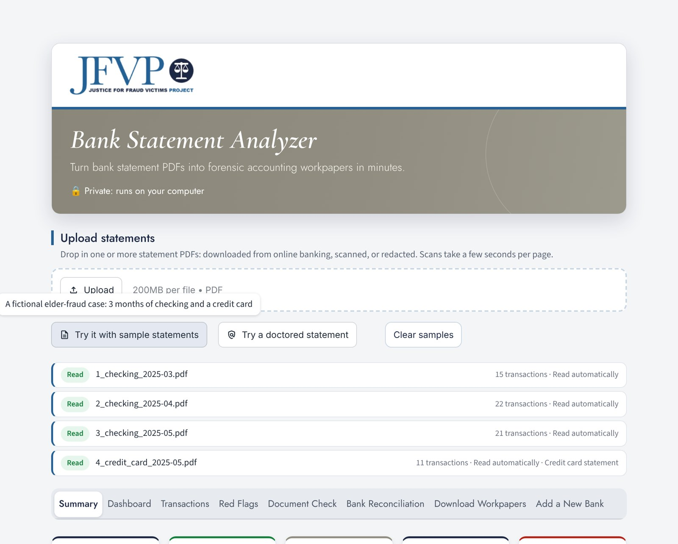
Step 1: drop in the statements
4
statements: three months of checking and a credit card
69
transactions read, with no template
4 of 4
statements reconciled to the bank's own totals
32
higher-risk items to look at first
In the app
Click Try it with sample statements, or drag your own PDFs onto Upload statements. Scanned pages are read with OCR in the version on your computer.
Notes:
DEMO: click "Try it with sample statements". Four statements load: March, April and May checking, and the May credit card.
Walk through the Summary tab: 69 transactions, money in $59,324.41, money out $77,569.80, a net change of minus $18,245.39, and 32 higher-risk items.
Point out the reconciliation status: all four statements reconcile, meaning the app read every transaction correctly. We'll see why that matters in a moment.

Slide 8
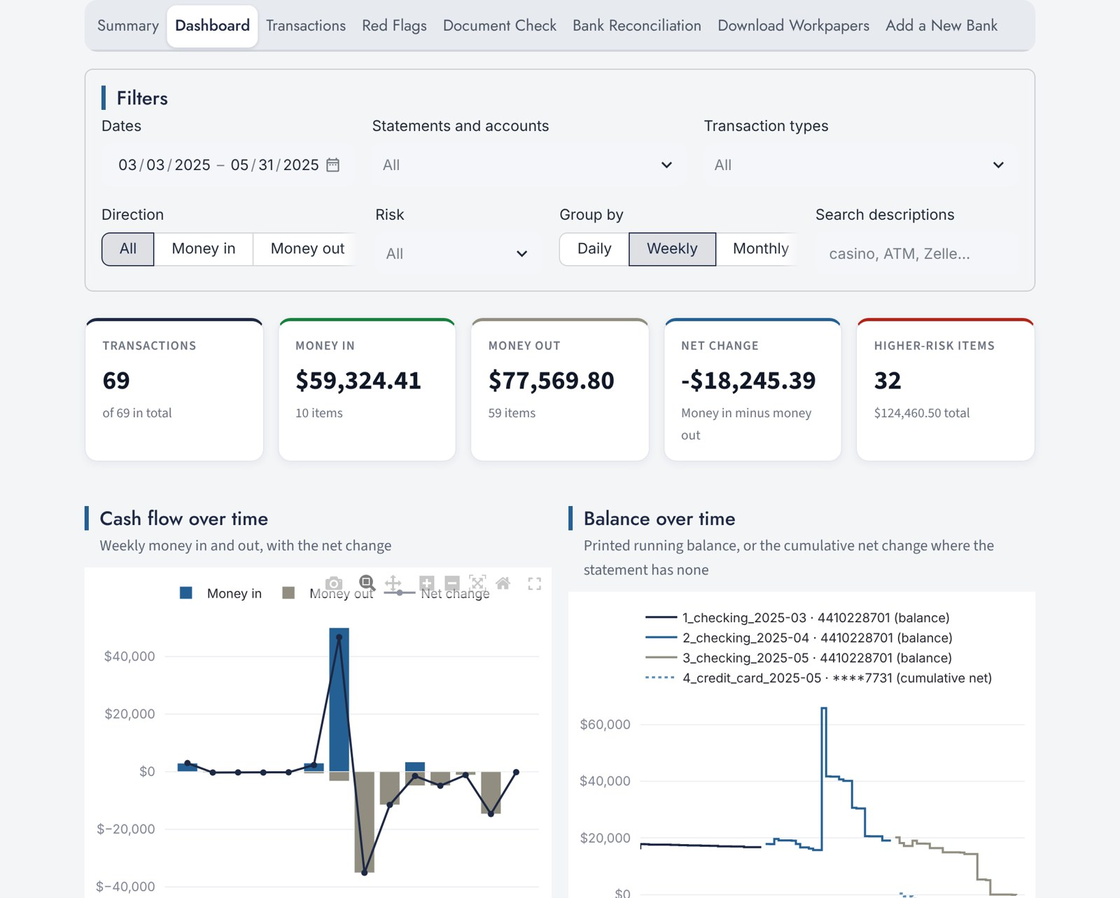
Step 2: see the money move
BALANCE PEAKED AT
$65,762.44
on 04/14, the day the CD matured
SIX WEEKS LATER
−$79.93
overdrawn, with an overdraft fee and a returned check
Filter by date, account, direction and risk; group the charts by day, week or month.
Notes:
DEMO: open the Dashboard tab.
Point to the balance-over-time chart: one spike in mid-April when the $50,000 CD lands, then a steady slide to zero. The cash-flow chart shows the big money-out weeks right after.
Try the filters: set Direction to "Money out" and Group by to "Weekly". Ask the audience what they'd want to look at next.

Slide 9

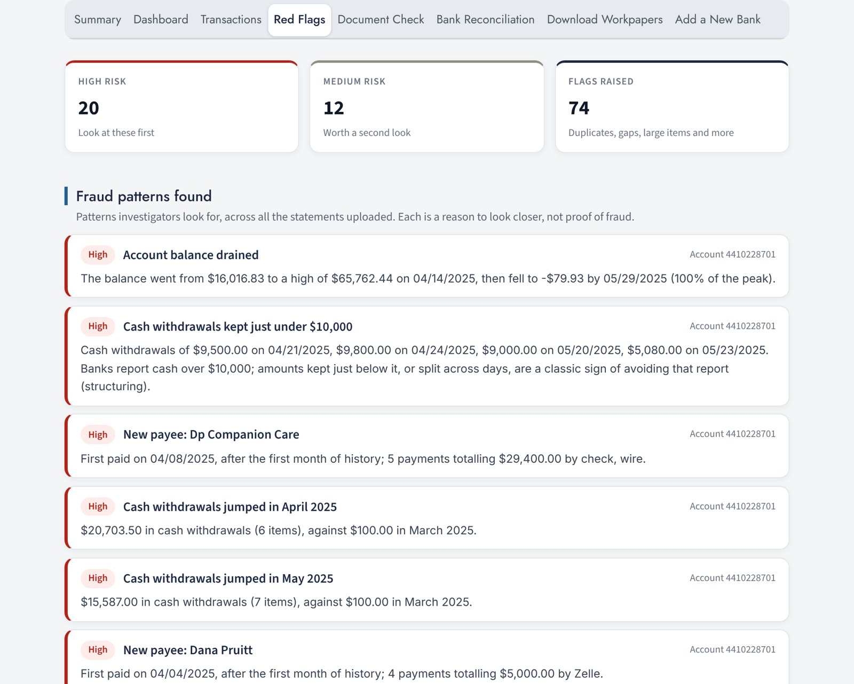





Step 3: the patterns an investigator looks for
Cash kept just under $10,000
$9,500, $9,800, $9,000 and $5,080 at the branch
A new payee taking large sums
DP Companion Care: 5 payments, $29,400
Zelle to the caregiver
Dana Pruitt: $5,000 in round-dollar transfers
Cash spike
$100 in March, $20,703.50 in April
Gambling, gift cards, cash advances
On both the checking account and the card
Duplicates, gaps and overdrafts
Two $1,200 checks a day apart; missing checks
Notes:
DEMO: open the Red Flags tab. The app reports 20 high-risk items, 12 medium, and 74 flags in all.
Read out the "Fraud patterns found" panel. The structuring one is a good teaching moment: banks report cash transactions over $10,000, so a run of withdrawals just under that line is a classic sign.
Then filter the Transactions tab for "Lucky Star" or "Pruitt" to show the underlying rows.
Key message: each of these is a reason to look closer, not proof of fraud. The caregiver payments might be legitimate wages; the investigator's job is to find out.

Slide 10
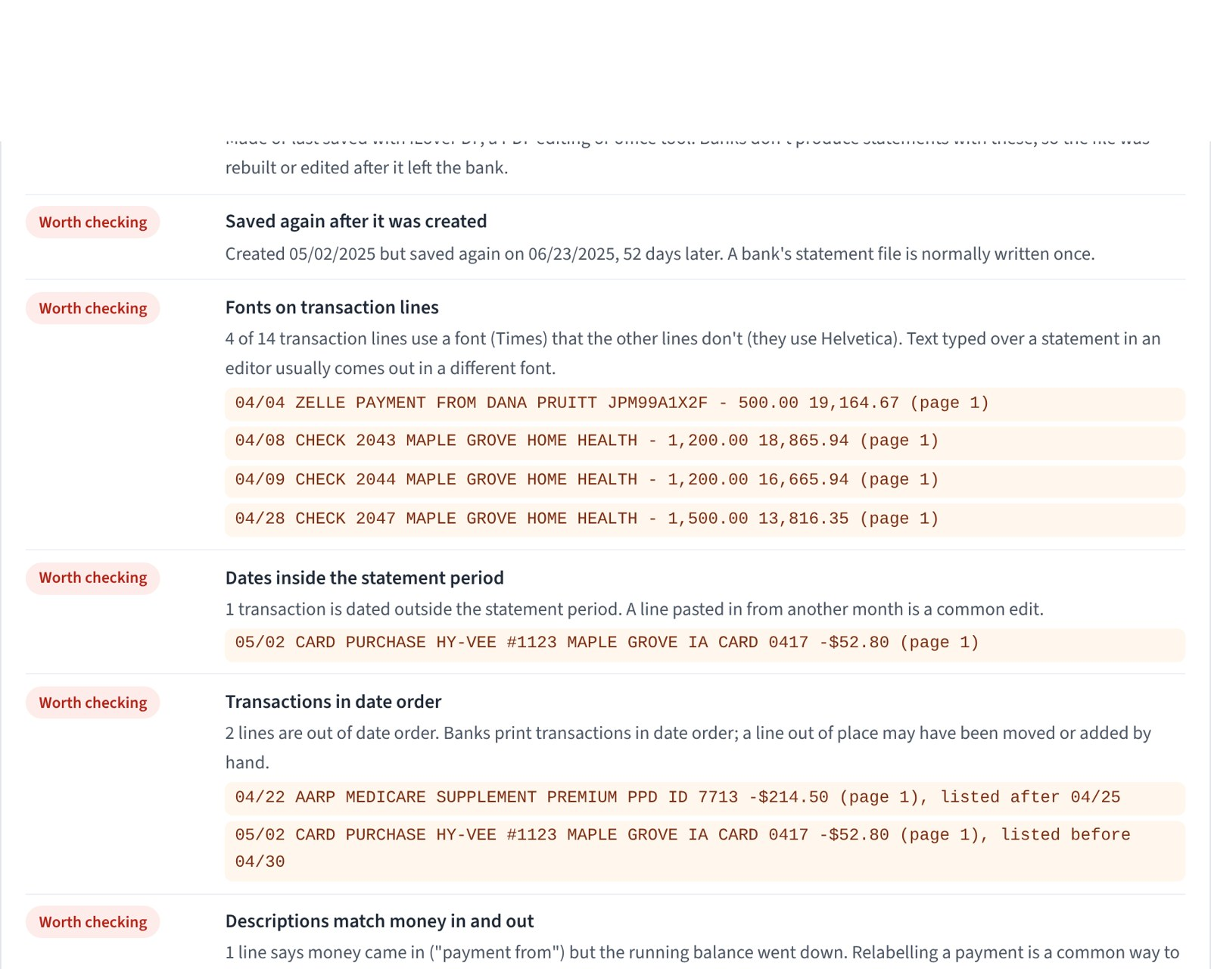
Step 4: is this the statement the bank produced?
The "family copy" of April hid the casino, wire, cash and CD lines. The edits left nine traces:
1
Made with a PDF editing tool
2
Saved again 52 days after it was created
3
4 transaction lines in a different font
4
A 05/02 purchase inside the April statement
5
Transactions out of date order
6
"Zelle payment FROM" recorded as money out
7
Running balances break at two checks
8
Summary deposits off by $1,500.00
9
"$13763.86" typed without its comma
None of these proves fraud alone. When it matters, get the statement from the bank.
Notes:
DEMO: click "Try a doctored statement". This loads the genuine April statement next to the family copy.
Open the Document Check tab. The genuine statement passes; the family copy shows nine signs. Signs 1 to 3 come from the file itself (the software that made it, when it was saved, fonts). Signs 4 to 9 come from the numbers and dates not hanging together.
Also show the Bank Reconciliation tab: the family copy shows Variance.
Teaching point to stress: a clean result doesn't prove a statement is genuine either. When a statement matters, get it directly from the bank, or by subpoena.

Slide 11
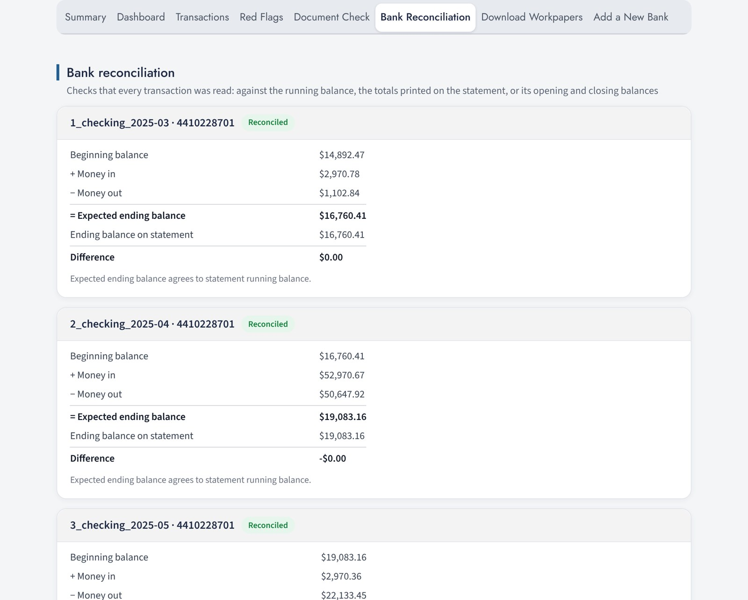



The analyzer checks its own work
Reconciled
Beginning balance, plus money in, minus money out, agrees with the balance the bank printed.
Variance
The numbers don't tie: a line was missed or misread, or the statement was edited.
Needs Review
The statement didn't print enough to check against. Compare it by hand.
Notes:
This is what makes the tool trustworthy enough for workpapers. Every statement is reconciled against what the bank itself printed: the opening and closing balances, the totals, the running balance.
If it says Reconciled, every dollar the bank recorded was read. If it says Variance, don't rely on the numbers until you've found out why. That's exactly what happened with the family copy.
Ask the audience: why does this matter more than the speed? (Answer: speed without accuracy is a liability in court.)

Slide 12
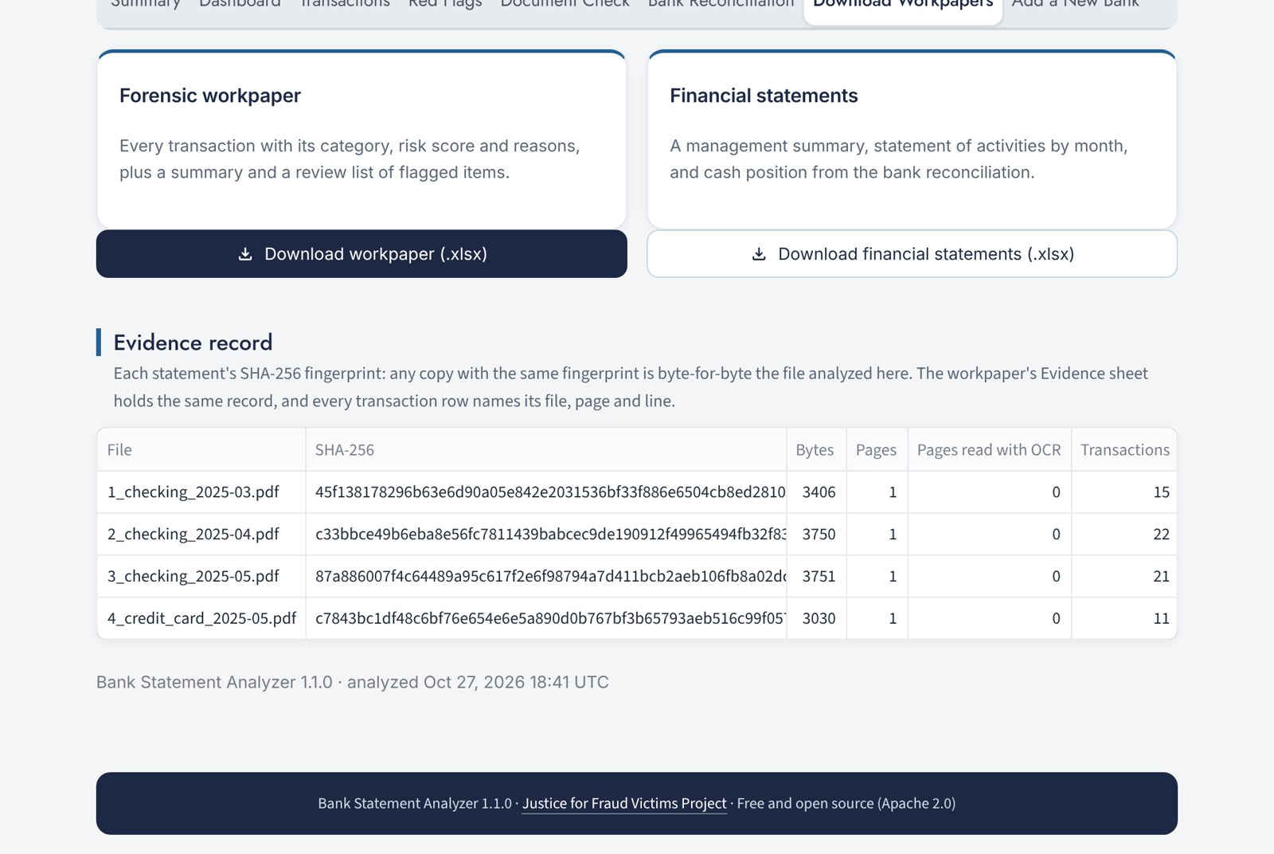



Step 5: workpapers that hold up
Forensic workpaper
Every transaction with its source file, page and line, plus the flags and document checks.
Financial statements
Monthly activity and cash position, built from the reconciliation.
Evidence record
A SHA-256 fingerprint of each statement, so anyone can confirm it's the same file.
Encrypted projects
Statements, notes and the case log, locked with your password.
Notes:
DEMO: open Download Workpapers and download the forensic workpaper. Open it in Excel and show the Flags_For_Review and Document_Checks sheets, and the Evidence sheet.
The fingerprint is the key idea for evidence: if anyone later questions which file you analyzed, run the same SHA-256 on the file and compare. Same fingerprint, same file, byte for byte.
Projects keep a case together: statements, notes on transactions, case notes, and a log of who did what and when, all encrypted.

Slide 13


Where do the statements go?
On your computer
Your university's copy
The online demo
USE FOR REAL CASES
USE FOR REAL CASES
FICTIONAL SAMPLES ONLY
Statements never leave your computer
Reads scanned pages with OCR
Start with start.bat (Windows) or start.sh (Mac)
Runs inside the school's own domain
Students sign in with the school login
No requests to outside servers
For practice and for this webinar
Never upload real statements
Shows a demo-copy banner
Projects are encrypted (AES-256). Passwords are never stored. The code is open source, so anyone can inspect it.
Notes:
Bank statements are some of the most sensitive documents there are, so this matters.
Real cases: use the copy on your own computer, or your university's copy once it's set up. The online demo is for the fictional samples only.
The analyzer doesn't send statements anywhere, and the university copy is built so it can't: the browser is told to refuse any connection to an outside server.

Slide 14


Getting started after today
STEP 1
STEP 2
STEP 3
Try the demo
Load the Hartwell samples and work through the case yourself. Can you find all nine edits?
Install it
Install Python 3.11 or newer, download the app, then double-click start.bat (Windows) or run start.sh (Mac).
Read the guides
The User Guide walks through every tab. Both guides are linked in the app's sidebar.
Download: github.com/jdaiken/parsing_tool · Free and open source (Apache 2.0)
Notes:
An exercise for after the webinar: load the doctored sample and see whether you can find all nine edits before opening the Document Check tab.
The app is free and open source under the Apache 2.0 license. Download it from GitHub; the first start installs what it needs, and after that it starts straight away.

Slide 15



Bringing it to your university
Browser build
SIMPLEST TO RUN
Server build
MOST CAPABLE
A folder of files on any school web server
Statements are read inside the student's browser and never sent anywhere
No server software to maintain
A Docker container behind the school's single sign-on
Reads scanned statements with OCR
Each user's projects are kept separate and encrypted
Start with a pilot: one course, one semester. The Implementation Guide covers setup, security review and IT questions.
Notes:
For faculty and IT staff on the call. There are two ways to host the analyzer inside your university's own domain, so statements stay under the school's control.
The browser build is the simplest: IT copies a folder of files to a web server. The server build adds OCR for scanned statements and sign-in through the school's login.
The Implementation Guide is written for IT and security reviewers. We'd welcome a pilot: one course for one semester. Contact JFVP to set one up.

Slide 16
Four things to remember
1
Automate the reading, keep the judgment
Let software do the typing; your time goes to analysis.
2
Reconcile before you rely
If the numbers don't tie to the bank's totals, don't use them yet.
3
Flags are leads, not conclusions
Every pattern is a reason to look closer and ask questions.
4
Get statements from the bank
When a statement matters, get it directly from the bank, or by subpoena.
Notes:
Summarize. If they remember one thing: the tool finds leads fast, but the conclusions are still the investigator's.

Slide 17

Thank you. Questions?
Download the app
github.com/jdaiken/parsing_tool
Justice for Fraud Victims Project
justiceforfraudvictimsproject.org
Try the sample case, read the guides, and tell us what you find.
User and Implementation Guides
Linked in the app's sidebar
November 6, 2026 · Justice for Fraud Victims Project
Notes:
Open the floor to questions.
Likely questions:
- Does it work with my bank? It reads statements by their layout, not by bank, so most banks work. If one doesn't, the "Add a New Bank" tab lets you teach it.
- Is it accurate? Check the Bank Reconciliation tab: Reconciled means every transaction the bank recorded was read.
- Can I use it on a real case? Yes, on your own computer or your university's copy; not on the online demo.
- What does it cost? It's free and open source under the Apache 2.0 license.

