Slide 1
TWO-WEEK SUMMARY
Gaspar vs JRC Flood Comparison in France
MAIN BUILD
France comparison app
Two-week delivery summary: July 2021 comparison, Streamlit diagnostics, national audit, horizon audit, and T20 screening.
AUDIT DOCS
T20 RESULT
EN + FR
1 / 49 hit
A France-wide comparison workflow now exists from raw commune rows to map-ready diagnostics.
The July 2021 mismatch has been documented with public evidence from both the Gaspar-only and JRC-only sides.
National commune-level event matching remains low, but department-level matching is materially higher.
The new 2015-2024 horizon audit shows the mismatch recurring across several major flood families.
The T20 point workflow is operational and already tested against processed JRC flood rasters.
CORE FINDING
Mismatch is structured, not random.
Prepared on 2026-06-04 | Scope: July 2021 comparison, Streamlit viewer, national plus horizon audit, and T20 point-screening workflow.

Slide 2
SYSTEM VIEW
We now have a reusable France comparison stack from raw codes to map-ready communes
The same stack now supports raw-data transformation, commune reconciliation, visual comparison, and manual evidence work.
Source layer
Harmonization layer
Project outputs
Analyst tools
Gaspar raw and processed event tables
Normalize commune keys to current INSEE communes
Bilingual audit documents, horizon audit, and July 2021 evidence note
Streamlit map with Gaspar, JRC, and Comparison modes
JRC processed France LAU event table
Handle old commune codes, LAU links, and Corsica alphanumeric cases
France comparison tables for 7-day and 30-day windows
Aggregated commune table plus filtered-row diagnostics
Old INSEE updates plus current LAU / INSEE lookup
Aggregate activity by date, month, quarter, year, or custom period
Quarter-region manual comparison maps
Downloadable CSV and HTML map exports
AdminExpress commune polygons
Track unresolved rows instead of silently dropping them
T20 workbook with point-level JRC flood checks
Reproducible scripts for docs and comparison outputs
Special-case logic matters: old INSEE updates, LAU reconciliation, and Corsica-style codes such as 2B246 are handled explicitly.
The final visual layer is current AdminExpress commune polygons, while LAU is used in the reconciliation logic.
Built from existing project logic in the France comparison scripts, commune-activity loader, and point-screening workflow.

Slide 3
JULY 2021 DEEP DIVE
July 2021 shows a real source disagreement, not just a cleaning error
The mismatch is material in both directions, and public evidence exists for flood impacts on both the Gaspar-only and the JRC-only sides.
ACTIVE COMMUNES
BOTH
GASPAR ONLY
JRC ONLY
Public evidence found
1,671
133
363
1,175
Gaspar-only side
Jura, Meuse, and Claye-Souilly all have press or official support on the Gaspar side.
France-wide commune activity split in the app
JRC-only side
Autet, Asfeld, the Sedan area, and Louhans also have local or departmental evidence on the JRC side.
Both: 133 (8.0%)
Gaspar only: 363 (21.7%)
JRC only: 1175 (70.3%)
Interpretation: the July 2021 mismatch is not just an extraction problem. Both sources capture real flood impacts, but they disagree strongly on which communes belong to the same episode and on how widely the flood footprint should extend.
Evidence report: docs/july_2021_gaspar_jrc_mismatch_evidence_report.md. Comparison counts from the France Streamlit app for 2021-07.

Slide 4
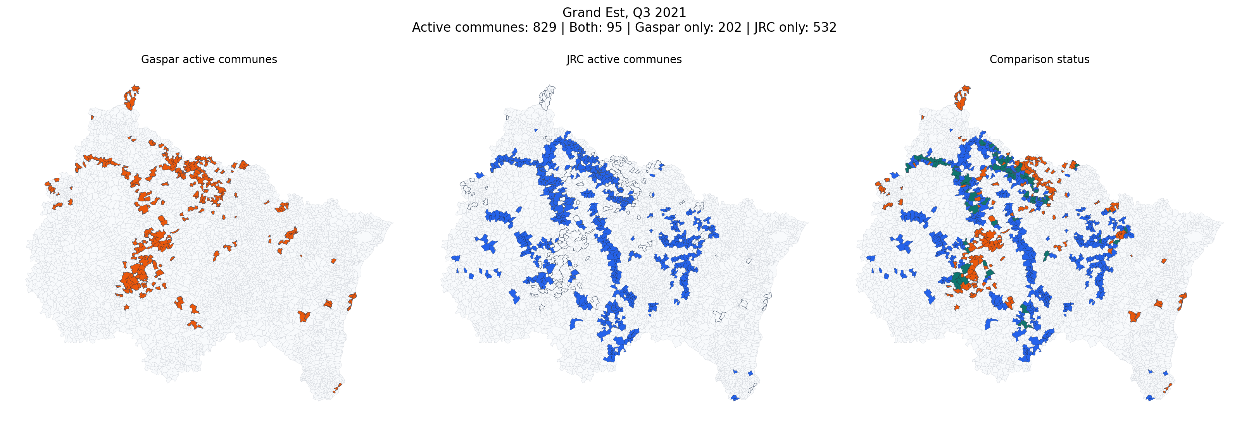
STREAMLIT APP
The new Streamlit app turns commune matching into a practical visual QA workflow
What the app now supports
Representative comparison view powered by the same commune-activity logic
Switch between Gaspar, JRC, and direct Comparison display modes.
Display mode: Comparison
Filter by exact date, month, year, quarter, or custom interval.
Period mode: Month
Year: 2021
Inspect active communes, filtered rows, matched rows, and unresolved rows.
Month: 07
Download the current aggregated table as CSV and the current map as HTML.
Basemap: CartoDB Positron
Departments: on
Use current commune polygons while keeping commune-code diagnostics visible.
Diagnostics tab
Comparison classes, filters, aggregated table, filtered rows, and unresolved-row diagnostics are all exposed in the app.
Raw and processed Gaspar inputs are both supported. | Comparison mode separates both-active, Gaspar-only, and JRC-only communes. | Core sources: src/france_commune_activity.py and src/gaspar_jrc_france_map_app.py.

Slide 5
NATIONAL AUDIT
National commune-level event match remains low even with a wider time window
Department-level rates are materially higher than commune-level rates, which points to commune fragmentation and timing differences rather than a total absence of overlap.
7-day window
30-day window
Commune-level event matching
Commune-level event matching
JRC matched (22.9%)
66/288
JRC matched (27.8%)
80/288
222 JRC events remain exclusive under this window.
208 JRC events remain exclusive under this window.
Gaspar matched (14.2%)
499/3505
Gaspar matched (16.7%)
587/3505
3,006 Gaspar event groups remain exclusive under this window.
2,918 Gaspar event groups remain exclusive under this window.
Department-level rates: 7-day JRC 43.4% / Gaspar 42.5%; 30-day JRC 59.4% / Gaspar 53.8%.
Row coverage: JRC 2,501 / 64,327 rows = 3.9% then 3,080 / 64,327 rows = 4.8%; Gaspar 1,983 / 19,217 rows = 10.3% then 2,204 / 19,217 rows = 11.5%.
Numbers pulled from data/processed/jrc_gaspar_comparison_flexible_7d and ..._30d using the existing France comparison logic.

Slide 6
DEPARTMENT VIEW
At department level, Gaspar and JRC align much more often than they do by commune
The gap between commune-level and department-level matching is large in both windows, which suggests that much of the disagreement comes from fine-grained commune allocation and event timing segmentation.
Uplift versus commune level: 7-day JRC +20.5 pp, Gaspar +28.3 pp | 30-day JRC +31.6 pp, Gaspar +37.1 pp.
7-day window
30-day window
Same event tables, but matched at department level instead of commune level.
Same event tables, but matched at department level instead of commune level.
JRC commune (22.9%)
66/288
JRC commune (27.8%)
80/288
JRC department (43.4%)
125/288
JRC department (59.4%)
171/288
Department view adds 20.5 percentage points for JRC.
Department view adds 31.6 percentage points for JRC.
Gaspar commune (14.2%)
499/3505
Gaspar commune (16.7%)
587/3505
Gaspar department (42.5%)
1488/3505
Gaspar department (53.8%)
1886/3505
Department view adds 28.3 percentage points for Gaspar.
Department view adds 37.1 percentage points for Gaspar.
Interpretation: once the same episodes are allowed to match at department scale, the overlap rises sharply. The strongest explanation is not 'no common floods', but rather different commune allocation and time slicing inside the same broader events.
Source: the same 7-day and 30-day comparison outputs used in the national audit, now read as commune-versus-department contrast.

Slide 7
HORIZON AUDIT
The new 2015-2024 horizon audit shows the mismatch recurring across multiple flood families
The low match rate is not tied to one famous event. It reappears in different hydrologic settings from 2016 to 2024, with both Gaspar-heavy and JRC-heavy profiles.
LARGEST MISMATCH
STRONGEST GASPAR QUARTER
RECENT MAJOR CASE
COVERAGE HORIZON
1,312 communes
707 Gaspar only
1,080 mismatch
2015-Q1 to 2024-Q4
Top disagreement periods
Other important flood families
Grand Est, Q1 2018: 1,312 disagreement communes | 8.4% overlap
Ile-de-France, Q2 2016: 583 Gaspar-only communes in the same national flood family as Centre-Val de Loire 2016.
Largest region-quarter mismatch in the ranking, dominated by a very broad JRC winter-flood corridor.
Centre-Val de Loire, Q2 2016: 707 Gaspar only | 22 JRC only
PACA, Q4 2019: 305 Gaspar-only communes during the Var and Alpes-Maritimes Mediterranean floods.
Strongest high-activity Gaspar-dominant quarter during the late-May / early-June 2016 flood family.
Grand Est, Q2 2024: 1,080 disagreement communes | 9.2% overlap
Hauts-de-France, Q4 2023: 302 Gaspar-only communes during the Pas-de-Calais and Nord flood sequence.
Recent end-of-horizon case where both real flood extent and administrative timing lag may matter.
Bottom line: the mismatch is historically persistent and changes shape over time, rather than disappearing once one famous flood is explained.
Source: docs/gaspar_jrc_horizon_audit_en.md and ..._fr.md, generated from the region-quarter ranking and mapped manual checks.

Slide 8
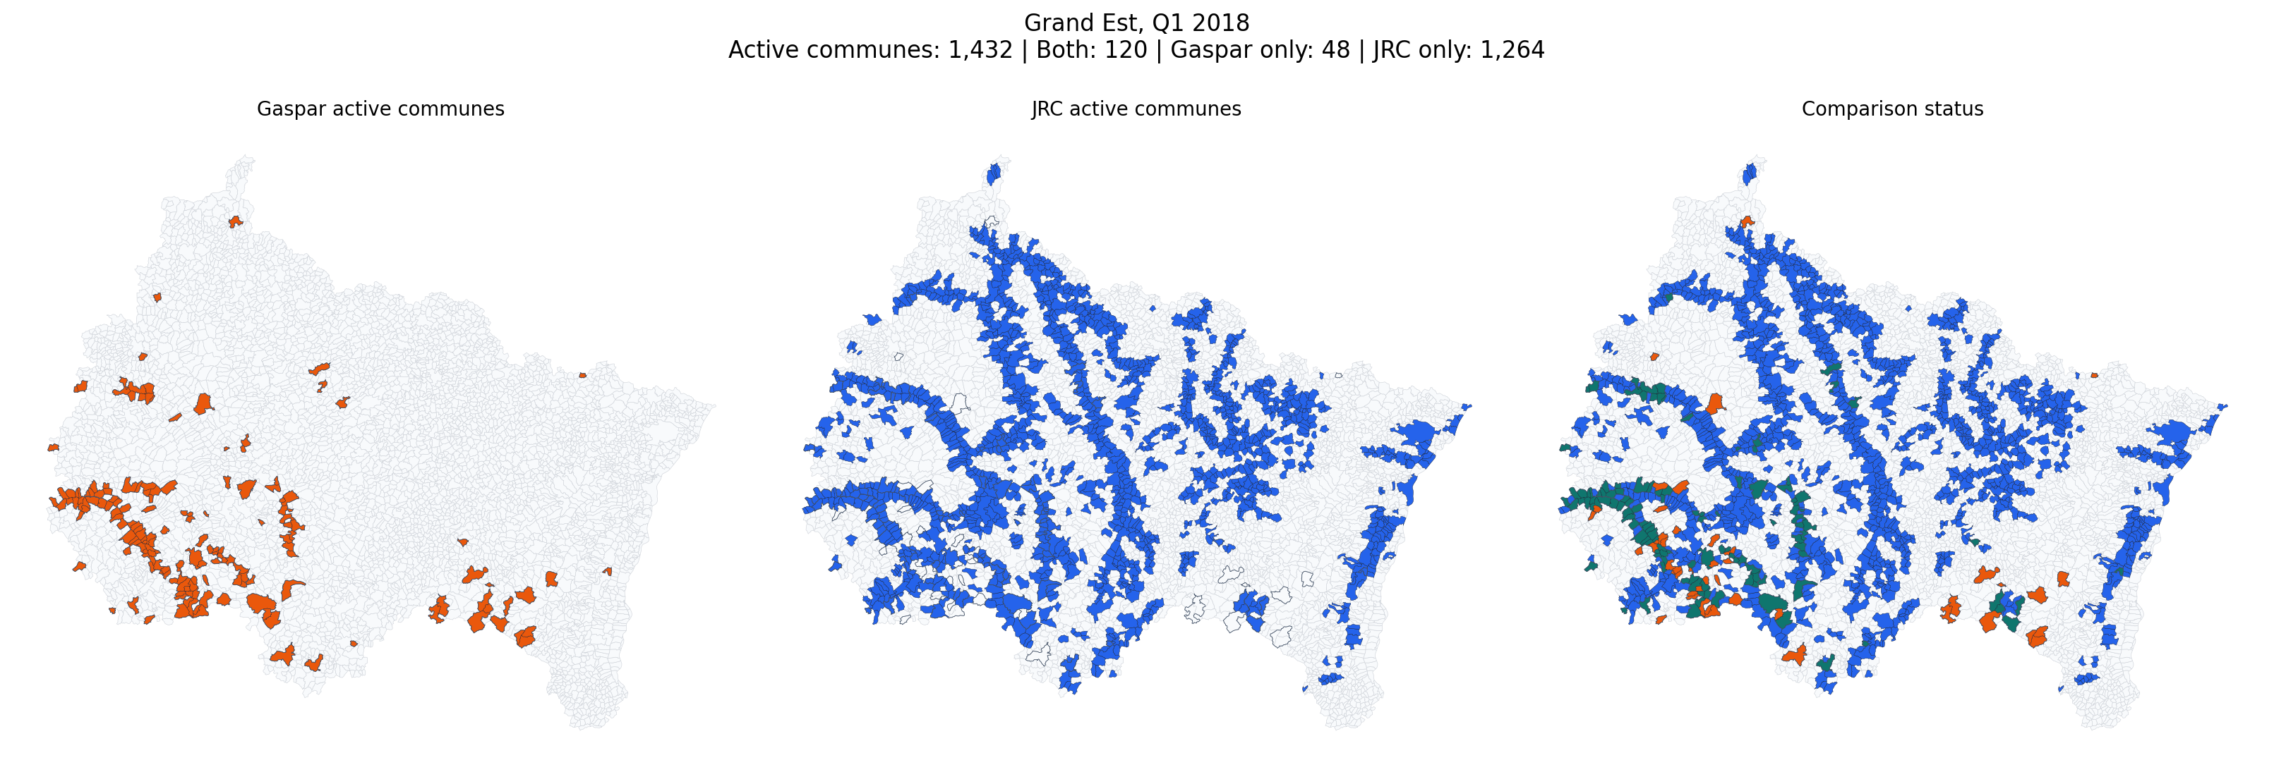
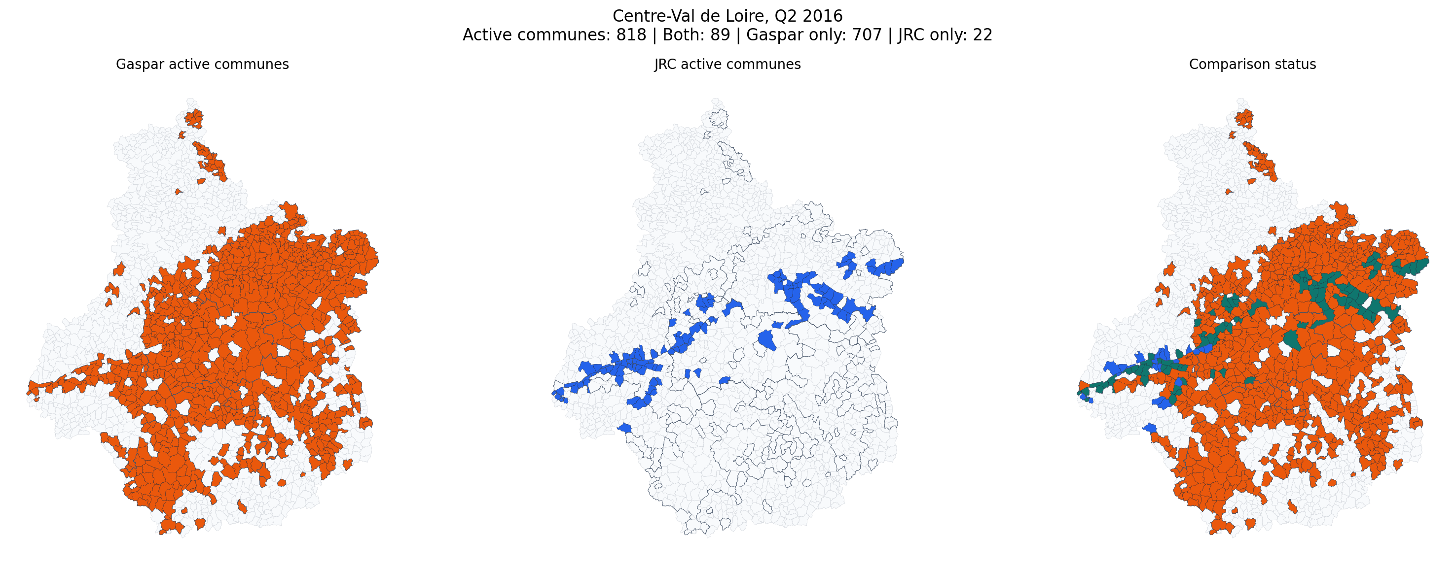
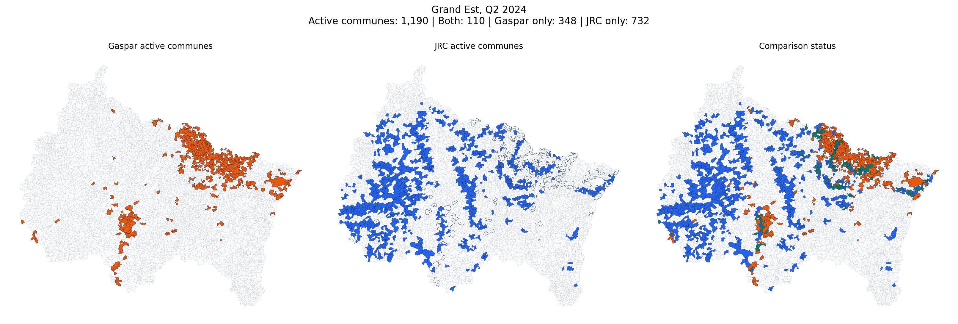
MANUAL CHECKS
Mapped manual checks now cover both Gaspar-dominant and JRC-dominant flood families across the horizon
These maps use the same commune-activity logic as the Streamlit app, but focus on quarter-region period overlap rather than event-pair matching.
Grand Est, Q1 2018
Centre-Val de Loire, Q2 2016
Grand Est, Q2 2024
Both 120 | Gaspar only 48 | JRC only 1,264
Both 89 | Gaspar only 707 | JRC only 22
Both 110 | Gaspar only 348 | JRC only 732
A very wide winter-flood corridor appears in JRC, while Gaspar remains concentrated in a much smaller administrative footprint.
The Loire flood family is heavily recognized in Gaspar, but much less aligned with JRC at commune level.
A recent case with large disagreement in both directions, consistent with both flood-extent differences and timing effects.
Rendered audit figures live in docs/assets/gaspar_jrc_horizon_audit and are referenced by the bilingual horizon-audit report.

Slide 9
T20 CHECK
The T20 rule is operational, but positive local JRC hits are rare in the current sample
ROWS CHECKED
LAU MATCHED
ANY JRC EVENT IN LAU
POSITIVE LOCAL HIT
POSITIVE EVENT HITS
49
44
8
1
4
Applied rule
Decision-path breakdown
Map each LAT / LONG point to a French LAU.
LAU not touched in processed JRC events
36
Keep only JRC events touching that LAU.
Touched, but no local flooded pixel above threshold
7
Use full history up to Closed_Default_Date, or Cut_off_Date when needed.
Point outside LAU polygon
5
Check local flood pixels in a 40 m point buffer and a 1 km surrounding buffer.
Positive local flood hit
1
Positive case: Allenjoie (Doubs, 25) is the only positive local case, with four matched event hits from 2018 to 2021.
Workbook: data/processed/T20_Anonymised_jrc_flood_check.xlsx. Decision paths show why most rows stay negative even after successful LAU geocoding.

Slide 10
READY NOW / NEXT
The project now has both a decision tool and a validation backlog
Ready today
Best next questions
France commune comparison app with map-first diagnostics
Test alternative event-grouping rules using the department-to-commune gap as a benchmark.
Bilingual Gaspar / JRC match audit docs plus the 2015-2024 horizon extension
Add more quarter-region manual checks where the horizon audit still shows the largest mismatch.
July 2021 mismatch evidence report with public links
Decide whether to add a LAU-geometry map mode alongside current communes.
T20 workbook checked against processed JRC flood rasters
Use the same point-screening workflow on additional credit portfolios.
Bottom line: the project moved from isolated scripts to a coherent comparison workflow with commune diagnostics, department-level contrast, and a reproducible audit trail across the 2015-2024 horizon.
Deliverables shipped this cycle: France comparison app, bilingual audit, 2015-2024 horizon audit, July 2021 evidence note, and T20 JRC flood-check workbook.

