Slide 1
Linux and Scripting
Computer Science First Year Seminar

Slide 2








Operating Systems
An operating system (OS) is software that sits between the hardware and the applications
Provides services for basic tasks
File management
Time-sharing / scheduling
Device management

Slide 3
Linux
Unix-like family of operating systems
First developed by Linus Torvalds in 1991
Many different versions, called distributions (distros)
Red Hat Enterprise Linux and Fedora
Ubuntu
Debian
SUSE
and more
3

Slide 4


Applications
Linux has both graphical (GUI) applications and command-line utilities
Two major desktop environments
GNOME
KDE Plasma
There is a very wide variety of command-line utilities

Slide 5

Connecting to a remote server
The department has a Linux server that you can connect to using SSH
cs.uml.edu
Be sure to use your CS login, not your UML login
I use PuTTY for this
Available at https://www.chiark.greenend.org.uk/~sgtatham/putty/
Can save session information

Slide 6

File Transfer
PuTTY does have a command-line file-transfer protocol (FTP) utility
There are also GUI apps available
I use FileZilla
https://filezilla-project.org/
Supports parallel navigation of local and remote directories
Can drag-and-drop files from Windows Explorer to transfer them

Slide 7
Terminal
The terminal is your command-line interface
Each runs a shell (interpreter) that executes your commands
Most are a variation of the Bourne shell
The Bourne-again (bash) shell is especially common
You type a command into the shell and it executes your command

Slide 8
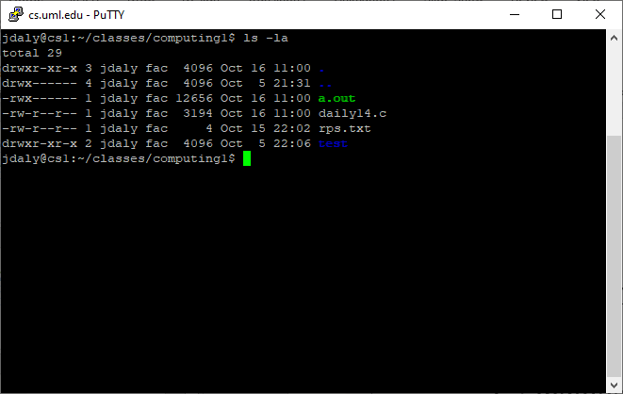
List Directory (ls)
The ls command lists the files in the current or given directory
Some flags
-a : include hidden files
-l : display information about files
-S : sort by file size
-t : sort by last modified date
-r : reverse order

Slide 9
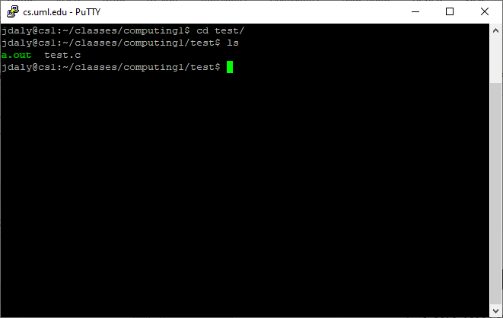
Change Directory (CD)
Moves to the listed directory (folder)
Four special directories
. : The current directory
.. : The parent of the current directory
/ : Root directory
~ : Your home directory

Slide 10
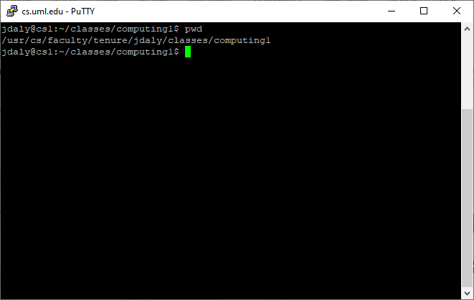
Print Working Directory (PWD)
Prints the path to the current directory
Helps keep track of where you currently are

Slide 11
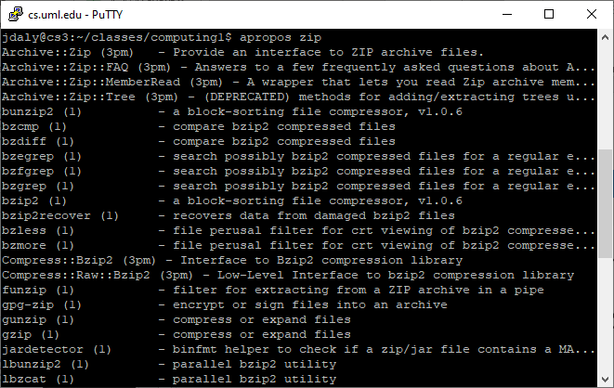
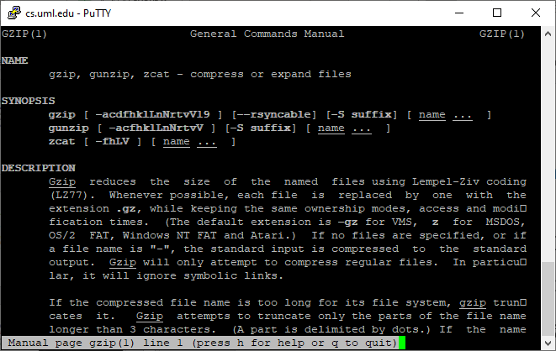
Manual (Man) and About (apropos)
man opens the manual for a given command
Use to get more information about how to use a command
apropos searches for manuals that contain the given term
Use to find the command that does something

Slide 12
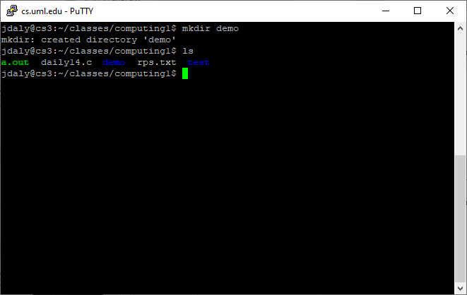
Make Directory (mkdir)
Makes a directory of the given name
Does NOT change the current directory

Slide 13
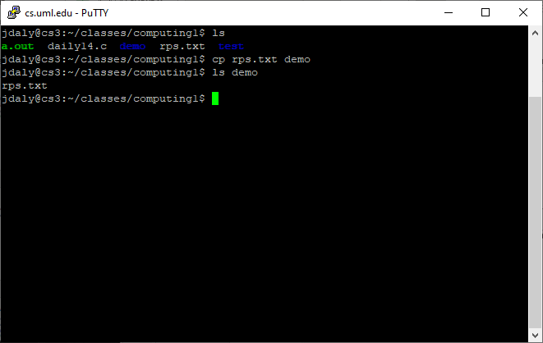
Copy (CP)
Creates a copy of the file in a new location
Some flags
-f : Force overwriting of existing files
-n : No overwriting
-r : recursively copy directory contents
-v : verbose (list files as copied)

Slide 14
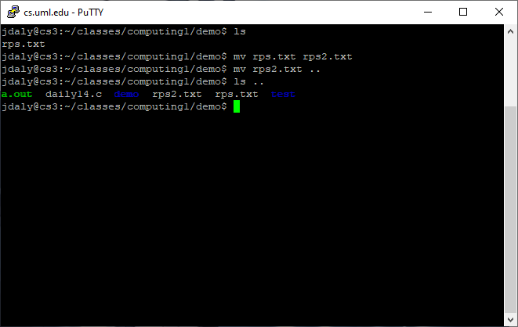
Move (MV)
Renames a file
Can be used to move it to a different directory
Similar flags to cp

Slide 15
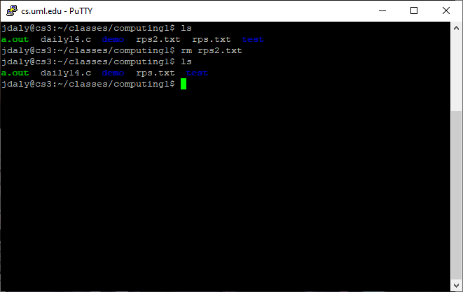
Remove (RM)
Deletes a file
Flags
-f : Force (never prompt)
-i : always prompt
-I : prompt when removing many files
-r : recursively remove contents of directory (very dangerous)
-v : list files that are removed

Slide 16
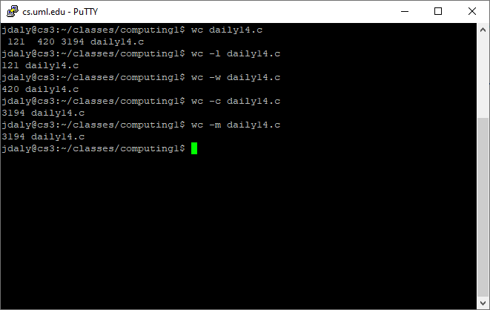
Word Count (WC)
Lists the number of lines, words, and characters in a given file
Flags
-l : Print the number of lines
-m : Print the number of characters
-c : Print the number of bytes
-w : Print the number of words

Slide 17
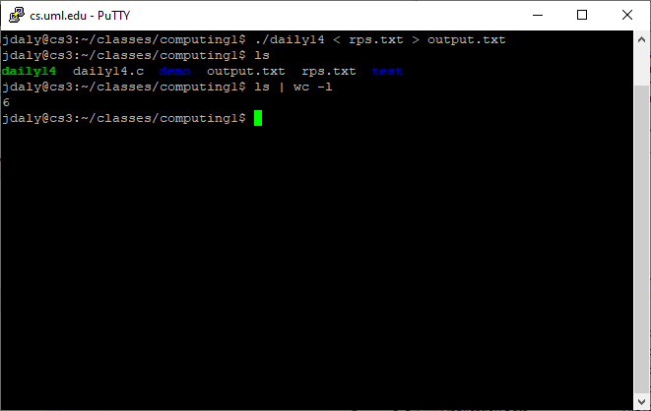
Piping
Sometimes you want to send the output of one program as the input of another
Other times, you want to save the output to a file
| : Use output of program on the left as input of the program on the right
< : Read input from a file
> : Write output to a file

Slide 18
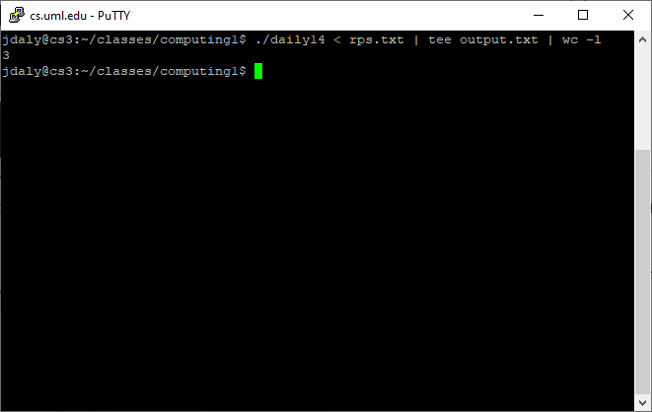
Tee
Both outputs to a file and prints to the terminal window (stdout)
Often used for saving an intermediate result that you still want to pipe to another program.

Slide 19
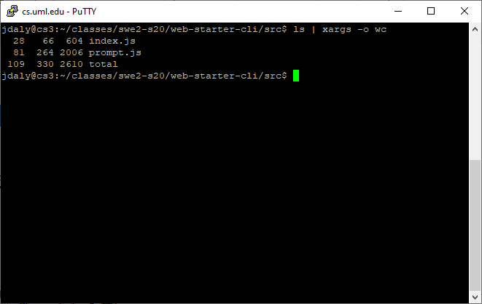
xargs
Converts input to arguments of another program
Specify program with the –o flag

Slide 20
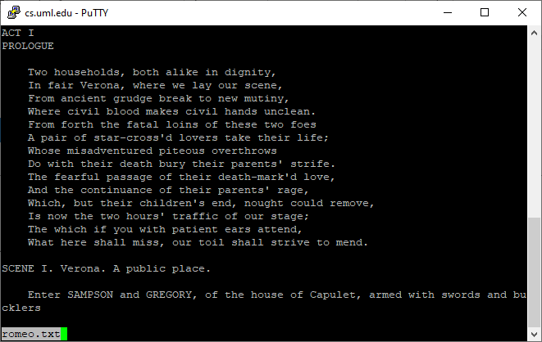
Less
Utility for viewing a file
Based on the earlier more utility with extra enhancements
less is more
Can scroll through a file
Use ‘q’ to quit

Slide 21
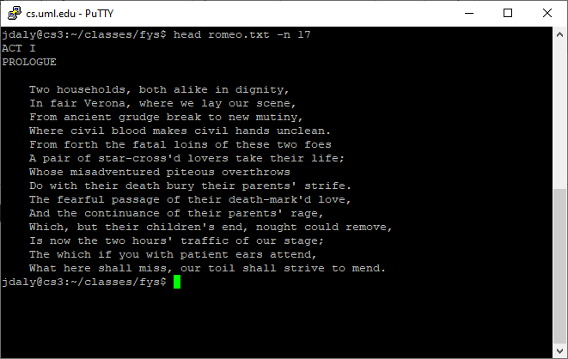
Head and tail
Utilities for printing the first or last couple lines of a file
Use –n <#> to control how many lines to show (default 10)

Slide 22
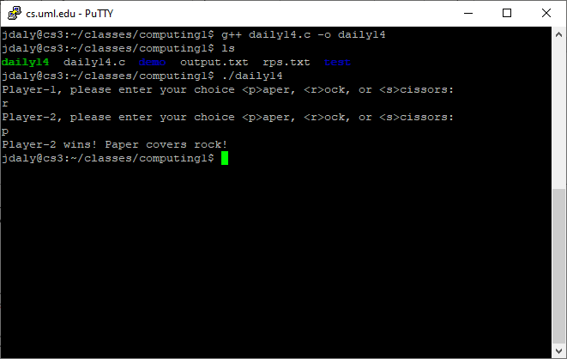
Compile Code (G++)
You can compile programs on the command line
g++ is a C and C++ compiler
By default the program is called a.out
You can change the name of the program with the –o <output file> option
Other compilers exist
javac for Java
For bigger programs, people use makefiles to organize the calls

Slide 23
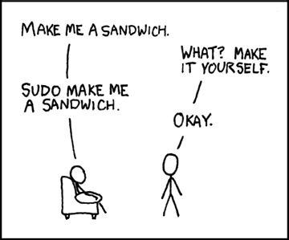
Run as administrator (SUDO)
Some apps require special permissions
Use sudo to grant these permissions
Can also use sudo to run a program as a different user
Originally short for “superuser do”, now sometimes expanded to “substitute user do”
Image source: https://xkcd.com/149/

Slide 24
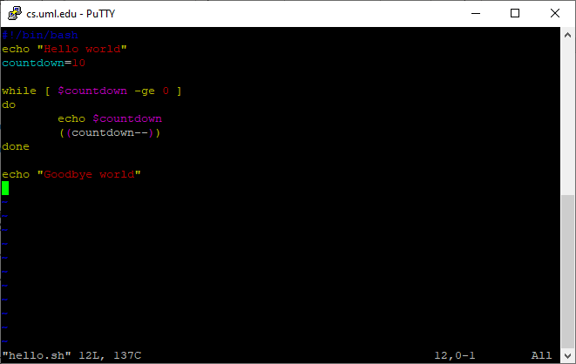
Scripts
Some sequences of commands might be done more than once
Put common sequences into a file (a script) for ease of use
Scripts start with #!/bin/bash
Tells which interpreter to use
Lines starting with # are comments
Can use any of the utilities discussed
Use echo to print text

Slide 25
Variables
Assign to a variable with varname=<exp>
Similar to C
Access the variable using $varname
Different from C
Special variables
$0 : name of the script
$1, $2, etc : parameters of script

Slide 26
Homework 6
Final homework
Due Wednesday, December 9
Tutorial to help you write a bash script to count how many lines contain a word in Romeo and Juliet

