Slide 1
Getting Help End of the Semester
Computer Science First Year Seminar

Slide 2
Homework 6
Final homework
Due Wednesday, December 9
Tutorial to help you write a bash script to count how many lines contain a word in Romeo and Juliet
Turn in the .bash file, not an image.

Slide 3
End of Semester Schedule
This is the last day of this class
The last day for regular classes is Thursday
Friday is Reading Day (no classes)
Exams start Saturday

Slide 4
Final Exams
There is no final exam for this class ☺
Most of your other classes will have finals
Can check SiS for your exam time
Exams are NOT during the normal class time
Exam times are set by the University, not the professor
Your professor should tell you when the exam is
Exams are 3 hours long
Note that this semester is weird because of COVID-19
You may be allowed to take the exam at a different time

Slide 5
Tutoring
The Tutoring Center has student tutors for many subjects
Including Computing I-IV, Assembly, Architecture, and OPL
Also look at your science classes, calculus, and many others
Schedule at https://www.uml.edu/class/tutoring/tutor-schedule/
Tutoring is free for students
The tutors have taken the class before

Slide 6
Asking the Instructor
The instructor should have given you their preferred contact at the beginning of the semester
Email, Blackboard, etc.
The instructor will also have office hours when you can visit them
Useful for if you have a more involved question
When you message them be sure to include:
Which class it is for (they teach several)
What your specific problem is
Any specific error message you are receiving
What you think the error message means
A specific time to meet (if desired)

Slide 7
Compiler Errors
Compiler errors are your compiler trying to tell you what it thinks is wrong with your code
Pay attention to the warnings as well
Often tell you about potential problems
Good to learn how to interpret them
Often tells you exactly what you messed up

Slide 8
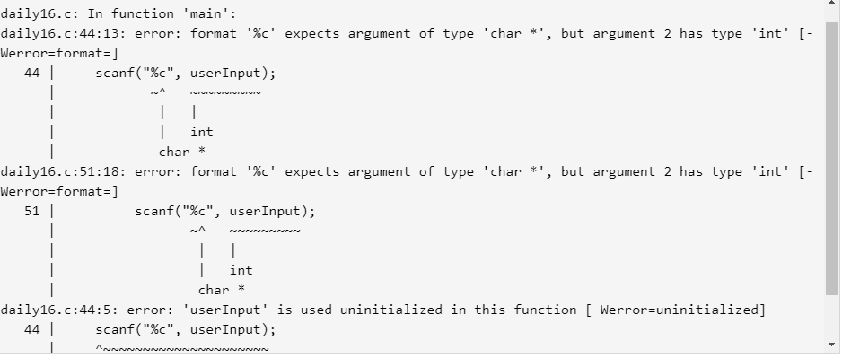
Deciphering an Error Message
Information about the first error
Expected a char* but received an int
Where the error occurs
Missing an & in front of userInput (and change type to char)
There are three errors

Slide 9
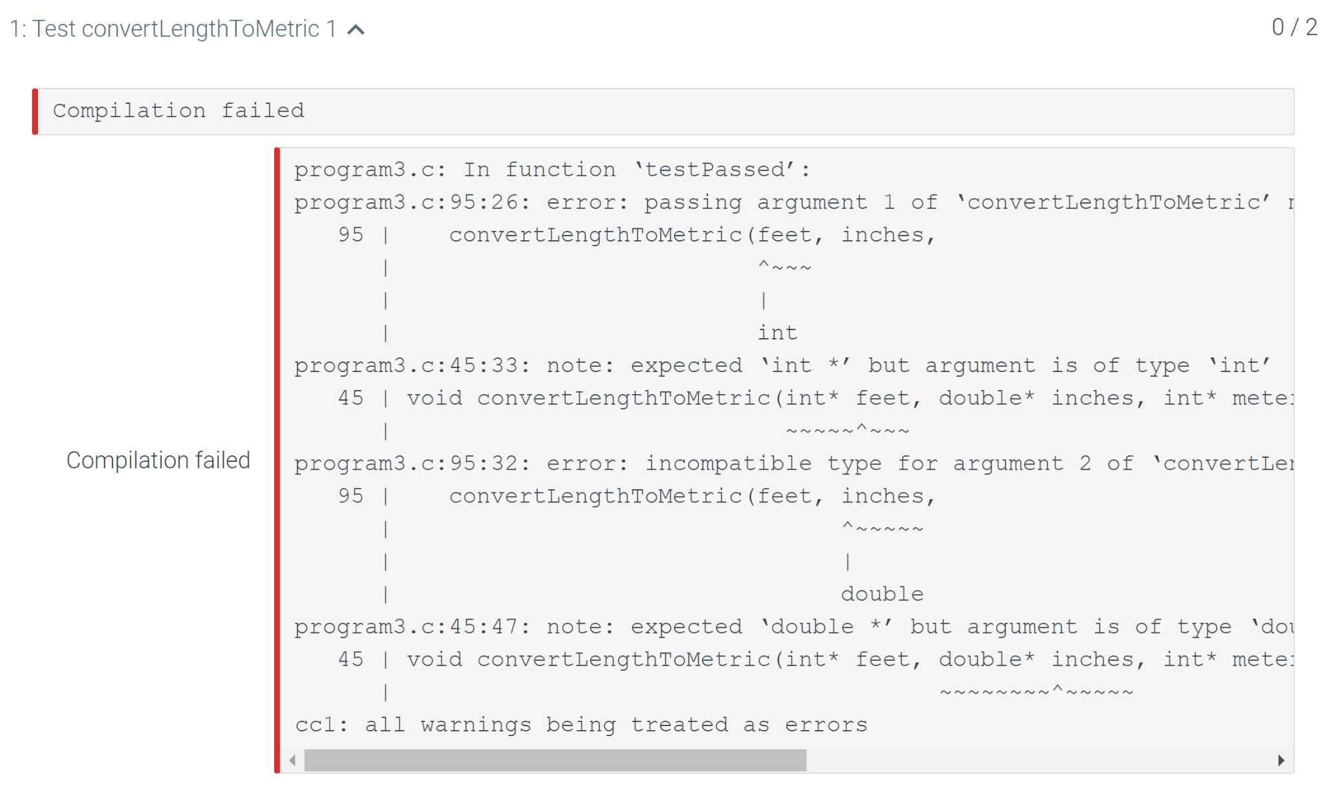
Deciphering an Error Message
Line not from your program
Actually part of tests
Test gives an int as the first argument
This part is your code
These two go together
But your function takes an int*
Can also see that first two parameters should be feet and inches

Slide 10
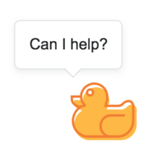
Rubber Duck Debugging
When you get an error try explaining your code to your stuffed animal, rubber duck, or potted plant
Explain what it supposed to do
Observe what it actually does
Is there any dissonance between the two?
Called rubber duck debugging after a story in The Pragmatic Programmer
Image: Stack Exchange April Fool’s day avatar

Slide 11
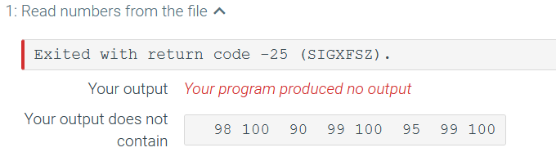
Once More
What does this one mean?

Slide 12
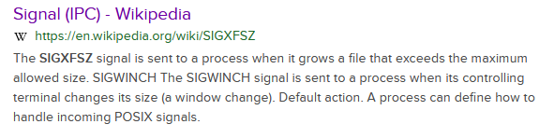
LMGTFY
Signal that a file exceeds the maximum allowed size
Writing to a file and it got too big
Probably an infinite loop with fprintf

Slide 13

Stack Overflow
Q&A site for programmers
https://stackoverflow.com
Created in 2008 by Jeff Atwood and Joel Spolsky
Your question has probably already been asked here
Gamification
Good questions and answers can be upvoted by other users
Answers with many upvotes appear first
Gain reputation for both good questions and answers

Slide 14
Stack Overflow student Questions
Most users on SO can tell when you ask a homework question
They won’t just give you the answer
They definitely won’t do your homework for you
They will help explain some of the ideas you need to do your homework

Slide 15
C Documentation
Sometimes you need more information on how something works
Common library functions are documented online
Several versions for C and C++
http://cplusplus.com/
https://en.cppreference.com/w/
More…

Slide 16
Documentation
Java
Documentation: https://docs.oracle.com/en/java/javase/15/docs/api/index.html
Tutorials: https://docs.oracle.com/javase/tutorial/
Python
Documentation: https://www.python.org/doc/
Tutorials: https://docs.python.org/3/tutorial/index.html
C#
https://docs.microsoft.com/en-us/dotnet/csharp/

Slide 17
Polyglot
Most of the ideas and concepts that we teach you will be broadly transferable between languages
Some of the notation might be slightly different, but the idea is the same
The libraries and tools will be different
Often a similar tool: vector in C++ vs ArrayList in Java
Won’t be exactly the same
Need to learn what the differences are
Each language has its own idioms (common patterns or expressions)
Ex: (x, y) = (y, x) #Python swap

Slide 18
Unlearning
Tools are continuously evolving
New, better ways of doing things come about frequently
Should learn the better way of doing things
May require unlearning the old way
Different models may require different approaches
What works well in one may be a bad idea in another
Ex: Object pooling
Rather than delete an object when you are done with it, keep it in a “pool” where you can reuse it
Works well in C and C++ because memory allocation is relatively slow
Bad in Java and C# because it interferes with the garbage collector
Also memory allocation is faster

