Slide 1
COMP1110 - Seminar
Computer Science First Year Seminar – Fall 2020

Slide 2
Computer Science Freshman Seminar Week 1 - Introduction
Introduction
Learning Management System – Using Blackboard
Utilized in some courses
Syllabi – How to read and understand
What is and is not in a syllabus (plural syllabi)
Academic Calendar – Sometimes, Tuesday is Monday
Important dates you must keep in mind

Slide 3
Introduction
Welcome to the University of Massachusetts – Lowell Computer Science Program
We are here to help – our goal is your success
Everyone is able to start fresh – Your High School grades don’t matter.
If you are a transfer student, courses that transferred are graded as ‘T’ – they do not impact your Grade Point Average (GPA)

Slide 4
Vocabulary
GPA (Grade Point Average) – A number on a scale of 0.0 – 4.0 Each letter grade is converted to a numeric value which is multiplied by the number of credits. The average (for a semester, over your entire time here, or for just particular courses) is a GPA.
There are requirements that you maintain an appropriate GPA – either overall or just Computer Science course (course prefix ‘COMP’)
Credits – An indication of how much time the course requires. For typical courses it is the number of hours per week. Credits for Labs are measured differently.

Slide 5
Vocabulary
Professor – Provides instruction for the course.
Different ranks (Full, Associate, Assistant). Some are focused on teaching (e.g. Assistant teaching Professor), others conduct research.
Teaching Assistant (TA) – assists the professor and may oversee Labs. Typically a student pursuing a PhD.
Grader – responsible for assisting by grading student work – typically an upper level student that has excelled in the course.
Chair – An elected professor that oversees the operation of the department
Computer science chair: Dr. Haim Levkowitz

Slide 6
Vocabulary
College – The University consists of several Colleges, each of which may contain several departments:
Kennedy College of Sciences
Computer Science
Mathematical Sciences
Chemistry
Physics
Francis College of Engineering
Computer Engineering
Electrical Engineering
Mechanical Engineering

Slide 7
Vocabulary
Dean – At the college level, may have a particular focus
Dr. Noureddine Melikechi
Provost – Chief Academic Officer for the University
Dr. Joseph Hartman
Chancellor
Dr. Jacqueline Moloney
Board of Trustees
Notes:
A dean of college supports and promotes the highest quality educational programs, research, public service and economic development activities of their respective colleges and schools. Each dean must be an effective advocate for his or her college, both within the university and externally.
A dean of students plans and directs university activities related to student services and campus life. As an administrator, a dean of students might help coordinate admissions, health services, financial aid, housing, and social programs for students.
A chancellor is a leader of a college or university, usually either the executive or ceremonial head of the university or of a university campus within a university system. ... The chancellor may serve as chairman of the governing body; if not, this duty is often held by a chairman who may be known as a pro-chancellor.
The Chancellor is responsible for the leadership of the Governing Authority. As Chair of its meetings, he/she is responsible for ensuring that the necessary business of the Governing Authority is carried out efficiently, effectively, and in a manner appropriate for the proper conduct of public business.
Elected by College Board member delegates, the Board of Trustees is the governing body of the College Board. Trustee responsibilities include: Approving the organization's mission, strategic goals, and objectives. Establishing policies related to membership, programs, and services.
A board of trustees is an appointed or elected group of individuals that has overall responsibility for the management of an organization. The board of trustees is typically the governing body of an organization and seeks to ensure the best interest of stakeholders in all types of management decisions

Slide 8
Blackboard
May be utilized in your course. Easiest way to get there:
https://uml.edu/myuml
In the “Info for Students” (you may need to scroll), click on the “Blackboard” link
Now click on the “On-campus Course Login” link
You may need to authenticate your self by supplying your uml email address and password (same authentication for email and SIS).
You should see any courses that are using Blackboard where you are a student.
It may take a day or so after you register for you to appear on Blackboard

Slide 9
Blackboard
If you have not used Blackboard before, it may take a bit of time to find your way around.
On the initial Blackboard screen you are directed to bbhelp@uml.edu or 978-934-4357 for assistance.
You may find it quicker to ask a friend, in particular at the beginning of the semester when the help desk may be fielding a large number of requests.

Slide 10
Syllabi
Many times, the answer is in the syllabus. For each course, you should receive a syllabus – either on paper or via Blackboard.
Short Quiz:
Approximately how many students are in this class?
How long does it take to ask a question about course policies?
Multiply the two numbers
Is it really an effective use of time?

Slide 11
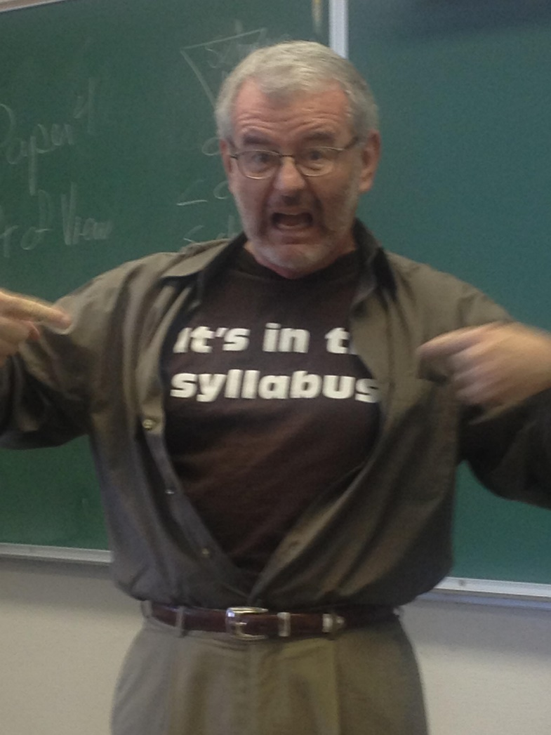

Slide 12
Syllabus
Please check the syllabus Before asking any policy, schedule or generic questions.
To Repeat, the following types of questions:

Slide 13
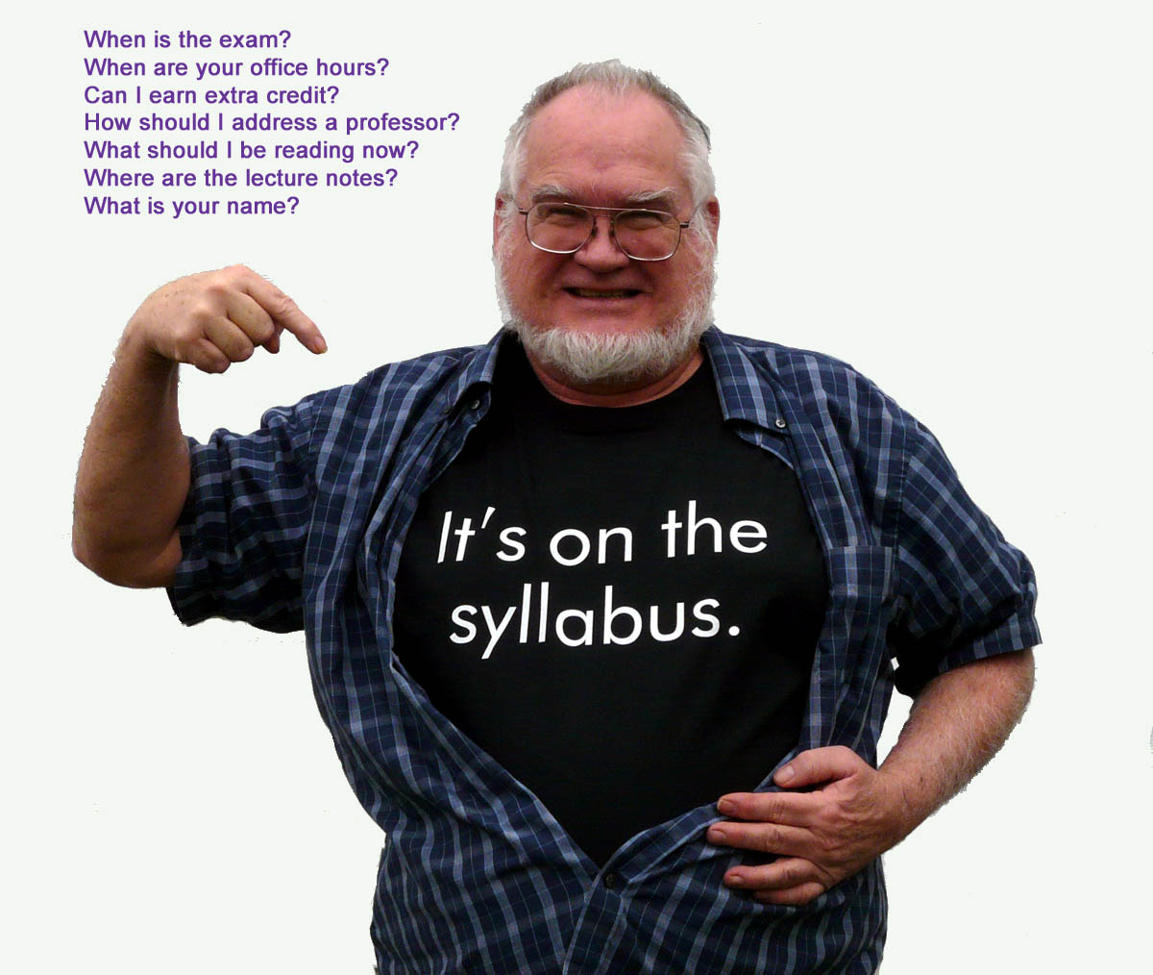

Slide 14
Syllabus Anatomy
We will use the syllabus for this seminar as an example. Other courses may use a different format and contain different information.
1. Course Number and Title: COMP.1110 First Year Seminar for Computer Science Students
2. Instructor’s Name: Dr. James Daly. email: mailto:james_daly@uml.edu
3. Instructor’s Office: DAN-347
4. Office Hours:
On Zoom, by appointment
Please send an email requesting a time to meet
Tuesdays and Thursdays are better
MWF after 3pm is doable
These times are reserved for you, but I may have to attend a meeting from time to time. If you are having difficulty with the material, I would strongly encourage you to make use of office hours for additional help.

Slide 15
Syllabus Anatomy
When you receive a syllabus use the course number and title to verify you are in the right place!
The instructor’s name, office hours and office should be listed.
The instructor will typically state his/her name in the first class. If you miss it or forget, don’t be afraid to ask how the name should be pronounced.
As with classes, the first three letters denote the building. Maps are available from UCAPS, which also has information regarding parking. In this case, ‘DAN’ is the abbreviation for Dandeneau Hall. This is located on the ‘North Campus’, part of the ‘Quad’ on the river side of Southwick Hall (large yellow brick arches).

Slide 16
Office Hours
A great deal of learning can occur during office hours.
Your professor wants you to be successful in the course
Asking questions in class is very helpful
Sometimes an explanation may require more time than can be allocated during class.
Many times, quick questions can be addressed via email
Office hours are not useful to try to gain the entire content just before the final exam (If you had questions earlier, ask earlier)

Slide 17
Office Hours
Do not wait for the last minute.
There may be a line of students. Your professor may have an obligation to attend to after office hours end.
Sometimes, your professor may have a meeting or other event that falls during office hours.
The time immediately after class is suitable for only very short questions – Just like you, your professor may have to travel to another class
Many courses will have a TA. The TA may also hold office hours.

Slide 18
Syllabus Anatomy
Course Description – should be self-explanatory
Course Co-requisites – What other courses MUST be taken at the same time (For example COMP.1010 Computing I and COMP.1030L Computing I Lab must be taken in the same semester).
Course Prerequisites – What courses MUST have been SUCCESSFULLY taken (or transfer credit received) BEFORE taking this course.
Course Category – Is this a ‘Required’ course (you must successfully complete this before you can receive your degree), or an ‘Elective’, from the point of view of the Bachelor of Science in Computer Science program.

Slide 19
Syllabus Anatomy
Student Outcomes – The end result of taking this course
Date, Time, Location – When and where the course meets
Requires Textbook – To be successful in the course, you need to obtain the textbook. There may be homework assignments that require the book. Make certain you have the correct Edition – many times, the publisher will rearrange problems and sections from one edition to another.
Recommended Books – Additional books that may be helpful.

Slide 20
Textbooks
Textbooks can be expensive. For courses in you major (Computer Science, in case you were wondering!), you may want to retain the book for reference, either in other courses or in the workplace).
Many times ‘used’ books are available for a significantly lower cost
If you are uncertain if you want to retain the book, purchasing it and then selling it after the semester may be a better option than renting.
Online books may be available. Be certain to consider the ‘expiration date’
When I was a student, I would find out what the textbook was before the semester started and read it before (over winter or summer break).

Slide 21
Textbooks
Textbooks are not like novels.
You shouldn’t expect to pick up everything on the first reading
The syllabus will typically indicate topics on the schedule, perhaps particular chapters and sections of the textbook. You will get much more out of class if you read the text before class. Don’t worry if you don’t understand everything.
You may need to read a section several times.

Slide 22
Syllabus Anatomy
Course Expectations – This section lists various policies
Attendance – Attending class is good. If you must miss class, please try to obtain notes from a classmate.
Academic Honesty – As with plagiarism, at the university level this is a BIG thing. Penalties can be severe. It is better to fail a test honestly than to attempt to cheat. A violation will follow you and have long range consequences (several public figures (aka politicians) have ruined their career this way).
Do you really thing a company would risk employing you if you are not honest?
Electronic devices – Permitted or not

Slide 23
Additional notes on Attendance
If you know in advance you are going to miss class, please take responsibility and read over any slides or lecture notes.
Don’t ask your professor: “Is there going to be anything important on Wednesday?” (If it was not important, we wouldn’t be doing it).
If you miss an exam, please make appropriate arrangements with your professor. The ‘Testing Center’ may be helpful.
Missing a class does not relieve you of turning in an assignment on time. If the assignment is to be turned in via Blackboard, please do so. If a paper copy is required, make arrangements with your professor.

Slide 24
Evaluation (aka grades)
The syllabus should clearly state how grades are calculated
It should indicate the weights for various Items (homework, quizzes, exams, participation, …)
At the end of the semester, numeric grades are translated to a letter grade.

Slide 25
Evaluation
Most CS courses (and probably most courses in natural science and engineering) use a weighted average
We will not be doing that in this class
To receive an A in FYS, students must
Attend at least 11 of the 13 classes
Do at least ¾ of the homework (which are graded credit/no credit)
Attend at least 4 CS Colloquia, department talks, or ACM presentations (waived F20 because of Covid-19)
Lower grades have reduced targets, as noted in the syllabus.
Attendance will use the system at
https://www.uml.edu/it/services/academic-technology/attendance.aspx

Slide 26
Due dates and late submissions
The policy for late submission of assignments should be clearly spelled out.
It may indicate a penalty for late submission
It may indicate the late submissions are not accepted (in this case a grade of 0 will be used)
Any policy regrading dropping the lowest homework/quiz grade will be listed
The syllabus should also speak about any ‘re-do’ policy (many times, re-doing an assignment or quiz is not permitted).

Slide 27
Academic Honesty
Academic Honesty is VERY important
Violations can take many forms:
Copying another student’s work on a homework assignment
Using a prohibited source such as
assignments from pervious semesters
Parents, siblings or friend
Internet question boards or ‘work for hire’
Allowing another student to use your work is also a violation
Plagiarism, including failure to properly cite another work

Slide 28
Academic Honesty
This is also a BIG issue in industry
Consider the results if you include code that does not belong to you in your company’s product:
A potentially company ending lawsuit may result
You (and all of your colleagues) suddenly find themselves unemployed
You basically become unemployable in the field (do you really think any company would take a chance hiring you?)
If in doubt, ask your professor if a particular source is permitted
Be certain to ask if group work is permitted, if this has not been made clear

Slide 29
Schedule
A schedule of topics, reading assignments, homework, exams and quizzes may be included
Schedules are subject to change (snow days, extra instruction time required for a particular topic, other unexpected events).
Reading should typically be done BEFORE the indicated class.
Even though you may not understand everything you read, it will help when you see the material again in class.
You should be aware that sometimes a different day’s schedule is run (Tuesday is a Monday schedule).

Slide 30
Schedule & Calendar
The academic calendar is available at: https://www.uml.edu/Registrar/Calendars/ (be sure to select the undergraduate version)
You may need to make arrangements with outside schedules (work, childcare, etc.)

Slide 31
SIS (Student Information System)
This is where you “shop” for courses
Register for courses
See your final grades
Request a transcript
Just about anything related to “being a student”

Slide 32
SIS is large and complex
Do not use your browser’s “back” button. You have to use the links within a SIS page to navigate
To have the best possible selection of courses, register as soon as possible.
You are permitted to register after any critical “holds” have been removed. These include items like:
Financial issues
Advising
Immunization

Slide 33
Advising
After the first year, you will be assigned a departmental advisor.
Your advisor is a faculty member and will help you navigate the various requirements.
You need to meet with your advisor (typically during “advising period”).
It will make the process go more quickly if you have looked at the CS Curriculum and have given some thought to what courses you would like to take next semester.

Slide 34
Advising
Many courses have pre-requisites.
The content of the pre-requisites is needed for the new course.
In rare cases, a professor may override a pre-requisite and allow you to register for the course (issue a “permission number”).
Permission numbers don’t let you get into a class that is full.

