Slide 1
Collaboration and Academic Integrity
Computer Science First Year Seminar

Slide 2
Outline
Academic Integrity
What it is?
Why do we care?
What are the results of academic misconduct?
Version Control
Git/GitHub
Creating a repository
Configuration

Slide 3
Academic Integrity
Academic integrity is the moral code for academia
Act with honor
Be honest
Do the right thing
Academic misconduct are academic integrity violations
Bring dishonor to you and the University
You can be punished and ostracized for them

Slide 4
Academic Misconduct
Academic misconduct is an act in which a student:
Seeks to claim credit for the work or efforts of another without authorization or citation;
Uses unauthorized materials or fabricated data in any academic exercise;
Forges or falsifies academic documents or records;
Intentionally impedes or damages the academic work of others;
Engages in conduct aimed at making false representation of a student’s academic performance; or
Assists other students in any of these acts.
https://www.uml.edu/catalog/undergraduate/policies/academic-policies/academic-integrity.aspx

Slide 5
Why we care
Deprives you of learning
If you cheat to do something, you never learn how to do it
Saying, “I’ll learn it later” is lying to yourself
May cause problems for you later when you need to know how to do it
Devalues the degree for everyone else
Employer: Why should I care you have a degree from UML? Everyone there just copies from each other and hardly any of them actually know anything.
Can land you in legal hot-water when you do this in the real world
Stealing code/other intellectual property can land you in a job/company ending-lawsuit
May become unemployable (no one wants to hire a legal liability)

Slide 6
What Counts as academic dishonesty?
Copying another student’s work
Using a prohibited source such as
Assignments from previous semesters
If you retake a course, you are expected to redo the work, not reuse your past work
Parents, siblings, or a friend
Internet question boards or ‘work for hire’
e.g. Chegg
May be considered a more serious offense then copying from another student
Allowing another student to use your work
Letting others copy your work usually gets you the same penalty they get
Plagiarism, including failure to properly cite another work
Distributing course materials (including notes, assignments, and exams)

Slide 7
Penalties for Academic Dishonesty
Typical
1st offense: Reduced grade or 0 on the assignment
2nd offense: Failure on the course
Other possible penalties
Reduction in the final grade (in addition to a 0 for the assignment)
A non-deletable failing grade (can’t be deleted or overwritten by retaking the course)
Suspension or Expulsion from the University
Generally only for serious premeditated violations (like having someone else take an exam for you)
All offenses will also include an academic dishonesty report
Allows the Provost to track repeat offenses across different classes

Slide 8
Quote
“If your hand or foot causes you to stumble, cut it off and throw it away. It is better for you to enter life maimed or crippled than to have two hands or two feet and be thrown into eternal fire.”
Matthew 18:8
It is better for you to not be able to complete the work honestly than for you to cheat.

Slide 9
What can you do?
You are allowed to discuss strategies with each other
But not to copy code or diagrams that you collaboratively create
May be best to take a break between your discussion and implementing what you talked about
It is recommended that you talk about conceptual ideas with each other
What did we learn in class today?
What is this assignment asking us to do? (as opposed to “How do we do it?”)
If you have doubts, ask the instructor
Better to ask for permission than to beg forgiveness

Slide 10
Version Control
In computer science, it is often useful to see how a program used to look
Especially if you made a mistake and need to undo your changes

Slide 11
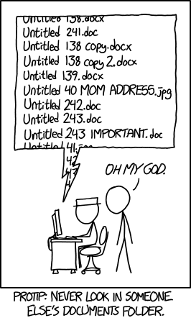
The bad way
source: https://xkcd.com/1459/

Slide 12
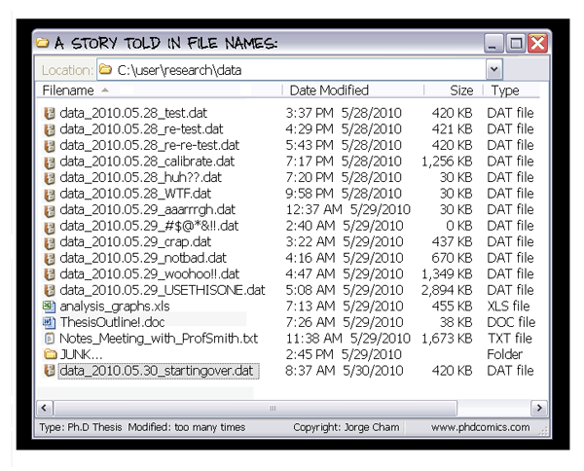
The bad way
source: http://phdcomics.com/comics/archive.php?comicid=1323

Slide 13


GitHub
https://github.com/
Online web-hosting repository
Helps enable collaboration
Use the Git tool to communicate with GitHub
Available at https://git-scm.com/
Versions for Windows, Mac OSX, and Linux
Plugins are available for many tools like Visual Studio
Many developers host their portfolios here
Serves as their advertising board
Use this to build your personal brand

Slide 14
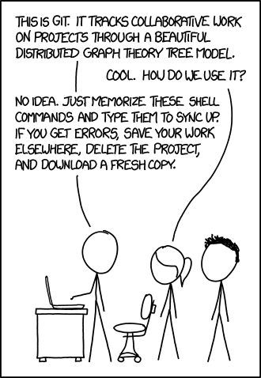
XKCD on Git
source: https://xkcd.com/1597/

Slide 15
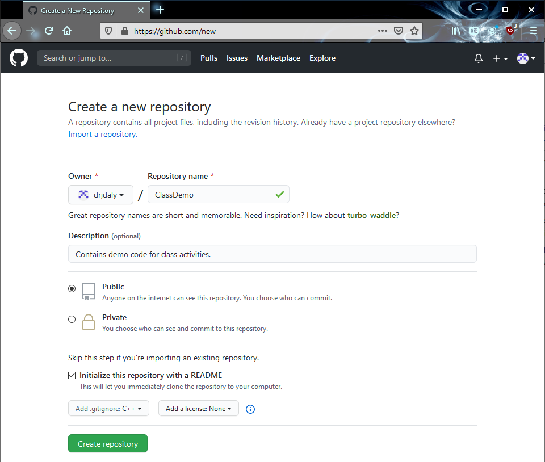
Creating a repository
Can create a repository directly on GitHub through the web interface
Make sure you give it a good name and description
You probably want to setup a readme and .gitignore file
Licenses affect how other people may use your code

Slide 16
Private Repositories
Anyone can download from a public repository
Use a private repository to limit who has access to it
Remember that if another student downloads your code from GitHub, you are guilty of enabling academic dishonesty
Keep your schoolwork in private repositories
High-level courses may be different (you are each making unique projects)

Slide 17
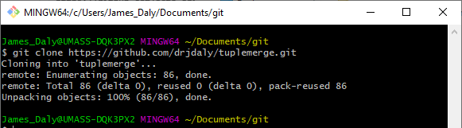
Cloning an existing repository
git clone [repository]
Creates a new local directory containing the repository

Slide 18
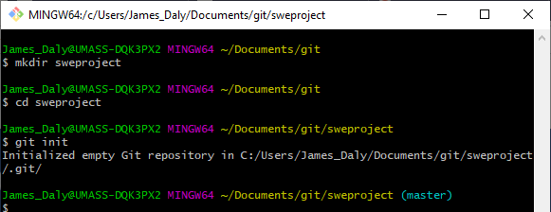
Initializing a New Repository
git init
Establishes a new repository in the current directory
Should cd into the directory that will contain your directory

Slide 19
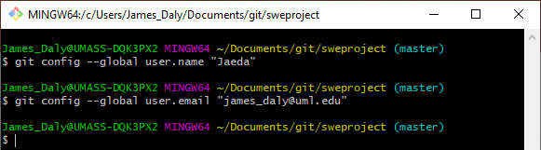
Setup your username and email
git config --global user.name “[username]”
git config --global user.email “[email]”
Applies to all repositories
Remove --global to apply to only this repository

Slide 20
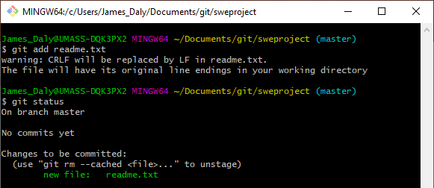
Add a new or modified file to the index
git add [Filename]
Marks the file as changed to commit
Recursively adds files in directories
Does not commit them to the repository

Slide 21
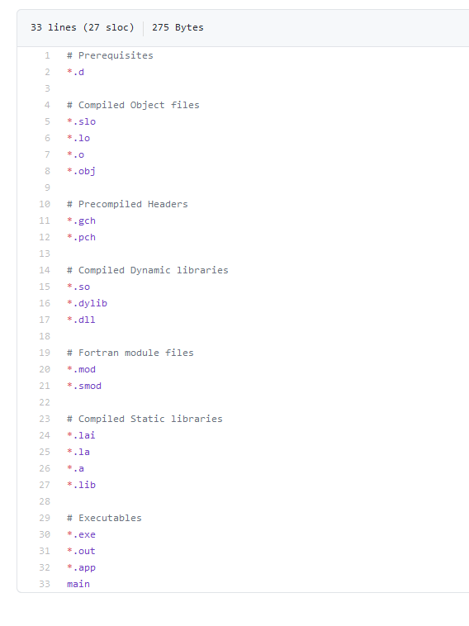
Hidden Files
.git
Hidden directory that contains the repository information
You usually don’t need to interact with it (that is why it is hidden)
.gitignore
Special file
Tells Git to ignore certain files
Don’t commit procedurally generated files
Compiled programs (.exe, .out, .dll)
Intermediate files (.obj, .class)
Hide environment variables

Slide 22
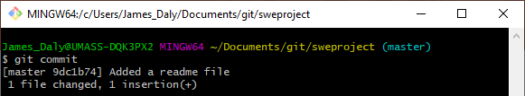
Commit Changes
git commit
Opens your editor to write a commit message
git commit -m [Message]

Slide 23
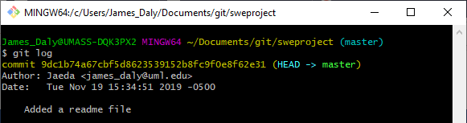
See recent changes
git log

Slide 24
Homework 1
Create a private GitHub repository
Create a directory for your Computing I (or other programming) class
Add me (jdalyuml) as a collaborator
Submit a link to the repository on Blackboard
Due Wednesday, September 16 at 5pm

