Slide 1
Agenda — What We'll Cover Today
Module 1: The Big Picture
Module 2: Developers, Developers, Developers
Module 3: AI Built-In
Module 4: The Core Engine — Security
Module 5: The Core Engine — Performance & Concurrency
Module 6: The Core Engine — Availability Groups
Module 7: Connected with Arc
Module 8: Fabric Integration & Mirroring
Module 9: Wrap-Up & Resources

Slide 2
Data Is the Fuel That Powers AI
The explosion of enterprise data and the need for AI integration at the data layer
Why the database — not a separate service — is the right place for AI building blocks
SQL Server's position: trusted engine meets modern AI workloads

Slide 3
Introducing SQL Server 2025
"The AI-ready enterprise database from ground to cloud"
Five pillars: AI Built-In, Best-in-class Security & Performance, Made for Developers, Cloud Agility through Azure, Fabric Integration
aka.ms/sqlserver2025

Slide 4

Building on a foundation of innovation
SQL Server 2017
SQL Server on Linux
Containers
Adaptive query processing
Automatic Tuning
Graph database
Machine learning services
SQL Server 2019
Data virtualization
Intelligent query processing
Accelerated database recovery
Data classification
SQL Server 2022
Cloud Connected
IQP NextGen
Ledger
Data Lakes
T-SQL enhancements
Notes:
When we think about SQL, we think for the long term. We are building on a strong foundation of previous versions and continuous investment in key areas that our users need.​
​
With that let’s dig in a little deeper into SQL Server 2025.

Slide 5
Things You Need to Do
Use Query Store
Use ADR

Slide 6
SQL Server 2025 — Areas of Innovation
AI Built-In: Vectors, embeddings, model management, RAG patterns
Develop Modern Data Applications: JSON, RegEx, REST API, CES, GitHub Copilot for SQL
Integrate Your Data with Fabric: Mirroring, near-real-time analytics

Slide 7
SQL Server 2025 — Meat and Potatoes
Secure by Default: Managed Identity, Entra, Defender integration
Mission Critical Engine: Optimized Locking, IQP enhancements, AG reliability
Connected with Arc | Assisted by Copilots | Built for All Platforms

Slide 8

The SQL Server 2025 Platform Architecture
Outbound connections: Azure AI Foundry, Event Hub, Fabric, Entra
Local connections: AI models (Ollama, ONNX), REST endpoints, Semantic Kernel
Management plane: Arc, SSMS 22 with Copilot, VS Code mssql extension
Secondary replica capabilities: Query Store, backups, tuning, diagnostics

Slide 9
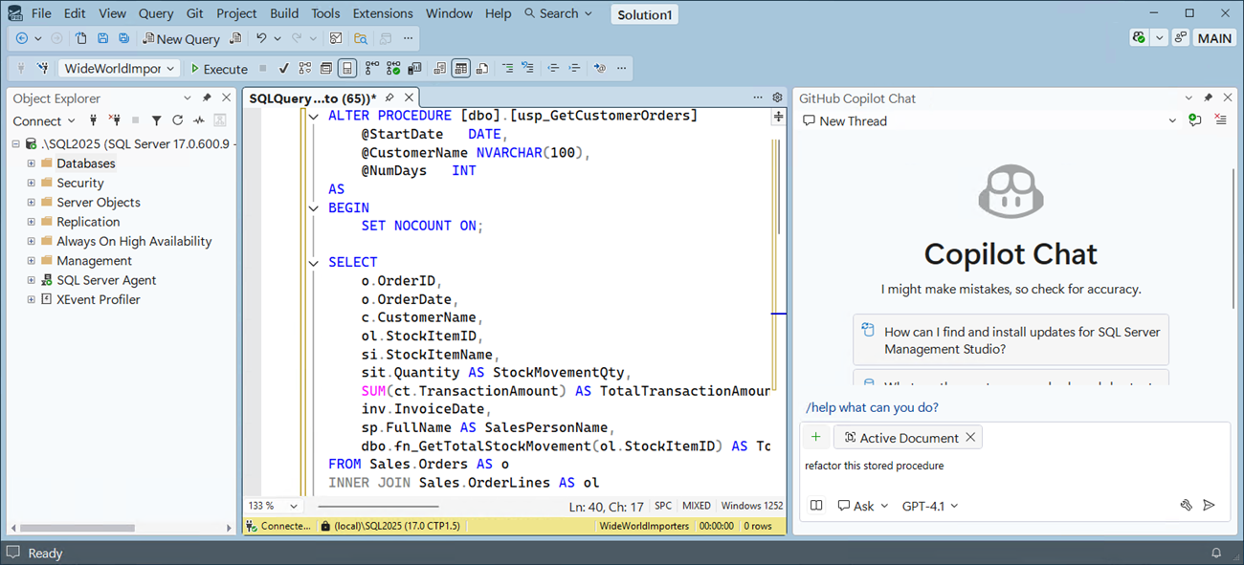
SSMS 22 — General Availability
Based on Visual Studio 2022 (64-bit)
Copilot integration (public preview)
Dark theme and multiple color themes
Git and TFS support
New connection experience
Windows ARM64 support

Slide 10
SSMS 22 — Developer Productivity Features
Query editor improvements
JSON viewer
Query hints recommendation
Zooming for grid results
Always Encrypted assessment
VS Installer / update experience

