Slide 1
SQL Server 2025 Deep Dive: Essential Innovations for DBAs and Database Developers
Joey D’Antoni
Matt Gordon

Slide 2
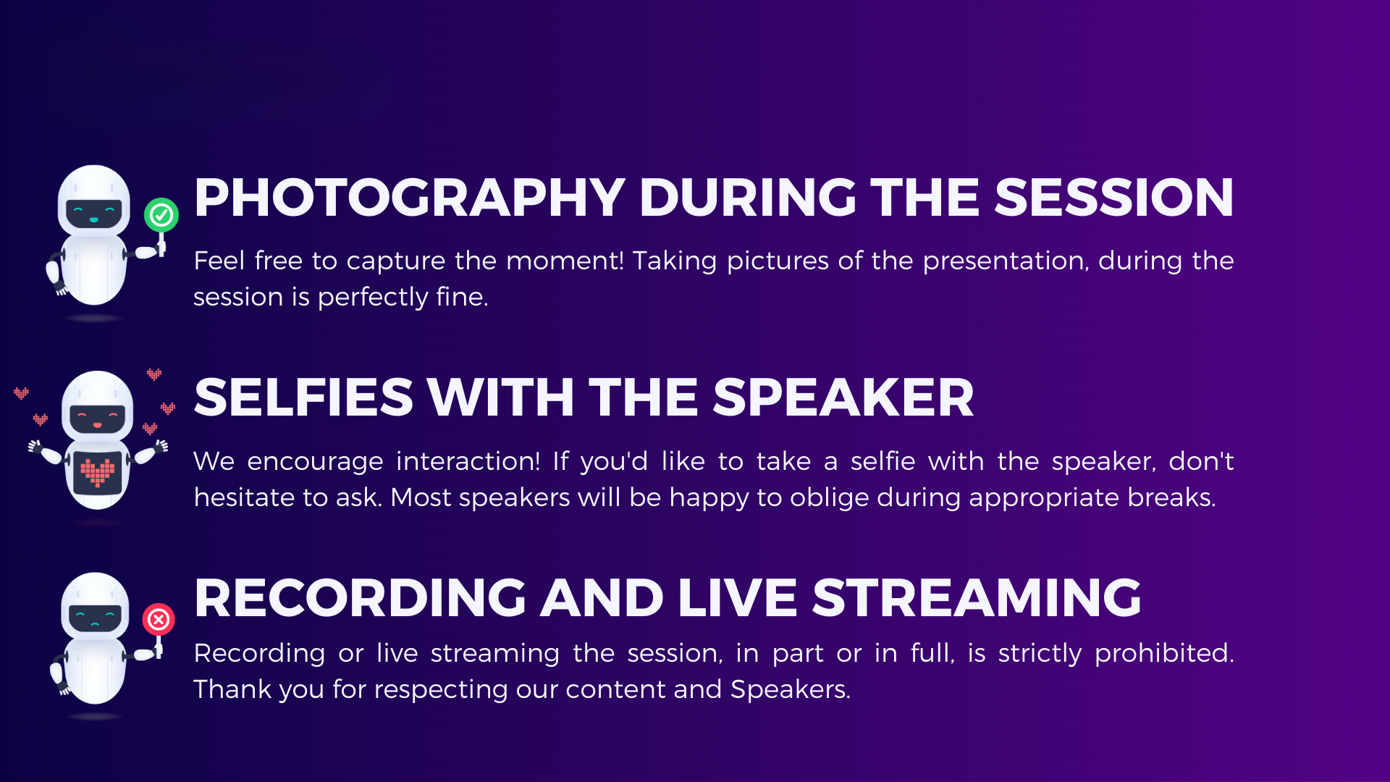


Slide 3


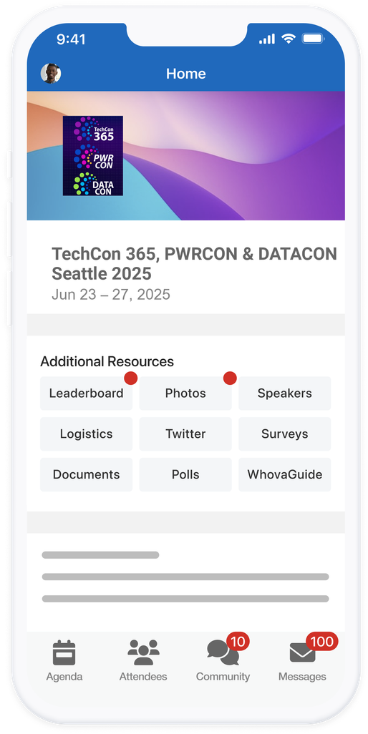
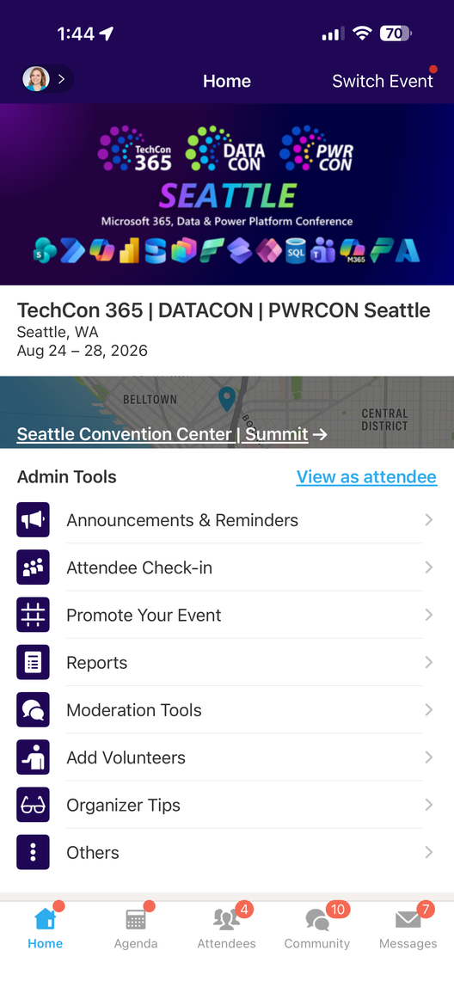
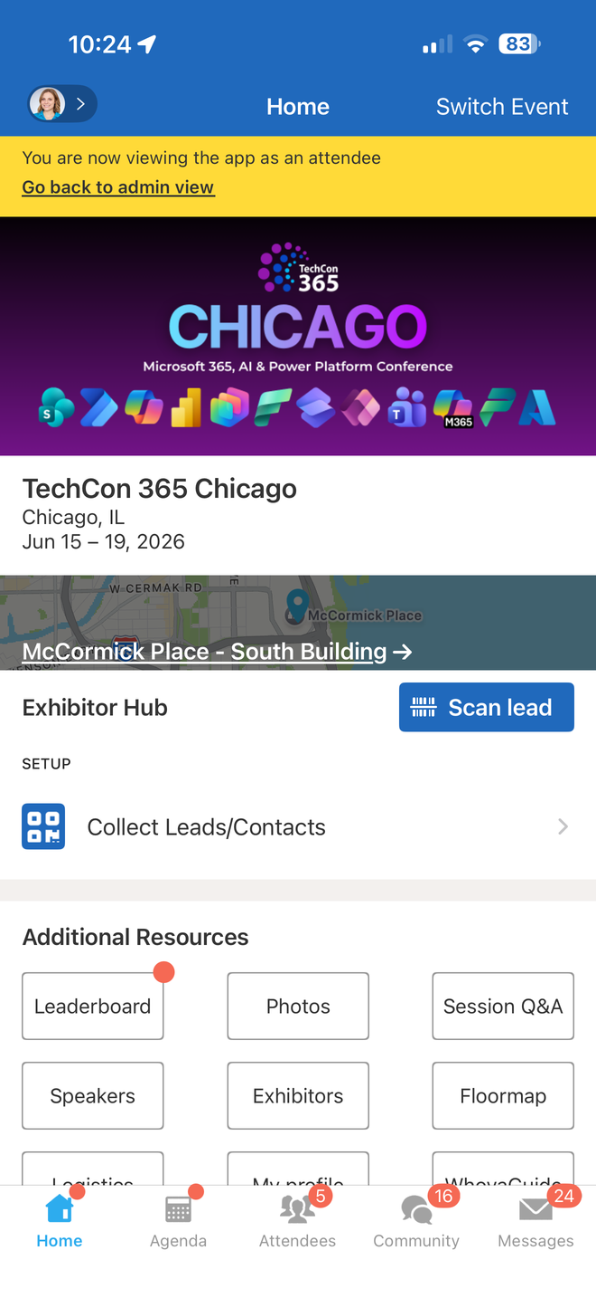


How was
the session?
Search for in the
App Store or Google Play
Fill out the Session Surveys in the
TechCon 365, DATACON, PWRCON
Event App and be eligible to WIN PRIZES!

Slide 4
Joey’s Info and Pic

Slide 5


Matt Gordon Director, Data & Analytics at Lean TECHniques
Worked on SQL Server since 2000
Been a lone DBA, led DBA teams, and consultant
Race car driver by hobby

Slide 6
Who Is Here and What Are You Hoping to Learn?
DBAs? Database Developers? Data Engineers? Developers?
New Stuff?
Improved Stuff?
Stuff That Isn’t Great?

Slide 7

Agenda — What We'll Cover Today
Module 1: The Big Picture
Module 2: Developers, Developers, Developers
Module 3: AI Built-In
Module 4: The Core Engine — Security
Module 5: The Core Engine — Performance & Concurrency
Module 6: The Core Engine — Availability Groups
Module 7: Connected with Arc
Module 8: Fabric Integration & Mirroring
Module 9: Wrap-Up & Resources

Slide 8
Data Is the Fuel That Powers AI
The explosion of enterprise data and the need for AI integration at the data layer
Why the database — not a separate service — is the right place for AI building blocks
SQL Server's position: trusted engine meets modern AI workloads

Slide 9
Introducing SQL Server 2025
"The AI-ready enterprise database from ground to cloud"
Five pillars: AI Built-In, Best-in-class Security & Performance, Made for Developers, Cloud Agility through Azure, Fabric Integration
aka.ms/sqlserver2025

Slide 10

Building on a foundation of innovation
SQL Server 2017
SQL Server on Linux
Containers
Adaptive query processing
Automatic Tuning
Graph database
Machine learning services
SQL Server 2019
Data virtualization
Intelligent query processing
Accelerated database recovery
Data classification
SQL Server 2022
Cloud Connected
IQP NextGen
Ledger
Data Lakes
T-SQL enhancements
Notes:
When we think about SQL, we think for the long term. We are building on a strong foundation of previous versions and continuous investment in key areas that our users need.​
​
With that let’s dig in a little deeper into SQL Server 2025.

Slide 11
Things You Need to Do
Use Query Store
Use ADR

Slide 12
SQL Server 2025 — Areas of Innovation
AI Built-In: Vectors, embeddings, model management, RAG patterns
Develop Modern Data Applications: JSON, RegEx, REST API, CES, GitHub Copilot for SQL
Integrate Your Data with Fabric: Mirroring, near-real-time analytics

Slide 13
SQL Server 2025 — Meat and Potatoes
Secure by Default: Managed Identity, Entra, Defender integration
Mission Critical Engine: Optimized Locking, IQP enhancements, AG reliability
Connected with Arc | Built for All Platforms

Slide 14

The SQL Server 2025 Platform Architecture
Outbound connections: Microsoft Foundry, Event Hub, Fabric, Entra, any other REST API you want
Local connections: AI models (Ollama, ONNX), REST endpoints, Semantic Kernel
Management plane: Arc, SSMS 22 with Copilot, VS Code mssql extension
Secondary replica capabilities: Query Store, backups, tuning, diagnostics

Slide 15
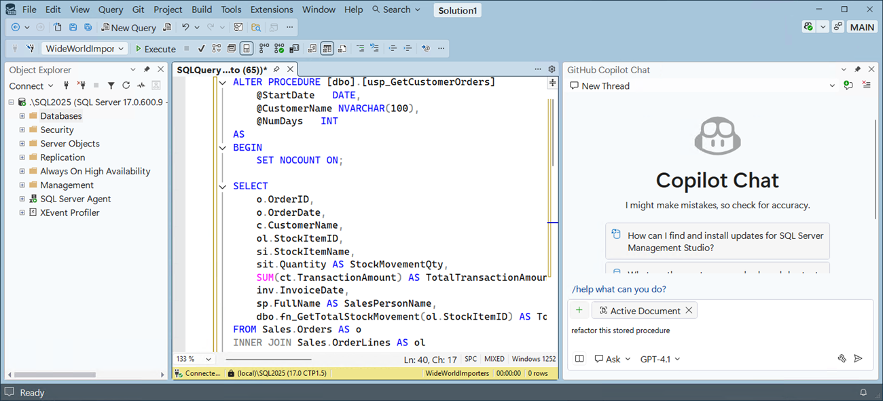
SSMS 22 — General Availability
Based on Visual Studio 2022 (64-bit)
Copilot integration (public preview)
Dark theme and multiple color themes
Git and TFS support
New connection experience
Windows ARM64 support

Slide 16
SSMS 22 — Developer Productivity Features
Query editor improvements
JSON viewer
Query hints recommendation
Zooming for grid results
Always Encrypted assessment
VS Installer / update experience

Slide 17
VS Code mssql Extension
GitHub Copilot integration for SQL authoring
Cross-platform SQL development (Windows, Mac, Linux)
Schema-aware IntelliSense
Modern development workflow integration
*Query Store Extension (self-promotion)
RIP Azure Data Studio 2017-2026

Slide 18
Developer Edition Changes
Choose your target production deployment: Standard or Enterprise
Develop and test with no license costs
Features and limits now match your target deployment edition
Two flavors: Developer Standard Edition and Developer Enterprise Edition

Slide 19
Timeline and Availability
SQL Server 2025 is now Generally Available (CU8 is current from August 13)
Upgrade methods same as previous releases
Requires Windows Server 2019 or higher, check your Linux versions

Slide 20

FAQ — Pricing, Licensing, and Editions
No pricing or licensing changes for SQL Server
Express: Now supports 50GB database, many new features included
Standard: Core limit increased from 24 → 32, memory from 128GB → 256GB, full Resource Governor
All new features are in both Standard and Enterprise Editions

Slide 21
Deprecated Features and Other Items
Discontinued: MDS, DQS, Synapse Link, Hot Add CPU, Purview Access Policies
PREVIEW_FEATURES database option: enables features in preview at GA
Power BI Report Server replaces SSRS for paid licenses
SSAS (Tabular) has performance improvements; SSIS still supported

Slide 22

Module 2
Developers, Developers, Developers

Slide 23
Built for Developers — Overview
This is the most developer-friendly SQL Server release in a decade
Native JSON, RegEx, REST APIs, Change Event Streaming
GitHub Copilot for SQL, Python driver, Data API Builder
GraphQL via Data API Builder

Slide 24
Native JSON — The Problem
Developers have been storing JSON in varchar/nvarchar columns for years
No validation, no specialized indexing, no binary optimization
JSON functions worked, but storage was inefficient

Slide 25
Native JSON — The Solution
New json data type: binary storage, up to 2GB
Automatic validation on insert/update
Compressed storage: less I/O, fewer page reads

Slide 26
Native JSON — Indexing
Dedicated json index type
Optimized for JSON path queries
Replaces the workaround of computed columns + standard indexes

Slide 27
Native JSON — New Functions
JSON_OBJECTAGG — aggregate rows into a JSON object
JSON_ARRAYAGG — aggregate rows into a JSON array
JSON_CONTAINS — test for membership
JSON_QUERY WITH ARRAY WRAPPER — wrap results as array

Slide 28
Native JSON — Use Cases
REST APIs and microservice payloads
Configuration storage
Document-style flexible schemas
E-commerce product catalogs with variable attributes
Log data and telemetry

Slide 29
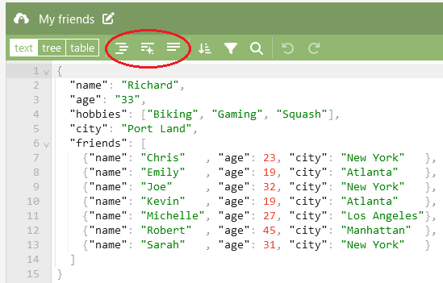
Demo
Native JSON in SQL Server 2025

Slide 30
T-SQL Enhancements — Regular Expressions
REGEXP_LIKE — test if a string matches a pattern
REGEXP_COUNT — count pattern occurrences
REGEXP_INSTR — find position of pattern match
REGEXP_REPLACE — replace pattern matches
REGEXP_SUBSTR — extract substring matching pattern
No more CLR functions or LIKE workarounds for pattern matching

Slide 31
T-SQL Enhancements — String and Data Functions
|| string concat operator (ANSI standard)
CURRENT_DATE returns DATE type
SUBSTRING() with optional length — omit to get "rest of string"
UNISTR() — Unicode string construction
DATEADD() now supports bigint

Slide 32
T-SQL Enhancements — Aggregates and Matching
PRODUCT() aggregate — multiplicative aggregate function
Fuzzy string match functions — approximate matching for data quality
BASE64_ENCODE / BASE64_DECODE — binary-to-text and back

Slide 33
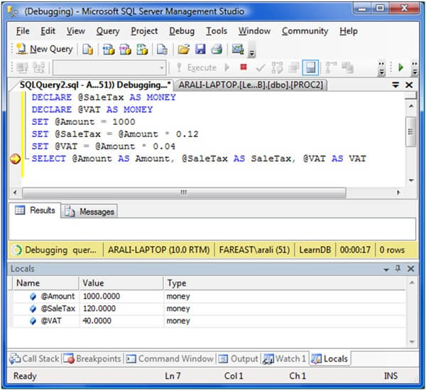
Demo
T-SQL Enhancements

Slide 34
GitHub Copilot for SQL — Overview
AI-assisted T-SQL authoring in VS Code and SSMS 22
Context-aware: understands your schema, tables, and relationships
Generate queries from natural language descriptions
Explain existing complex queries
Suggest optimizations

Slide 35
GitHub Copilot for SQL — In Action
Inline suggestions as you type
Chat-based query generation: "Show me top 10 customers by revenue last quarter"
Query explanation: highlight a query, ask "What does this do?"
Schema exploration: "What tables relate to orders?"
Notes:
Still has restricted visibility with performance DMVs so YMMV there

Slide 36
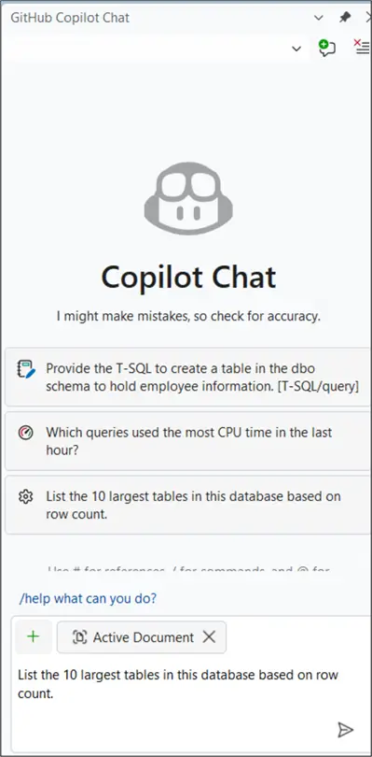
Demo
GitHub Copilot for SQL
Notes:
Copilot Free gets you…
Code Completions: Up to 2,000 real-time code suggestions per month.
Chat & Agent Requests: 50 requests per month for chatting, editing, or asking questions in the IDE.
AI Models: Access to top-tier models like GPT-4o and Claude 3.5 Sonnet.
IDE Support: Available in Visual Studio Code, Visual Studio, and JetBrains IDEs.
Accessibility: No credit card or subscription needed, just a personal GitHub account.

Slide 37
Change Event Streaming (CES) — The Problem
Change Data Capture (CDC) and Change Tracking (CT) are pull-based — applications must poll for changes
Modern architectures demand push-based, event-driven patterns
Microservices, real-time analytics, and AI agents need instant notification

Slide 38
Change Event Streaming (CES) — The Solution
Stream data changes in near-real-time from SQL directly to Azure Event Hubs or Fabric Eventstreams
Push-based delivery
"IO-less" — reads committed transactions from the transaction log
Supports DDL changes
Single destination per configuration

Slide 39
CT vs. CDC vs. CES — Comparison
Change Tracking (CT): Sync capture, system tables (minimal), row identifier only, pull-based, immediate availability
Change Data Capture (CDC): Async from log, system tables (extra logging), row identifier + data, pull-based, near-real-time, requires SQL Agent
Change Event Streaming (CES): Async from log, event stream ("IO-less"), row identifier + data + DDL, push-based, near-real-time

Slide 40
CT vs. CDC vs. CES — When to Use What
Change Tracking (CT): Sync capture, system tables (minimal), row identifier only, pull-based, immediate availability
Change Data Capture (CDC): Async from log, system tables (extra logging), row identifier + data, pull-based, near-real-time, requires SQL Agent
Change Event Streaming (CES): Async from log, event stream ("IO-less"), row identifier + data + DDL, push-based, near-real-time

Slide 41
CT vs. CDC vs. CES — When to Use What
CT: Cache invalidation, sync scenarios
CDC: Data warehousing, auditing, ETL pipelines
CES: Event-driven architectures, microservices integration, real-time analytics, cache sync, AI Agents

Slide 42
CES Architecture — F1 Race Operations Example
Scenario: An F1 team's pit wall detects live race changes via CES — position swaps, pit stops, safety car deployments
Flow: Race data changes → CES → Azure Event Hub → Azure Functions → Azure AI Foundry
AI Agent analyzes tire degradation and gap data → recommends optimal pit stop window and compound selection
Demonstrates real-world event-driven architecture with AI integration — where milliseconds matter

Slide 43
CES — Event Payload and Configuration
Event structure: operation type (INS/UPD/DEL), row data with old and new values, schema information
Configuration via T-SQL: sp_enable_event_stream, sp_create_event_stream_group, sp_add_object_to_event_stream_group
Monitoring and diagnostics via dm_change_feed_errors and dm_change_feed_log_scan_sessions
Error handling and retry behavior

Slide 44
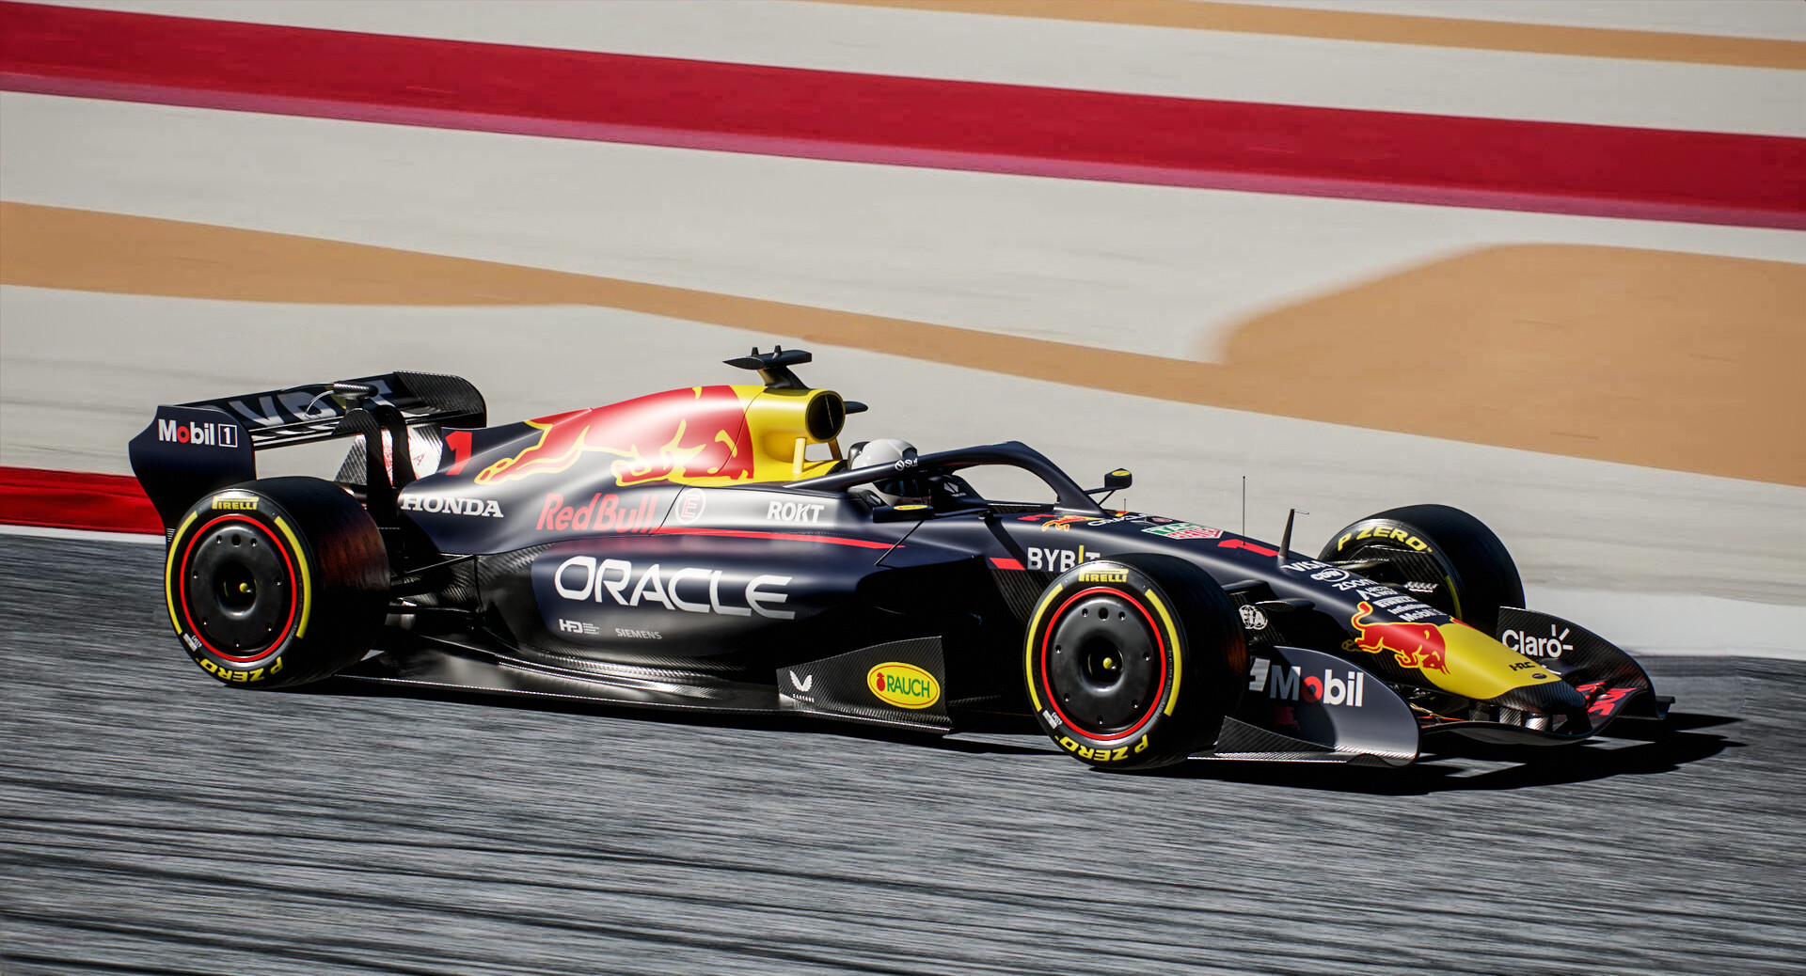
Demo
Change Event Streaming

Slide 45
REST API Connectivity
sp_invoke_external_rest_endpoint — call any REST service from T-SQL
Not limited to AI models: any REST service, webhooks, external APIs
Enables SQL Server as an orchestration point for external services

Slide 46
Data API Builder and GraphQL
Data API Builder: generate REST and GraphQL APIs from SQL Server tables
Dramatically reduces backend code for data applications
Built-in authentication, authorization, and filtering
Works with SQL Server on-premises and in Azure (and Cosmos, PostgreSQL, MySQL)

Slide 47
Microsoft Python Driver for SQL Server
Official Microsoft Python driver
First-class Python support for SQL Server connectivity
Integrates with popular data science and ML frameworks
Complements the existing ODBC, JDBC, and .NET drivers

Slide 48

Module 3
AI Built-In

Slide 49

What Problems Are We Trying to Solve with AI?
Smarter searching on existing text data
Centralized vector searching across documents and data
Building blocks for intelligent assistants, RAG, AI Agents
Taking advantage of AI in a secure and scalable fashion
Overcoming complexity by using familiar T-SQL

Slide 50

Why AI in the Database?
Your data is already in SQL Server — why move it?
Security and governance already in place
T-SQL is the language your team already knows
Combine structured queries with semantic search (hybrid search)
Reduce architectural complexity: fewer moving parts

Slide 51
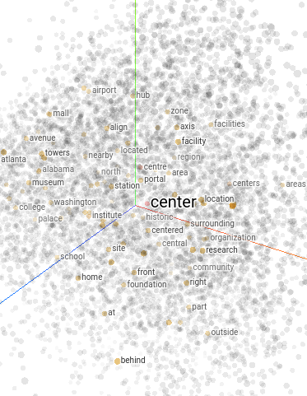
Vector Search — The Concept
Traditional search: keyword matching (LIKE, Full-Text Search)
Semantic search: meaning-based matching using embeddings
Embeddings: numerical representations that capture meaning
"The prompt may contain words not found in your data!" — this is why vector search matters

Slide 52

Vector Search with Your Data — The RAG Pattern
Prompt → Embedding Model → Vector embedding
Vector embedding compared to stored embeddings via similarity search
Results augment the original prompt
Augmented prompt sent to Language Model → Generated response
All under SQL Server security

Slide 53
Agentic RAG — Three Patterns
Vector Search: Retrieve most semantically relevant data to ground LLMs
Operational RAG: Store vectors and data together for consistency
Structured Queries: Allow LLMs to query structured data with rich metadata and query optimization
Good repo for testing: https://github.com/Azure-Samples/azure-sql-db-session-recommender

Slide 54
The Vector Data Type
New native vector data type
Stores arrays of floating-point numbers
Configurable dimensions (e.g., 1536 for OpenAI ada-002, 384 for smaller models)
Driver support across all major SQL client libraries
Binary storage optimized for efficient I/O

Slide 55
Model Definitions — CREATE EXTERNAL MODEL
Declarative model definitions using CREATE EXTERNAL MODEL
Supported API types: Azure OpenAI, OpenAI, Ollama, ONNX Runtime
Points to a REST endpoint — models run outside the engine
System view for managing model definitions
Ground or cloud deployment

Slide 56
Embedding Generation
T-SQL functions to generate embeddings from your data
Text chunking: break large text into model-appropriate segments
Multi-modal embedding support
Works with any REST-accessible embedding model
Store embeddings in vector columns alongside your relational data

Slide 57
Searching with VECTOR_DISTANCE (KNN)
Brute-force exact nearest neighbor search
Compares prompt embedding against all stored embeddings
Accurate but slower on large datasets
Good for smaller datasets or when precision is critical

Slide 58
DiskANN Index and VECTOR_SEARCH (ANN)
DiskANN: Microsoft Research technology for billion-scale approximate nearest neighbor
Create a vector index on your vector column
VECTOR_SEARCH uses the index for fast approximate results
Orders of magnitude faster than brute-force on large datasets
Index maintenance considerations
Enabled by PREVIEW_FEATURES
Index is not currently updateable

Slide 59
Hybrid Search — The Best of Both Worlds
Combine VECTOR_DISTANCE or VECTOR_SEARCH with standard SQL WHERE clauses
Example: "Find products similar to 'lightweight hiking gear' WHERE price < 100 AND category = 'Outdoor'"
Leverages the full power of the SQL query optimizer
This is what sets SQL Server apart from standalone vector databases

Slide 60
SQL Server 2025 Vector Architecture — Overview
Seven-step flow: Model Definition
Generate Embeddings
Create a Vector Index
T-SQL Prompt
Generate Prompt Embedding
Vector Search
Other Filters (hybrid search)

Slide 61
Vector Architecture — Model Definition and Embeddings (Steps 1-3)
Step 1: CREATE EXTERNAL MODEL pointing to Azure OpenAI, Ollama, etc.
Step 2: T-SQL to generate embeddings from your existing data and store in vector column
Step 3: Create DiskANN vector index for fast retrieval
Models run outside the engine — you choose where

Slide 62
Vector Architecture — Search and Retrieval (Steps 4-7)
Step 4: User submits a natural language prompt
Step 5: Same model generates an embedding for the prompt
Step 6: VECTOR_DISTANCE or VECTOR_SEARCH compares prompt to stored data
Step 7: Standard SQL WHERE clauses for hybrid filtering
Extensibility via sp_invoke_external_rest_endpoint for any REST model endpoint

Slide 63

Security, SQL, and AI
You control all access with SQL security
You control which AI models to use
AI models (ground and/or cloud) are isolated from SQL Server
Use RLS, TDE, and Dynamic Data Masking on vector data
Track everything with SQL Server Auditing

Slide 64

AI Provider Flexibility
Azure OpenAI — cloud hosted, enterprise grade
OpenAI — direct API access
Ollama — locally hosted open-source models (Llama, Mistral, etc.)
ONNX Runtime — local inference engine (PREVIEW_FEATURES)
KServe, vLLM, NVIDIA Triton — network hosted
Hugging Face models via compatible serving layers
sp_invoke_external_rest_endpoint for anything else

Slide 65

Demo
Intelligent Search in SQL Server 2025

Slide 66

Lunch

Slide 67

The Core Engine: Secure by Default

Slide 68
Security Vision for SQL Server 2025
Microsoft Entra authentication (building on SQL 2022)
Managed Identity support — the big new story
Microsoft Defender integration
Passwordless everywhere

Slide 69
Managed Identity — Inbound Connections
System-assigned managed identity for SQL Server
Passwordless authentication for applications connecting to SQL
Eliminates credential management overhead
Reduces attack surface — no passwords to rotate or leak
Enabled by Azure Arc/Entra
Notes:
Let’s call out what this doesn’t work with - yet

Slide 70
Managed Identity — Outbound Connections
Backup to URL with managed identity
Managed identity support for EKM (Extensible Key Management)
Managed identity for AI model access
No more storing secrets in SQL Server for external service calls

Slide 71
Microsoft Entra Enhancements
Entra logins with non-unique display names
Broader Entra integration scenarios
Custom password policy on Linux

Slide 72
Encryption and Protocol Enhancements
OAEP support for encryption (replacing legacy PKCS#1 v1.5)
PBKDF password hashing — modern key derivation
TDS 8.0 / TLS 1.3 support for tools
Security cache improvements — better application concurrency under security operations
Notes:
Need to dig in a little more on this slide
This is a good place to talk about why modernizing your security approach is good…even if you’re good where you are, bad actors are modernizing every day

Slide 73
Microsoft Defender for SQL
Threat detection for SQL Server on-premises via Arc
Vulnerability assessment and recommendations
Alerting on suspicious database activities
Unified security posture management in Azure Portal

Slide 74

Demo
Managed Identity and Security

Slide 75

The Core Engine: Mission Critical Performance
SQL Server 2025

Slide 76
Mission Critical Engine — Three Investment Areas
Improve
Improve Concurrency: Optimized Locking, tempdb governance
Accelerate
Accelerate Performance: IQP enhancements, batch mode, columnstore
Increase
Increase HADR: (covered in Module 6)
Design
Design principle: "Get faster with no code changes required"

Slide 77
Optimized Locking — The Problem
Traditional lock escalation: row > page > table
Causes blocking, deadlocks, and unpredictable concurrency
Applications forced to design around locking internals
Lock memory consumption grows with concurrent workloads

Slide 78
Optimized Locking — The Solution
Transaction ID (TID) locking replaces traditional escalation
Hint free lock management built into the engine
Already proven in Azure SQL Database
No application code changes required

Slide 79
Optimized Locking — Benefits
Dramatically improved concurrency for update-heavy workloads
Reduced lock memory overhead
Eliminated lock escalation blocking scenarios
Simpler troubleshooting — fewer locking-related issues

Slide 80

Demo
Improving Application Concurrency with Optimized Locking
Notes:
https://github.com/microsoft/bobsql/tree/master/sql2025book/ch7%20-%20Core%20Engine/optimized_locking

Slide 81
Intelligent Query Processing — What's New
CE (Cardinality Estimator) feedback for expressions
Optional parameter plans optimization (building on PSP from 2022)
DOP (Degree of Parallelism) feedback — now ON by default
Key theme: the optimizer learns and adapts, fewer code changes needed

Slide 82
Optimized sp_executesql
Better plan reuse for parameterized queries
Reduces compilation overhead
Significant impact for ORM-generated workloads (Entity Framework, Hibernate, etc.)
No application changes required

Slide 83

Batch Mode Optimizations
Batch mode: processes ~900 rows at a time in columnar arrays (~64KB pages)
Leverages vectorized CPU execution (SIMD/AVX instructions)
Works for both columnstore AND rowstore SQL Server 2025 further optimizes batch mode for rowstores
Especially benefits aggregate queries and large scans

Slide 84
Columnstore Index Improvements
Better ordered columnstore indexing
Columnstore index maintenance improvements
Performance enhancements for columnstore queries
Segment elimination improvements

Slide 85

Query Store Enhancements
Query Store on readable secondary replicas
Persist statistics on secondaries
Better insight into read workload performance on AG replicas
Enhanced diagnostics for query performance regression

Slide 86
Tempdb Resource Governance
Control tempdb space consumption using Resource Governor workload groups
Prevent runaway queries from exhausting tempdb
Per-group tempdb space limits
Full Resource Governor now available in Standard Edition!

Slide 87

Demo
Tempdb Resource Governance
Notes:
https://github.com/microsoft/bobsql/tree/master/sql2025book/ch7%20-%20Core%20Engine/tempdbrg

Slide 88
ABORT_QUERY_EXECUTION Hint
New query hint to forcefully terminate long-running queries after a threshold
Practical for BI/reporting environments with unpredictable query patterns
Complements Query Governor and Resource Governor

Slide 89

Demo
ABORT_QUERY_EXECUTION
Notes:
https://github.com/microsoft/bobsql/tree/master/sql2025book/ch7%20-%20Core%20Engine/tempdbrg

Slide 90
Other Performance Enhancements
ADR (Accelerated Database Recovery) in tempdb
tmpfs support for tempdb on Linux
Remove In-Memory OLTP from a database (finally!)
Persisted statistics for readable secondaries
Change tracking cleanup improvements

Slide 91

Break

Slide 92
The Core Engine: Availability Groups

Slide 93
AG Enhancements — The Big Theme
"Customers love Always On Availability Groups but there are situations where they get stuck in a not synchronizing state”
SQL Server 2025 enhances AG algorithms for reliable failover
Better diagnostics, better tuning, better backups

Slide 94
Reliable Failover
Fast failover for persistent AG health events
Enhanced algorithms to prevent "stuck in not synchronizing" state
Switching to resolving state improvements
Reduced manual intervention during failover scenarios

Slide 95
Improved Health Diagnostics
Better visibility into AG state and health
Enhanced DMVs and diagnostic views
Easier root cause analysis for AG issues
Proactive detection of health degradation

Slide 96
Communication and Tuning
Communication control flow tuning
AG group commit waiting tuning — optimize for throughput vs. latency
Async page request dispatching
Fine-grained control over AG behavior

Slide 97

AG Configuration Enhancements
Remove listener IP address — simplify configurations
NONE routing option for routing lists
Contained AG support for Distributed Availability Groups (DAG)
DAG sync improvements

Slide 98
Backup Enhancements — ZSTD Compression
ZSTD backup compression algorithm
Significantly faster and better compression ratios than legacy algorithm
Reduced backup windows and storage costs
Easy to enable — just specify the new compression option

Slide 99
Backup Enhancements — Azure and Secondary
Backups on secondary replicas — offload backup workload from primary
Backup to Azure immutable storage — compliance and ransomware protection
Backup to URL with Managed Identity — passwordless backup to Azure
Combines with Arc for seamless configuration with Azure Backup

Slide 100
Demo
Availability Group Improved Health Check Diagnostics

Slide 101
WSFC Cluster Log – New and Improved
[Verbose] 000035b8.00001a64::2024/04/18-23:56:35.536 ERR [RES] SQL Server Availability Group: [hadrag] Failure detected, diagnostics heartbeat is lost
[Verbose] 000035b8.00001a64::2024/04/18-23:56:35.536 WARN [RES] SQL Server Availability Group: [hadrag] AG health check failed, logging perf counter data collected so far
[Verbose] 000035b8.00001a64::2024/04/18-23:56:35.536 WARN [RES] SQL Server Availability Group: [hadrag] Date/Time, Processor time(%), Available memory(bytes), Avg disk read(secs), Avg disk write(secs)
[Verbose] 000035b8.00001a64::2024/04/18-23:56:35.536 WARN [RES] SQL Server Availability Group: [hadrag] 4/18/2024 23:55:25.0, 21.857418, 3248349184.000000, 0.000000, 0.000253
[Verbose] 000035b8.00001a64::2024/04/18-23:56:35.536 WARN [RES] SQL Server Availability Group: [hadrag] 4/18/2024 23:55:35.0, 11.442071, 3255394304.000000, 0.000907, 0.000382
[Verbose] 000035b8.00001a64::2024/04/18-23:56:35.536 WARN [RES] SQL Server Availability Group: [hadrag] 4/18/2024 23:55:45.0, 9.979768, 3253981184.000000, 0.000415, 0.000549
[Verbose] 000035b8.00001a64::2024/04/18-23:56:35.536 WARN [RES] SQL Server Availability Group: [hadrag] 4/18/2024 23:55:55.0, 9.762850, 3251232768.000000, 0.001989, 0.000638
[Verbose] 000035b8.00001a64::2024/04/18-23:56:35.536 WARN [RES] SQL Server Availability Group: [hadrag] 4/18/2024 23:56:5.0, 9.827234, 3250462720.000000, 0.002250, 0.001418
Notes:
Remember this is SQL log info in the cluster log…now it’s a one-stop shop

Slide 102
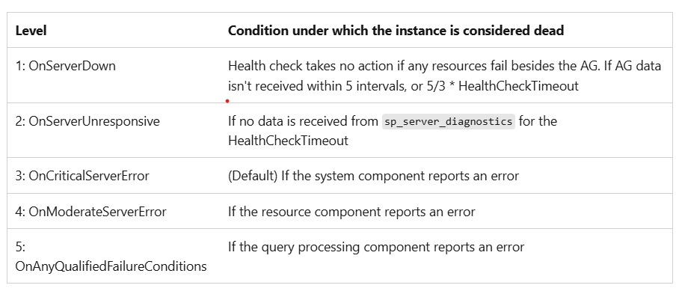
Health Check Timeout Flexibility
Notes:
Should we briefly talk contained AG improvements?

Slide 103
Demo
Availability Group Tuning

Slide 104
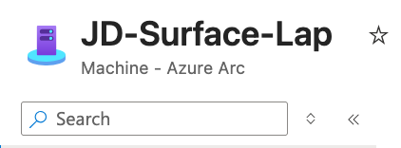
Connected with Azure Arc

Slide 105
Azure Arc for SQL Server — Why It Matters
Arc enables cloud management for on-premises and multi-cloud SQL Server
Foundation for Managed Identity, Entra authentication, Defender, Azure policies
The bridge between on-premises SQL and Azure services

Slide 106
What Arc Enables — Security
Managed Identity (inbound + outbound)
Entra authentication for on-premises SQL Server
Microsoft Defender for SQL threat detection
Unified security posture in Azure Portal

Slide 107
What Arc Enables — Management
Azure Portal visibility for all SQL instances
Azure Policy enforcement for SQL Server
Inventory and governance across your estate
RBAC through Azure

Slide 108
What Arc Enables — AI and Fabric
Secure AI model access via Arc-managed credentials
Fabric mirroring configuration and management
Backup to URL with Managed Identity
Backup to Azure immutable storage

Slide 109
Arc Architecture and Onboarding
Arc agent installation and registration
Connecting SQL Server instances to Azure Arc
Azure resource representation of on-premises
SQL instances Network requirements and connectivity options

Slide 110

Demo
Azure Arc Integration

Slide 111
Integrate Your Data with Microsoft Fabric

Slide 112

Why Fabric Mirroring?
Offload read/analytics workloads from production SQL Server
No ETL pipeline required
Near-real-time data availability in Fabric
Unlock Power BI, Copilot, and AI/ML capabilities on operational data

Slide 113

Mirroring Architecture
SQL Server 2025 → Change Feed → OneLake (Delta Parquet format)
Reads committed transaction log changes
Pushes automatically to Microsoft Fabric OneLake
SQL Analytics Endpoint in Fabric for querying

Slide 114
Mirroring — What It Unlocks
Unified analytics: combine SQL Server data with other Fabric data sources
Power BI real-time dashboards on operational data
Lakehouse and warehouse integration
AI/ML training data pipelines
Cross-platform data exploration

Slide 115
Mirroring — Configuration and Management
Configuration via Arc and Azure Portal
Monitoring latency and sync status
Table selection and filtering
Security and access control

Slide 116
Wrap Up
Call To Action

Slide 117
Edition Highlights Recap
Express: 50GB database, many new features
Standard: 32 cores, 256GB RAM, full Resource Governor
Enterprise: All features, DiskANN vector index, all AG enhancements
Developer: Free for dev/test, Standard and Enterprise flavors

Slide 118


Sound off.
The mic is all yours.
Influence the product roadmap.
Join the Fabric User Panel
Share your feedback directly with our Fabric product group and researchers.
https://aka.ms/JoinFabricUserPanel
Join the SQL User Panel
Influence our SQL roadmap and ensure it meets your real-life needs
https://aka.ms/JoinSQLUserPanel

Slide 119
How was
the session?
Search for in the
App Store or Google Play
Fill out the Session Surveys in the
TechCon 365, DATACON, PWRCON
Event App and be eligible to WIN PRIZES!

Slide 120
Resources
Blogs: aka.ms/sqlserver2025
Docs: aka.ms/sqlserver2025docs
Demos: aka.ms/sqlserver2025demos
Book: aka.ms/sql2025book — SQL Server 2025 Unveiled by Bob Ward (Apress)
Download: aka.ms/getsqlserver2025

Slide 121

Questions

