Slide 2

Building the Well-Architected Framework for Microsoft Fabric
Joey D’Antoni
Joeydantoni.com
joey@joeydantoni.com

Slide 3

Downloads
bit.ly/FabricWAF
(also github.com/jdanton)

Slide 4

Why This Talk?
Azure WAF is mature — Fabric is still the Wild West
Fabric collapses compute, storage, and services into a single platform — different architectural thinking required
Governance patterns that work in Azure don't translate 1:1

Slide 5

A Couple of Things to Note
Don’t let perfect be the enemy of good.
Getting to ”good” will be hard enough.
If you are coming from administrating/engineering similar systems you will get frustrated.
Balance security and controls with user productivity

Slide 6
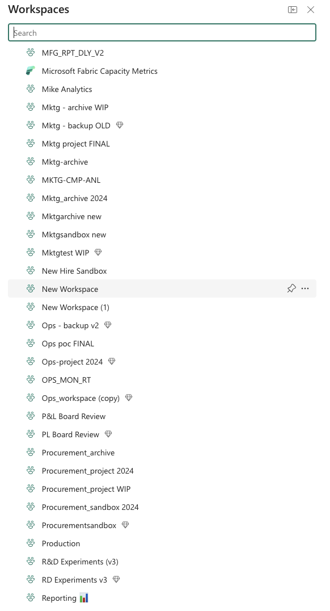
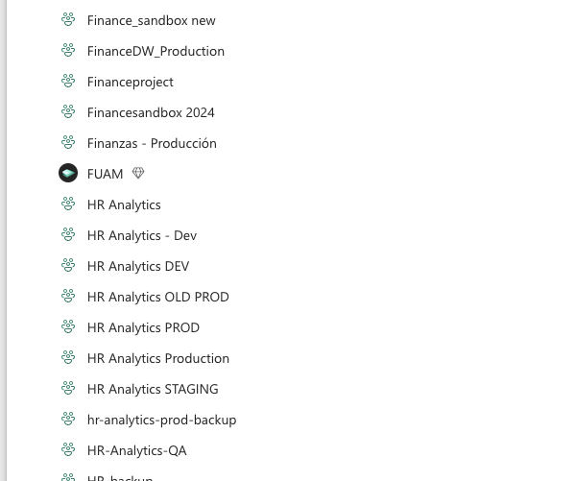
Is this Your Fabric Environment?

Slide 7

Azure Well-Architected Framework (WAF) Refresher: The Five Pillars
Operational Excellence
Security
Reliability
Cost Optimization
Performance Efficiency
Brief reminder of how these apply in Azure
Resource groups
Management Groups
Subscriptions
Azure Policy
Role-based access control (RBAC)

Slide 8
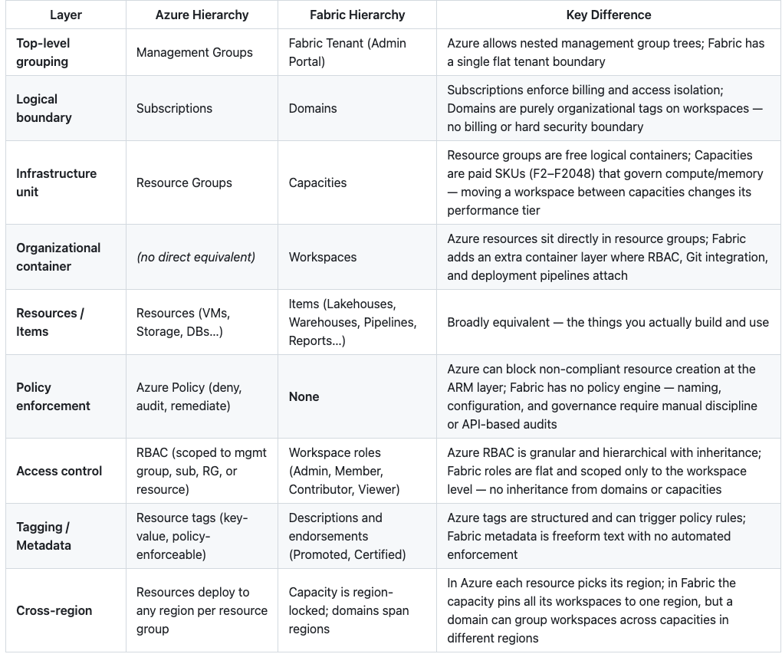
Key Differences Between Fabric and Azure

Slide 9

Pillar 1: Operational Excellence

Slide 10
Capacity as the New Subscription
In Azure you segment by subscriptions and resource groups — in Fabric, the capacity is your primary unit of isolation
Capacities should be segmented by business unit (Sales/Finance), function (Warehouse, Lakehouse, Real-Time), and environment (Dev / Test / Prod)
Example topology: Sales-Analytics-Prod, Finance-ETL-Dev, Marketing-Reporting-Test

Slide 11

Why Capacity Segmentation Matters
Performance isolation: a runaway Spark job in Dev shouldn't throttle Prod dashboards
Cost attribution: chargeback/showback per business unit becomes possible
Governance boundary: permissions and workspace assignment scoped per capacity

Slide 12
Naming Conventions
bit.ly/FabricWAF
Establish a standard early: {BU}-{Function}-{Env}-{Region} (e.g., fin-dw-prod-eus)
Apply consistently across capacities, workspaces, lakehouses, warehouses, and pipelines
Fabric has no policy engine to enforce naming — discipline and automation are your only tools

Slide 13
Tagging
Tag capacities and workspaces with: Owner, Cost Center, Environment, Data Classification
01
Use tags to drive automation (e.g., auto-pause Dev capacities after hours)
02
Challenge: tagging support in Fabric is limited compared to Azure Resource Manager — supplement with a CMDB or metadata catalog
03

Slide 14
Deploying Code
Use Git integration as your single source of truth
Deploy through Fabric deployment pipelines, not manual promotion
Parameterize everything that changes between environments
Automate with the Fabric REST APIs in your CI/CD pipeline

Slide 15
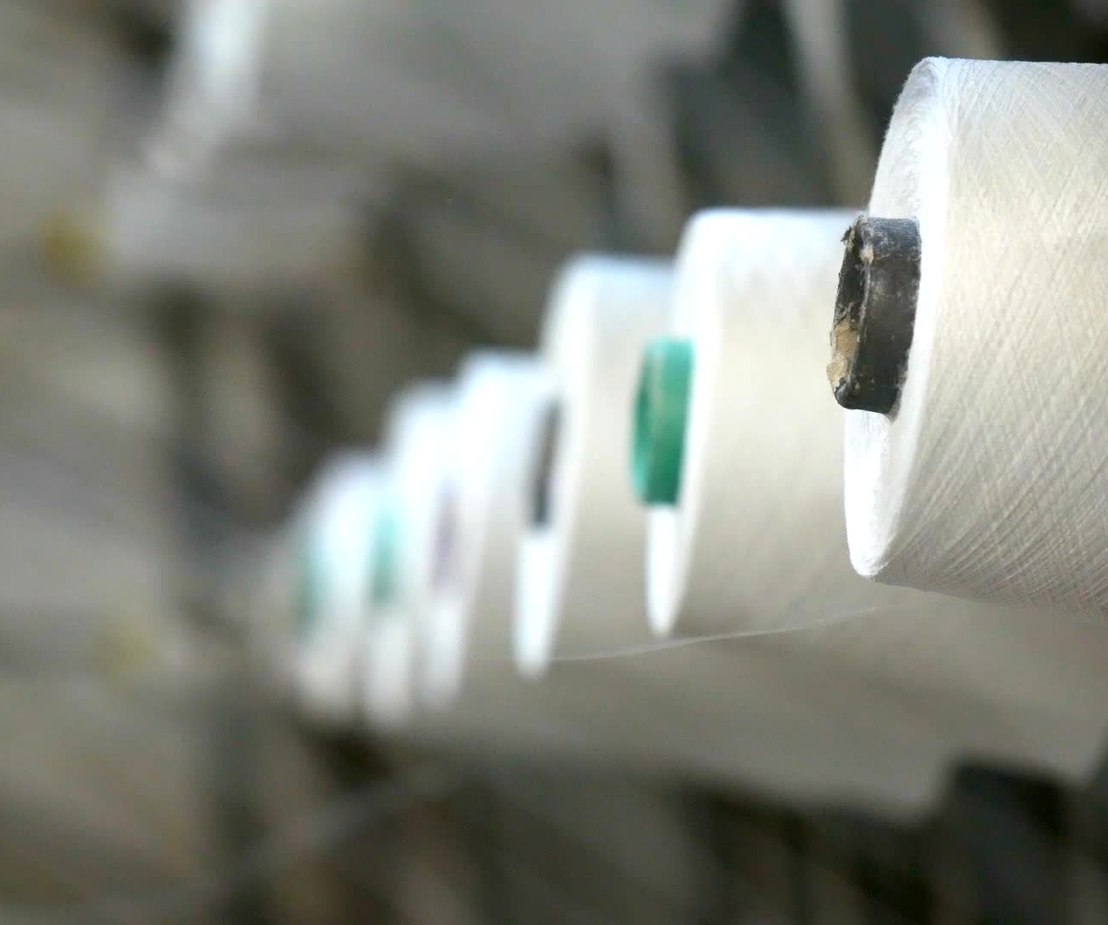
The Governance Gap: No Azure Policy for Fabric
Azure Policy can't enforce rules inside Fabric workspaces today
No built-in guardrails for workspace creation, lakehouse proliferation, or configuration drift
Mitigations: Fabric REST APIs + automation, admin monitoring APIs, and organizational process

Slide 16

Pillar 2: Security

Slide 17

RBAC: The Fabric Reality Check
No permission inheritance — each workspace is a silo; no assign-once-flow-down model
Only 4 roles, no custom roles — can't separate "pipeline operator" from "lakehouse editor"
Contributor+ bypasses data security — OneLake RLS/CLS only constrains Viewers
OneLake security gaps — RLS is static, limited to Delta tables, engine-dependent
No deny assignments — can't explicitly block access granted by a group
No built-in access reviews — permission sprawl is invisible without custom tooling
No ABAC or PIM — no attribute-based conditions, no just-in-time elevation
No dynamic RLS — can't resolve user attributes at query time for row filtering
Azure has hundreds of granular built-in roles — Fabric has a handful (Admin, Member, Contributor, Viewer)
Workspace-level RBAC is coarse; item-level permissions are limited and inconsistent across item types
Plan for this: use workspace segmentation as a proxy for fine-grained access control

Slide 18
Identity and Access Patterns
Entra ID (Azure AD) is your identity plane — leverage Conditional Access and PIM, it’s all you’ve got.
Service principals for automation and CI/CD, but be aware of current Fabric SP limitations
Minimize personal accounts in production workspaces

Slide 19
Private Networking & Data Exfiltration
Fabric supports Managed Private Endpoints and Private Link for inbound connectivity
Configure VNet data gateways for secure access to on-prem and IaaS data sources
Disable public access to capacities where compliance requires it
Challenge: not all Fabric experiences support private networking equally — know the gaps

Slide 20
Audit & Compliance Shortfalls
Azure has Activity Log, Diagnostic Settings, Defender for Cloud — Fabric has the Admin Monitoring workspace and activity log APIs
Audit footprint is narrower: limited event types, no native SIEM integration out of the box
Recommendation: export Fabric activity logs to Log Analytics or Sentinel and build custom detection rules

Slide 21
Security Recommendations
Workspace-per-security-boundary: Split items that need different access into separate workspaces rather than trying to share one workspace with complex item-level permissions
Security groups over individuals: Assign Entra security groups to workspace roles, not individual users — easier to audit and rotate
Least privilege by default: Default to Viewer; elevate to Contributor only for specific needs with documented justification
Automated audits: Use the Fabric Admin REST API to scan workspace memberships on a schedule and flag Contributor+ sprawl
Separate prod from dev: Never give developers Contributor on production workspaces — use deployment pipelines to promote content instead
Document everything: Since there's no policy engine to encode your rules, write them down and socialize them relentlessly

Slide 22

Pillar 3: Reliability

Slide 23
Capacity Reliability Considerations
Fabric capacities can throttle and even suspend under sustained overload — understand the smoothing and throttling model
Separate workloads by criticality: don't run exploratory notebooks on the same capacity as mission-critical reporting
This reinforces the BU / Function / Environment segmentation argument

Slide 24
Disaster Recovery & Business Continuity
Fabric is region-pinned — understand your BCDR story for regional outages
OneLake data replication options and workspace-level BCDR are still maturing
Maintain pipeline definitions and semantic model metadata in source control (Git integration) as your recovery baseline

Slide 25

Pillar 4: Cost Optimization

Slide 26
Understanding the Fabric Cost Model
Capacity Units (CUs) are your currency — consumed differently by Spark, SQL, Power BI, Data Pipelines
Segmented capacities make cost attribution straightforward via Azure Cost Management
Right-size capacities per environment: Prod might be F64, Dev might be F2

Slide 27
Cost Controls & Automation
Auto-pause / auto-scale strategies for non-production capacities
Monitor CU consumption with the Fabric Capacity Metrics app (or use FUAM)
Set budgets and alerts at the Azure resource level (the capacity itself is an ARM resource)

Slide 28

Pillar 5: Performance Efficiency

Slide 29
Workload Isolation = Performance Predictability
Co-located workloads compete for the same CU pool — isolation by capacity is your primary lever
Use capacity segmentation to guarantee SLAs for Prod analytics
Monitor for background operations (OneLake indexing, table maintenance) consuming capacity
Use Surge Protection to set a maximum capacity unit (CU) spend per workspace, expressed as a percentage, within a rolling 24-hour window.

Slide 30

Lakehouse & Warehouse Design Patterns
Medallion architecture (Bronze/Silver/Gold) as an organizational best practice
V-Order and file compaction for read-optimized performance
Choose Warehouse vs. Lakehouse based on query pattern, not just habit
Lakehouse when your workload is Spark-heavy, schema-on-read, or you need to store unstructured/semi-structured data alongside tables
Warehouse when your team thinks in T-SQL, needs full DML (UPDATE/DELETE/MERGE), or you're migrating from a traditional SQL DW
You can use both in the same workspace — lakehouse for ingestion and transformation, warehouse for curated serving. They share OneLake storage underneath.
Use OneLake shortcuts to reference data across lakehouses instead of copying it — one physical copy, many logical access points
Don't create one mega-lakehouse with everything — you lose the ability to apply different security, lifecycle, and capacity boundaries
Resist the temptation to put all three layers in one lakehouse — separation gives you independent RBAC, cleaner lineage, and simpler OneLake security roles

Slide 31

Bringing It All Together

Slide 33
What's Missing and What's Coming
Honest assessment: Fabric governance is still catching up to Azure (and other platforms)
Key gaps to watch: granular RBAC, enhanced auditing, BC/DR maturity
Gaps to ask for: Azure Policy, Azure Monitor
The framework you build now positions you to adopt these features as they ship
It only took three years to get workspace identity fixed ☹

Slide 34
Key Takeaways
Treat capacities like subscriptions — segment deliberately by BU, function, and environment
Don't assume Azure governance patterns work in Fabric — know the gaps
Compensate with naming standards, tagging, automation, and monitoring
Build the framework now; the platform will grow into it

Slide 35

Q&A

Slide 36
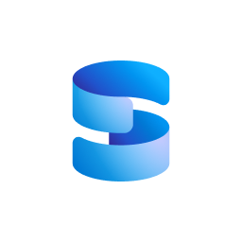

Sound off.
The mic is all yours.
Influence the product roadmap.
Join the Fabric User Panel
Share your feedback directly with our Fabric product group and researchers.
https://aka.ms/JoinFabricUserPanel
Join the SQL User Panel
Influence our SQL roadmap and ensure it meets your real-life needs
https://aka.ms/JoinSQLUserPanel

Slide 38
Sound off.
The mic is all yours.
Influence the product roadmap.
Join the Fabric User Panel
Share your feedback directly with our Fabric product group and researchers.
https://aka.ms/JoinFabricUserPanel
Join the SQL User Panel
Influence our SQL roadmap and ensure it meets your real-life needs
https://aka.ms/JoinSQLUserPanel

