Slide 1

Preventing HTML injection vulnerabilities

Slide 2
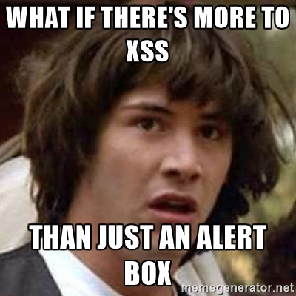
What is an HTML injection vulnerability?
"><img src=X onerror="alert(localStorage.getItem('id_token'))">
Notes:
When a user can inject arbitrary HTML code into a web page.
Typically used to inject scripts
User input from text field, stored in db and returned by API, addressbar
<show example pages, docs feature progression>
XSS consequences
Sharability

Slide 3
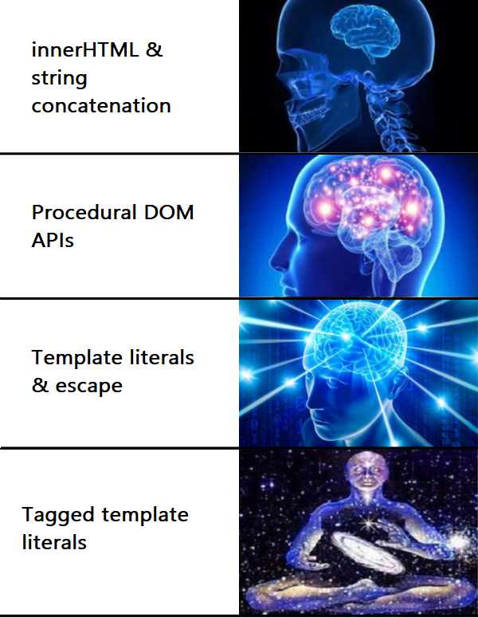
Evolution

Slide 4
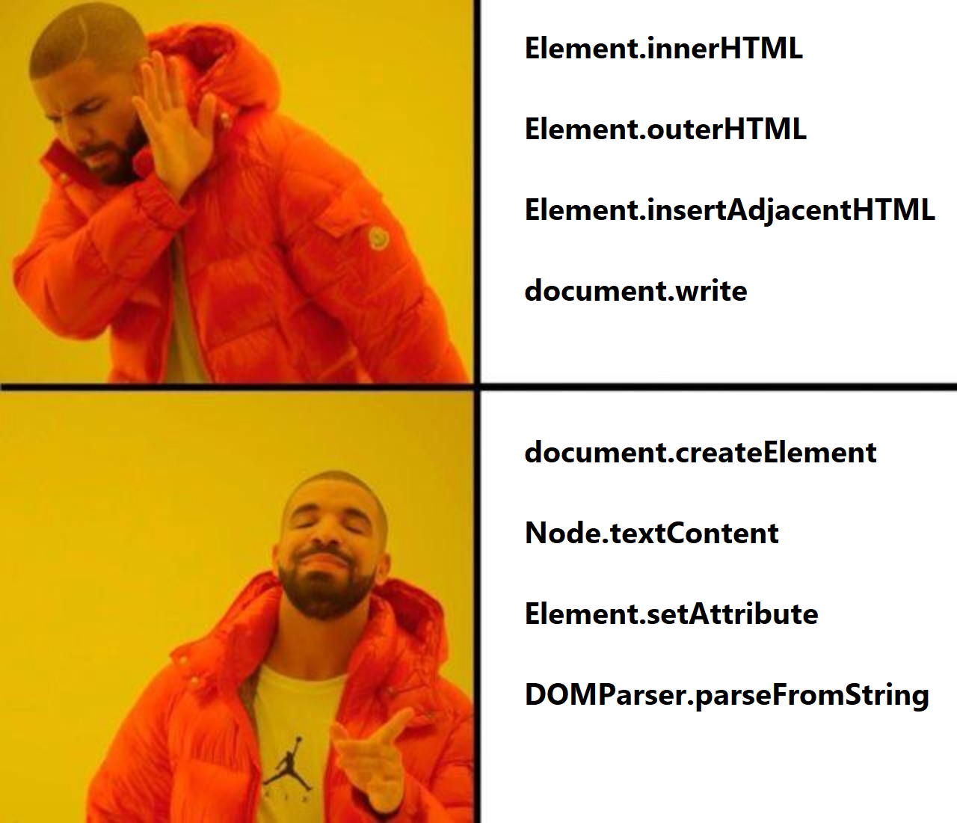
DOM APIs

Slide 5

Open Redirects

