Slide 1
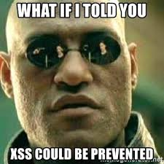
Preventing HTML injection vulnerabilities

Slide 2
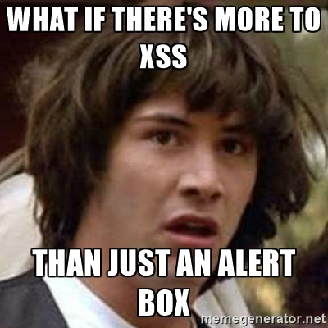
What is an HTML injection vulnerability?
"><img src=X onerror="alert(localStorage.getItem('id_token'))">
Notes:
Heard of HTML Injection?
How about XSS?
When a user can inject arbitrary HTML code into a web page.
Typically used to inject scripts Steal credentials, log keys, make API calls impersonating the user.
On Docs, the user’s azure creds are in local storage.
Learn features are driving more users to sign in.
Potential impact is growing all the time.
Persistable/shareable - As an attacker you want to be able to share a link to a page with your exploit as many users as possible
I’m going to show you some of the bugs we’ve had in our **client side** rendering, and the coding patterns that enabled them.
You’ll see that these types of bugs are very easy to cause.
had a number of these bugs on docs
User input from text field, stored in db and returned by API, addressbar
<show example pages, docs feature progression>

Slide 3
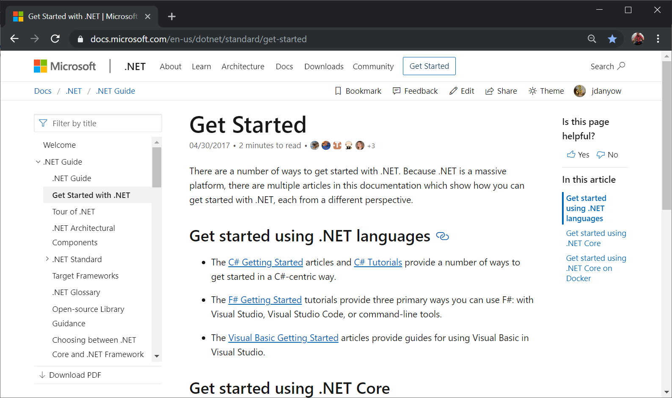
Notes:
Conceptual & Reference – common pages

Slide 4
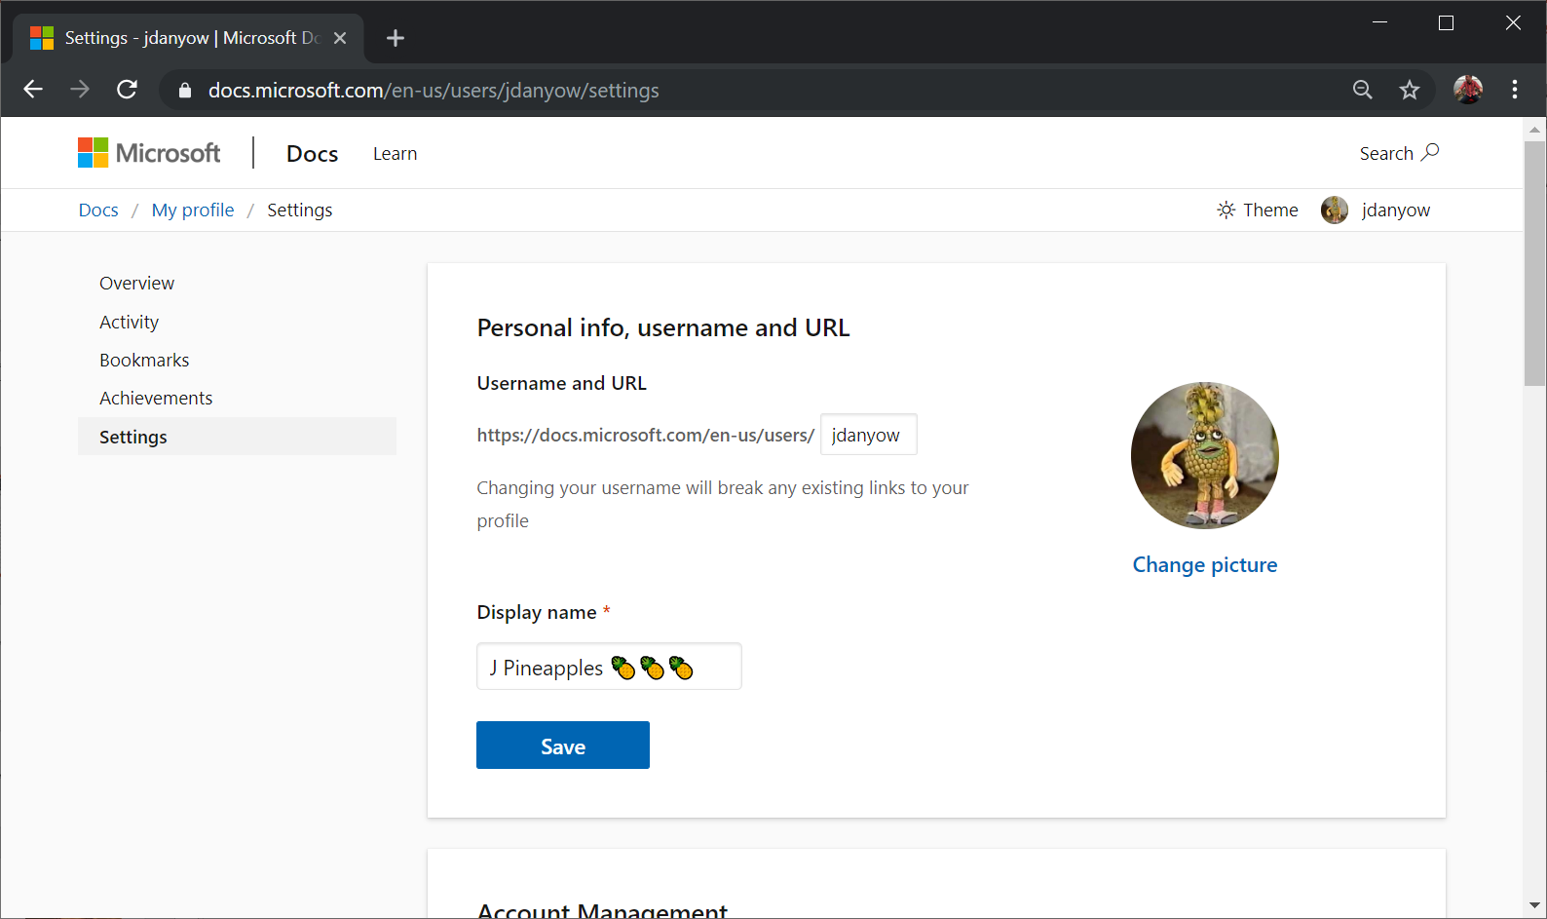
Notes:
Profile
Several bugs
Crafting a display name to inject html, sharing on twitter

Slide 5
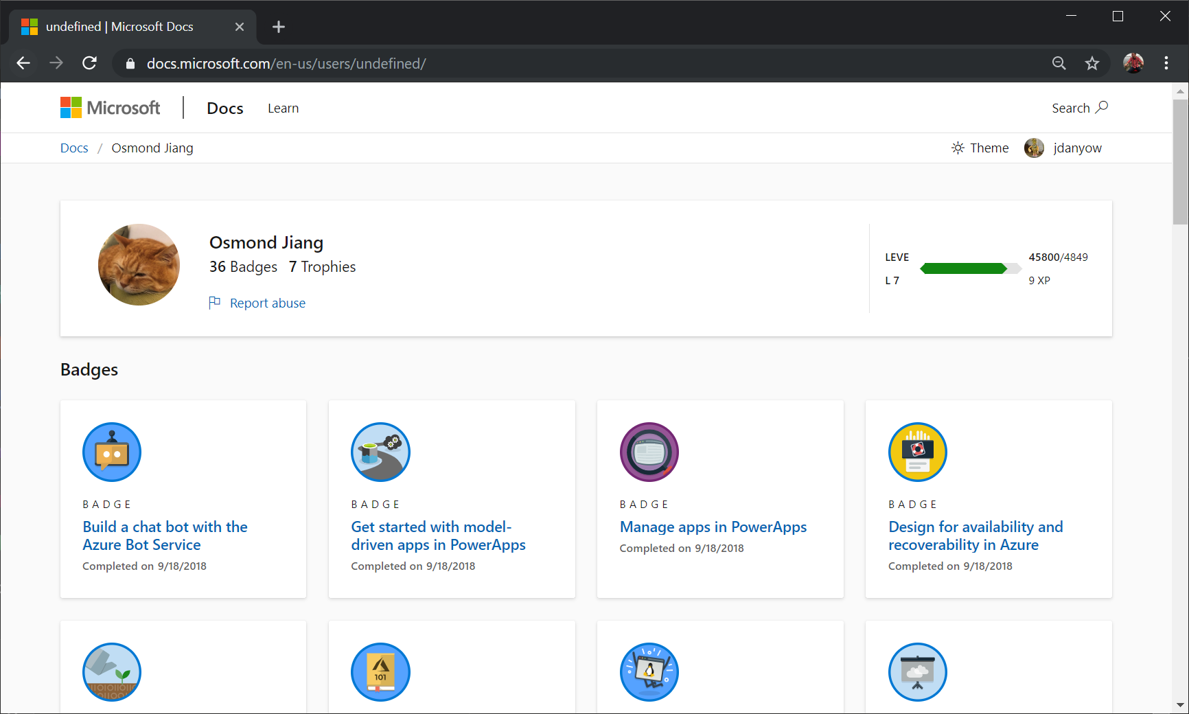
Notes:
Not always input, it can be lack of input.
Osmond chose a display name that took advantage of a bug in our function to retrieve the docs user id from the url.

Slide 6
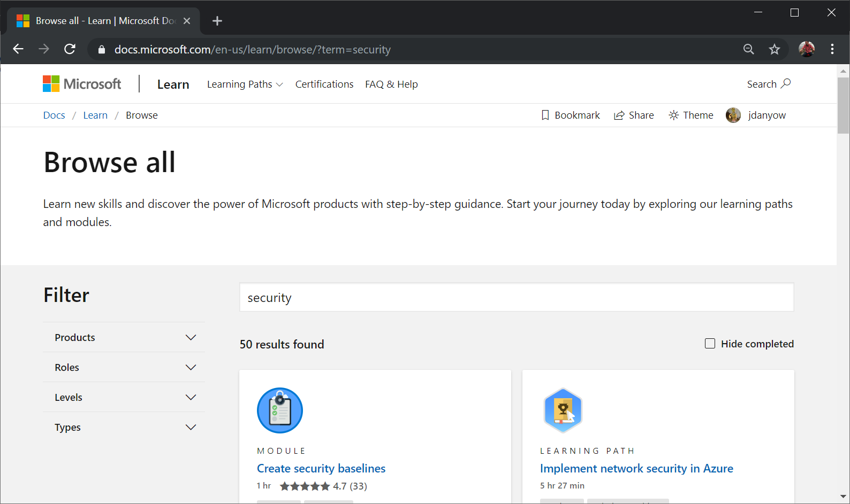

Slide 7
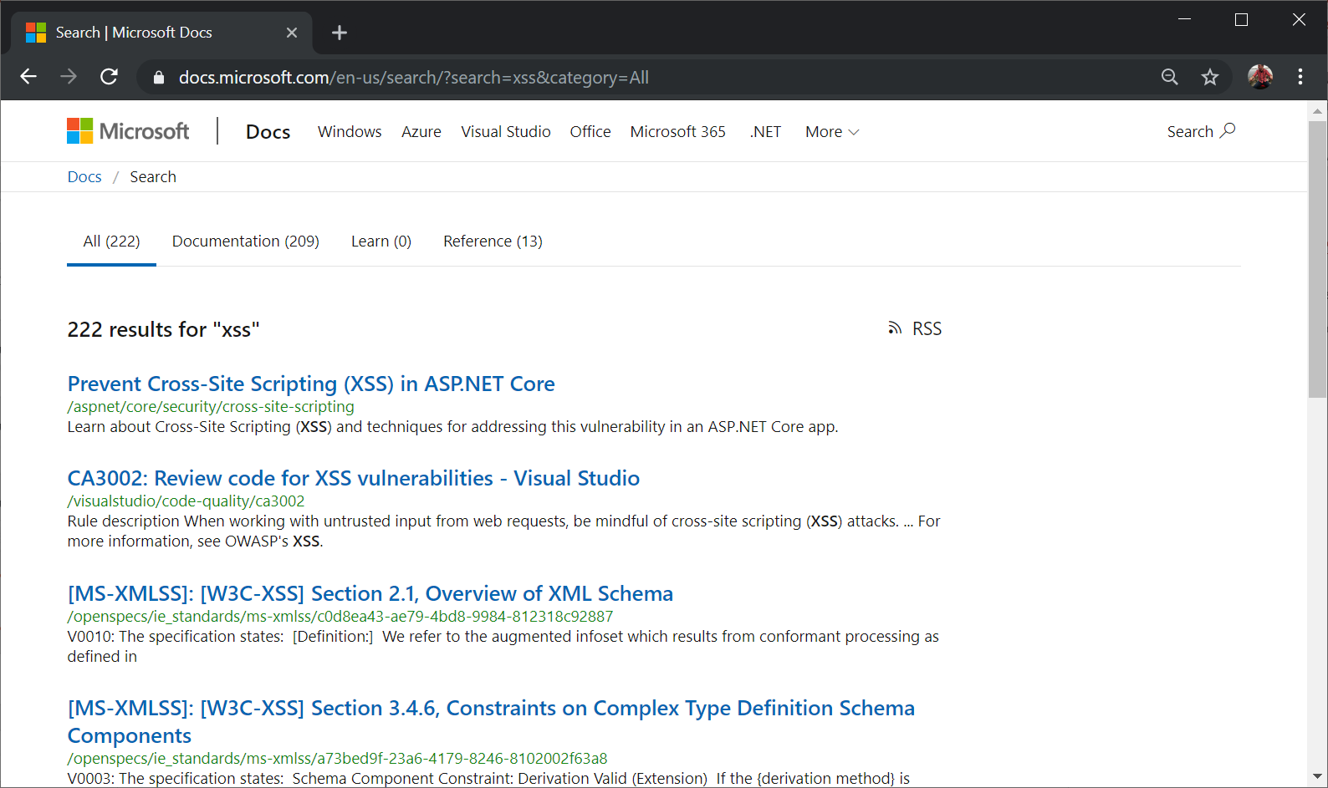

Slide 8
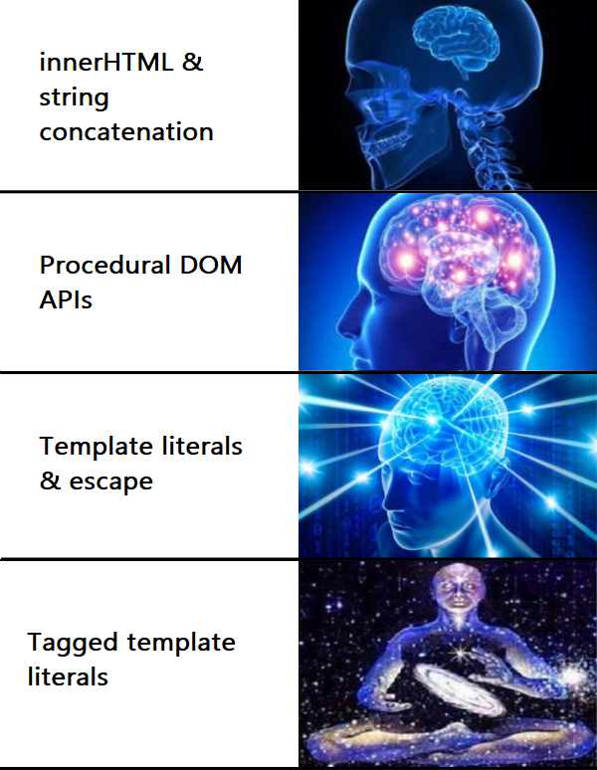
Evolution

Slide 9
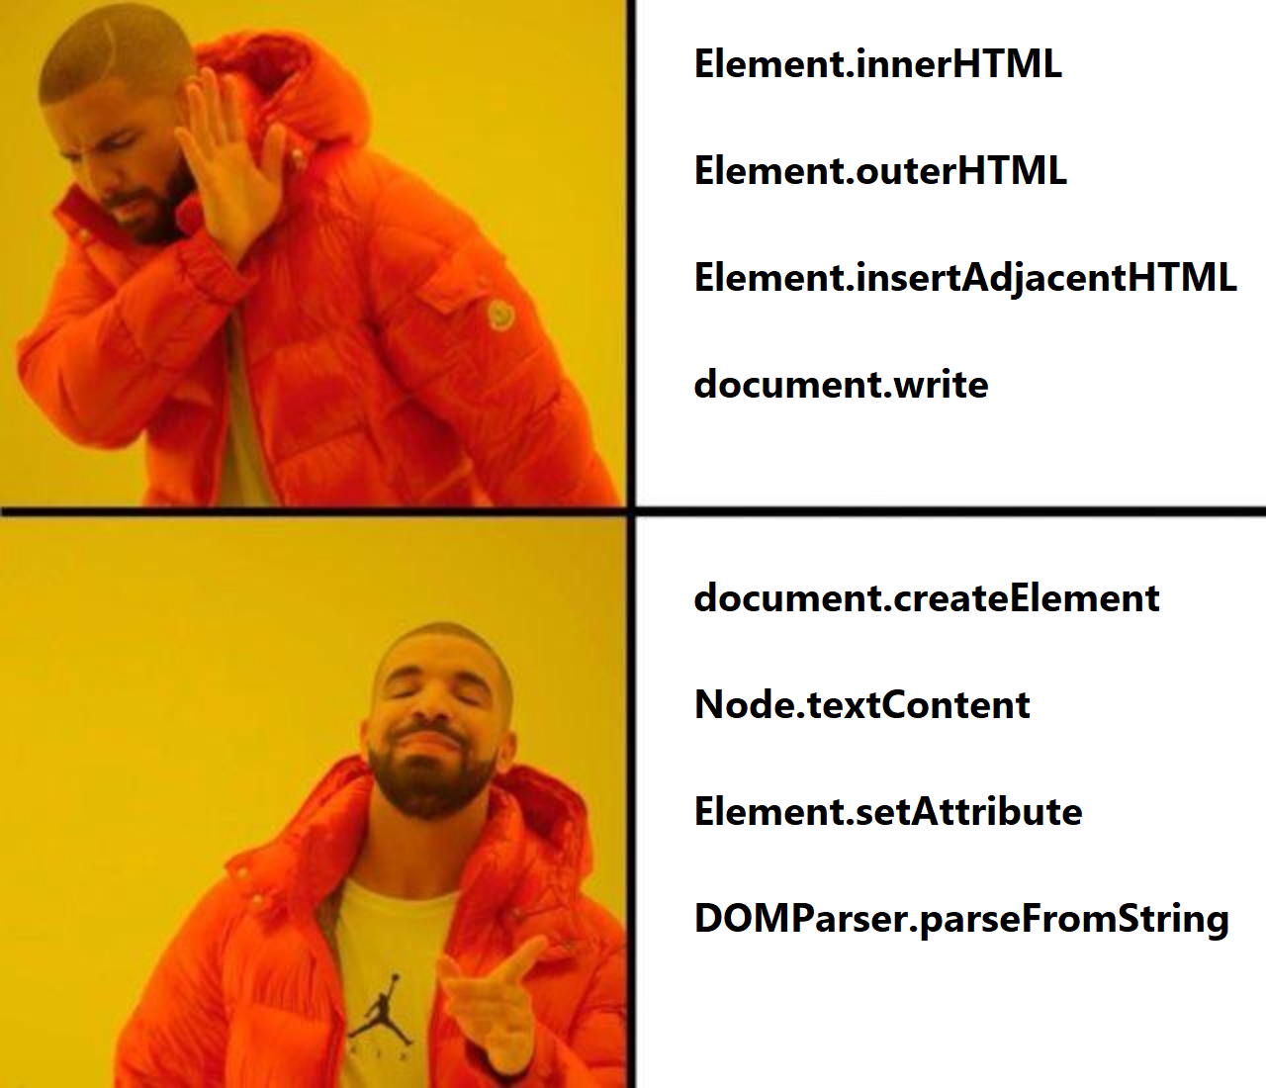
DOM APIs

Slide 10

Open Redirects

