Slide 1
Location Based Computing – Practical Activities
Pre-written code execution activities using Jupyter notebooks
No software installation required
Notebooks available via:
notebooks.azure.com (requires student registration)
OU hosted notebook server (hopefully!)
Notes:
Location based computing activities require students to execute some simple code using Jupyter notebooks.
The notebooks will not require additional software to be installed, although students will be able to run notebooks on their own computers if they want to install additional software themselves. (Optional activity guidance will be provided for this.)

Slide 2
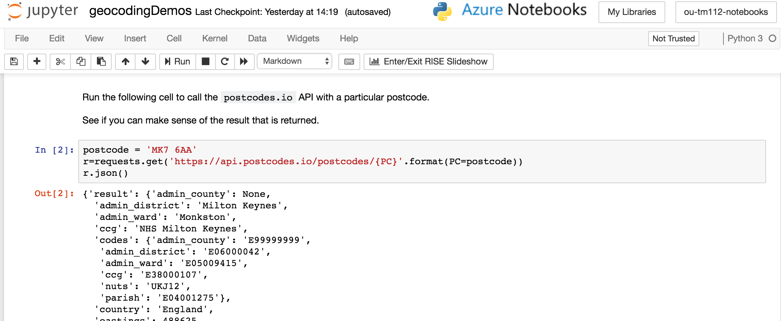
Notebooks can be found in notebooks/ folder
Filenames and final instructions are still to be finalised….
Notes:
The Jupyter notebook environment is one we have used successfully in TM351 and on the OU / FutureLearn “Learn to code for data analysis” MOOC.
The notebooks provide an interactive, browser based interface to an IPython environment.
Notebooks contain text and modifiable, executable code cells.

Slide 3
Activities include:
Calling a postcode geolocation service
Putting markers on a Google Map using a geolocated location
Notes:
TM112 notebook activities will show students how to:
Call a third party API to find the geolocation (latitude and longitude) corresponding to a postcode area;
Plot markers on a map using a contributed python mapping package (folium)

Slide 4
Try Jupyter notebooks
in general at:
https://try.jupyter.org
Notes:
If you are new to Jupyter notebooks, there are demo notebooks available at: try.jupyter.org

Slide 5
Module notebooks
Clone the Azure notebooks library:
https://bit.ly/2pAkdPA https://notebooks.azure.com/psychemedia/libraries/ou-tm112-notebooks
Docker:
ousefulcoursecontainers/ou-tm112-notebooks
docker run -d -p 8899:8888
ousefulcoursecontainers/ou-tm112-notebooks
start-notebook.sh
--NotebookApp.token=''
Binderhub:
(Github: ouseful-course-containers/ou-tm112-notebooks)
Or direct: https://bit.ly/2DKeqfr
Notes:
You can also try out the latest version of the TM112 notebooks yourself.
The easiest way to try the notebooks is probably via Azure notebooks. This requires:
Create an Azure account (needs to be a (free) personal account; notebooks login doesn’t seem to work with my OU Microsoft / Azure credentials)
Clone the library at https://notebooks.azure.com/psychemedia/libraries/ou-tm112-notebooks
The notebooks themselves are on Github at: https://github.com/ouseful-course-containers/ou-tm112-notebooks
They should be runnable from the repository via Binderhub: https://mybinder.org/v2/gh/ouseful-course-containers/ou-tm112-notebooks/master
The repo is linked to dockerhub; if you are a docker user, the latest docker image (which will be used for the OU hosted notebook server) can be grabbed from Dockerhub as: ousefulcoursecontainers/ou-tm112-notebooks The container is built on top of an official Jupyter image - jupyter/base-notebook – see the docs.

