Slide 1
Establishing a Just Learning Culture
Barriers and Challenges to Implementation Jordan Dardar CSD 380 DevOps Module 8.2 7/13/2026
1

Slide 2
What Is a Just Learning Culture?
• Encourages employees to report mistakes without unfair punishment. • Treats failures as opportunities to improve systems. • Holds people accountable for reckless behavior. • Promotes continuous learning and collaboration. A just learning culture focuses on fixing systems rather than blaming individuals.
2

Slide 3
Why It Matters in DevOps
• Faster incident resolution • Better collaboration between teams • Improved software quality • Increased trust and innovation • Supports Continuous Integration and Continuous Delivery (CI/CD) Organizations that learn from failures become more resilient.
3

Slide 4
Barrier #1: Fear of Blame
• Employees fear discipline or embarrassment. • Mistakes go unreported. • Small issues grow into larger outages. • Teams become hesitant to innovate.
4

Slide 5
Barrier #2: Poor Leadership Support
• Leaders focus on blame instead of improvement. • Lack of psychological safety. • Poor communication. • Employees lose trust. Strong leadership encourages transparency and learning.
5

Slide 6
Barrier #3: Organizational Resistance
• Resistance to change • Department silos • Legacy processes • Limited training • Poor cross-team communication
6

Slide 7
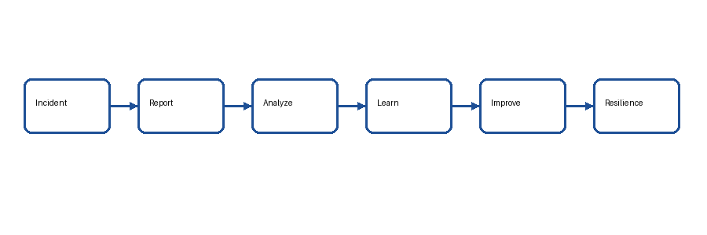
Learning Cycle
A just learning culture follows a cycle of reporting incidents, analyzing root causes, learning from failures, and improving systems.
7

Slide 8
Strategies for Success
• Encourage psychological safety. • Reward honest reporting. • Conduct blameless postmortems. • Improve automation. • Share lessons learned. • Invest in training.
8

Slide 9
Conclusion
• A just learning culture strengthens DevOps. • Fear of blame is the biggest barrier. • Leadership commitment is essential. • Continuous improvement leads to reliable systems.
9

Slide 10
References
Forsgren, N., Humble, J., & Kim, G. (2018). Accelerate.
Kim, G., Humble, J., Debois, P., & Willis, J. (2021). The DevOps Handbook (2nd ed.).
Google Cloud. Blameless Postmortems: https://sre.google/sre-book/postmortem-culture/
10

