Slide 1
A Mixed-Methods Analysis of Virtual Sociology in World of Warcraft
Senior design project in partial completion of Masters of Modeling and Simulation, University of Central Florida
Jordan Dauble, Simon Soschinski, Emmanuel Otero, Rhyse Bendell

Slide 2

Personality, Preferences, and Personal Impact in the Virtual

Slide 3
Overview
Why should we care about video game experiences?
How can we quantify the impact of video game play?
Does World of Warcraft provide a meaningful test case?
What can we take-away?

Slide 4
Background
Video games have superseded television as the main form of media consumed in first world countries
Increasingly, young people turn to video games to fulfill their desire for hedonistic activity
A multiplicity of questions surround the relationship between individuals and their interaction with video games

Slide 5
Background
The issue that has dominated the forefront of the debate surrounding the effect of video games is that of violence
Few empirical studies have rendered any meaningful data regarding the issue of the impact of video games on individuals’ behaviors
The prevailing argument seems to be an extension of the one raised against film media: exposure to violence begets violence

Slide 6
Background
What facets define the relationship between a player and a game?
Can we predict the behaviors of players in game?
Is it possible to extend that prediction to players’ tendencies post-play?
If it is possible to connect predisposition to virtual enaction, and virtual enaction to post-action, can predisposition alone predict post-action?

Slide 7

World of Warcraft

Slide 8
Why World of Warcraft
The World of Warcraft is without doubt one of, if not the, most played massive-multiplayer online role-playing games that has ever existed
The reach and implications of the playership of WoW can only be understated – the community involved in WoW truly spans age, socioeconomic status, motivation to play, and many other measures by which we typically discretize humanity

Slide 9
Wat is World of Warcraft
Overview

Slide 10
Wat is World of Warcraft
Races (and why we should care)

Slide 11
Wat is World of Warcraft
Classes (and why they are relevant to players’ choices)

Slide 12
Wat is World of Warcraft
Specializations (and what they may implicate)

Slide 13
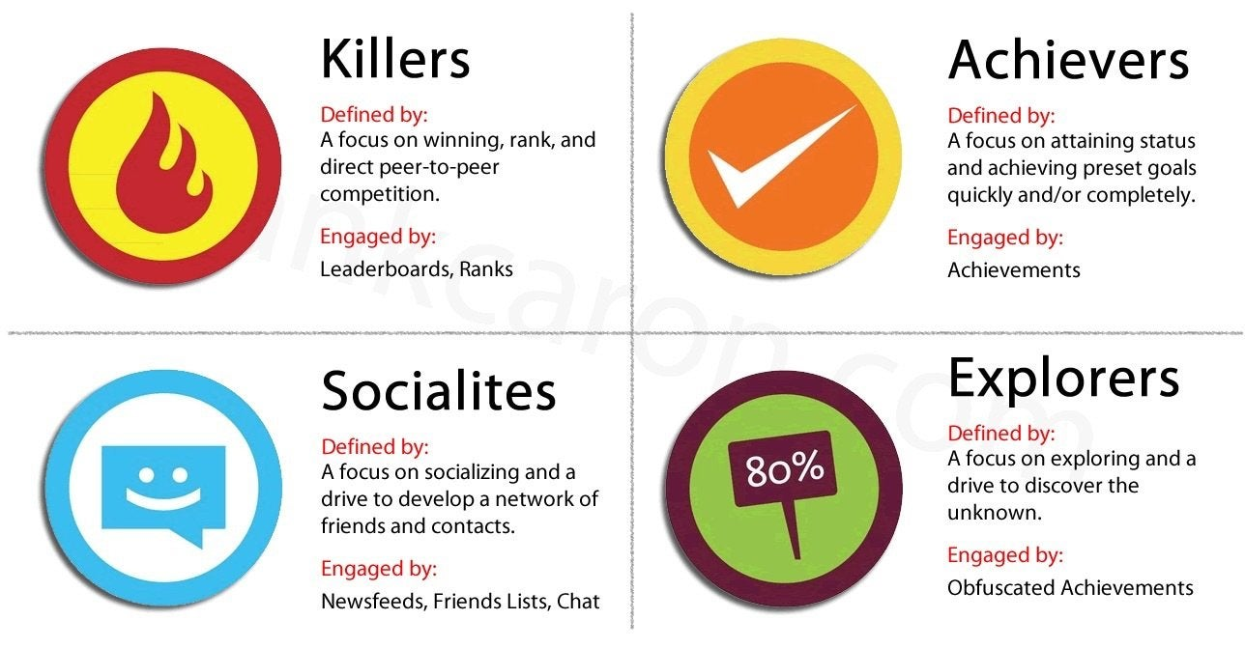
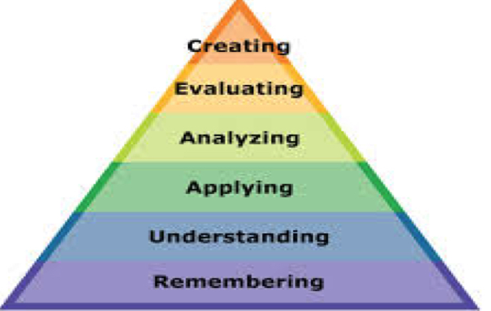
Studying Video-Gamers
Previous research into the self-reported and behavioral tendencies of video-gamers has yielded fascinating insight into individuals’ reasons to play as well as their motivations to engage with others
A number of taxonomies have arisen which perceive themselves to be paramount to the discussion of video games and the populations which engage with their worlds.

Slide 14
Why This Research?

Slide 15
Why This Research?

Slide 16
What IS the Take-away?

Slide 17
How will We do it?

Slide 18
How will We do it?

Slide 19
How will We do it?

Slide 20
What IS the Take-away?

