Slide 1
WoW Team Meeting
09-25-19

Slide 2
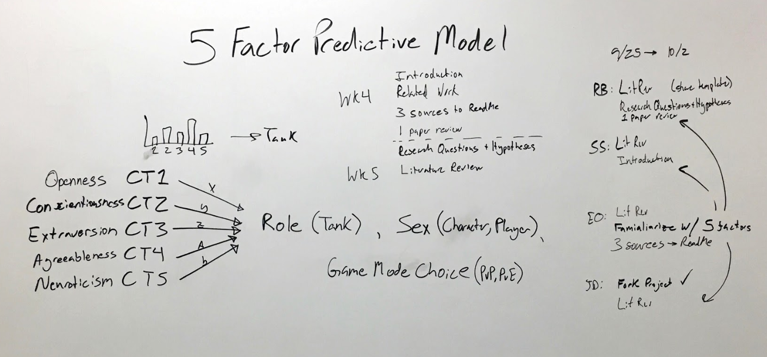

Slide 3
Take-aways
Research questions following from Bean & Groth-Marnat
Adding “player recurrence” to possibly account for play styles changing as a function of experience in the game and therefore potentially straying from or getting closer to being predicted by personality

