Slide 1
Investment Crowdfunding
Silicon Prairie
Portal and Exchange * Established 2016

Slide 2


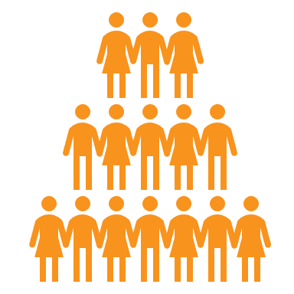

We help business raise Money

Slide 3
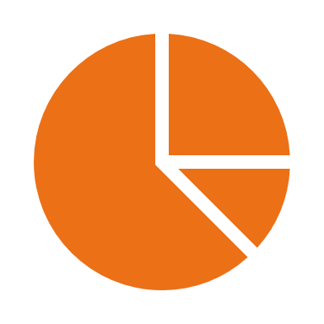

 | Raise Money for Business
 | Selling a Piece *OR* Taking a Loan
 | From a Crowd of Regular People

Slide 4

Rule of Thumb
No Angle or Bank that will do $100K?
...Raise from 100 people
w/ $1,000 each!

Slide 5




What’s For Sale?
You decide what to offer:
Equity (Ownership) | Debt (Loans) | Convertible Note | Revenue Share | Other?

Slide 6




Regulations
Minnesota “MNvest”
Portal 2016
National “FINRA”
Portal 2018
Wisconsin “WDFI”
Portal 2017

Slide 7




Process
Sign Contract
+ Pay fees
Homework w/ Lawyer
+ Effective Exemption
Market Campaign
+ Funds into Escrow
Achieve Min.
+ Investors Sign /Release

Slide 8

Advantages
Ask Strangers
Regular People
Uses Self-Directed IRA
Liquidity

Slide 9







SAMPLE - Raise $1 Million USD | National (Reg CF) | Multi-State (SCOR) | Single State: Iowa, Michigan Wisconsin | Single State: Minnesota
Legal Fees (estimate) | $7,500 | $7,500 | $5,000 | $5,000
Accountant Fees (estimate) | $3,000 | (NA) | (NA) | (NA)
Software Fees | $2,500 + 5 - 7% | $2,500 + 5 - 7% | $2,500 + 5 - 7% | (Ask)
Cost to Raise One Million Dollars | $83,000 | $80,000 | $77,500 | (TBD)

Slide 10

Right for Me?
No Bank/ Angel
No Bank/ Angel
$50,000to $5M
Willing to Market The Deal
Must Keep “Control”

Slide 11

Distributed Ledger
... like a Spreadsheet

Slide 12

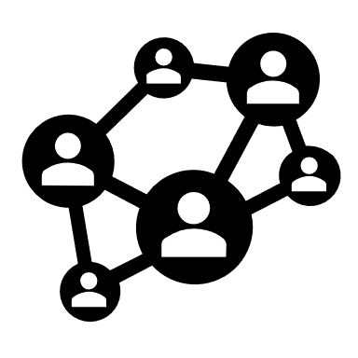
Everyone gets a Copy

Slide 13


Entries grouped
Software math
Output inheritance
fraud “breaks” the bloodline

Slide 14
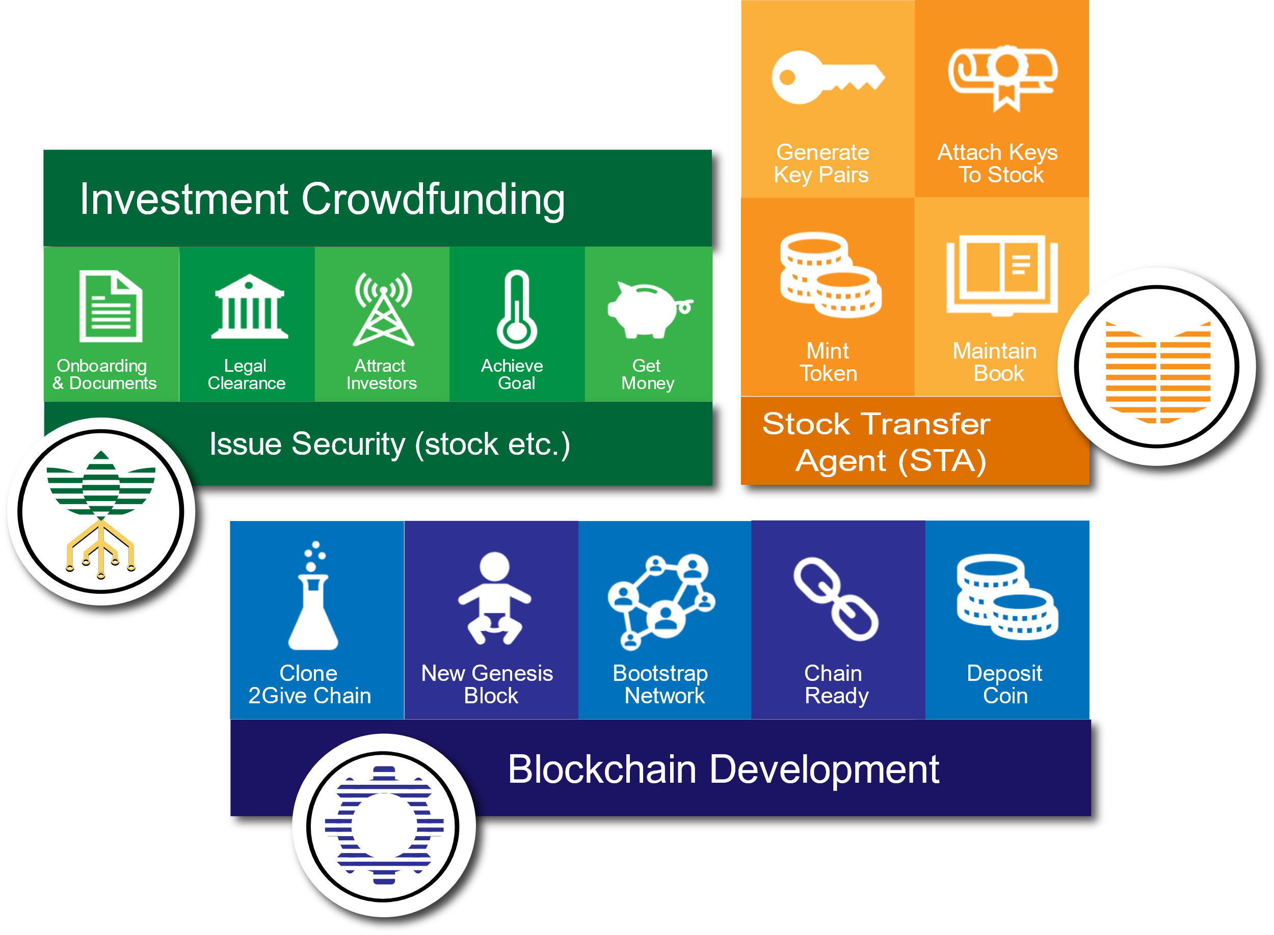

Issue *REAL* Stock
Add Crypto Keys
Track on
Blockchain

Slide 15

Come See ME!
Open Office every Friday
***FREE*** from 9:30 - 11:30 AM
475 Cleveland Ave NORTH, suite 103
St. Paul, MN 55124
(Park on south Side of building, entrance to far left, not Main entrance)
David.Duccini@sppx.io Jade.Barker@sppx.io

