Slide 1

PERFECT SOLAR POWER FORECASTS
Step 1 to Least-Cost, Ultra-High PV Penetration
Richard Perez, University at Albany
Marc Perez, Clean Power Research
Marco Pierro, University of Rome
Jim Schlemmer, University at Albany
Sergey Kivalov, University at Albany
John Dise, Clean Power Research
Patrick Keelin, Clean Power Research
Mark Grammatico, Clean Power Research
Agata Swierc, Clean Power Research
Jorge Ferreira, Clean Power Research
Andrew Foster, Clean Power Research
Morgan Putnam, RESurety
Thomas Hoff, Clean Power Research
ASES SOLAR 2019
Minneapolis

Slide 2

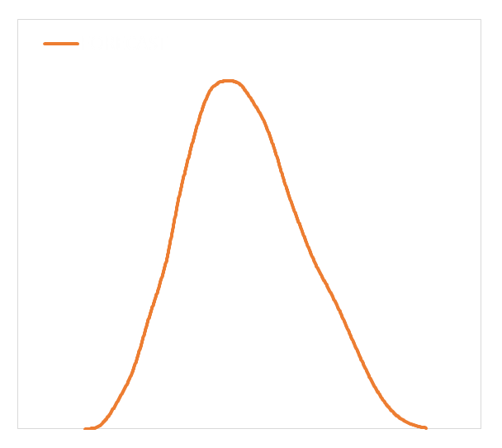
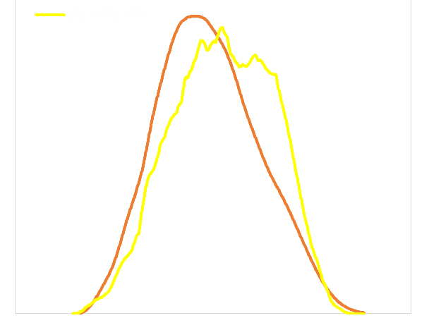
PERFECT SOLAR POWER FORECASTS
+
SOLAR OVERSUPPLY & CURTAILMENT
GUARANTEED PRODUCTION
PERFECT FORECAST
Metric
Operational strategy
Ultra-high penetration

Slide 3
METRIC
Standard metrics: MBE, RMSE, MAE
%MBE, %RMSE, %MAE
SKILL
Perfect forecast metric
Night time values?
Reference?
Mean? Nominal?
Which persistence?
IEA Smart persistence
$
$
@ current technology cost:
$1200/kW PV $200/KWh Storage
@ future technology cost:
$400/kW PV $50/kWh Storage

Slide 4
METRIC
FORECAST MODELS
SUNY (SOLAR ANYWHERE)
GFS
ECMWF
NDFD
HRRR
Smart Persistence
1, 3, & 24 Hours Ahead
© Perez & et al.

Slide 5
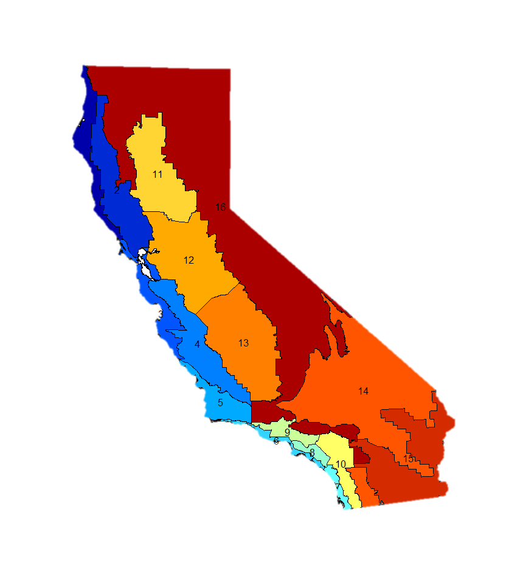
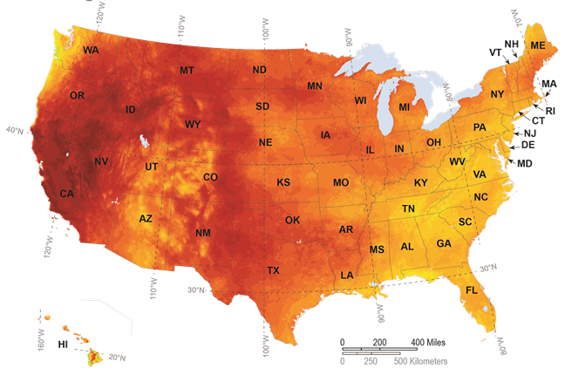
METRIC
VALIDATIONS
Fort Peck
Sioux Falls
Penn State
Bondville
Boulder
Desert Rock
Goodwin Creek
16 POINT CALIFORNIA FLEET
7 SURFRAD
All validations are fully independent

Slide 6
METRIC
MAE (Wm⁻²)
SKILL (%)
© Perez & et al.

Slide 7
METRIC
Perfect Forecast ($/kWp)
MAE (Wm⁻²)
@ Current technology costs

Slide 8
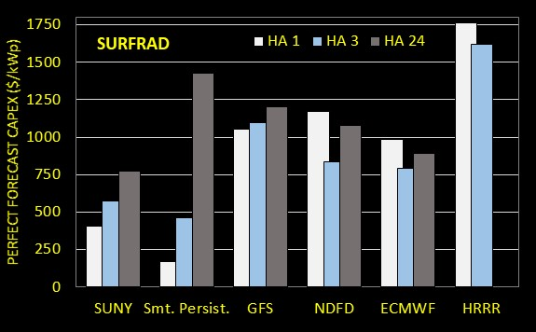

METRIC
Perfect Forecast ($/kWp)
MAE (Wm⁻²)
@ Future technology costs
SURFRAD

Slide 9
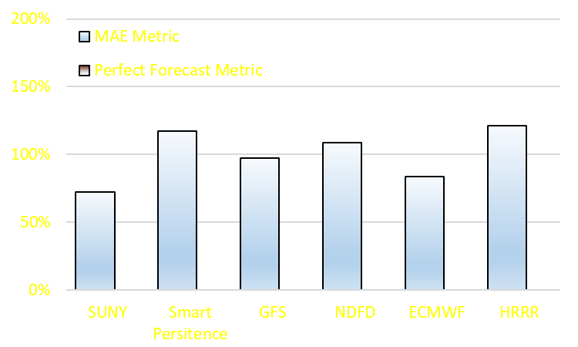
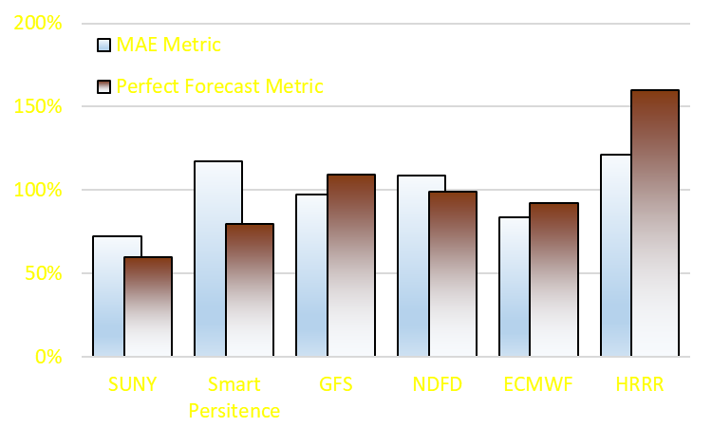
COMPOSITE ERROR METRIC ACROSS ALL SITES & TIME HORIZONS
Normalized to the mean of all models

Slide 10
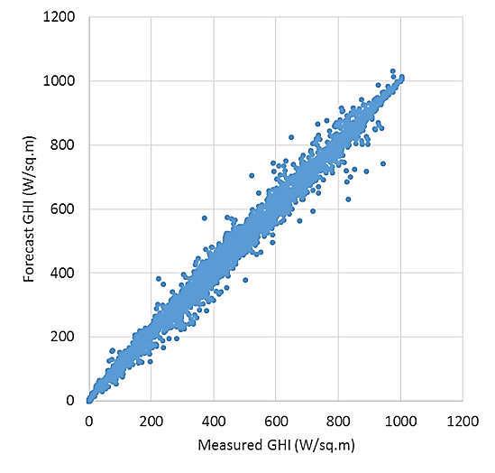
PERFECT FORECAST OPERATIONAL STRATEGY
+
SOLAR OVERSUPPLY & CURTAILMENT
GUARANTEED PRODUCTION
CAISO 24 hours ahead
California Fleet day-ahead
solar power forecast

Slide 11
PERFECT FORECAST OPERATIONAL STRATEGY
$200/kWh
< $50/kWh
$1,200/kW turnkey
< $400/kW turnkey
+
SOLAR OVERSUPPLY & CURTAILMENT
CAISO 24 hours ahead
California ISO day-ahead
solar power forecast
$200/kWp CAPEX
$50/kWp CAPEX

Slide 12
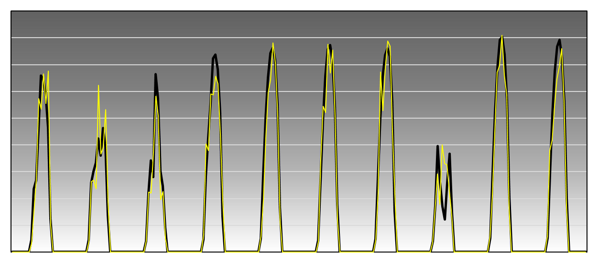
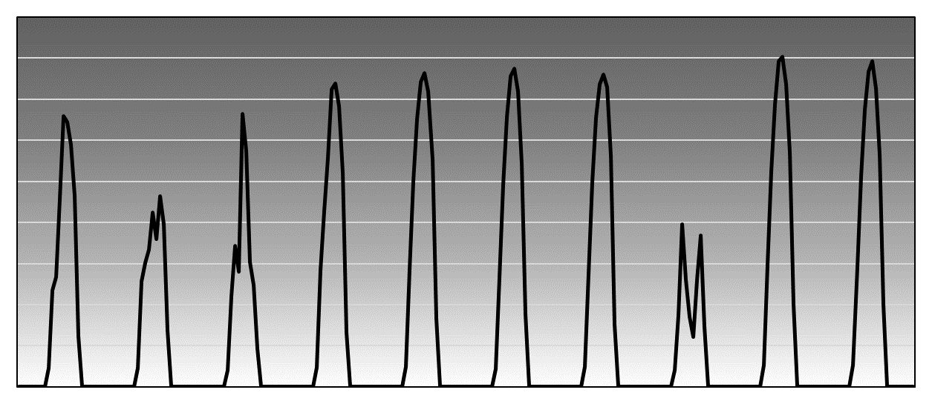
PERFECT FORECAST
SCALABILITY TO ULTRA-HIGH PENETRATION
+
SOLAR OVERSUPPLY & CURTAILMENT
Firm power (100%-ready) logistics
Perfect forecast logistics
actual
forecast

Slide 13
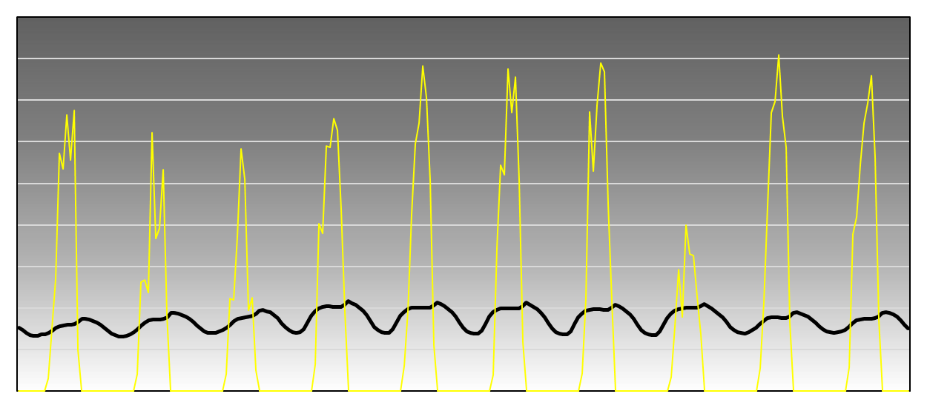
PERFECT FORECAST
SCALABILITY TO ULTRA-HIGH PENETRATION
+
SOLAR OVERSUPPLY & CURTAILMENT
Firm power (100%-ready) logistics
actual
load shape

Slide 14
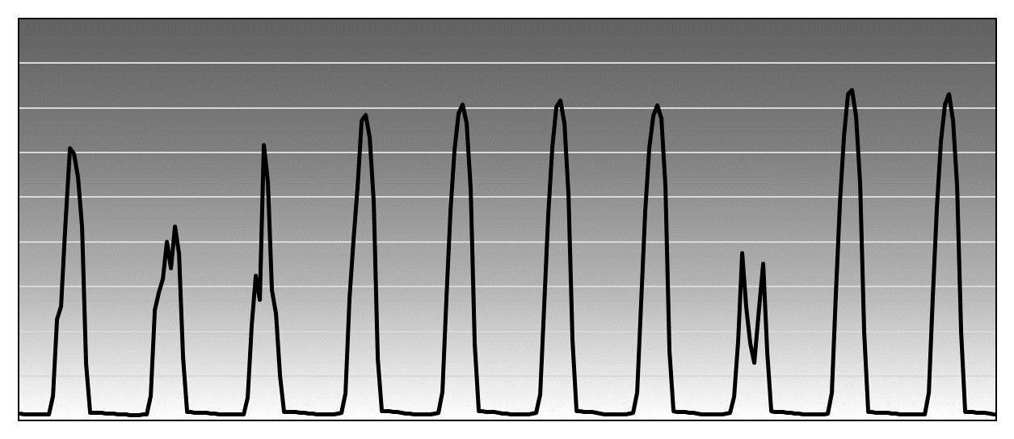
PERFECT FORECAST
SCALABILITY TO ULTRA-HIGH PENETRATION
+
SOLAR OVERSUPPLY & CURTAILMENT
© Perez & et al.
© Perez & et al.

Slide 15
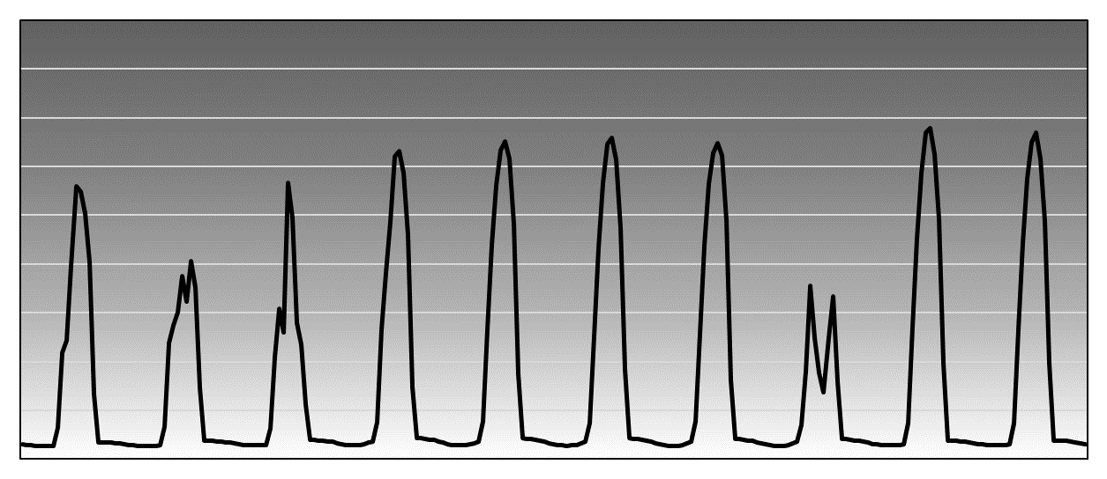
PERFECT FORECAST
SCALABILITY TO ULTRA-HIGH PENETRATION
+
SOLAR OVERSUPPLY & CURTAILMENT
© Perez & et al.
© Perez & et al.

Slide 16
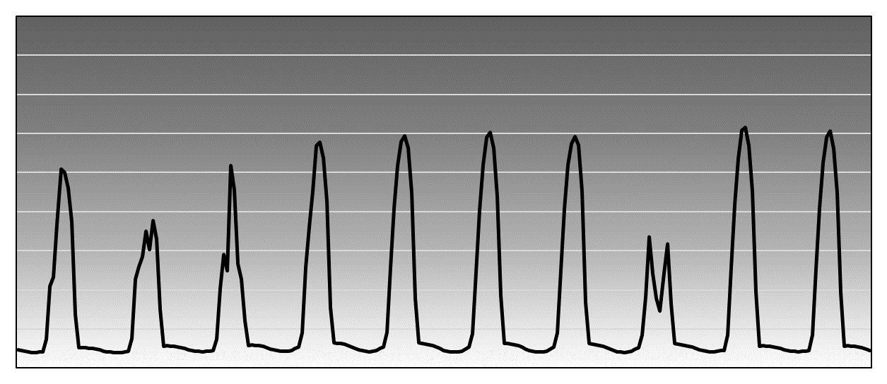
PERFECT FORECAST
SCALABILITY TO ULTRA-HIGH PENETRATION
+
SOLAR OVERSUPPLY & CURTAILMENT
© Perez & et al.
© Perez & et al.

Slide 17
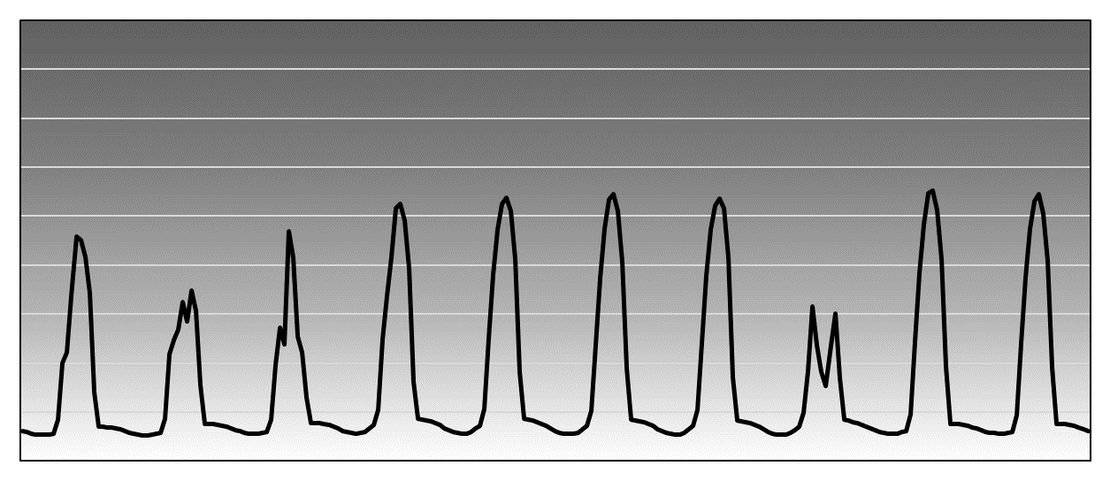
PERFECT FORECAST
SCALABILITY TO ULTRA-HIGH PENETRATION
+
SOLAR OVERSUPPLY & CURTAILMENT
© Perez & et al.
© Perez & et al.

Slide 18
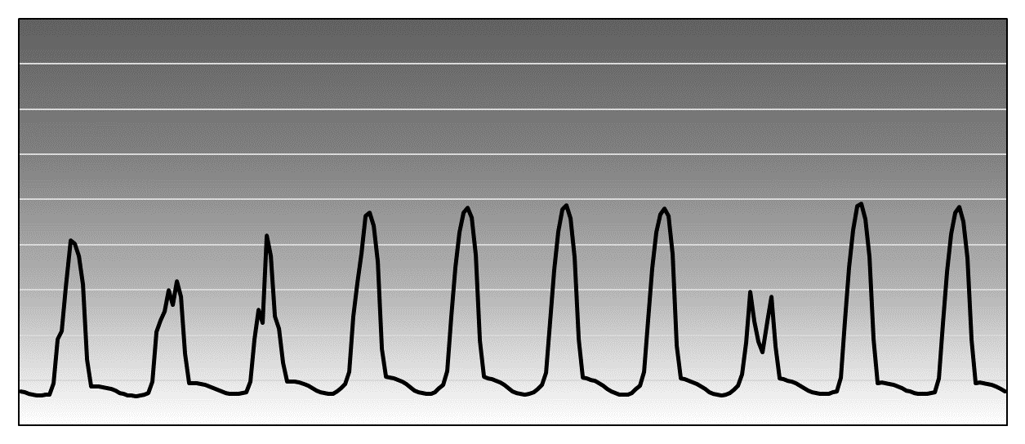
PERFECT FORECAST
SCALABILITY TO ULTRA-HIGH PENETRATION
+
SOLAR OVERSUPPLY & CURTAILMENT
© Perez & et al.
© Perez & et al.

Slide 19
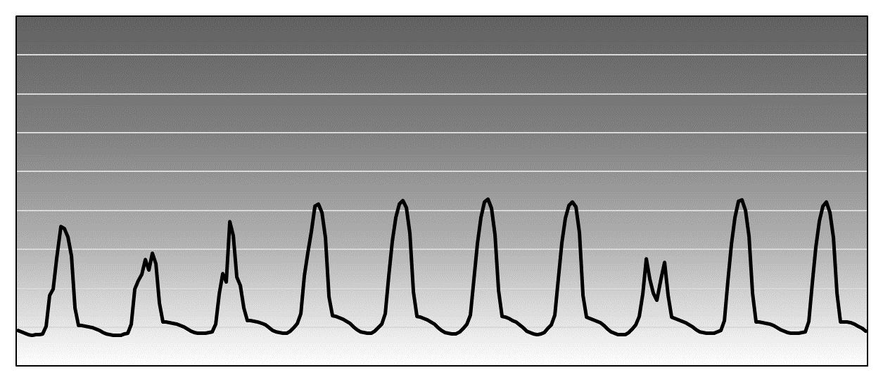
PERFECT FORECAST
SCALABILITY TO ULTRA-HIGH PENETRATION
+
SOLAR OVERSUPPLY & CURTAILMENT
© Perez & et al.
© Perez & et al.

Slide 20
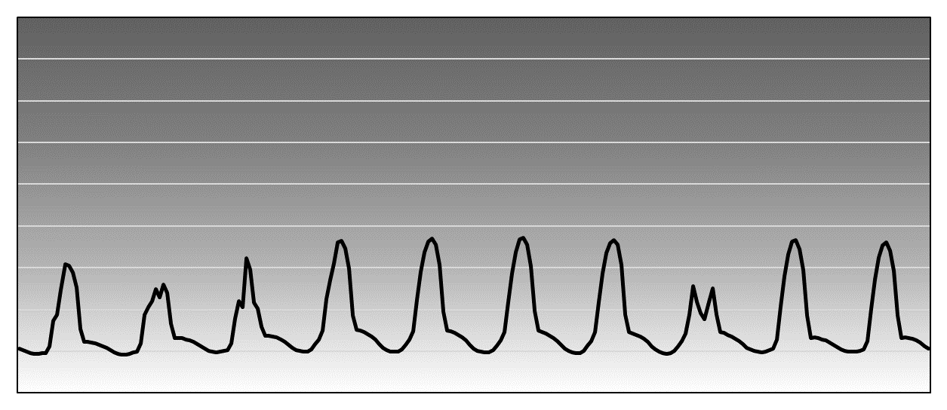
PERFECT FORECAST
SCALABILITY TO ULTRA-HIGH PENETRATION
+
SOLAR OVERSUPPLY & CURTAILMENT
© Perez & et al.
© Perez & et al.

Slide 21
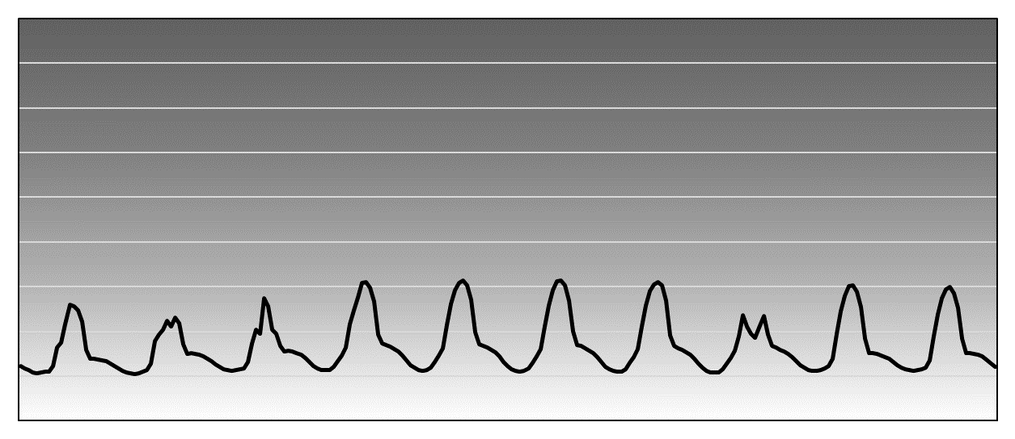
PERFECT FORECAST
SCALABILITY TO ULTRA-HIGH PENETRATION
+
SOLAR OVERSUPPLY & CURTAILMENT
© Perez & et al.
© Perez & et al.

Slide 22
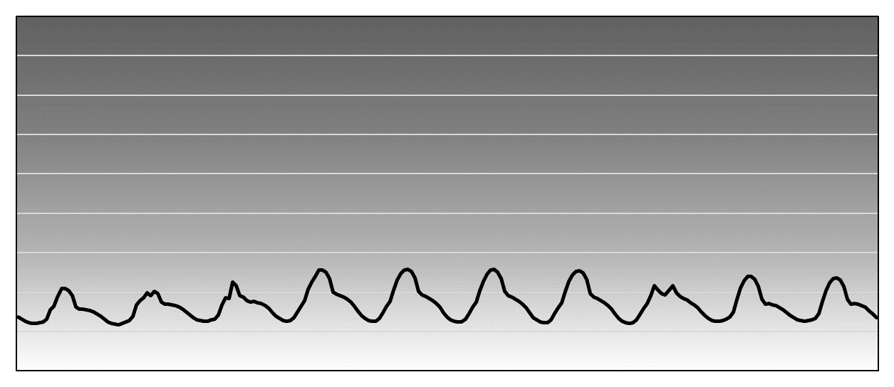
PERFECT FORECAST
SCALABILITY TO ULTRA-HIGH PENETRATION
+
SOLAR OVERSUPPLY & CURTAILMENT
© Perez & et al.
© Perez & et al.

Slide 23
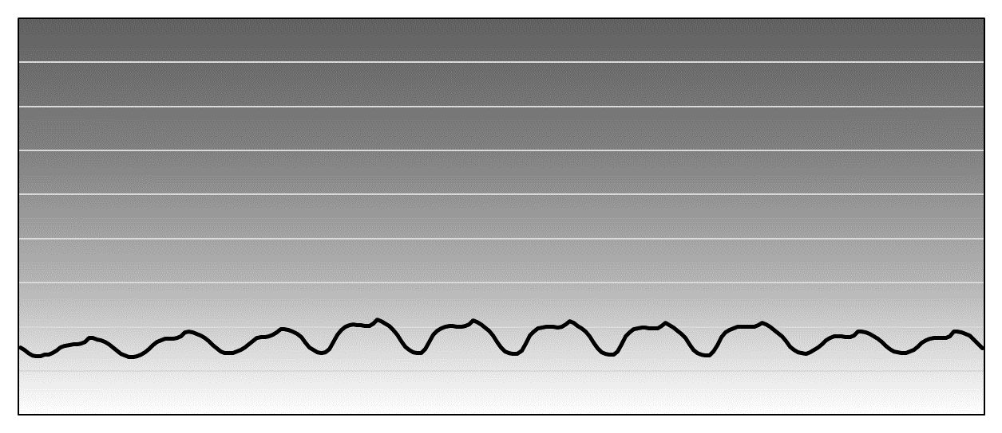
FIRM POWER GENERATION
LEAST-COST ULTRA-HIGH PENETRATION
PERFECT FORECAST
SCALABILITY TO ULTRA-HIGH PENETRATION
+
SOLAR OVERSUPPLY & CURTAILMENT
© Perez & et al.
© Perez & et al.

Slide 24
FIRM POWER GENERATION
LEAST-COST ULTRA-HIGH PENETRATION
+
SOLAR OVERSUPPLY & CURTAILMENT
© Perez & et al.
© Perez & et al.

Slide 25
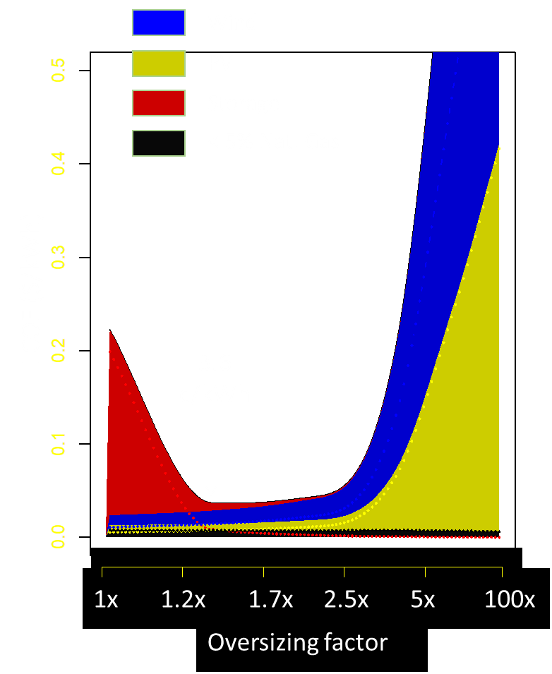
FIRM POWER GENERATION
LEAST-COST ULTRA-HIGH PENETRATION
+
SOLAR OVERSUPPLY & CURTAILMENT
MINNESOTA
Optimally overbuilt
95% Wind/PV
Horizon 2050
24¢/kWh
© Perez & et al.

Slide 26
FIRM POWER GENERATION
LEAST-COST ULTRA-HIGH PENETRATION
+
SOLAR OVERSUPPLY & CURTAILMENT
Thank you
© Perez & et al.

