Slide 1
Behavior-Driving Apache Wicket
Making the Most of WebDriver and JDave-Wicket
ApacheCon EU 2009
Markus Hjort, Timo Rantalaiho and Marko Sibakov
firstname.lastname@ri.fi

Slide 2

Markus

Slide 3

Timo

Slide 4

Marko

Slide 5
Reaktor Innovations
Established in 2000
Reaktor employs approximately 110 software industry specialists
Leader in Agile methods in Finland
Turnover 13.7 MEUR in 2008; profitable operations
Selected as the best workplace in Europe, 2008.
Chosen as the information and communications technology company of the year 2008 by Computerworld Finland.
Headquartered in Helsinki, Finland with branch offices in Jyväskylä and Seinäjoki, Finland, and Buenos Aires, Argentina

Slide 6
Behavior-Driven Development

Slide 7
”TDD done right”

Slide 8
Top-Down

Slide 9
A way to create software designs
– not just about programming spec-first

Slide 10
JDave

Slide 11
JDave adds to JUnit

Slide 12
Context objects

Slide 13
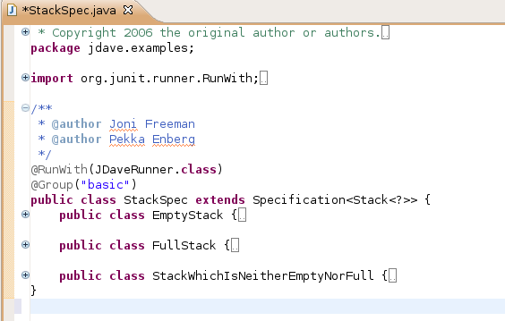

Slide 14
Syntax

Slide 15
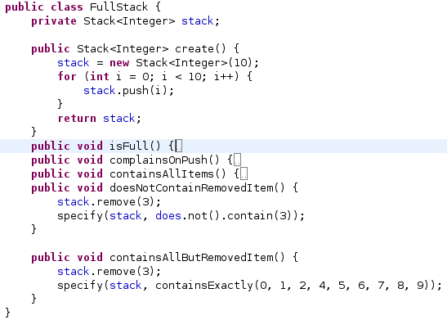
Context objects

Slide 16
Good Jmock 2 and Hamcrest integration

Slide 17
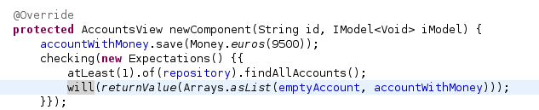

Slide 18
Some help with some frameworks
– e.g. jdave-wicket

Slide 19
Kansanpankki
Simple web bank

Slide 20
Kansapankki
Own accounts
Transfers between own accounts
Transfer history of an account

Slide 21
Kansapankki
AJAX

Slide 22
Kansapankki
Simplified for the training

Slide 23
Kansapankki
No persistence

Slide 24
Kansapankki
No IoC framework
– just set the package-protected field

Slide 25
Kansapankki
Test data fixture hardcoded in the DAO class

Slide 26
jdave-wicket-webdriver
We had 100 % branch coverage

Slide 27
jdave-wicket-webdriver
100 % branch coverage of UI code

Slide 28
jdave-wicket-webdriver
And we still had bugs!

Slide 29
jdave-wicket-webdriver
=> Blackbox testing of the real, deployed application

Slide 30
jdave-wicket-webdriver
Real browser
...well, Firefox 2

Slide 31
jdave-wicket-webdriver
Real database
- Oracle flashback

Slide 32
jdave-wicket-webdriver
We got WebDriver working more easily than Selenium
- your mileage may vary

Slide 33
jdave-wicket-webdriver
jdave-wicket-webdriver has code that helps to use WebDriver
- with Wicket
- with BDD

Slide 34
jdave-wicket-webdriver
Channel class
to wait for Wicket AJAX requests

Slide 35
jdave-wicket-webdriver
Some code to take care of common plumbing tasks

Slide 36
jdave-wicket-webdriver
The ”elements” programming model

Slide 37
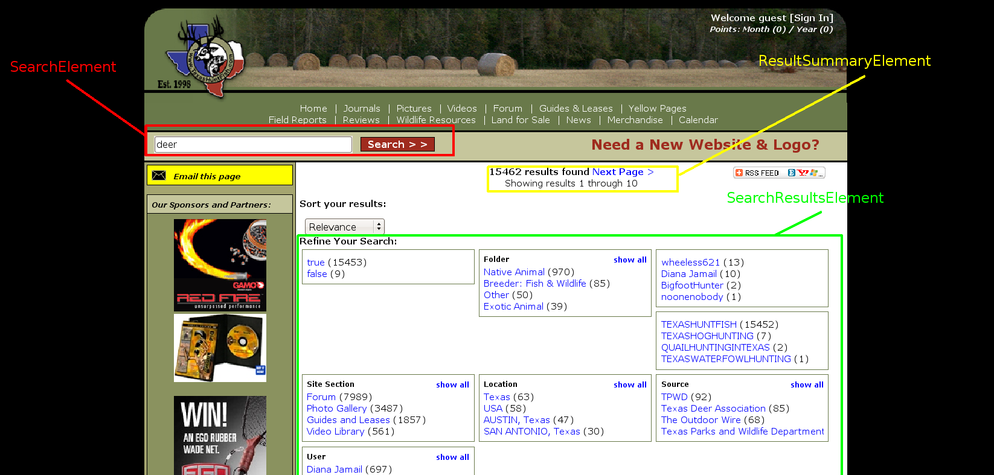
The ”elements” programming model

Slide 38
Elements
Correspond to logical parts of UI

Slide 39
Elements
High abstraction level

Slide 40
Elements
Towards a DSL for testing the UI of your application

Slide 41
Elements
Testers can write UI specs using elements classes

Slide 42
Elements
Programmers can help in developing elements classes

