Slide 1
Prolog Applications in AI
Author: Jesus Nuñez
Advisor: prof. dr. hab. Ryszard Kozera

Slide 2
INTERPRETATION IN PROLOG
(META-PROGRAMMING)
GRAPH
SEARCH
PROBLEMS
PROBABILISTIC
GRAPHICAL
MODELS
(BAYESIAN META-INTERPRETER)
ACTION
RECOGNIGTION
KNOWLEDGE REPRESENTATION
AND REASONING
CONSTRAINT ABDUCTIVE
BAYESIAN LANGUAGE

Slide 3



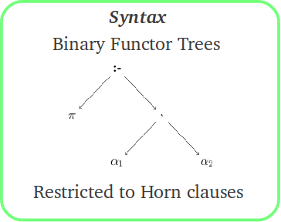
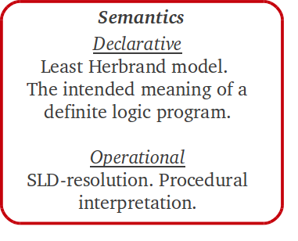
INTERPRETATION → GRAPH SEARCH PROBLEMS → PROBABILISTIC GRAPHICAL MODELS → CONSTRAINT ABDUCTIVE BAYESIAN LANGUAGE → ACTION RECOGNITION
→ PROLOG → INTERPRETATION
PROLOG

Slide 4
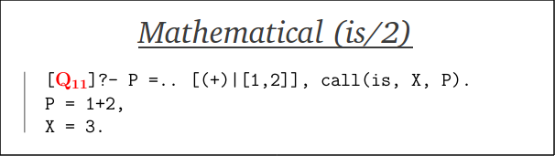
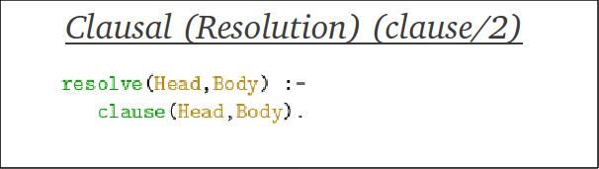
INTERPRETATION → GRAPH SEARCH PROBLEMS → PROBABILISTIC GRAPHICAL MODELS → CONSTRAINT ABDUCTIVE BAYESIAN LANGUAGE → ACTION RECOGNITION
→ PROLOG → INTERPRETATION
Interpretation in PROLOG
  Interpretation is the status-quo in PROLOG,
  PROLOG can be seen as an interpreter, rather than as a language (mostly due to its symbolic nature),
  New paradigms can be invented as long as they underlie thruth,
  This work is mostly about all this.
meta-call
This predicate is a clone
of the PROLOG engine
These are some of
the techniques
used while doing
meta-programming
in PROLOG

Slide 5
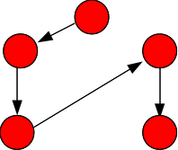
INTERPRETATION → GRAPH SEARCH PROBLEMS → PROBABILISTIC GRAPHICAL MODELS → CONSTRAINT ABDUCTIVE BAYESIAN LANGUAGE → ACTION RECOGNITION
→ SOLUTION TO GRAPH SEARCH PROBLEMS → INTERPRETATION
Key Points in the Solution
of (Graph) Search Problems
  Each of this problems spans a discrete search space
  for which SLD-tree search techniques are suitable
  exploration candidates.
  Knight Path.
  Zebra Problem.
  8 queens Problem.
  Wolf, Goat and Cabbage Problem.
  Water-Jug Problem.
  These problems are de facto graph searching
  problems!

Slide 6
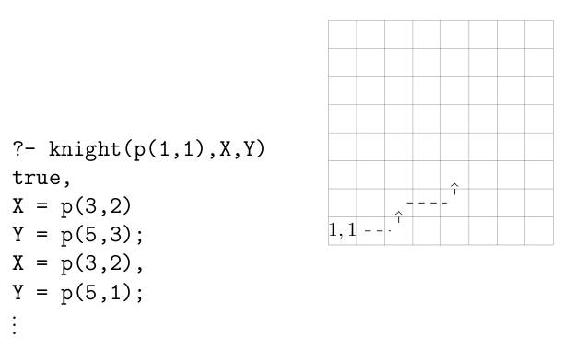
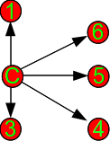
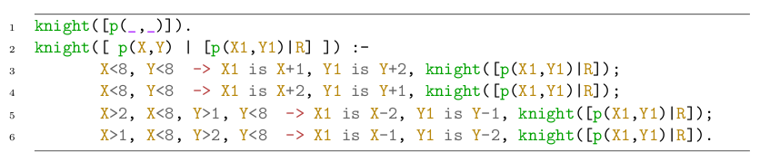
INTERPRETATION → GRAPH SEARCH PROBLEMS → PROBABILISTIC GRAPHICAL MODELS → CONSTRAINT ABDUCTIVE BAYESIAN LANGUAGE → ACTION RECOGNITION
→ SOLUTION TO GRAPH SEARCH PROBLEMS → KNIGHT PATH
Key Points (Knight Path)
From any given point, all possible 2-lenght paths
Choice-points
(backtracking)
Alternative
selection
token (OR)
Recursive check
of constraints
Implicit constraints
Base case

Slide 7

Key Points (Night Path)
Collecting all solutions with bagof/3
bagof(T+,G+,B-)
Template
Goal
Bag
The use of this built-in also allows us to provide extra conditions for success (goals), as in this case, where we have forbidden to retrieve cycles, i.e., paths in which the knight returns to the start point.

Slide 8

Key Points (Zebra Problem)
The problem consists of facts about a street containing five houses with the following characteristics:
  each of a different colour,
  each owned by a man of a different nationality,
  each has a different drink, pet and sport.
Known approaches in the literature
Constraint programming (CLPFD)
Purely declarative
We wil discuss yet another approach
Features, Sorts and Contraints
Still declarative but introduces a sort of type system to PROLOG!

Slide 9
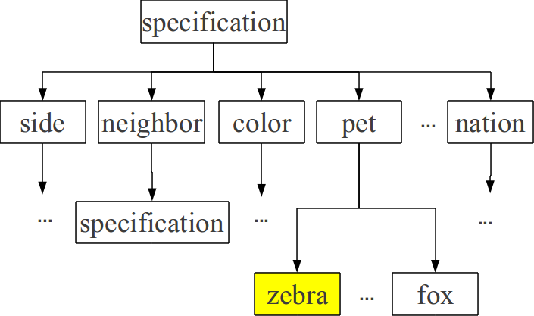
Key Points (Zebra Problem)
Sort
Features
Constraints
Through this framework PROLOG
becomes in a typed language!

Slide 10
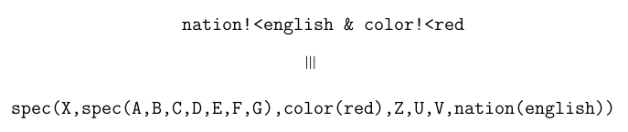
Key Points (Zebra Problem)
Feature-tree (specification)
Our claims
                This approach gives a major focus to what we have
                got from the specification,
                It provides a more practical way of handling
                information for general purpose PROLOG programs,
                Potentially reduces the semantic gaps between what
                is in our thoughts, what we code and how it gets
                finally interpreted.

Slide 11
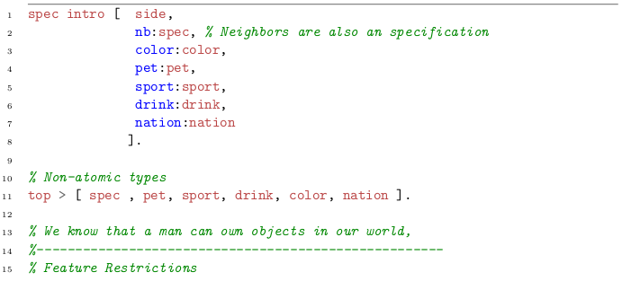
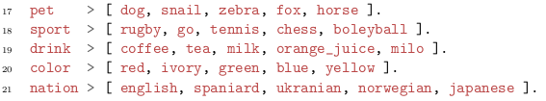
Key Points (Zebra Problem)
Feature-tree (specification)

Slide 12
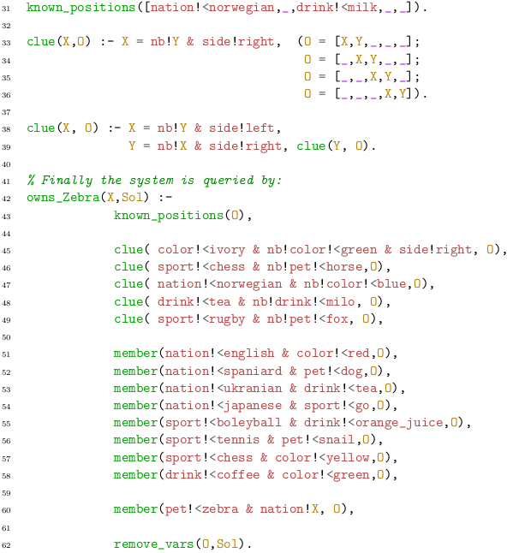

Key Points (Zebra Problem)
known order
positional
patterns
Neighboring
clues
Miscelaneous
clues
Who owns the zebra?

Slide 13
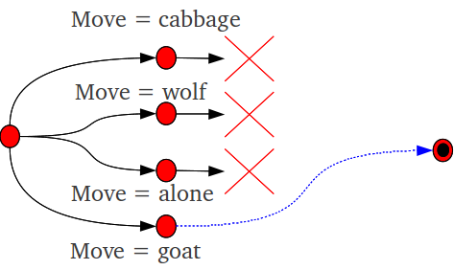
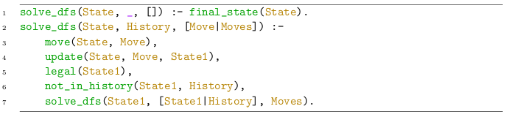
Key Points
cabbage, goat & wolf
eat(wolf, goat)
eat(goat, cabbage)
Initial state
Final state
eat(wolf, goat), eat(goat,cabbage)
At least one legal path
State = [farmer,wolf,goat,cabbage] / [ ]
State = [ ] / [farmer,wolf,goat,cabbage]
Inheriths the search technique
directly from PROLOG
namely depth first search

Slide 14
Probabilistic Graphical Models
  Probabilistic graphical models are graphs in which nodes represent random variables, and the (lack of) arcs represent conditional independence assumptions.
  Bayesian Networks are directed graphs in which arcs account for causal dependency (A causes B). We only deal here with Bayesian Networks
  The representation and inference issues are naturally handled in PROLOG. Our approach here is meta-programming!.

Slide 15
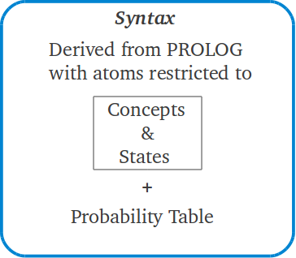
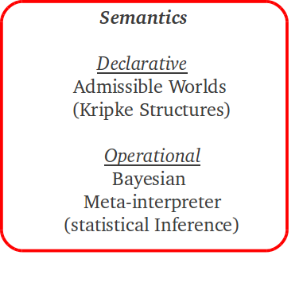
Probabilistic Graphical Models
Concept causality program
Representation issues

Slide 16


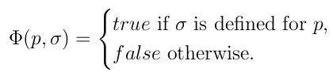
Probabilistic Graphical Models
Concept causality program
Syntax: Concepts & States
In the discrete case, the nodes of a Bayesian Network can be though of as concepts restricted to a set of states.
Copula mapping
Set of concepts
Set of states

Slide 17
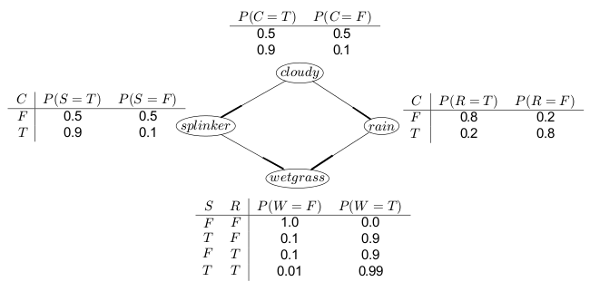
Probabilistic Graphical Models
rain can be though of as
a categorical variable
with values (states) in
{T, F}
Wetgrass is the
Top conceptual
proposition
Wet grass example (Directed Graph)
: a set of concepts from categorical variables.
: Non overlapping set of states that a categorical variable can take

Slide 18


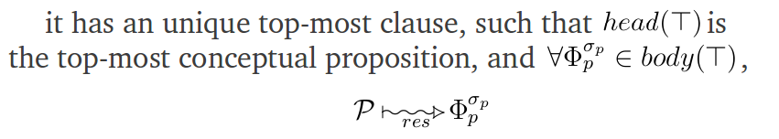
Probabilistic Graphical Models
Concept causality program
Restricted to concept-state representation,

Slide 19
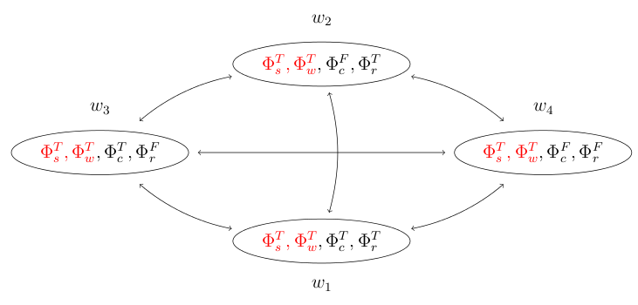




Probabilistic Graphical Models
Semantics: Modal Logic (Kripke Structures)
The semantics for the formation of possible worlds can
be suitably expressed in terms of Kripke structures.
In an operational sense
the edges of the Kripke
structure indicate avaliable
backtracking routes in
PROLOG.

Slide 20

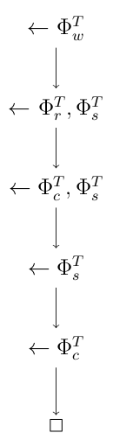
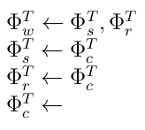

Probabilistic Graphical Models
Operational Semantics
Derivation
Program

Slide 21



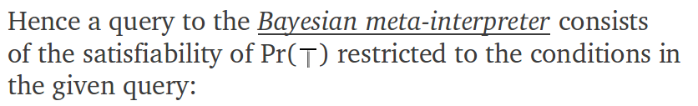




Probabilistic Graphical Models
Operational Semantics

Slide 22

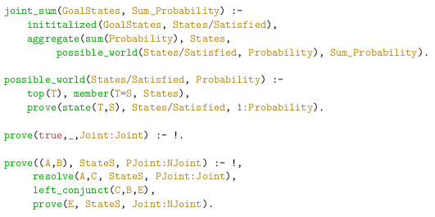
Probabilistic Graphical Models
Bayesian meta-interpreter
Analogous to
SLD meta-interpreter

Slide 23
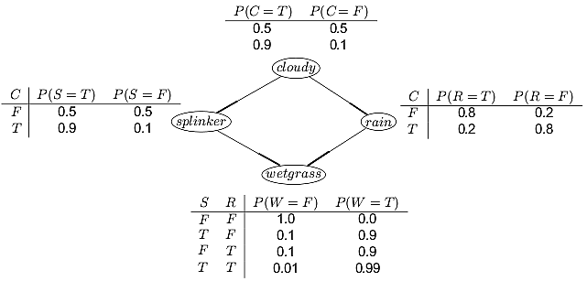
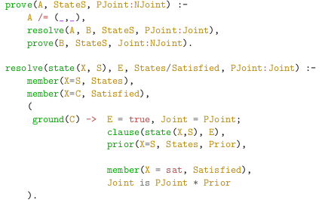

Probabilistic Graphical Models
Do not multiply the
prior X=S for given
States if it has been
already satisfied
Along the resolution.
Bayesian interpretation
of a clause

Slide 24
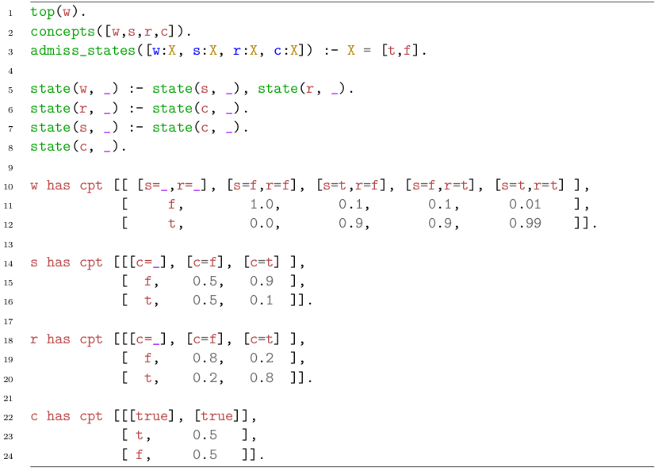
Example program
Concept Causality
Program
Probability Tables

Slide 25

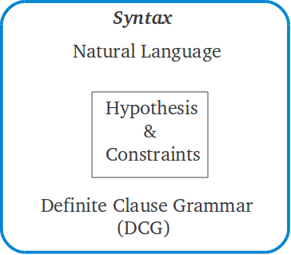
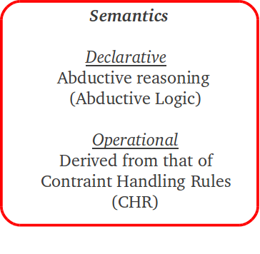
Constraint Abductive Bayesian Language ( )
Representation issues

Slide 26
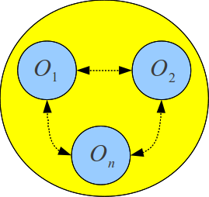
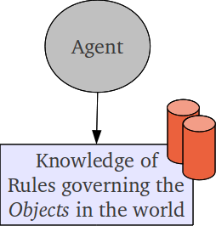
Constraint Abductive Bayesian Language ( )
Motivation
Objects in
the World
Interaction Network
(Unknow to Agent)
The Agent's goal is to make inferences
(either Logical or Probabilistic) over the
observations from its environment
From a Bayesian standpoint
We have two tasks:
  Learning the Network Structure
  Learning the probability tables

Slide 27


Constraint Abductive Bayesian Language ( )
Abductive Logic Programming (ALP)
Our approach for ALP is CHR in PROLOG!

Slide 28
Constraint Abductive Bayesian Language ( )
We use ALP to find out whether a set of hypotheses are consistent with the given integrity constraints along with an admissible explanation of the hypotheses.
Theory (or theories) which may articulate
the regularities of the given domain in the
course of causality (CHR Simulation)
Given a discourse we are going from admissible worlds, to a generalized probabilistic knowledge of the situation
Admissible Herbrand Models
(Abductive Logic Programming)

Slide 29
Constraint Abductive Bayesian Language ( )
Signature
The Signature of CABL is a tuple (Q , ) :
Q : A set of entities
: A set of states
Analog to the case of Concept causality program!
However, there is a new type of entity: Interactive Entities

Slide 30



Constraint Abductive Bayesian Language ( )
Structure
Calculated along the
course of causality
(CHR simulation)

Slide 31



Constraint Abductive Bayesian Language ( )
Support Network

Slide 32
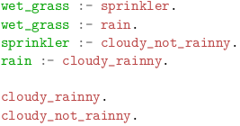
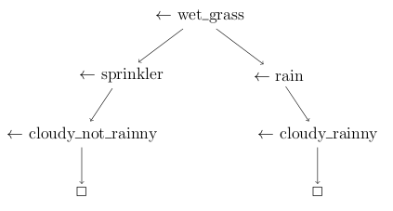
Constraint Abductive Bayesian Language ( )
Support Network
From a proof theoretical perspective, the set of all proofs (derivations) of a given goal G, captures all information needed to compute the support network of G.
Typically SLD-trees are used to automate this ask,
However, in the current approach we use CHR as
a simulation of the course of causality

Slide 33
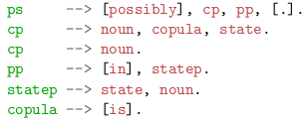
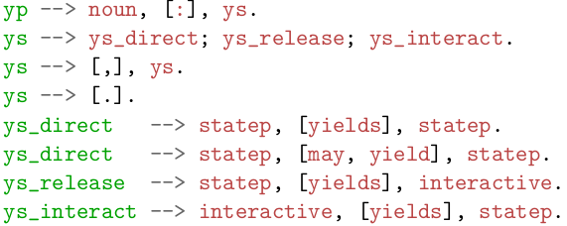
Constraint Abductive Bayesian Language ( )
Syntax (DGC)
Minimal syntax consisting of two kind of statements
Possibly statement
Yield statement
possibly STATIVE FACT
in SITUATION.
A new kind of entity

Slide 34
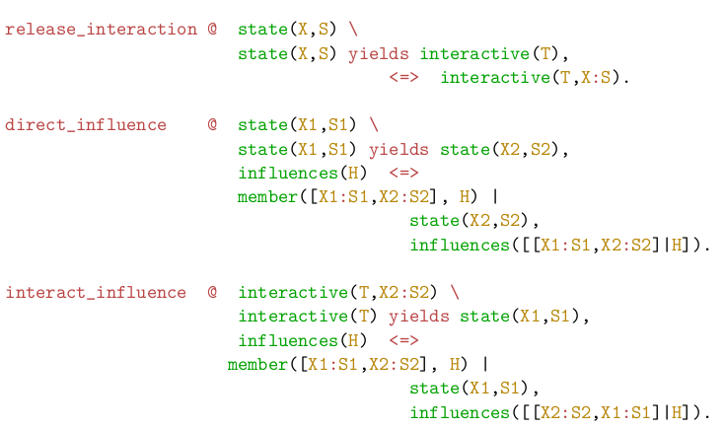
Constraint Abductive Bayesian Language ( )
Integrity Constraints
Object X in state S
emits an interactive
entity; e.g. open
umbrella emits cover.
Object X1 in state S1
induces object X2 to
state S2. e.g. cloudy
weather may induce
rain to the true state.
Aggregation model
Interaction with an
interactive entity
induces object X1
to state S1. e.g.
liquid induces grass
to wet state.
Keep track of the state of the object
releasing the interactive entity

Slide 35

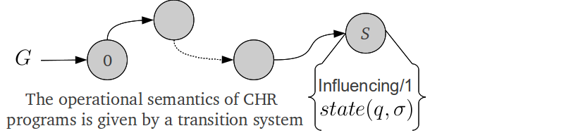
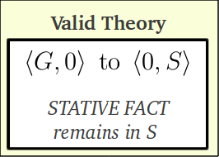
Constraint Abductive Bayesian Language ( )
Semantics
CHR provides a simulation of the course of causality, releasing a theory in which the given hypotheses hold.
Goal
Constraint store
Constraints
possibly STATIVE FACT in SITUATION.

Slide 36
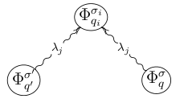
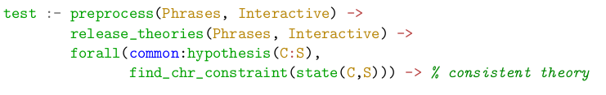

Constraint Abductive Bayesian Language ( )
Semantics (Cont.)
CHR interfase
One-vs-all inhibition
for same-nature
interactive entities

Slide 37
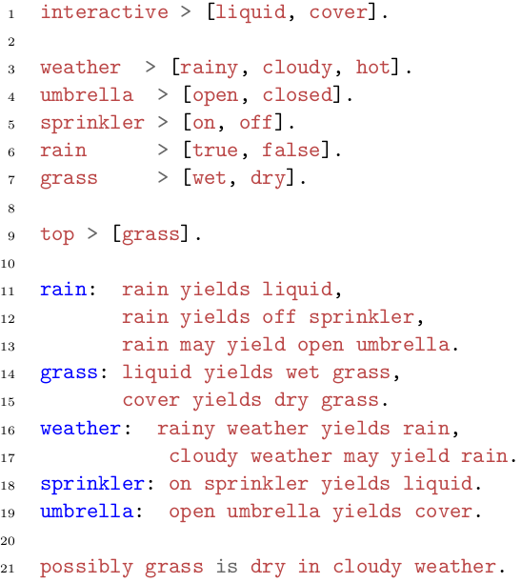
Example program
Interactive entities
Concept > [ States ]
Top concept
For which the support network
is generated.
Constraints (regularities)
Hypothesis (w.r.t the top concept)

Slide 38
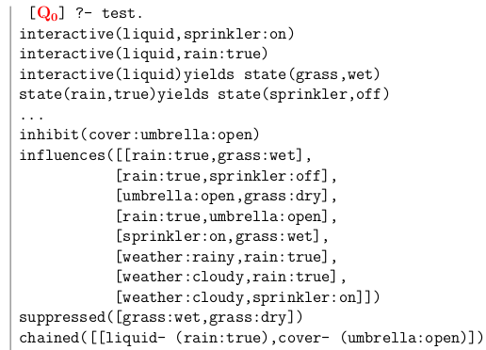
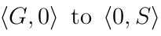
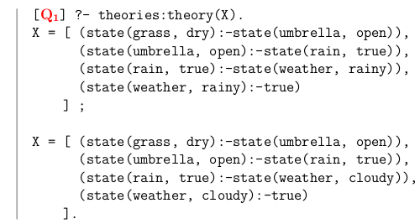
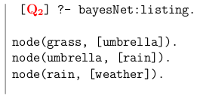
Example program (cont.)
Contents of the constraint store
The resulting theories are meant
to be suitable explainations of the
hypotheses, as such they are
susceptible to Bayesian analysis.

Slide 39
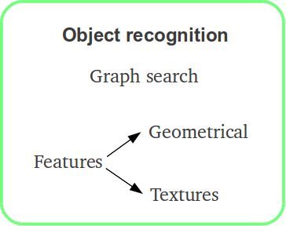
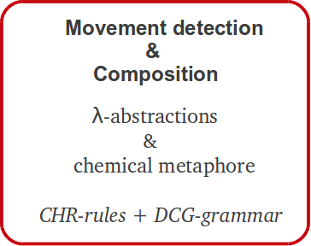
Action Recognition
Representation issues

Slide 40
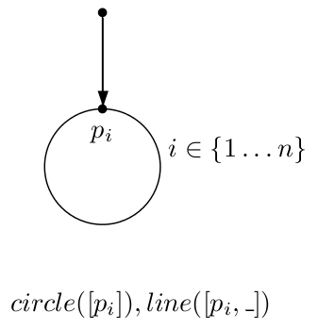
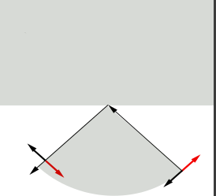

Action Recognition
Object Detection
Object detection relies on two kind of features
valid texture
transitions
A consistency check rather than a search
Geometrical
Textures

Slide 41



Action Recognition
Object Detection
Line conventions
Types convention for slope lines

Slide 42


Action Recognition
Object Detection
Geometrical description
Valid transitions for material testing
+
bg
Mat=metal

Slide 43


Action Recognition
Lambda Abstractions
Input-Output tuple
Constant symbols in
the domain of our model
e
Basic types
t
Predicates yielding
either true of false
- reductions
Lambda Abstractions
are a model of missing
Information.
The supposition here is
that there exist an oracle
which determines the
safety in the application
of folding rules.

Slide 44

Action Recognition
Lambda Abstractions
Role Reversing
  The car
  The man
  Role reversing through Lambda Abstractions
After a series of B-reductions
stands(man) & towards(moves(car), man)

Slide 45
Action Recognition
Movement Detection & Composition
Self-contained structures
Features are the building blocks of a puzzle consisting of 3 characterized components conforming a graph structure:
only valid actions are intransitive, e.g John runs
Entitiy
with missing
information
Action
with missing
information
Links are only recognized once all missing information for the given entity is recovered.
Once folded the entities become a self-contained structure

Slide 46
Action Recognition
Movement Detection & Composition
Relating super-structures
Self contained events are themselves the missing information of a higher order structure which embodies the way an event affects another entities not involved in the event itself and viceversa. The nuclei of this super-structure are prepositions.
This entity is the
object of the
preposition
Action
with missing
information
Entity
with missing
information
Prepositions usually indicate 3 types of relationships of its objects with the rest of the clause: temporal, spacial, logical.

Slide 47

Action Recognition
Movement Detection & Composition
Supposition
Things happen at constant velocity
It is ok since we are not answering to the
how or degree of the actions performed

Slide 48



all points (from features)
t1
t2
No point is removed
from the constraint
store (all are moving)
Moving points

Slide 49



Action Recognition
Template for CC
Cluster all closed
geometries that
are coherent w.r.t
texture testing.
Texture testing

Slide 50

Action Recognition
Lambda Abstractions
DGC grammar with Lambda Abstractions
Type of sentences
that can be told.
Extension to the original grammar (relating super-structure)

Slide 51


Telling Actions

Slide 52
Action Recognition
Feature' store
Object
Detection
Application Rule
Centroid Match
Movement
Detection
Relating
Structures
Prepositional
statements
Event' Store
Event's composition
Rules

Slide 53




Slide 54
More on next meeting...
Thank you.
Any Questions Are welcome

