Slide 1
Spatial Connections Between Acanthogorgiid Genus and Environmental Factors
Jaymes Awbrey

Slide 2
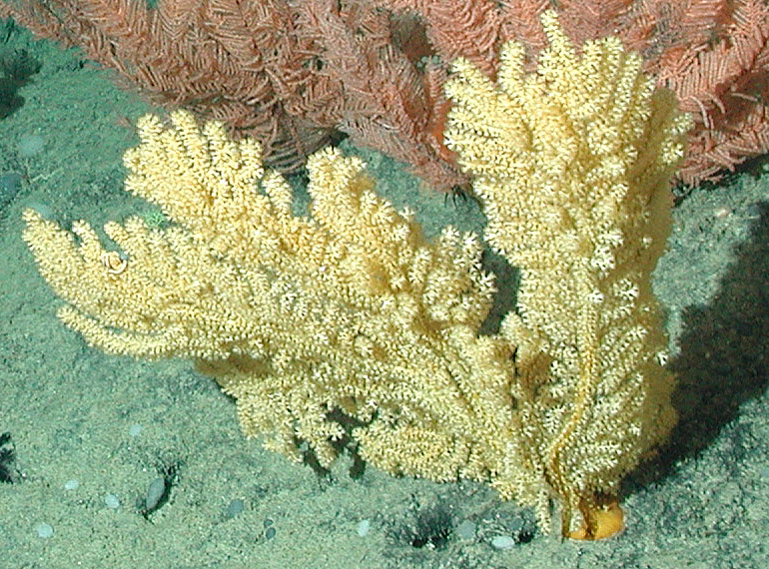
Acanthogorgiidae
Sea Fans with spikes
Ecological Importance
Not much known besides species diversity

Slide 3
Question
Is there a connection between environmental factors and species/genus occurrence?

Slide 4
Methods
Data-Specimens found from the Smithsonian, Harvard, and Yale Collections
Sorted by genus and removed points lacking coordinates
Worldwide ocean depth data
Moran’s I for correlation by depth
Predictive Maps

Slide 5
Moran’s I Results
 | Moran’s Index | Expected Index | Variance | Z-Score | p-Value
Acanthogorgia | 0.441161 | -0.002915 | 0.004707 | 6.472482 | 0.000000
Anthogorgia | 0.440345 | -0.004717 | 0.001432 | 11.762908 | 0.000000
Calcigorgia | 0.467377 | -0.030303 | 0.229317 | 1.039279 | 0.298675
Cyclomuricea | 0.999505 | -0.111111 | 0.984702 | 1.119210 | 0.263051
Muricella | 0.374559 | -0.0010638 | 0.003327 | 6.677775 | 0.000000

Slide 6
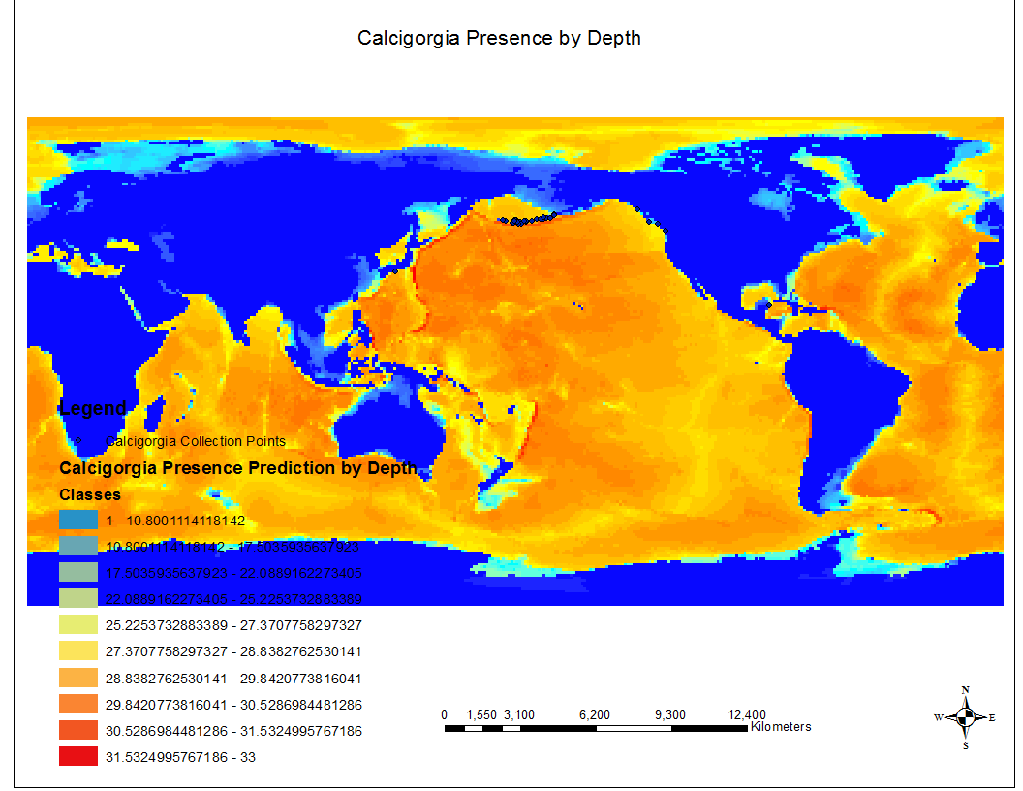
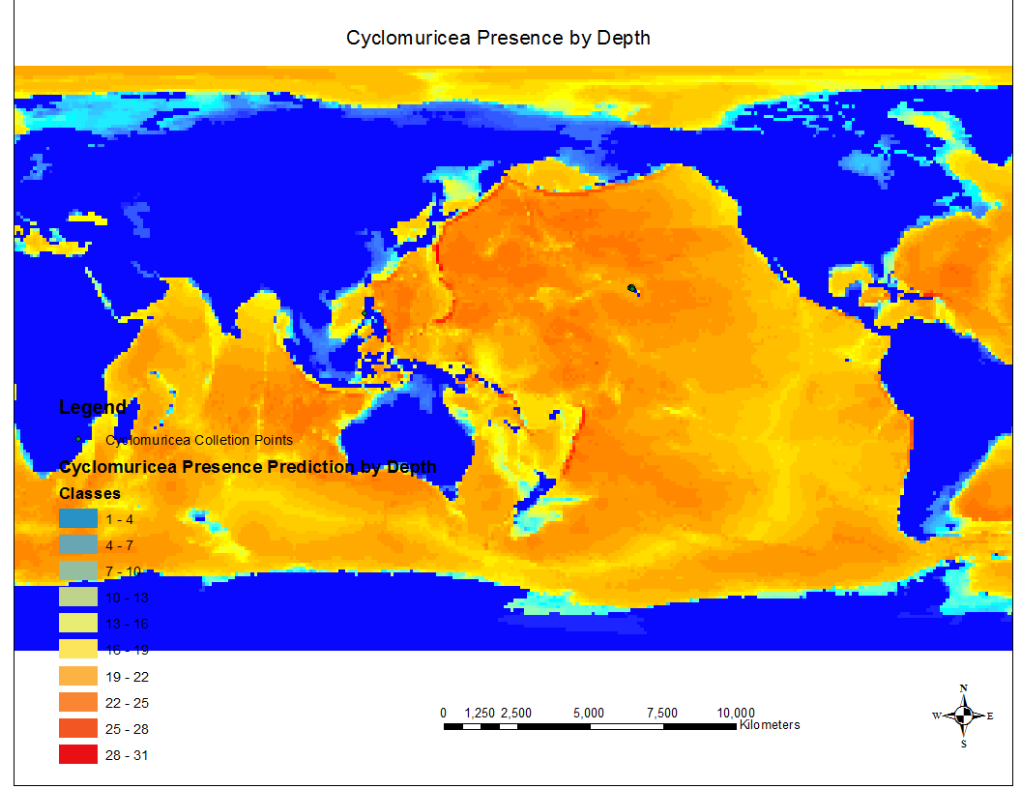
Inverse Distance Weighting

Slide 7
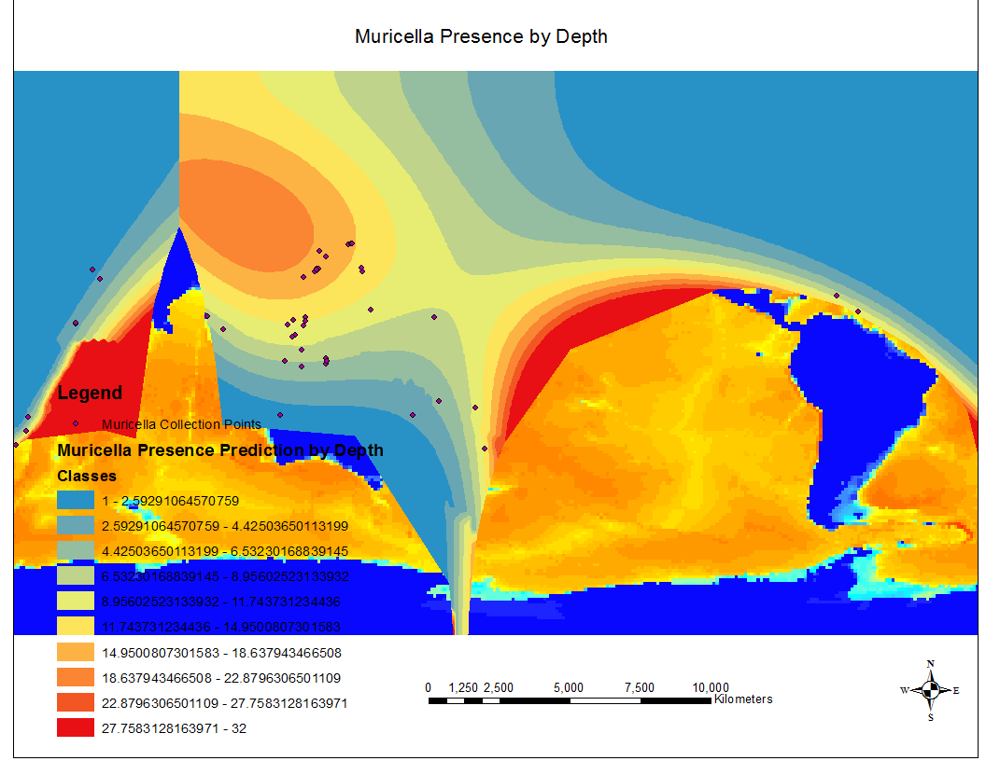
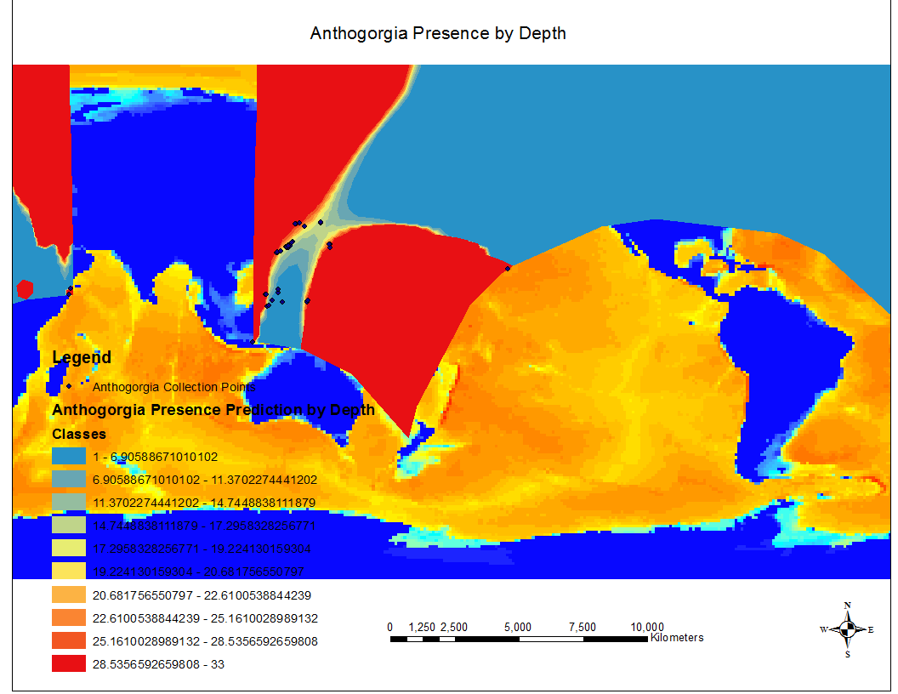
Krigging

Slide 8
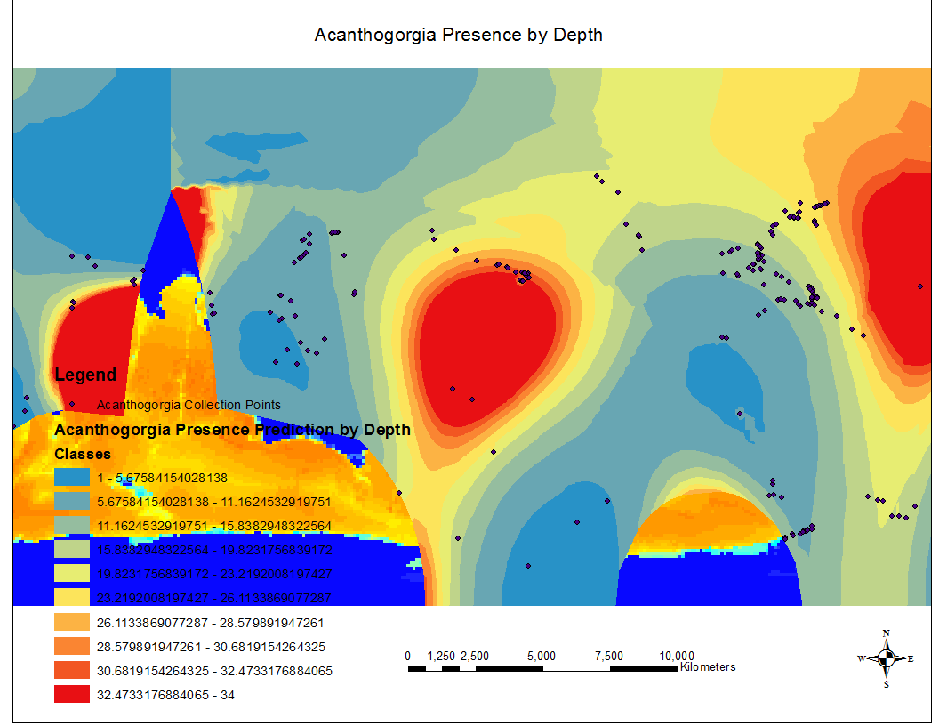
Last One

Slide 9
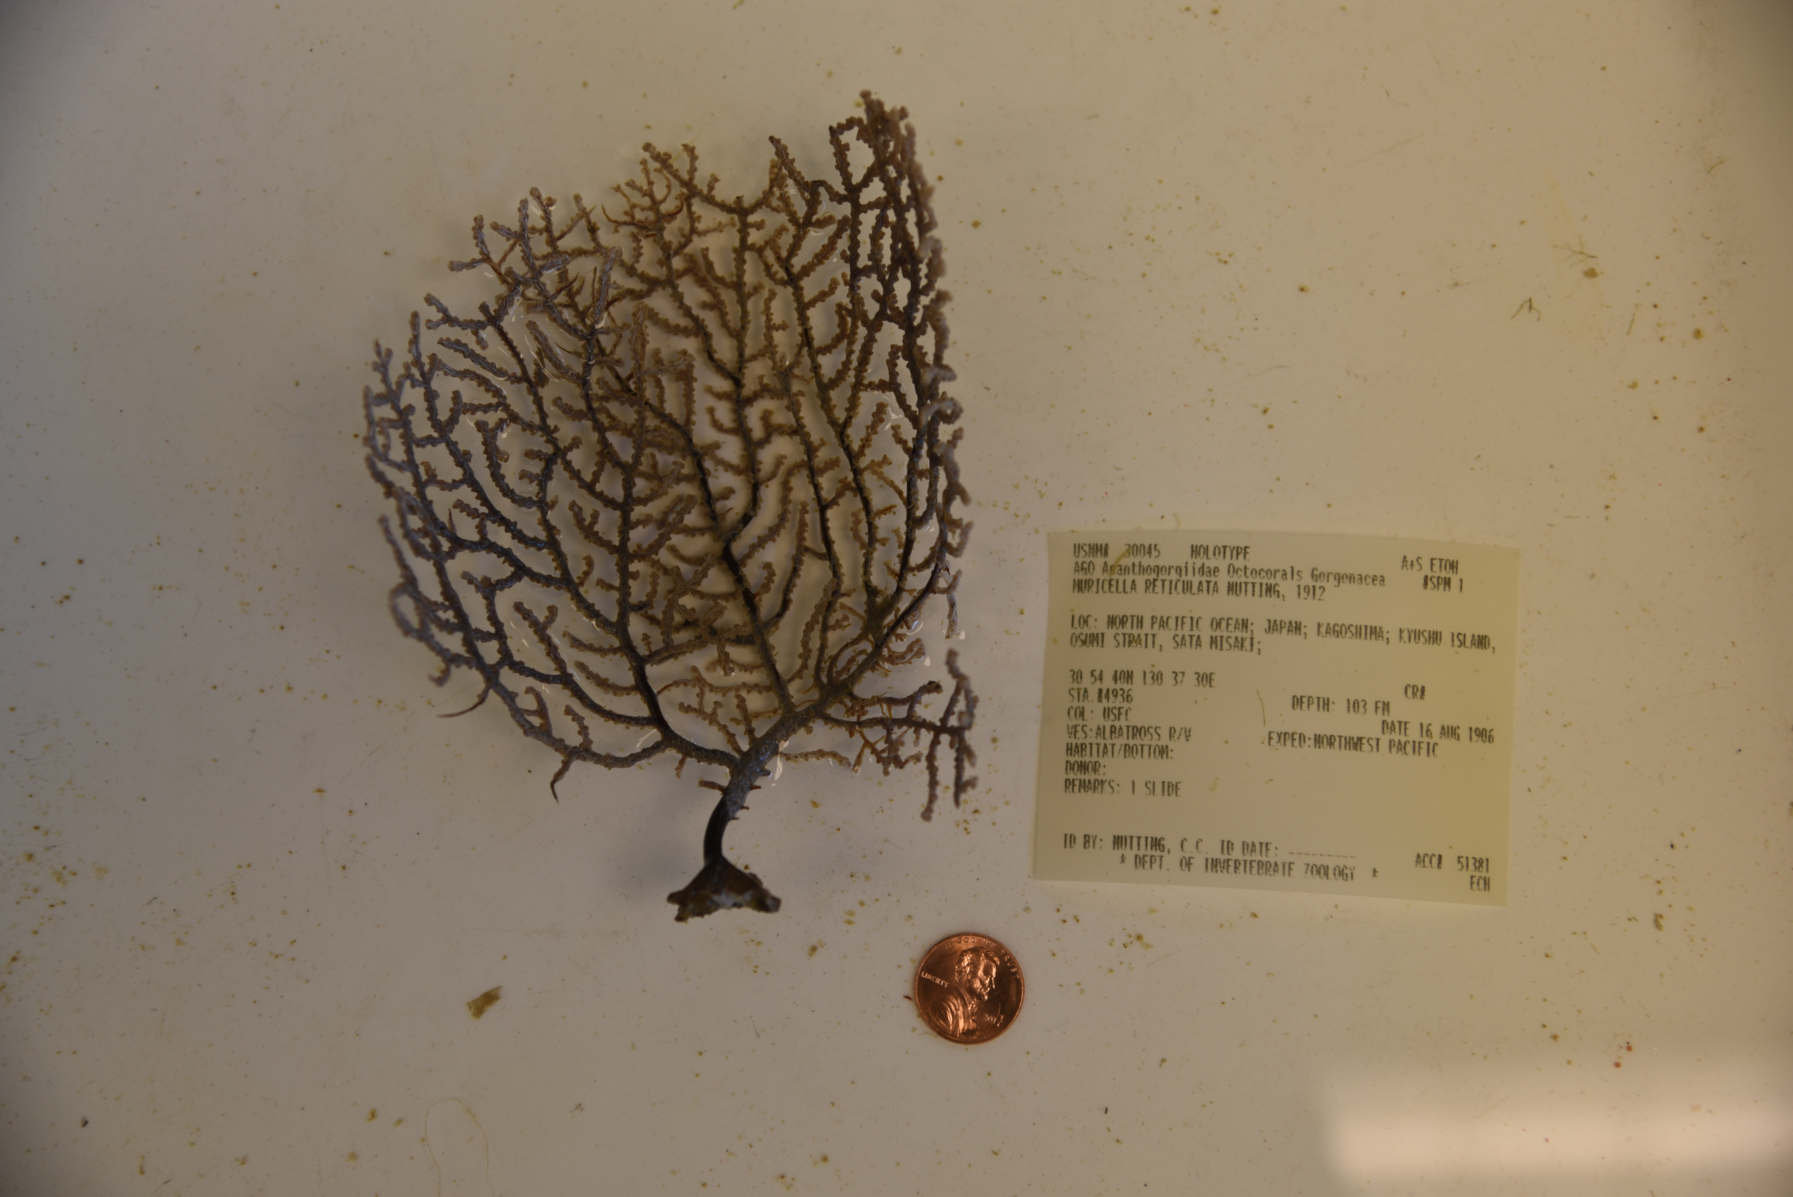
Questions?

