Slide 1
CSS Class vs. ID Selectors
Presented by: Justin Bench

Slide 2
Class
An attribute
Can be assigned to multiple elements on the same page
The CSS class selector is “.”

Slide 3
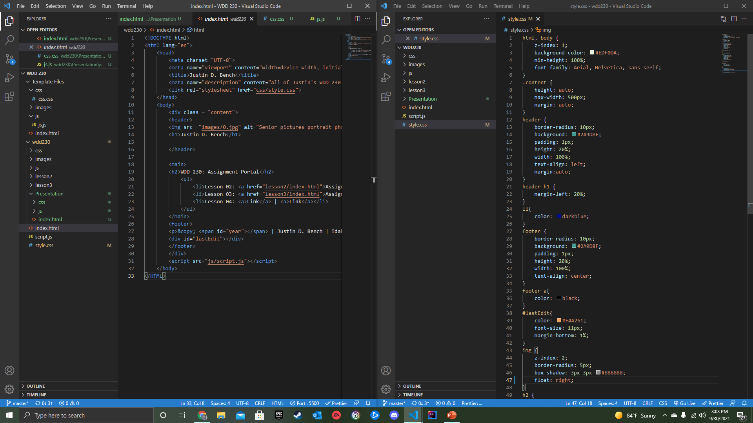
Example:

Slide 4
ID
An attribute
Can be assigned to one element on the same page
The CSS ID selector is “#”

Slide 5
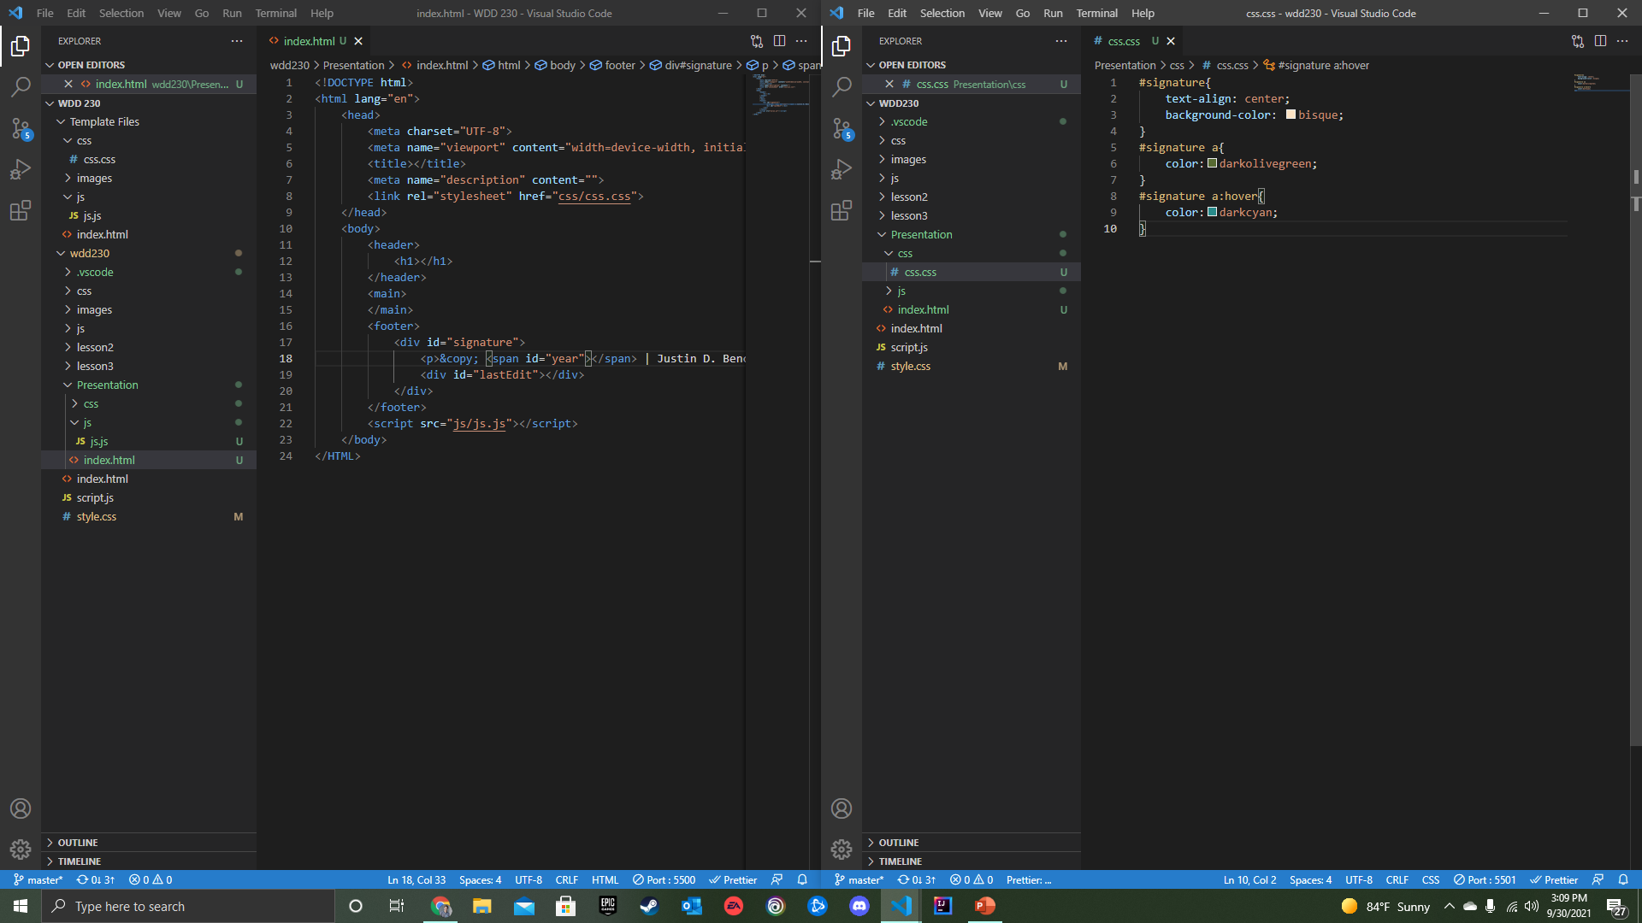
Example:

Slide 6
Which One Should I Use?

Slide 7
It Depends…
The “class” attribute is great for creating similar looking containers on an extensive webpage and website.
The “ID” attribute is good to be used when you want a specific container to look unique or to add unique functions to a webpage.

Slide 8
Examples:
<button class=“mainButton”>
</button>
<p class=“p1”></p>
<div id=“output”></div>
<form id=“name”></div>

