Slide 1
Gravitational wave event report
JD Black

Slide 2
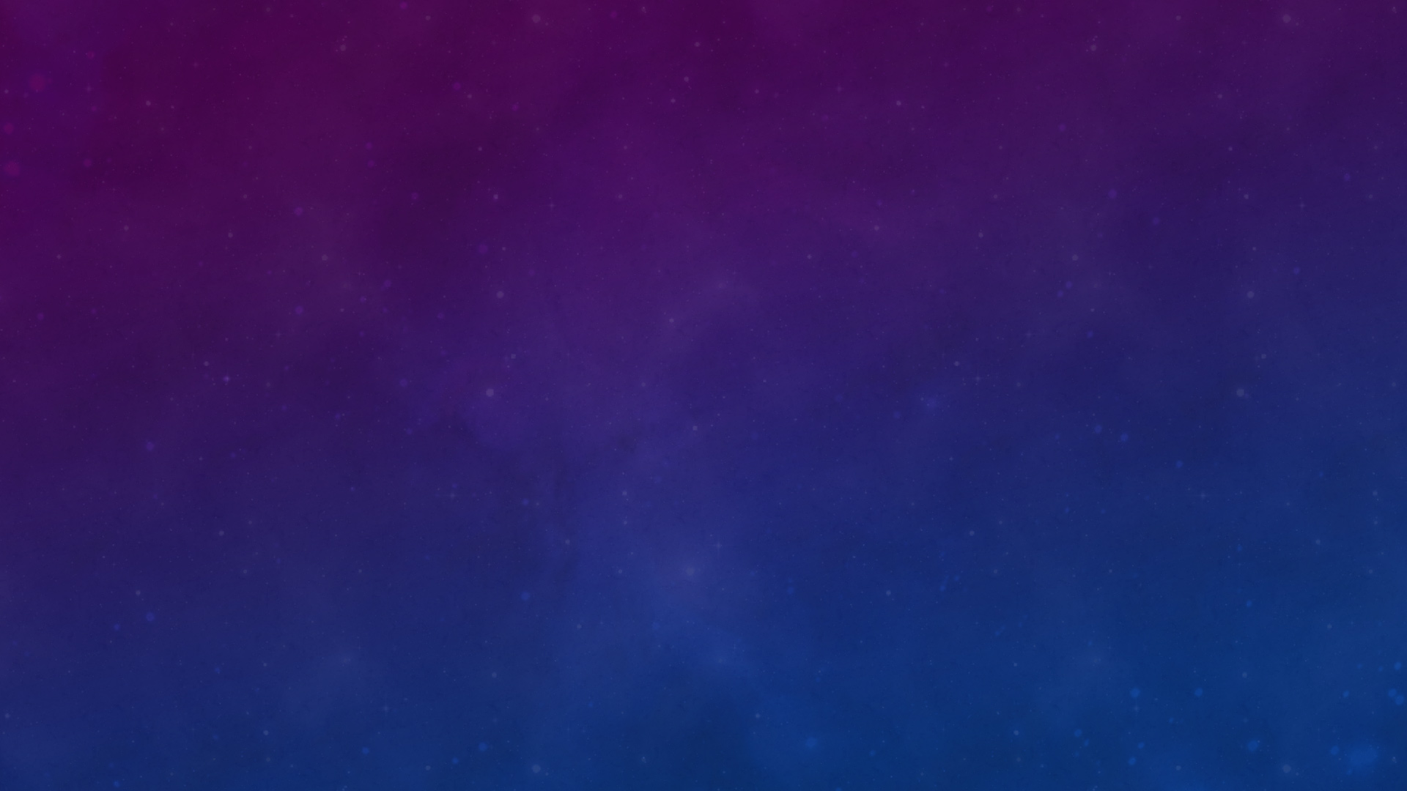
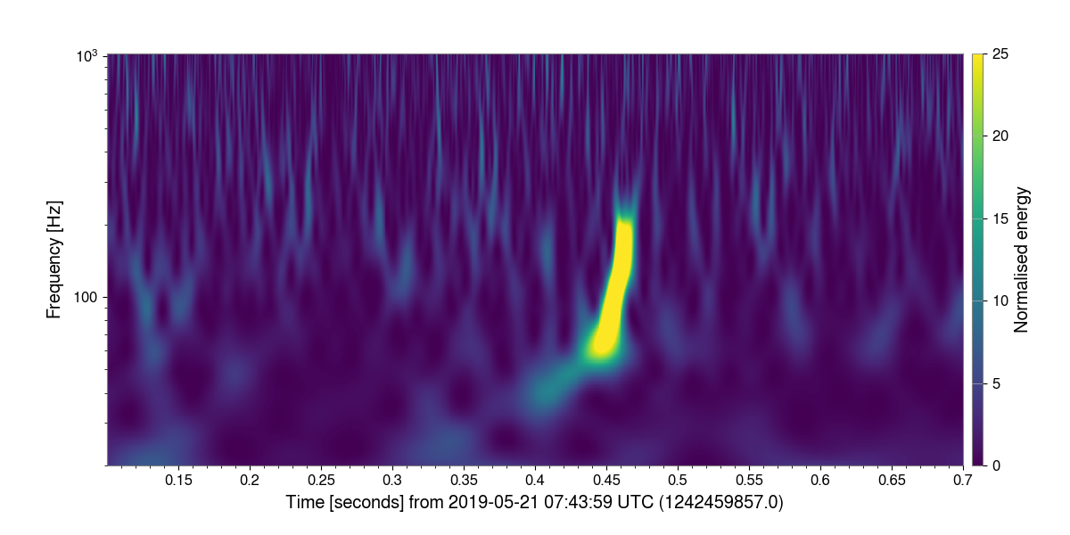
Motivation
Goal: Examine Gravitational Wave Event GW190521_074359
Create clear and compelling charts to show how the event occurred
Create a human listenable sound representation of the event

Slide 3
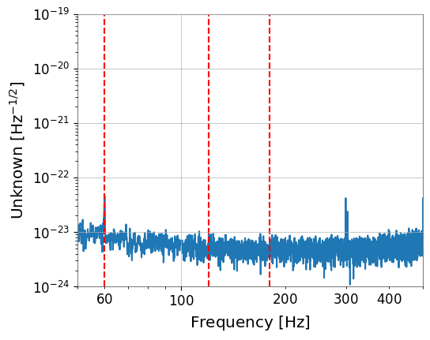
Step 1: Filter out Interference
By performing a Fourier Transform, we can see there is electrical interference at 60Hz.
We can create a filter and insert notches at 60, 120, and 180Hz to eliminate this interference

Slide 4
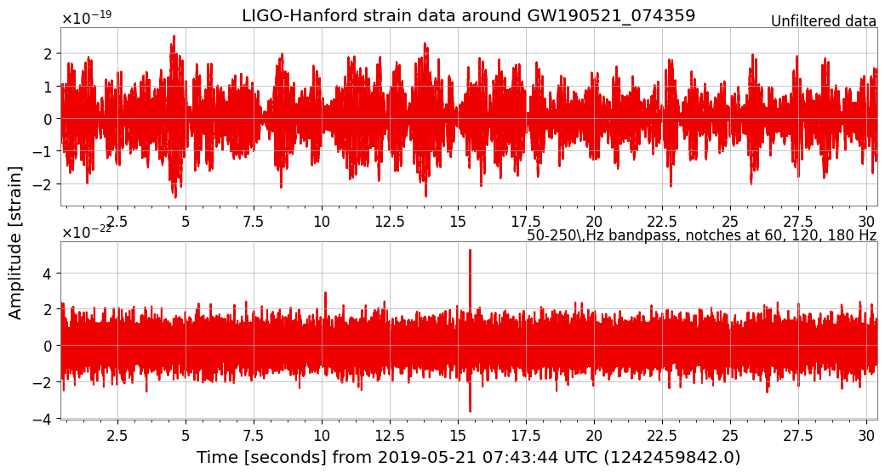
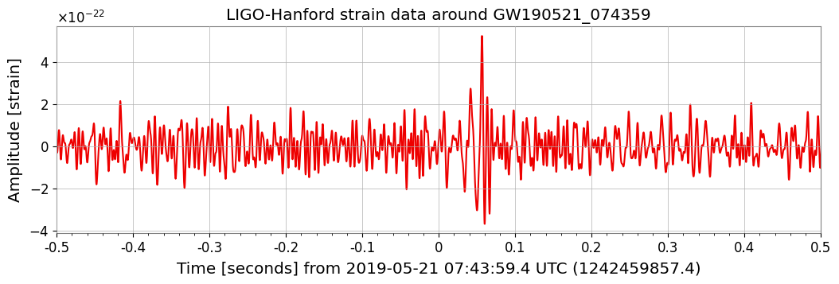
Before/ After filtering
After filtering out interference we can clearly see the event occurring
Cropping in further allows us to see it even more clearly

Slide 5
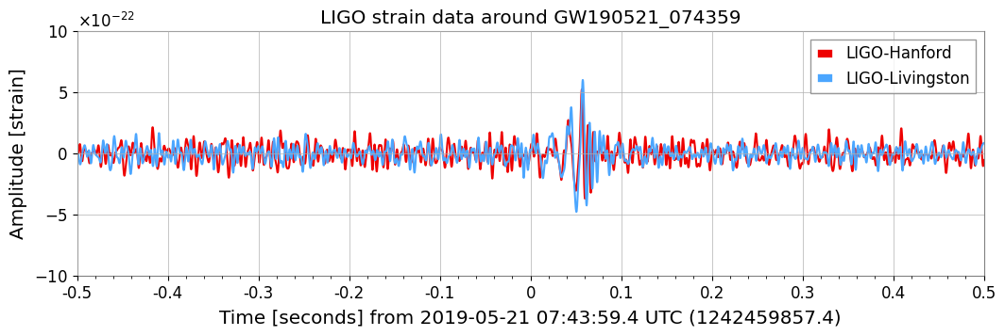
Comparing with other station
To ensure this is a legitimate gravitational wave event, we need to compare the results of both LIGO stations
Plotting each of the time series, we can see the event occurring in both locations with a delay consistent with the “speed” of gravitational waves

Slide 6

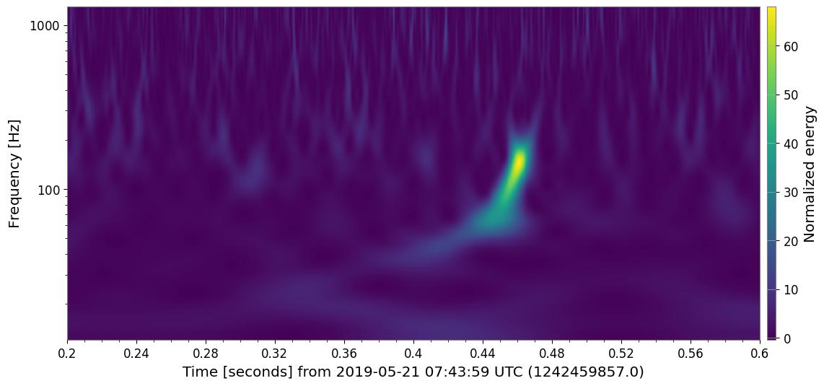
spectrogram
By using built-GWPY library, we can create a spectrogram plot of the event

Slide 7
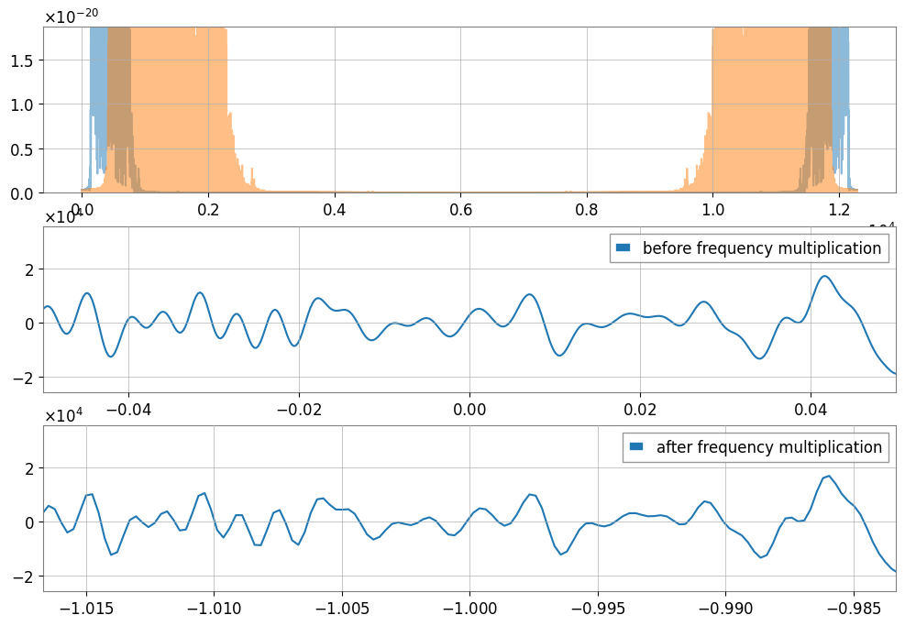
Creating sound file
Crop the audio around the event.
Normalize the audio.
Amplify data for human hearing.
Determine sampling rate from data.
Adjust pitch (multiplied frequency by three).
Download the final sound for playback.

Slide 8
Conclusions
Clear gravitational wave event signal detected by both LIGO stations.
Achieved audio conversion of gravitational wave events using signal processing.
Alternative method: DAW for pitch correction and amplification.

