Slide 1

Version Control
Introduction
Copyright © Software Carpentry 2010
This work is licensed under the Creative Commons Attribution License
See http://software-carpentry.org/license.html for more information.

Slide 2


Slide 3
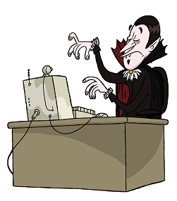

Slide 4
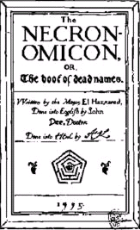
Notes:
Necronomicon image from http://www.2dollarstore.payloadz.com/details/801984-eBooks-Religion-and-Spirituality-Abdul-Alhazred-Al-Azif-The-Cipher-Manuscript-Known-As-Necronomicon.html

Slide 6
?

Slide 7


Slide 12


Slide 13
version control!

Slide 15


Slide 16


Slide 22
?

Slide 27
!

Slide 30
Better

Slide 31
No Overwrites

Slide 32
No arguments

Slide 33
nothing ever lost

Slide 35
1

Slide 36
1
2

Slide 37
1
2
.
.
.
6

Slide 38

1
2
.
.
.
6

Slide 39
nothing's perfekt

Slide 41


Slide 42

Notes:
Cthulhu image from http://www.nyder.com/cthulhu/cthulhucomic.html

Slide 43


Slide 44
created by Greg Wilson (July 2010)
modified by Diego Barneche (October 2013)
Copyright © Software Carpentry 2010
This work is licensed under the Creative Commons Attribution License
See http://software-carpentry.org/license.html for more information.

