Slide 1

Welcome!
Software Carpentry Bootcamp
at the
University of Chicago
Special thanks to our financial support from:
  Department of Human Genetics
  BSD Office of Graduate and Postdoctoral Affairs

Slide 2
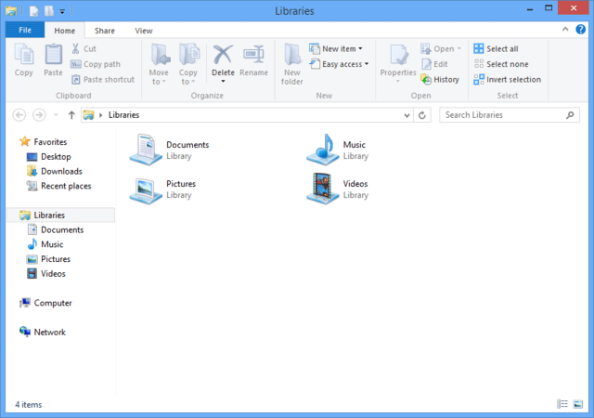
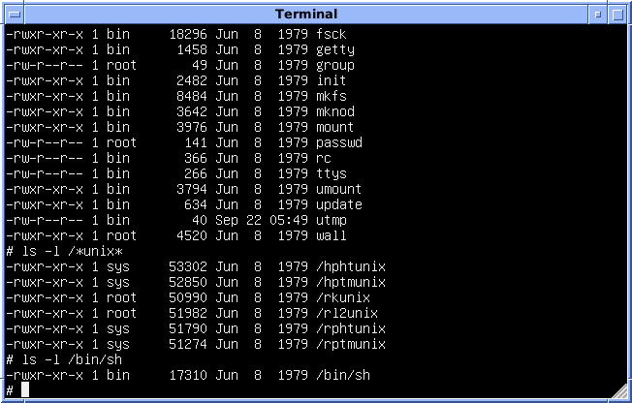
The Unix Shell

Slide 3
Git and GitHub

Slide 4

R

Slide 5
About Us
Get Involved
We are fellow scientists that are also volunteer instructors
Learn more at http://software-carpentry.org/

