Slide 1
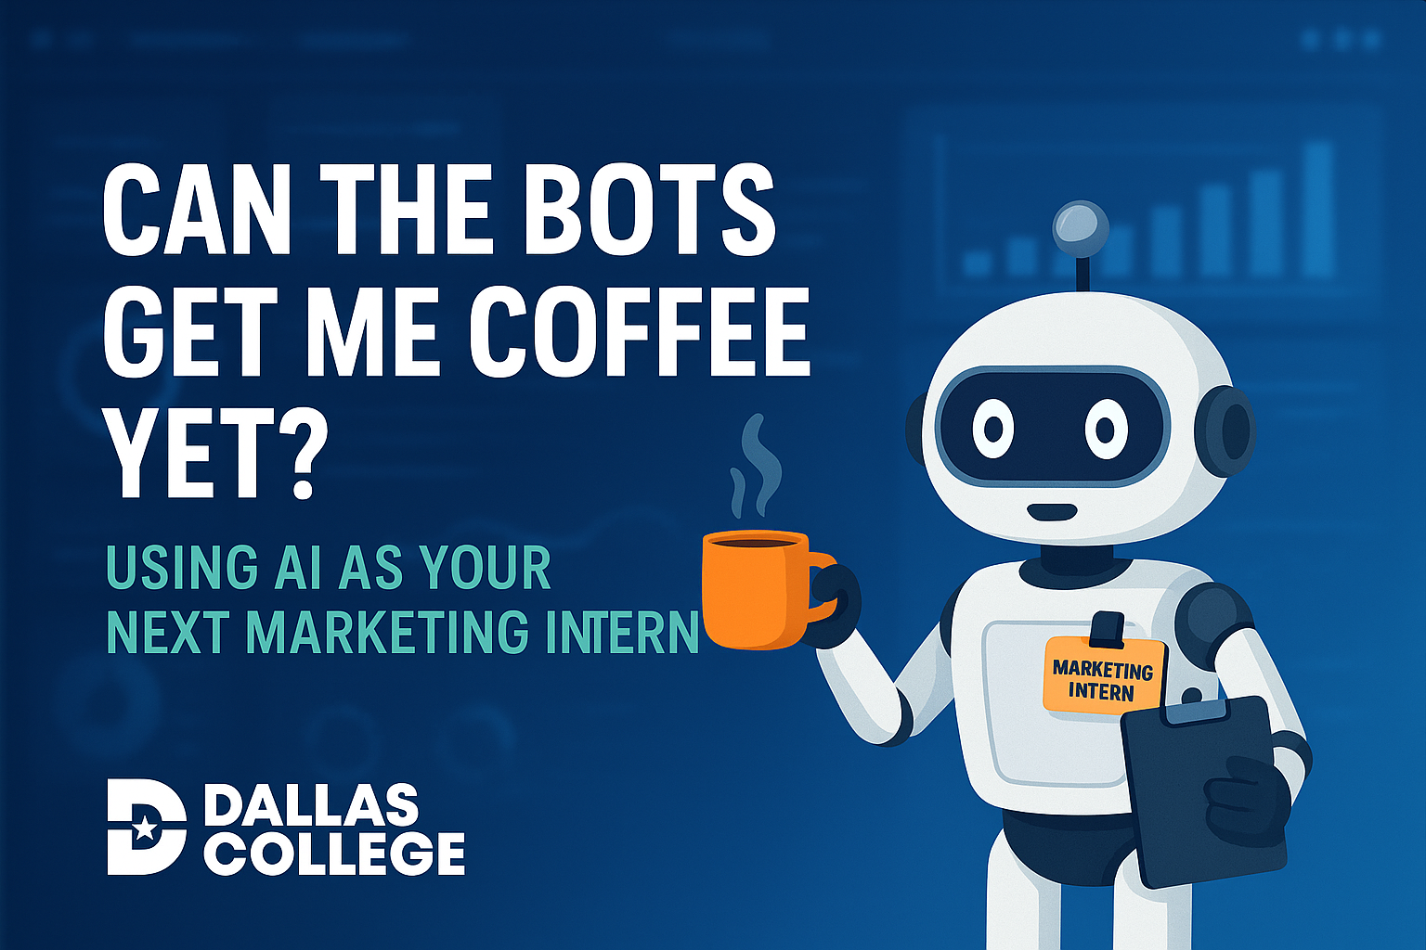
Can the bots get me coffee yet?
*AI Generated Image

Slide 2
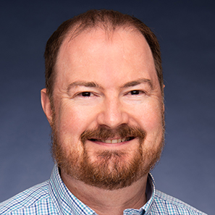
Jonathan Blundell
*AI Generated Image (with Edits)
Jonathan Blundell
Senior Director, Digital Experience
Dallas College
jblundell@dallascollege.edu
linkedin.com/in/jdblundell/
TACCM.org/Slack jdblundell.github.io/taccm-ai

Slide 3
Judgment Free Zone
“The biggest room in the house, is the room for improvement.”
- Dr. Wright Lassiter, Jr. Former DCCCD Chancellor

Slide 4

Rule #1: AI Doesn’t Always Get It Right
*AI Generated Image

Slide 5
Rule #2: The AI tools you use today are the worst they’ll ever be.
Notes:
Since I wrote the bulk of this presentation, Google has released their new Veo modeling tool with some AMAZING results – not covering that today.

Slide 6
This Presentation is Not …
A bashing of interns or work-study students
An ethics lesson on AI
A complete how-to on AI
A sales pitch on a bunch of expensive tools you’ll have to buy

Slide 7
Why compare AI to an Intern?
Interns fill in gaps around the office
They lack context and experience
They can do amazing work when given proper instructions
Notes:
Day Kibilds compared her AI to her Severance “Innie” – they do all the work for us

Slide 8
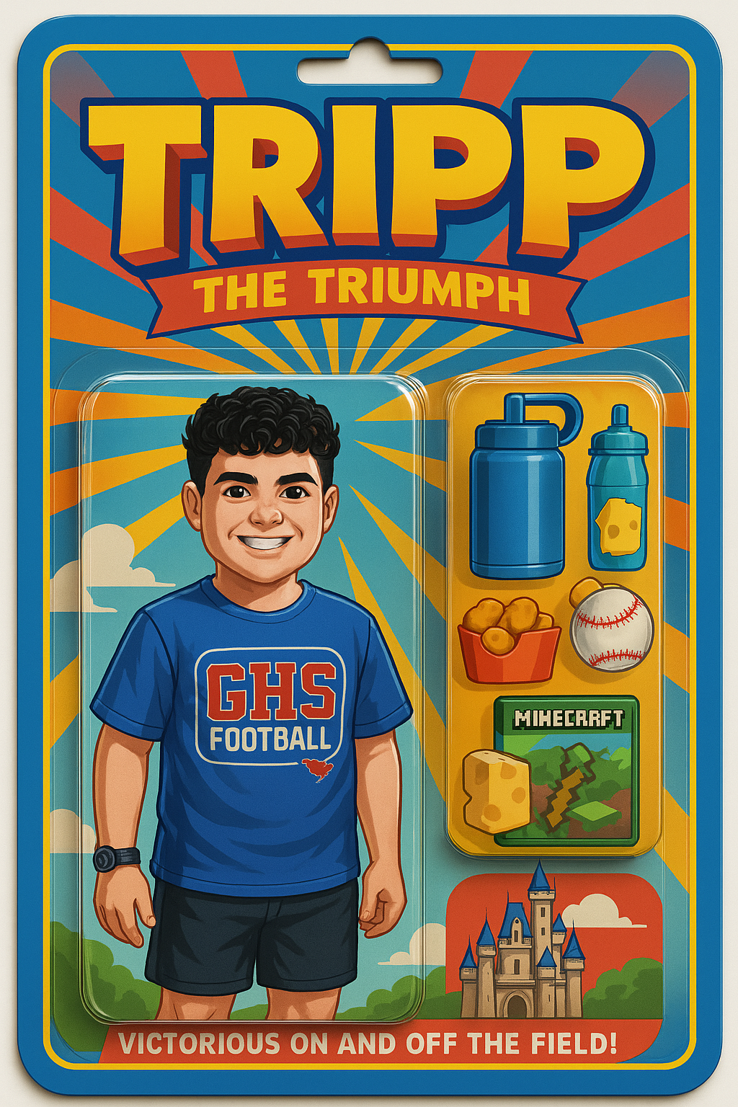
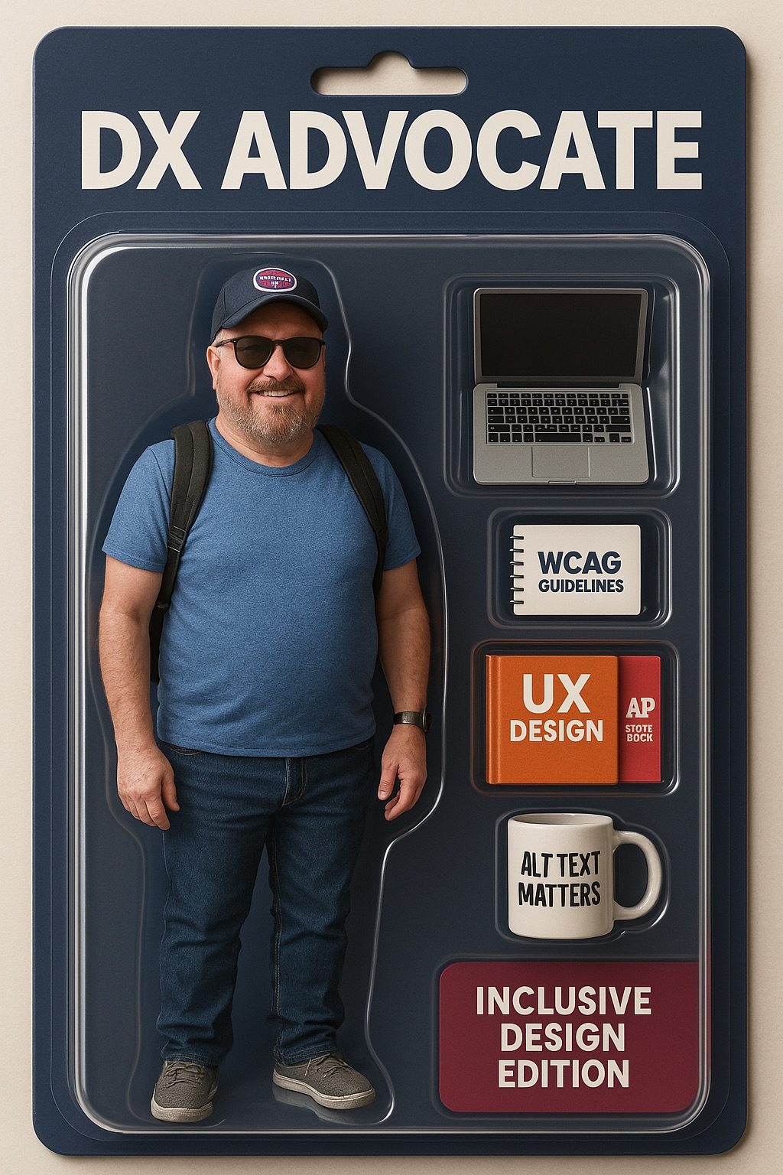
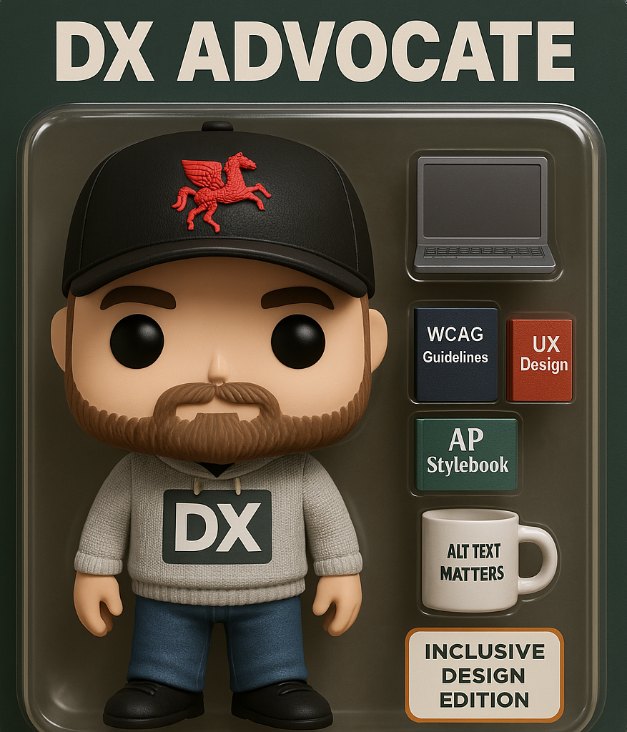
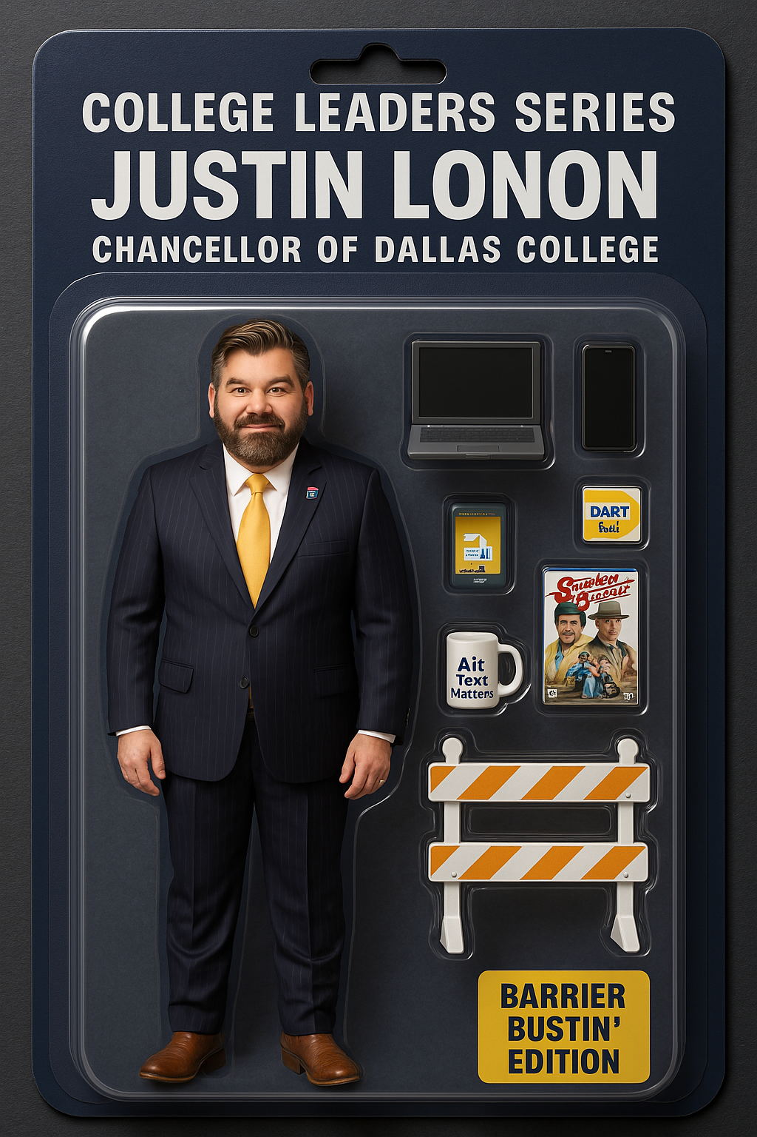
Action Figures in Action
Notes:
Several months ago you may remember the action figure fad when ChatGPT rolled out their new image processor. I played around with several different images and created a few I liked. My co-worker said he tried all weekend to get an action figure for his son to work. In the end … it was all in the instructions or “the prompt.”

Slide 9

Action Figure Prompt
Create a Funco pop figurine of the person in this photo. The action figure should be full-figure and displayed in its original blister pack packaging. On top of the box is the name of the toy 'DX Advocate' across a single line of text. In the blister pack packaging, next to the figure, show the toy's accessories, including a laptop, a WCAG guideline booklet, a UX Design book, an AP Stylebook, and a coffee mug labeled 'Alt Text Matters'. Include a large “DX” logo on the figurines shirt. There should be a label on the corner of the box that says 'Inclusive Design Edition’.
This figure should look like a premium collector's item and everything should be inside the plastic!

Slide 10
How Can We Use AI at Work?
Proofing Content or Editing for Tone and Voice
Generating Ideas
Repetitive tasks
Coding
Analysis and Reporting
Training development

Slide 11
What are we really talking about?
AI tools simulate intelligence by finding patterns in extensive amounts of data at high speed
AI then organizes data and responses based on those patterns

Slide 12
Some gotchas
AI will often take the short route and leave out content it deems unessential
Slight changes can input or context can lead to different outcomes

Slide 13
Tools I use
Copilot
ChatGPT
Claude
Google Notebook LM
Gemini

Slide 14
It begins with a story or prompt
Think of the story of Goldilocks and the three bears and how they might have treated Goldilocks differently.
Consider the story of Goldilocks and the three bears. Imagine if Goldilocks arrived after breakfast, how would the bears have treated her differently.
Imagine if Goldilocks ran away and got a new job in the city and learned from her experience. Tell me that story.

Slide 15
Apply a persona
You’re a momma bear telling the story of Goldilocks and the three bears to your children and wanting to warn them to lock the doors when they leave.
You’re a six-year-old child reading Goldilocks and the three bears to a group of preschoolers. Write the story for your audience.
You’re a college English professor wanting to impress the dean on your writing abilities. Rewrite the story of Goldilocks and the three bears as if it was a new story to impress your dean.

Slide 16
Optimize your prompts
You’re a six-year-old child reading Goldilocks and the three bears to a group of preschoolers. Merge the story with the story of the big bad wolf into the storyline. Adapt the narrative so the big bad wolf if already eating the bowl of porridge when Goldilocks arrives. Using simple words, write the story for your audience.

Slide 17
Basic Prompt Guidelines
Set a persona – remind the bot who they are in their role
Be clear and specific – include the who, what, why and how
Provide context – add background info or constraints to guide the AI
Define the output – do you want a list, paragraph, table, HTML
Break down complex tasks
Avoid ambiguity – words like “it,” “thing,” or “do that” can confuse the bot

Slide 18
Context is king
The more information and context you can give AI, the happier you’ll be with the results.

Slide 19

Generating Ideas
You’re a content strategist for a community college. Review these search engine queries for the website and create a list of 5 blog posts to boost SEO for the website. Create a basic outline for each of the posts and suggest social media posts to help promote the published posts. Take your time.

Slide 20
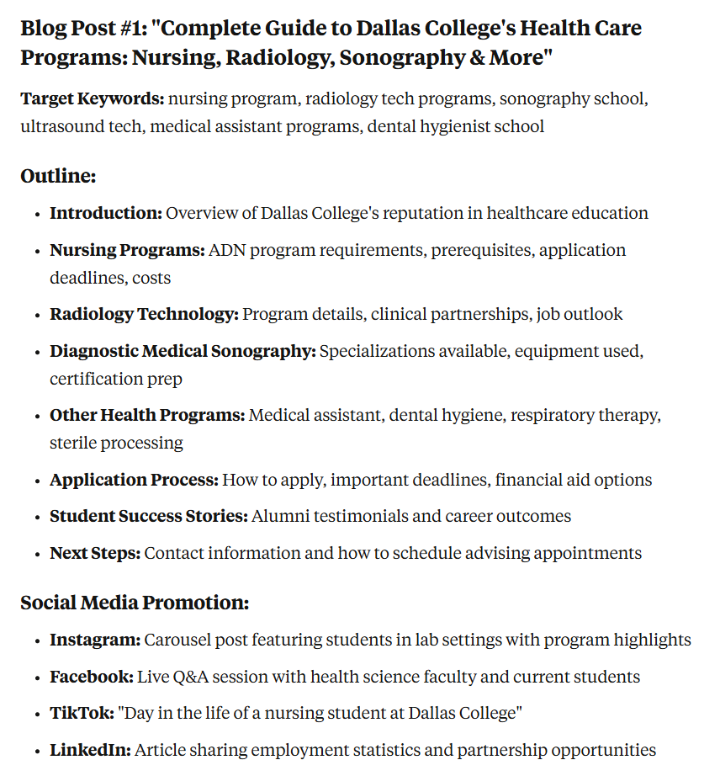
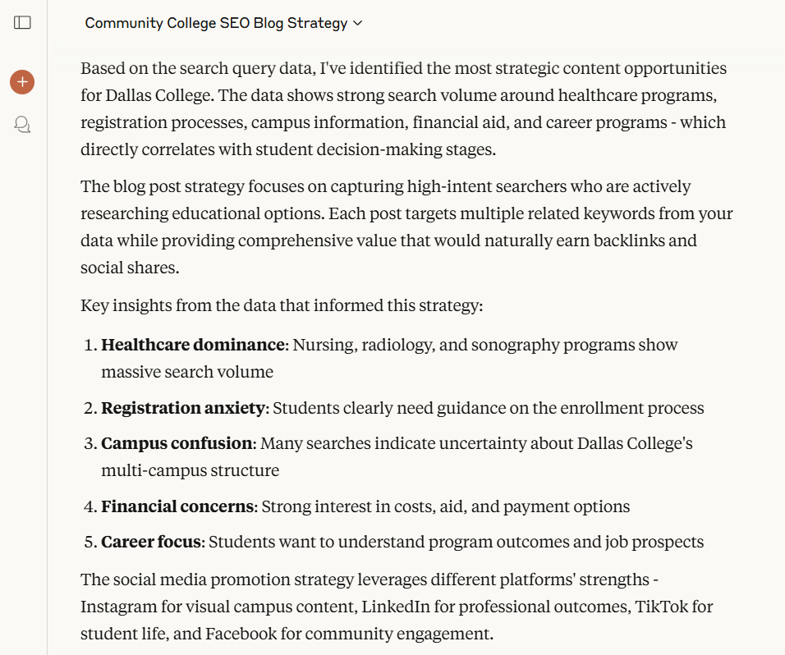
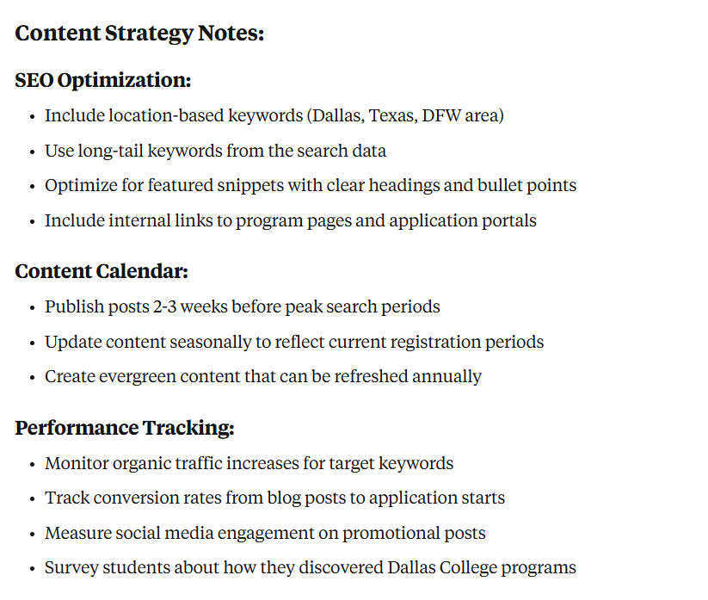
Generating Ideas Responses

Slide 21
Proofing for Tone and Voice
Review this landing page and optimize the page to attract adult learners to the program. The ideal site visitor will be 25-40 years in age, working and possibly under-employed and considering the chance to go back to college and learn a new skill to find a better paying job. Also suggest images to go along with the content. Make sure to follow the college tone and voice. Take your time.
Notes:
We saw a 16% bump in CTA clicks after making some of these changes for our fall campaign.

Slide 22
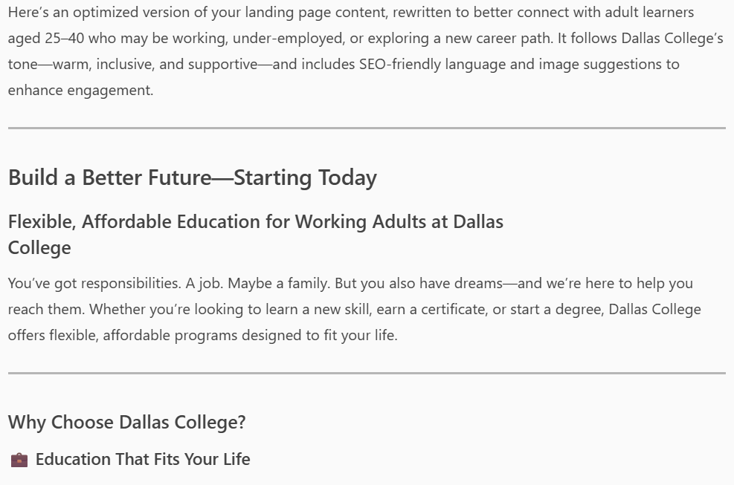
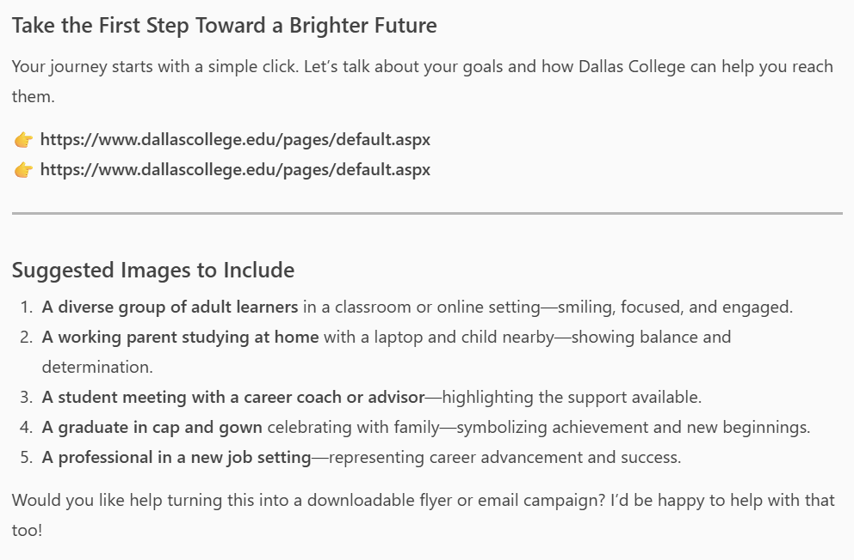
Proofing for Tone and Voice Results
Notes:
We saw a 16% bump in CTA clicks after making some of these changes for our fall campaign.

Slide 23
Generating Content
You’re a content strategist for a community college. Review the degree plans at XXX, XXX and XXX. You want to promote these three degrees to adult learners. Write a marketing landing page to promote these three degree plans in a single landing page for prospective students. Write it using the college tone and voice and optimize for SEO. Take your time.

Slide 24
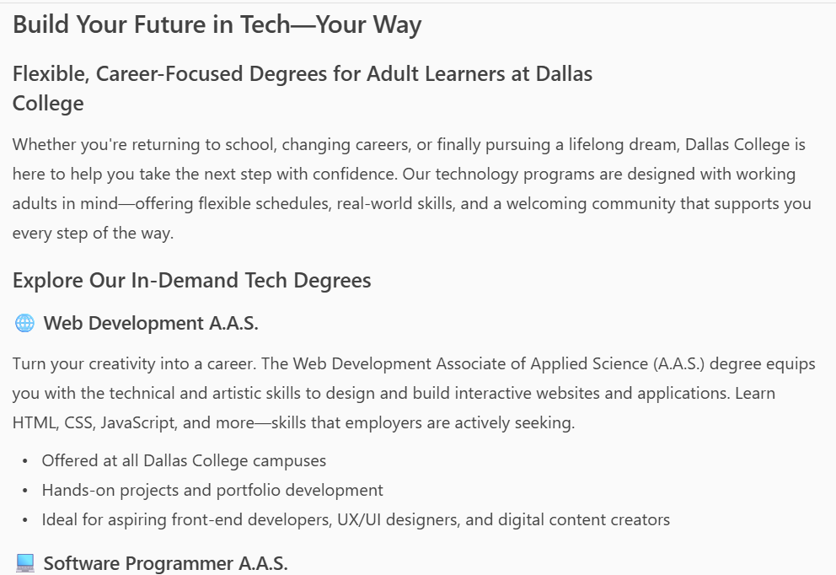
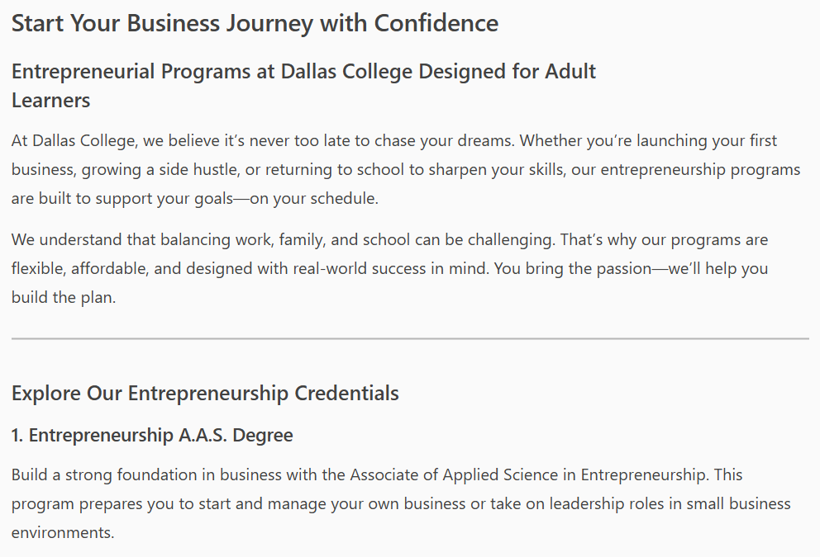
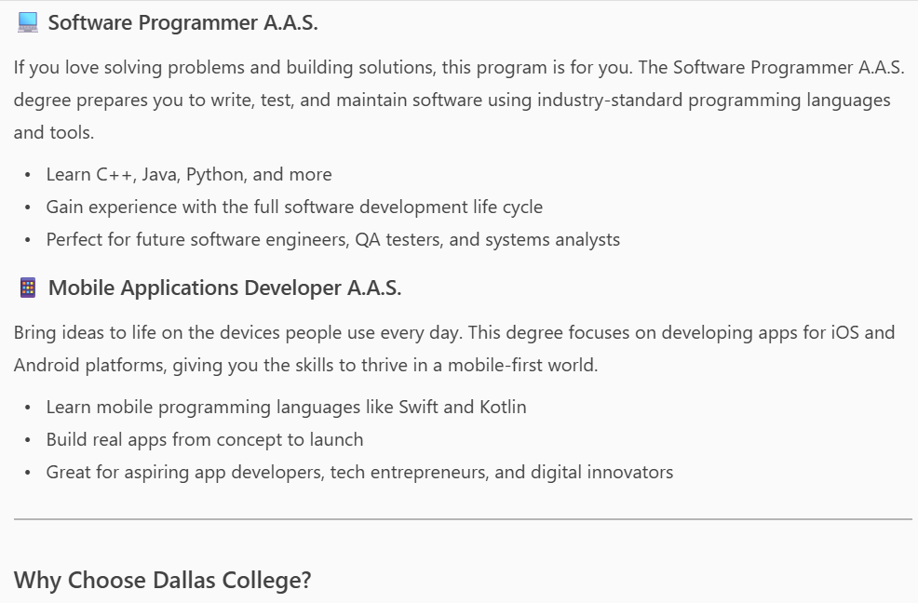
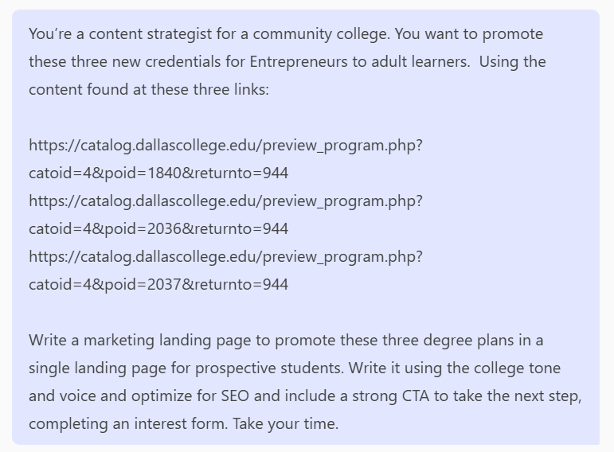
Generating Content Response

Slide 25
Repetitive Tasks
Take this list and create proper HTML for it. Create an H2 for each unique date, put the individual items in UL lists underneath the H2 and remove all the (PDF - XXkb) references.
Update this HTML code so the aria-hidden tags are converted to accessible aria-labled tags for the table.

Slide 26
Coding
Review this Bootstrap 3 code and convert it to valid Bootstrap 5 code.
Validate this code with Bootstrap 5 and ensure it meets accessibility standards.
I’m getting an error XXX. Explain what this means and show me how to make the code accessible.

Slide 27
Coding From Scratch
Review this design element and code it with the Bootstrap 5 framework. Ensure it’s valid HTML, uses built in Bootstrap 5 classes and meets all accessibility requirements. Include any additional CSS styles needed to replicate the design. Take your time.

Slide 28
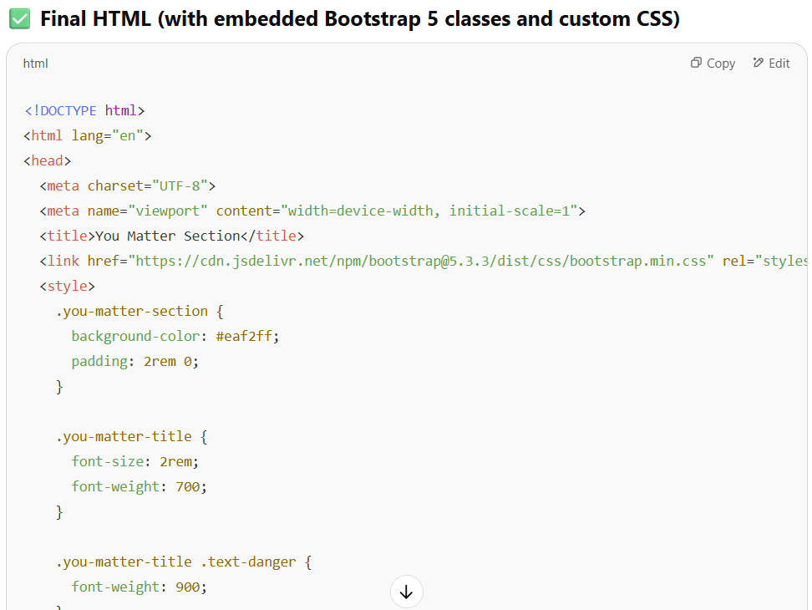
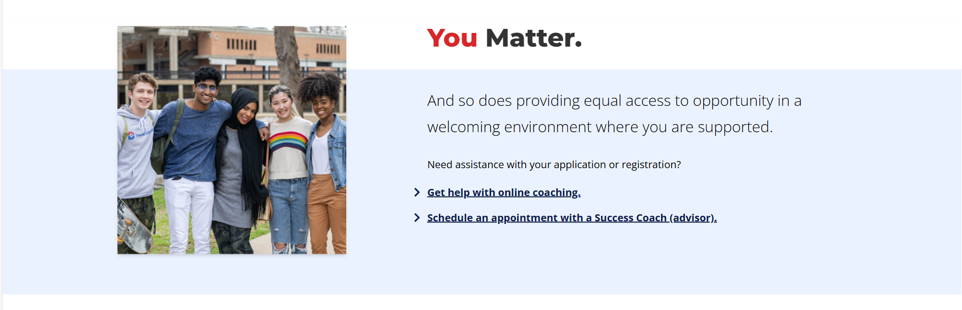
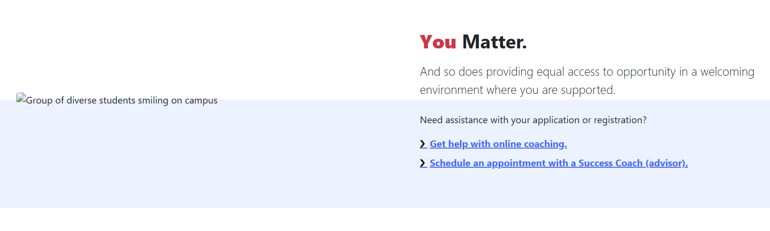
Coding From Scratch Results

Slide 29
Analysis
You’re a marketing analyst for a community college. Review this spreadsheet that includes data from our Fall campaign. Analyze the data and highlight trends, oddities and other key data points that would be valuable for sharing in a presentation to your CMO. Take your time.

Slide 30
Deeper Analysis
Looking at these two data sets - one lists all the leads from Sept. 2023-today. The other only lists leads that show a confirmed conversion based on their email address (noted by a contact ID).
Analyze this data and give me key talking points for FY23 and FY24 and also provide possible scenarios for and trends or changes. Ask any clarifying questions you need and pause between each question to get a response before moving on and continuing your analysis.

Slide 31
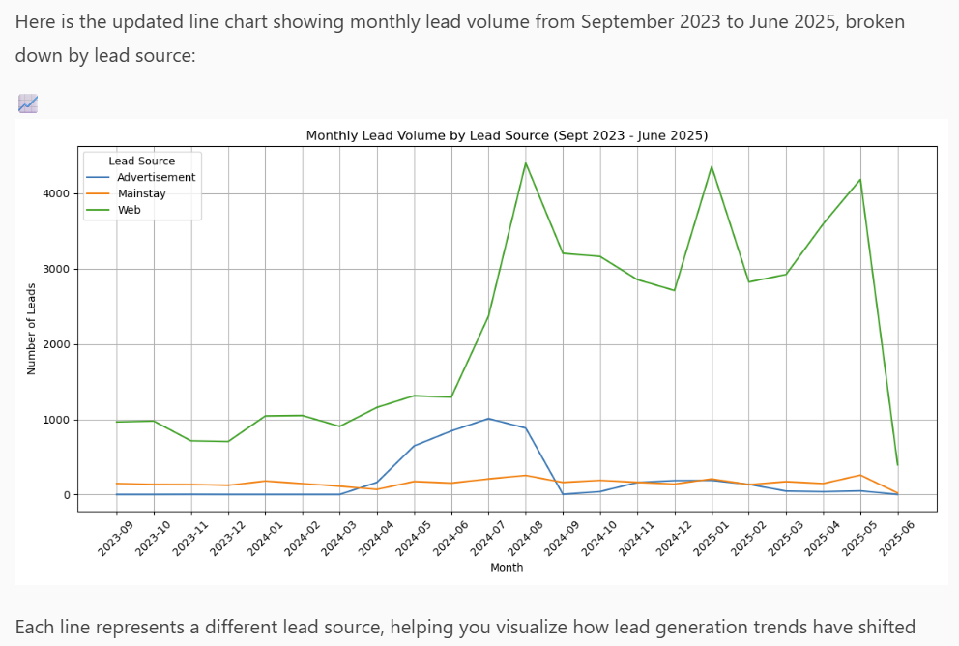
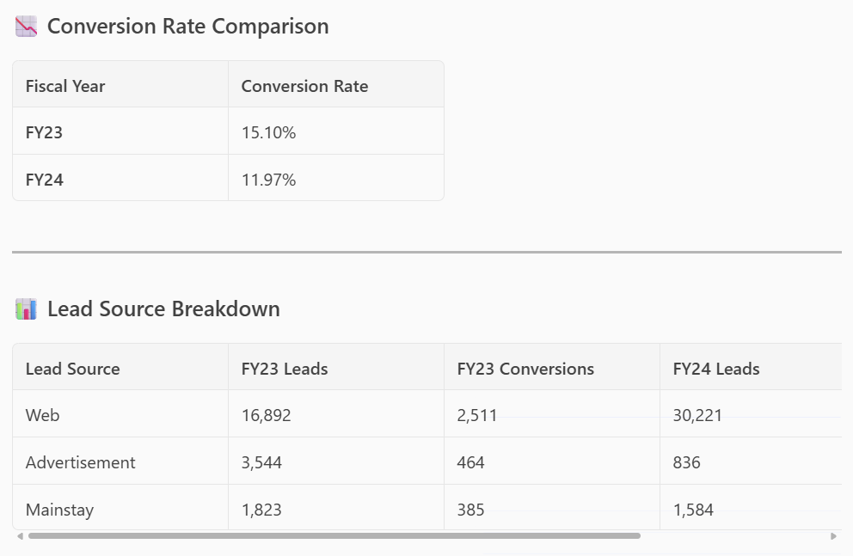
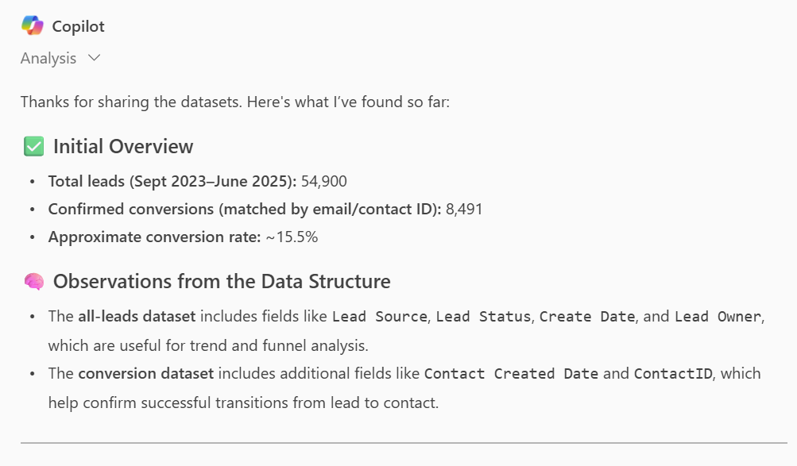
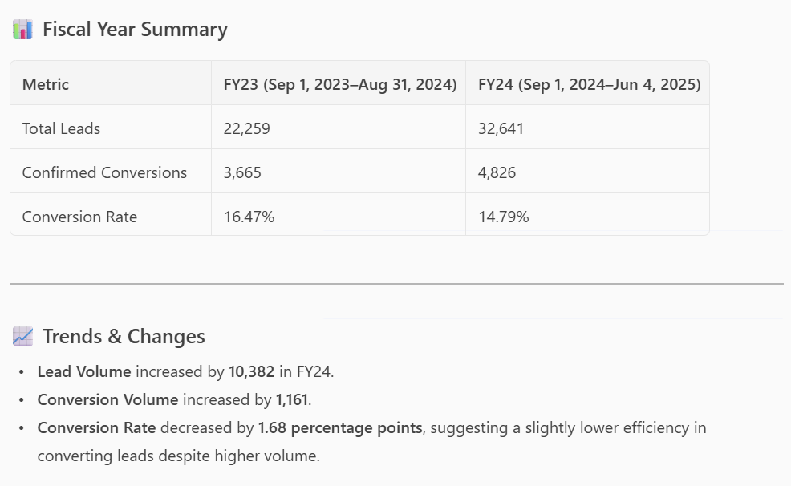
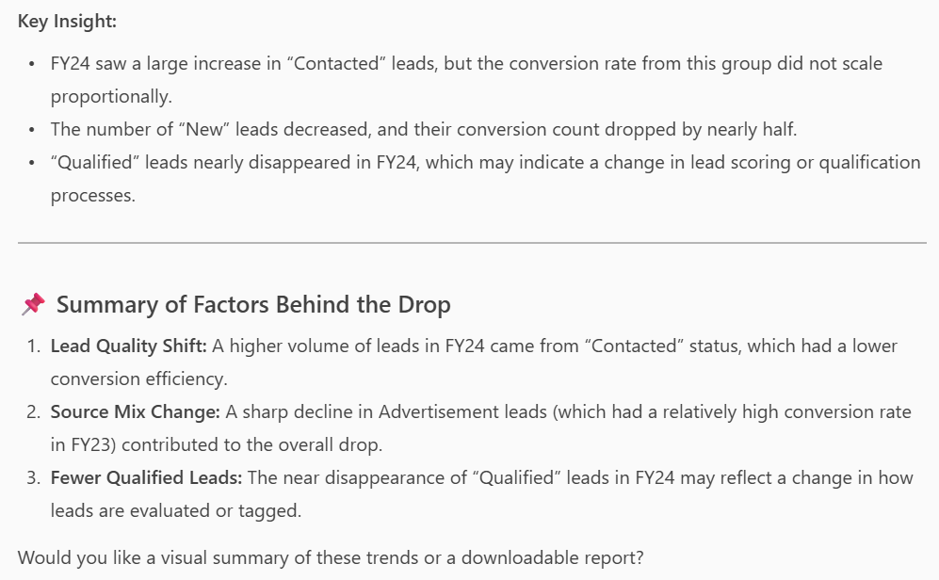
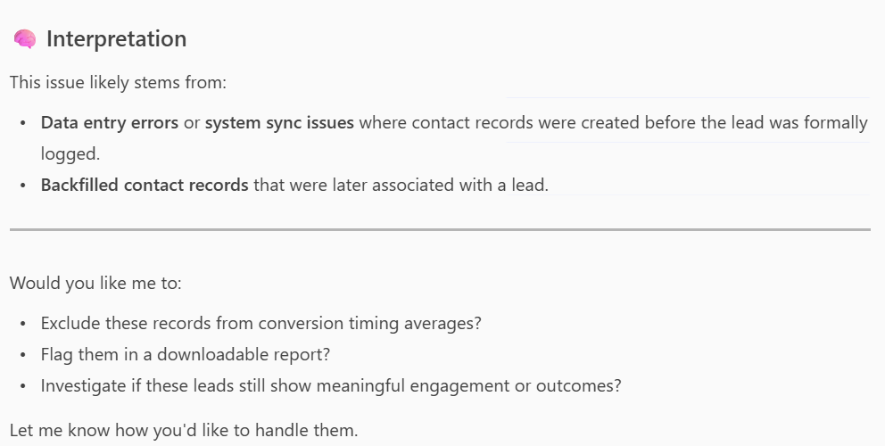
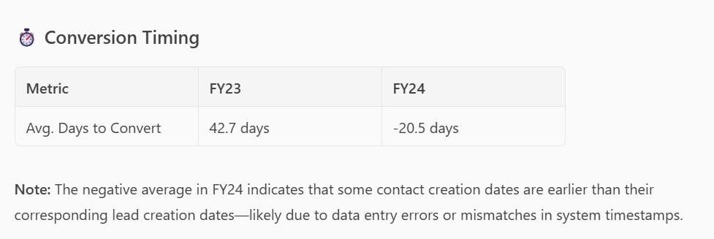
Deeper Analysis Results

Slide 32
Analysis and Simplifying Ideas
Review this email from IT and explain it to me like I’m a 5th grader.
Based on this documentation, from THECB, give me a basic comparison of all the credentials listed in the glossary. Include the associate and other degrees that are mentioned.

Slide 33
Simplifying Ideas
Rewrite this email and optimize it for the CMO and other executives.
MailedIt GPT

Slide 34
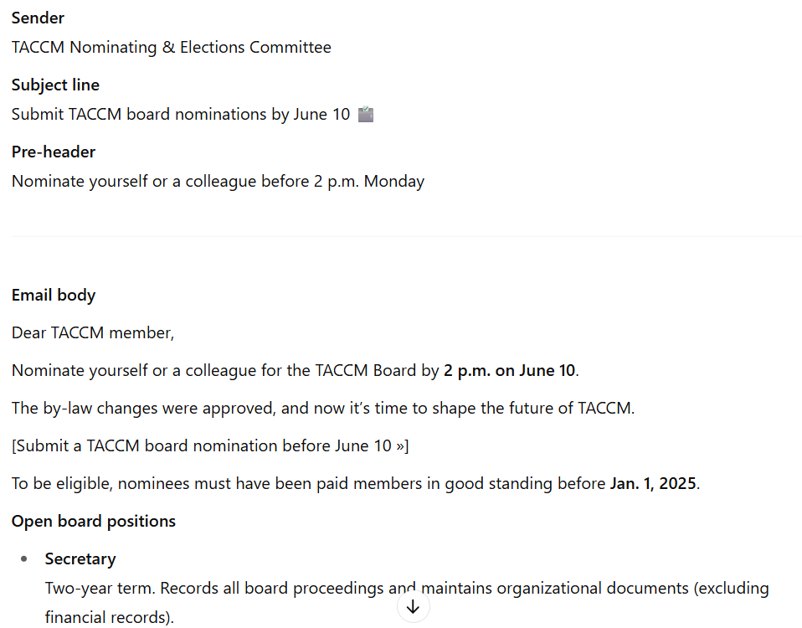
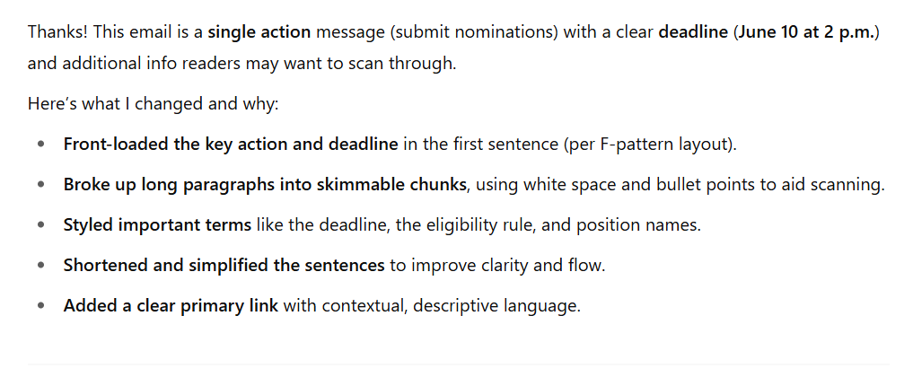
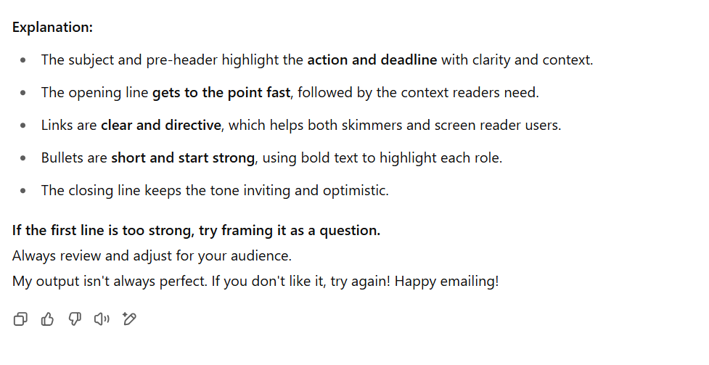
MailedIt

Slide 35
Conflict Resolution
Upload the text or screenshots of a difficult conversation you’re having with a colleague and then use the prompt:
In this conversation I’m having a hard time interpreting the messages from X. Help me decode it and use a gentle, generous interpretation, assuming the best intent from the other individual, and suggest conflict resolution methods.

Slide 36
Strengthening Ideas
You’re a CMO and your web director has presented you with a new policy outlining how they will handle upcoming web projects. Review the policy and ask clarifying questions to strengthen the policy and remove any questions and objections from partners. Ask each question and then wait for a response before continuing. Consider all the responses as you continue to refine and optimize the policy. Take your time.

Slide 37
Setting Goals
Review these personal goals and turn them into SMART goals. Ask any clarifying questions about metrics, timelines or any measurements as needed. Pause after each question for a response.

Slide 38
Setting Team Goals
You’re a community college marketing director and you need to set goals for your team for the coming academic school year. Your team includes writers, project managers, email marketing and brand awareness. Write 5 SMART goals for each group. Provide options for stretch goals. Ask questions as needed about the team and wait for my responses to improve the goals.

Slide 39
Competitive Analysis
You’re moving to North Texas and trying to decide what college to attend. Create a list of the pros and cons for the following community colleges and provide a breakdown of tuition and other costs. Also highlight programs in high-paying jobs. Take your time. Dallas College Tarrant County College Collin College TSTC
Notes:
It’s a good idea to verify this information as some of it may be outdated … BUT the analysis of your own data is definitely key because it’s the data your students are using to compare you to other institutions. So is it correct on your website and elsewhere?

Slide 40
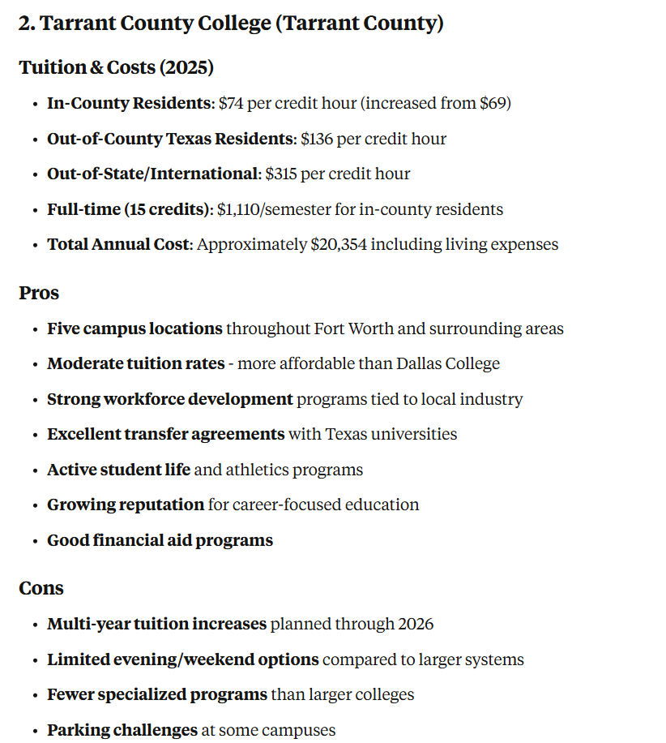
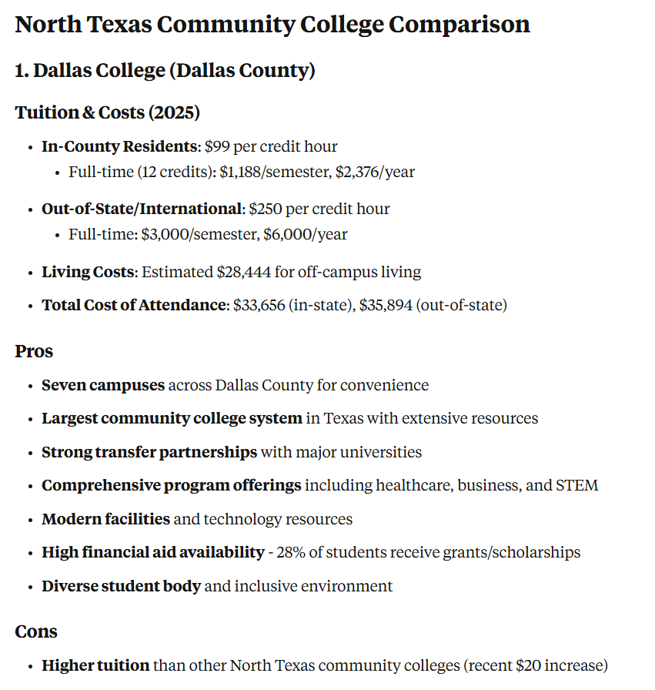
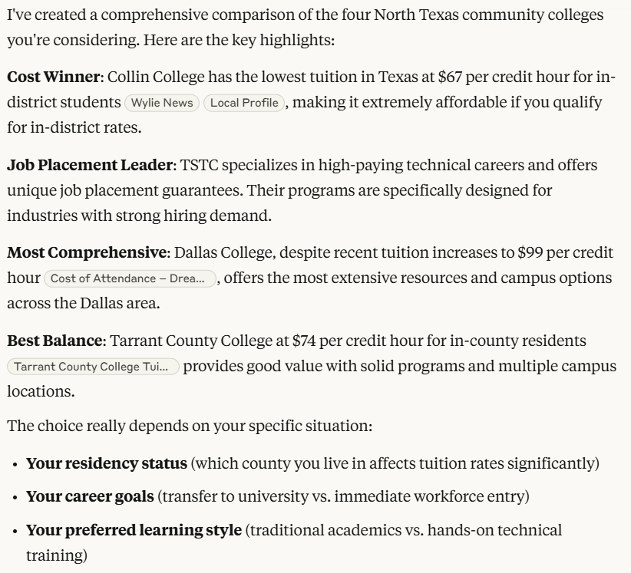
Competitive Analysis Response
Notes:
It’s a good idea to verify this information as some of it may be outdated … BUT the analysis of your own data is definitely key because it’s the data your students are using to compare you to other institutions. So is it correct on your website and elsewhere?

Slide 41
Training and Support
Based on the documentation found at docs.Terminalfour.com show me how to use Handlebars to limit code when “Location” does not equal “All Locations.”

Slide 42
Training and Validation
Based only on content from DallasCollege.edu what are the steps to apply and register for classes at Dallas College. Include any important timelines a student should be aware of and include your source webpages. Take your time.

Slide 43
Google Notebook LM
Upload content to the Google Notebook LM for a wide variety of analysis tools.
Training
Summaries
Quizzes
Podcasts

Slide 44
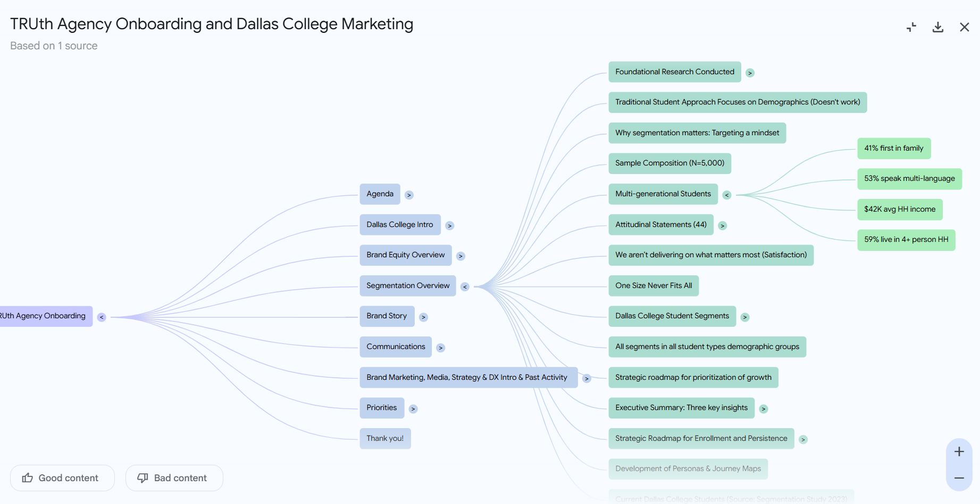
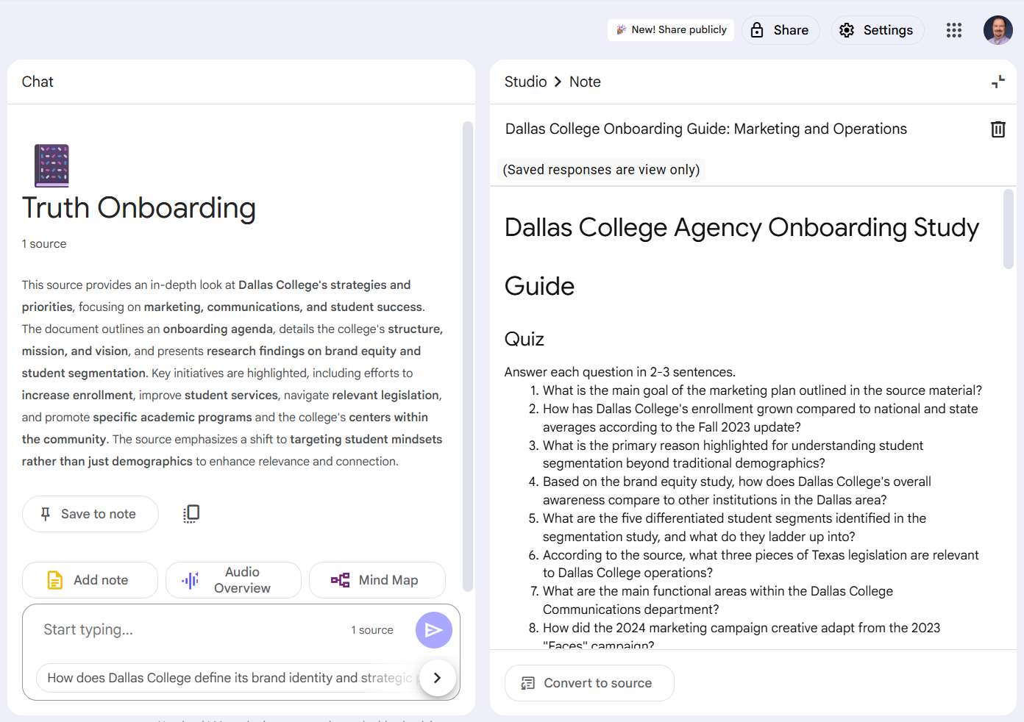
Notebook LM results

Slide 45

Google Notebook LM Audio Overview

Slide 46
Pulling it all Together
Review my notes and create a one-minute script that provides a summary of key topics and lessons learned at the TACCM Conference.
Upload script to HeyGen.com

Slide 47
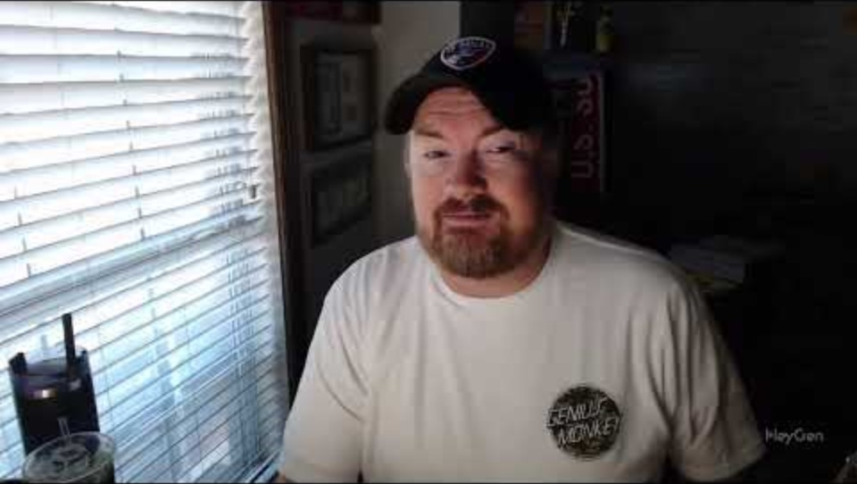
HighEd Web Video

Slide 48
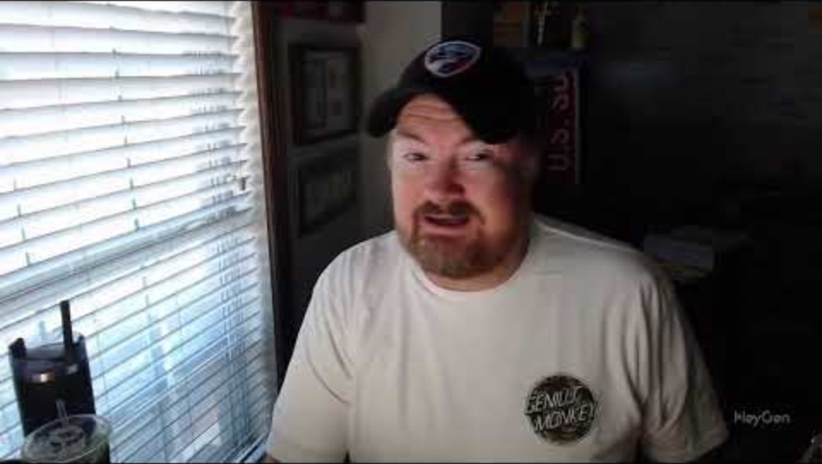
HighEd Web Video in Spanish

Slide 49
Questions? Ideas? Concerns?

Slide 50
Jonathan Blunell contact info
Jonathan Blundell
Senior Director, Digital Experience
Dallas College
jblundell@dallascollege.edu
linkedin.com/in/jdblundell/
TACCM.org/Slack
jdblundell.github.io/taccm-ai

