Slide 1

Used Car Price Prediction Using Data Mining
Joshua Custodio
Joshua White
CAP 4770 Data Mining

Slide 2
Problem
Used car prices vary a lot
Hard to estimate fair value
Need data-driven prediction

Slide 3
Why it Matters
Helps buyers avoid overpaying
Helps sellers price correctly
Real-world business value
The goal of this project was to predict used car prices using vehicle features and compare model performance. This could help dealerships, sellers, or buyers estimate fair market value more consistently.

Slide 4
Dataset
We used a Kaggle used car dataset with 10,000 records and 12 features. Our target variable was price in U.S. dollars. Some of the main features included make year, engine size, fuel efficiency, fuel type, owner count, and transmission
Source: Kaggle Used Car Price Dataset Extended
10,000 records
12 features
Target variable: price_usd
Example features
make_year
engine_cc
mileage_kmpl
fuel_type
owner_count
transmission

Slide 5
Data Preprocessing
Before modeling, we cleaned and prepared the data. We filled missing values in the service history column, encoded categorical variables into numbers, and then split the dataset into training and testing sets.
Filled missing values in service_history with “Unknown”
Encoded categorical variables using LabelEncoder
Split data into training and testing sets (80/20)
Prepared data for regression modeling

Slide 6
Models Used
Linear Regression
Random Forest Regressor
Evaluation Metrics
MAE
RMSE
R²
We used two models: Linear Regression and Random Forest Regressor. We then compared them using Mean Absolute Error, Root Mean Squared Error, and R² to see which one performed better.

Slide 7
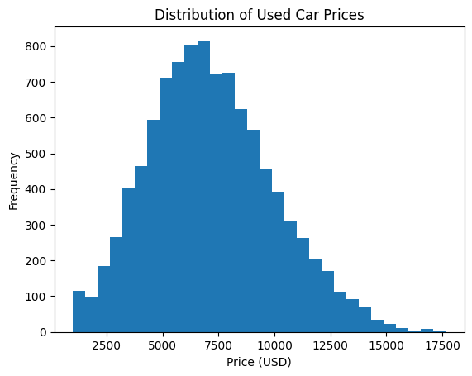
Distribution of Used Car Prices
Histogram view of pricing spread across the sample
Key observations
The distribution is unimodal and slightly right-skewed, with the highest concentration around the mid-price range.
Most vehicles appear to cluster roughly between about $4k and $11k, suggesting a strong mid-market segment.
Higher-price vehicles exist, but they thin out quickly, creating a long tail toward the premium end.
Implication
Median-focused pricing strategies may be more representative than relying on the few expensive outliers.
Source: provided notebook screenshots

Slide 8
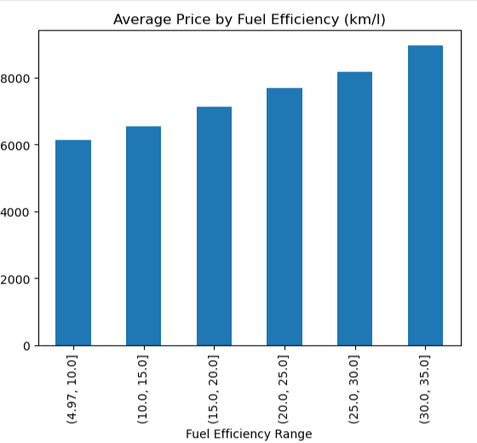
Average Price by Fuel Efficiency
Grouped bar chart comparing average selling price across mileage bands
Key observations
Average price increases consistently as fuel efficiency improves.
The highest-efficiency band has the strongest average price.
No band reversal appears, so the relationship looks directional.
Implication
This chart shows that as fuel efficiency increases, the average price also increases. So in this dataset, higher fuel efficiency is associated with higher prices, although it may be influenced by other factors as well. Fuel economy is important and should be highlighted in pricing or listing strategy.
Source: provided notebook screenshots

Slide 9
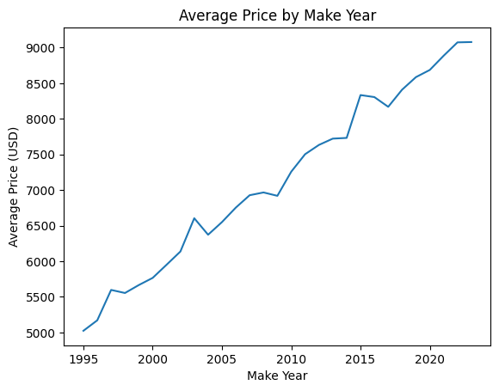
Average Price by Make Year
Line chart showing how pricing changes with vehicle age
Key observations
Newer model years are associated with higher prices.
There are small dips, but the overall trend is strongly upward.
Recent years capture the highest price levels.
Implication
Vehicle age should remain a primary pricing anchor when comparing listings.
Source: provided notebook screenshots

Slide 10
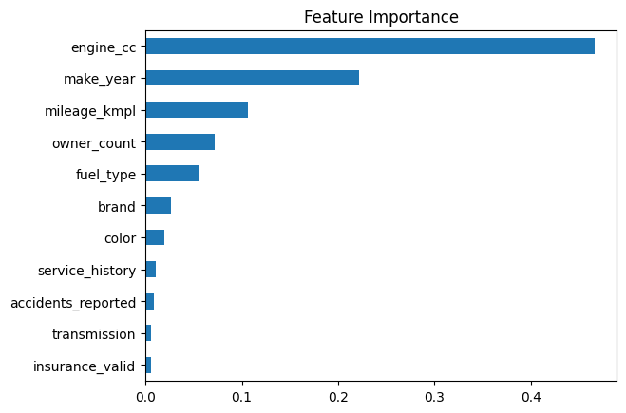
Feature Importance from the Model
Relative importance learned by the fitted random forest
Key observations
Engine size is the dominant driver in the model.
Make year and mileage are the next strongest inputs.
Transmission, insurance validity, and accident reporting add little.
Implication
This chart shows that engine size is the most important factor in predicting price, followed by make year and mileage. Other features like transmission and insurance status have much less impact.”
Source: provided notebook screenshots

Slide 11
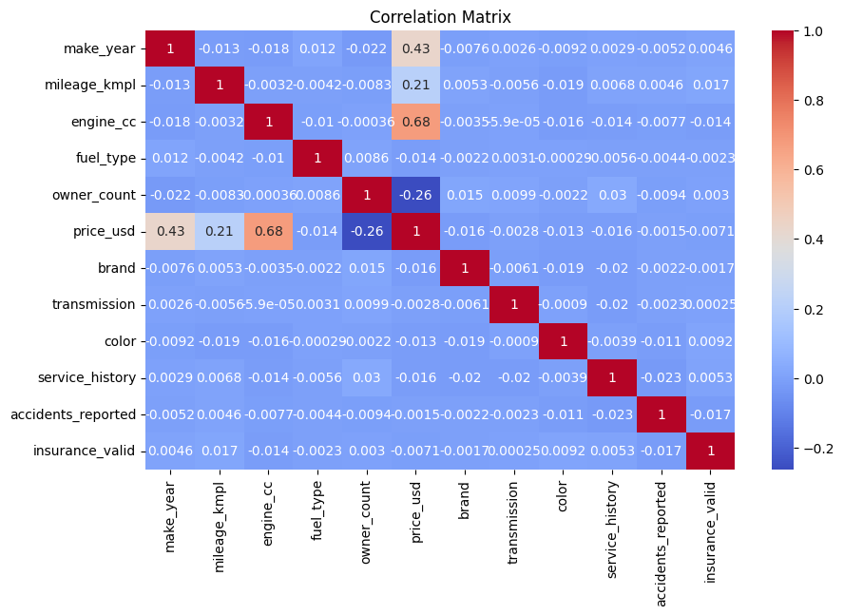
Correlation Analysis
Correlation between key features and price
Key observations
engine_cc had the strongest positive relationship with price meaning bigger engines are generally associated with higher prices.
make_year had a positive relationship with price as well
owner_count had a negative relationship with price meaning cars with more previous owners usually have lower prices.
Implication
This heatmap shows linear relationships between features. Engine size has the strongest positive relationship with price, make year is also positive, and owner count is negative. Correlation doesn’t imply causation, which is why we also used Random Forest for more complex relationships.
Source: provided notebook screenshots

Slide 12
Model Results
Linear Regression
Random Forest
MAE: 1005.38
RMSE: 1317.78
R²: 0.782
MAE: 959.83
RMSE: 1220.94
R²: 0.813
When we compared the two models, we used three metrics: Mean Absolute Error, Root Mean Squared Error, and R².
Mean Absolute Error tells us the average difference between predicted and actual prices. Root Mean Squared Error penalizes larger mistakes more heavily. And R-squared shows how well the model explains the data.
The Random Forest model performed better across all three metrics. It had lower errors and a higher R² value, so it was our best model.

Slide 13
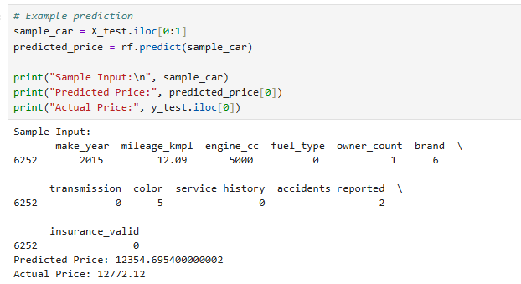
Model Demonstration
Example Input
Make Year: 2015
Mileage: 12.09 km/l
Engine: 5000 cc
Fuel Type: Diesel
Owner Count: 1
Prediction
Predicted Price: $12,354
Actual Price: $12,772
This slide shows an example prediction from our Random Forest model. We input a car with specific features, and the model predicted a price of about $12,354. The actual price was about $12,772, so the prediction is very close, showing that the model performs well.

Slide 14
Limitations
Results are based on one Kaggle dataset
Some real-world factors were not included
Vehicle condition and location were missing
Results may vary with other datasets
One limitation is that this project is based on one dataset, so it may not capture every real-world pricing factor. For example, vehicle condition, local market differences, and location were not included.

Slide 15

Conclusion
Machine learning can effectively predict used car prices
Random Forest was the best-performing model
Engine size, make year, and fuel efficiency were the strongest predictors
This project shows the value of data-driven pricing
In conclusion, machine learning was effective for predicting used car prices, and Random Forest gave us the strongest results. Overall, this project shows how data-driven models can support real-world pricing decisions

