Slide 1
Analyzing Neighborhoods for Luxury Apartment Development
A Coursera Capstone Project Presentation

Slide 2
Problem
Luxury apartments are expensive to build, however, have tremendous potential for Return On Investment (ROI)
Developers need a way to quickly assess multiple areas to determine where to build the luxury apartments for a maximum ROI
The problem to be answered is:
“Which city is most likely to attract the most demand for a luxury apartment to maximize potential ROI?”

Slide 3
Data
Five cities were used as example for the code as the cities are user-defined and can be changed to explore many different areas
Alexandria, Atlanta, Birmingham, Denver, Seattle
Using the Foursquare API, venues within four kilometers of each city center were found and details for each captured
Venue details were used to determine which city is best for development
The data was further cut down later in the tool via Machine Learning code to create a dataset that better fit the problem

Slide 4
K-Means Clustering
Using K-Means Clustering, a large dataset of venues surrounding a city is categorized into different sets and compared
This process is iterated multiple times for each city with random points to find the dataset that provides the best set to compare against the other cities
This is done to prevent a grouping or spacing of venues unique to a location to give an unfair advantage to one location over another
The method splits the venue locations between two sets and compares the sets against each other, providing a “center” location for final results

Slide 5
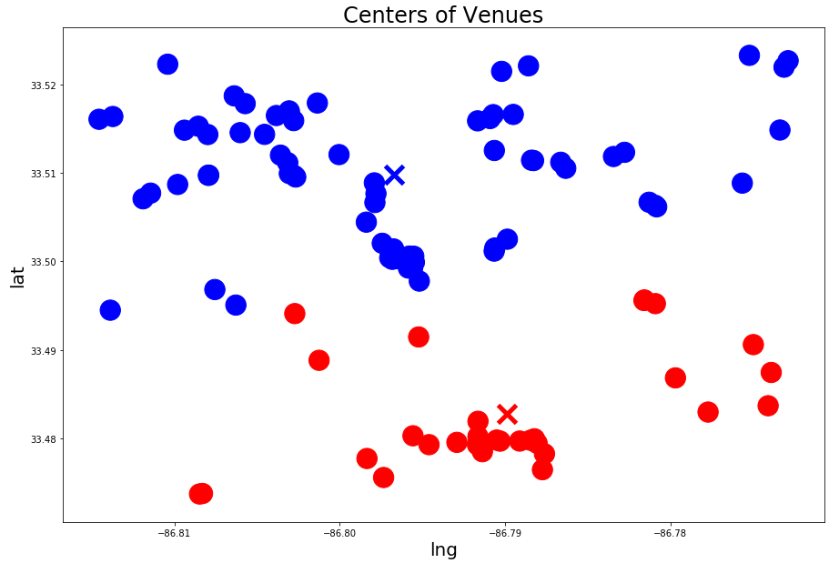
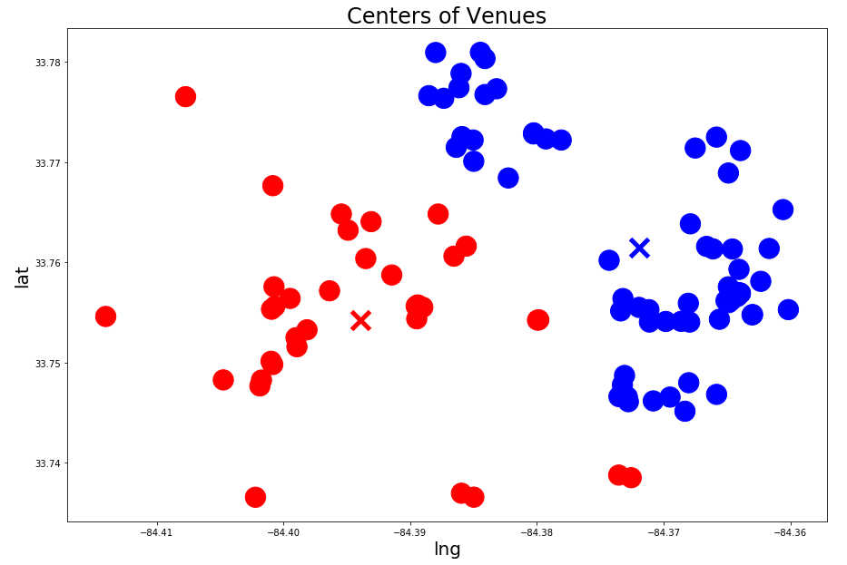
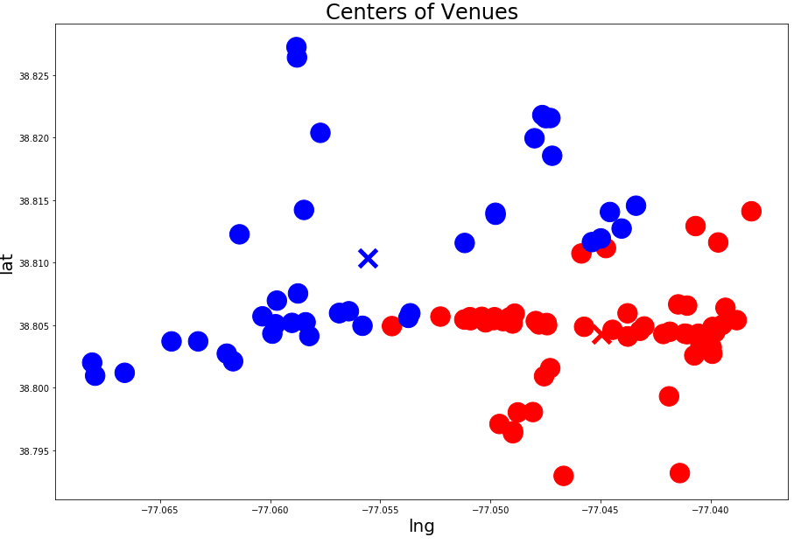
K-Means Clustering
Example of K-Means Clustering process
Input and Random point with venues split between the two, appropriately
First iteration of K-Means Clustering attempting to optimize center points
Tool continues to iterate until centers no longer need to be moved

Slide 6
Scoring a City
Once each city’s venue dataset is determined and recorded, the tool begins to score each city
The venues’ ratings out of ten, as determined by the Foursquare user database, are averaged together
The number of unique venue categories for each city is summed and divided by 50
The maximum amount of results Foursquare can deliver is 500
This allows a max score of 10 in the category of uniqueness
The two scores are added together for each city to provide a rating between 0 and 20 for each city to be compared to each other

Slide 7
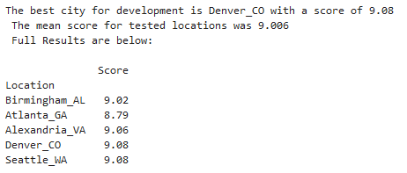
Problem Example Results
The tool provides the results and some additional information
Tool Output

Slide 8
Conclusions
Tool to compare multiple cities to determine which is best for luxury apartment development built and easy to use
More factors should be used to improve the tool’s accuracy
Cost of Living
City Growth
Zoning Laws
Weather
Population
Etc.

