Slide 1

Let’s Wub
Wub tutorial
jos.decoster@gmail.com

Slide 2
What is Wub?
HTTP 1.1 Webserver
Written by Colin McCormack
100% Tcl Web application framework
Domain based
Heavy user of recent Tcl features:
dicts
coroutines
tclOO
zlib
Successor of tclhttpd

Slide 3
Wub in action
Tcler’s wiki runs on Wub since 2007
http://wiki.tcl.tk
Wubchain (web interface to Tcler’s chat)
http://wiki.tcl.tk:30008
Intranet application to manage tool releases

Slide 4
Requirements
Tcl 8.6 (dicts, coroutines, tclOO, zlib)
Tcllib 1.11
Unix or Windows

Slide 5
Getting Wub
Wub’s hosted at Google
http://code.google.com/wub
Checkout via SVN:
svn checkout http://wub.googlecode.com/svn/trunk Wub
Available together with required Tcllib modules as part of WubWikit
http://code.google.com/p/wubwikit

Slide 6
Documentation
Wub’s wiki page:
http://wiki.tcl.tk/15781
Wub documentation:
http://wiki.tcl.tk/_wub/

Slide 7
Tutorial goals
Overview different parts of Wub
Step-by-step introduction of File, Mason, Direct, Nub, Init and jQuery domains
Wub API: utilities to generate HTML, cache, handle queries, convert response types

Slide 8
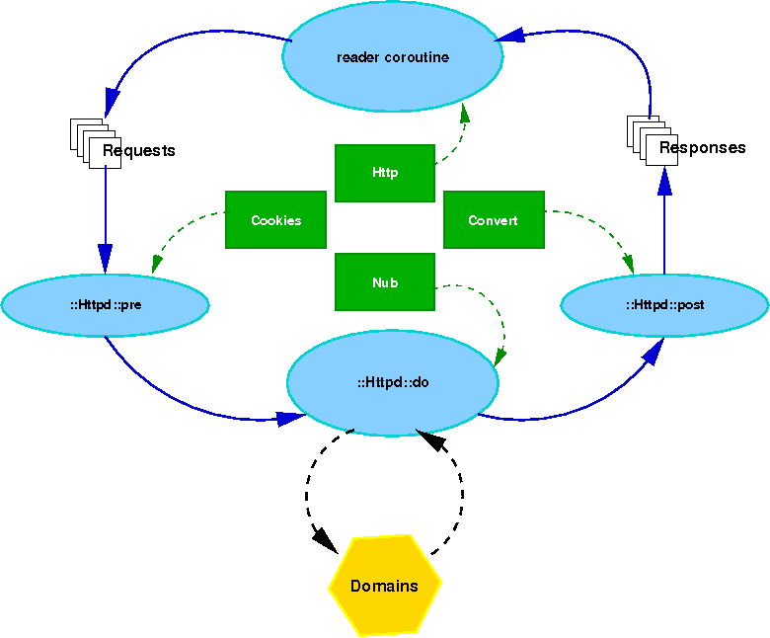
Wub’s architecture

Slide 9
Wub’s dataflow
Httpd module converts HTTP client request into request dicts.
Caching and blocking based on request dict
Request dicts are transformed into response dicts by the web application using Wub utilities and domains.
Response dicts are send back to the client by the Httpd module (protocol / non-protocol fields in dict)

Slide 10
Example 1: Wub out-of-the-box
Running the default setup, start the webserver with these lines:
package require Site
Site start home .
What’s being served?
Files from html, images, css and scripts subdirectories of ./docroot

Slide 11
Example 1 (continued)
How are these file served:
On port 8080
Using caching
The html, images, css and scripts subdirectories are served as root in the URL
On server | On client | Expires
./docroot/html/file.html | http://myurl:8080/html/file.html | tomorrow
./docroot/images/file.gif | http://myurl:8080/images/file.gif | next week
./docroot/css/file.css | http://myurl:8080/css/file.css | tomorrow
./docroot/scripts/file.js | http://myurl:8080/scripts/file.js | tomorrow

Slide 12
Example 1a: adding some Nub
Nub is a configuration utility for Wub
Specify redirect from root URL to ./docroot/html/ex.html in ex.nub:
redirect / /html/ex.html
Start Wub with these lines:
package require Site
Site start home . nubs ex.nub

Slide 13
Example 1a: Nub redirect syntax
redirect <from url> <to url>
Argument | Description
from url | URL for which to send a redirect.
to url | URL to redirect to

Slide 14
Example 2: the File domain
Making File domains explicit in ex.nub:
domain /css/ {File css} root [file join . docroot css] expires tomorrow nodir 1
domain /images/ {File images} root [file join . docroot images] expires "next week" nodir 1
domain /scripts/ {File scripts} root [file join . docroot scripts] expires tomorrow nodir 1
domain /html/ {File html} root [file join . docroot html] expires tomorrow nodir 1
Add new File domain:
domain /disk/ {File disk} \
root / \
indexfile index.* \
hide {^([.].*)|(.*~)|(\#.*)$} \
redirdir 1 \
expires tomorrow \
dateformat "%Y %b %d %T" \
nodir 0
Add Rewrite to ex.nub:
rewrite {/[^/]+[.]html} {/html/[file tail [dict get $r -path]]}

Slide 15
Example 2: Nub domain syntax
domain <url> <list of domain_name and name> <args>
Argument | Description
url | Url to be processed with the specified domain
domain_name | name of domain to use (File, Mason, Direct, jQ, …)
name | Name of this domain usage
args | Domain specific arguments

Slide 16
Example 2: File domain arguments
Argument name | Description
root | File-system root directory of File domain.
indexfile | Name of the file which stands for a directory, such as index.html. The contents of that file will be returned in stead of the directory listing.
hide | A regular expression to hide temp and other uninteresting files (default hides .* *~ and #*).
redirdir | Should references to directories be required to have a trailing /?
expires | A tcl clock expression indicating when contents expires.
dateformat | A tcl clock format for displaying dates in directory listings.
nodir | Don't allow the browsing of directories (default: 0 - browsing allowed).

Slide 17
Example 2: Nub rewrite syntax
rewrite <regexp> <script>
Argument | Description
regexp | Regular expression to select an URL to be transformed
script | Script to be called to transform the URL (evaluated in Nub namespace)

Slide 18
Example 3: Mason domain

Slide 19
Example 4: Direct domain

