Slide 1
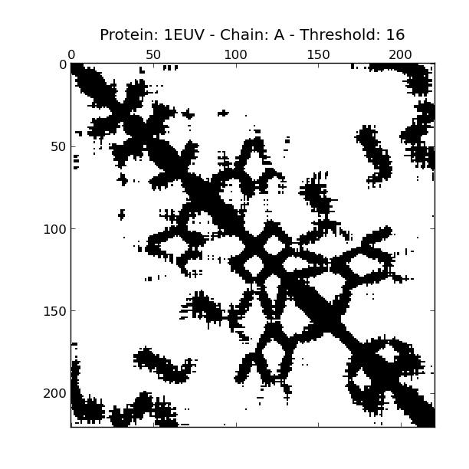
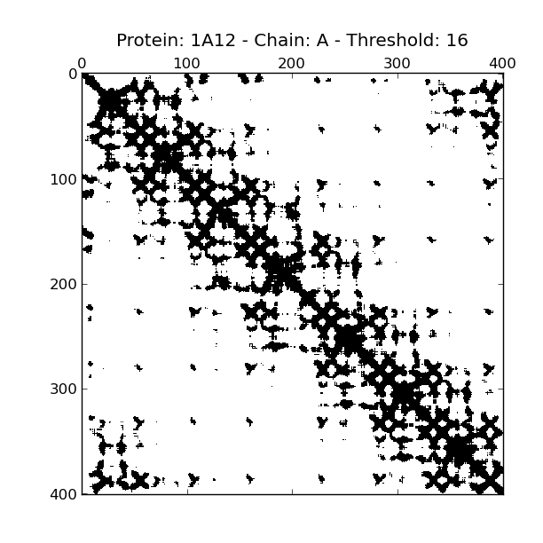
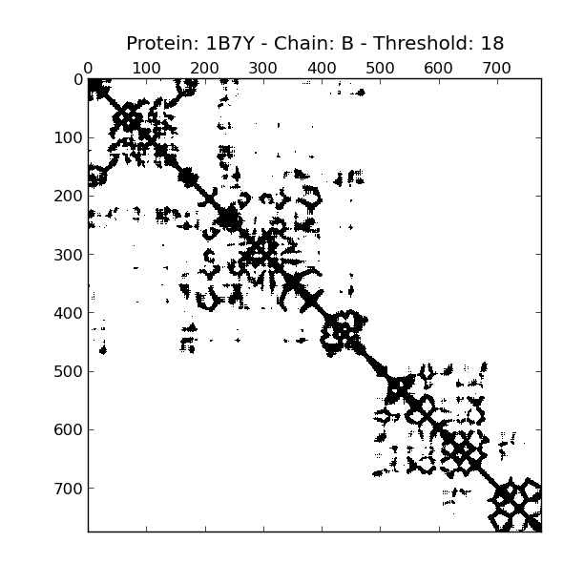
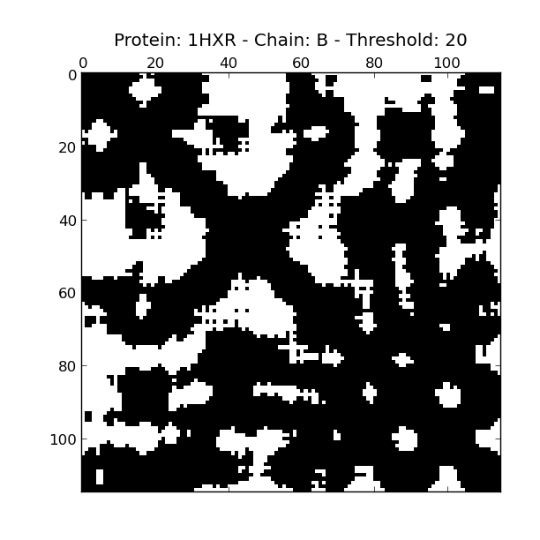
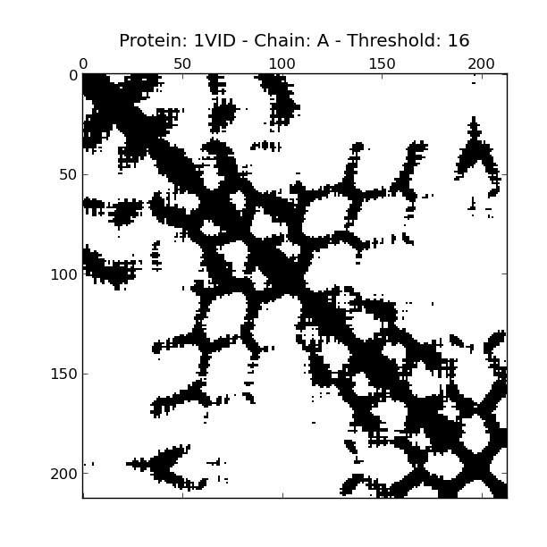
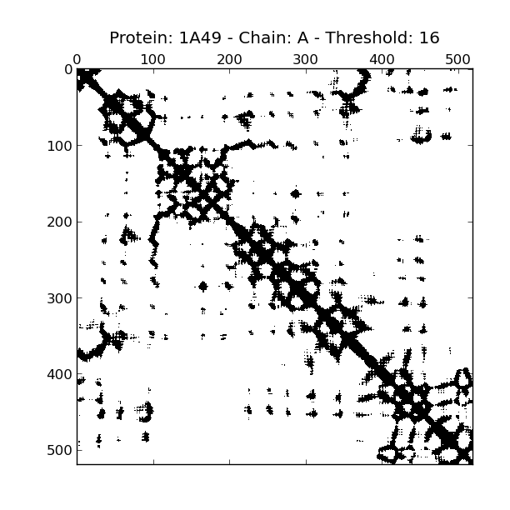
The Long and Winding and Foldy Road From Proteins to Contact Maps and Back
Justin Clark

Slide 2
Outline
How are proteins structured?
What's a contact map?
Who cares?
How do I make a contact map? (Easy)
How do I unmake a contact map? (Hard)
Downsides

Slide 3
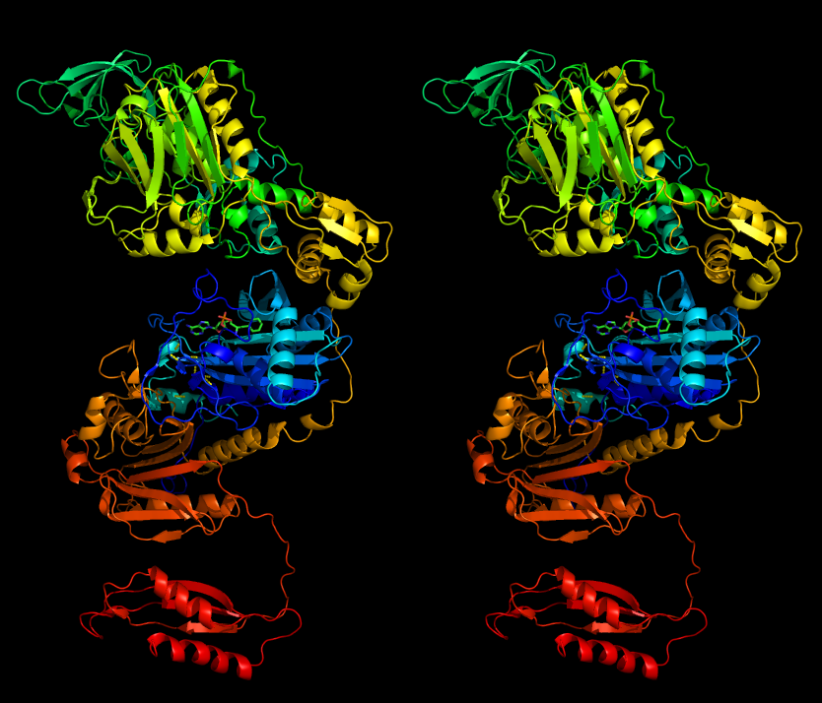
How are proteins structured? (1)
I'm not a biologist
Or a computer scientist
Cross your eyes

Slide 4
How are proteins structured? (2)
Made of amino acids
Four levels of structure
  Primary: amino acid sequence (ELVSAEGRNRK...)
  Secondary: shapes that commonly occur (alpha helix and beta sheets)
  Tertiary: the folds
  Quarternary: different protein bits folding together
Structure determines function (for the most part)

Slide 5
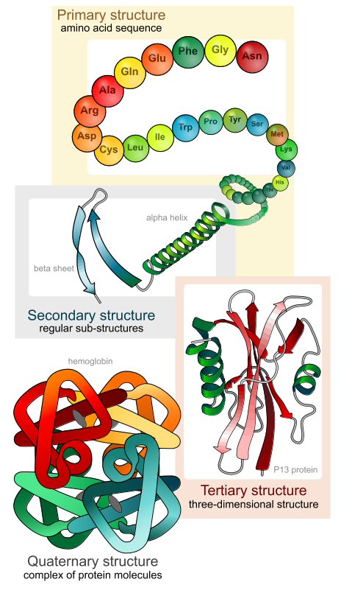
How are proteins structured? (3)
We've got this
We want this
(and measuring it is intensive)
https://upload.wikimedia.org/wikipedia/commons/c/c9/Main_protein_structure_levels_en.svg

Slide 6
What's a contact map? (1)
Once folded, which amino acids “contact” which other amino acids?
“Contact” means whatever we say it means
I mostly say it means the alpha carbons are within 12 Angstroms of each other (so do other people)
The “map” is an nxn symmetric binary matrix where index i, j is 1 if atoms i and j contact and 0 otherwise

Slide 7
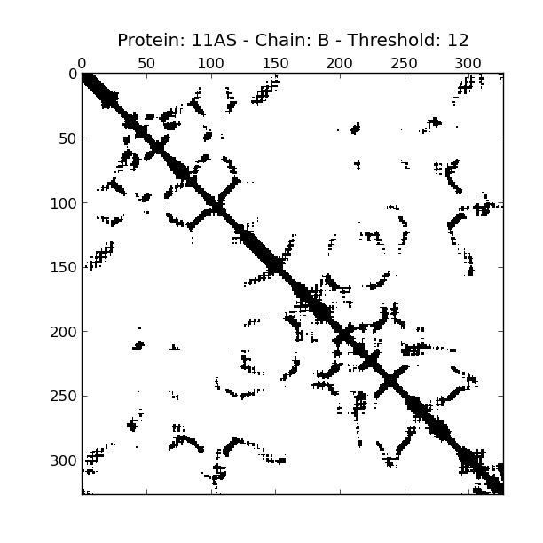
What's a contact map? (2)
See

Slide 8
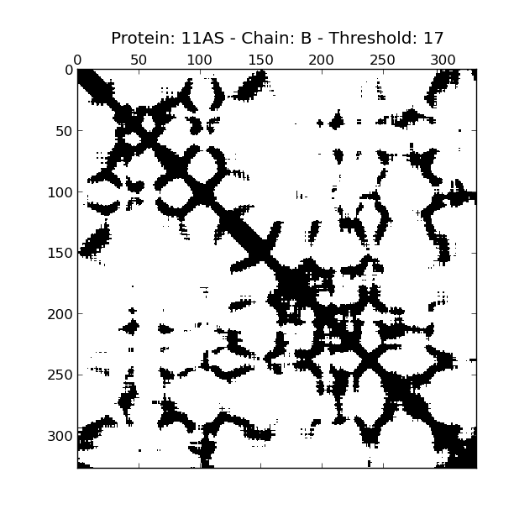
What's a contact map? (3)

Slide 9
Who cares? (1)
Actually a pretty convenient representation
Rotation invariant
Translation invariant
Chirally invariant
Highly compressed – represents complex structure in very few bits (n choose 2)
Allows for structure comparison between proteins

Slide 10
Who cares? (2)
Folks attempting to predict structure from sequence
  For machine learning tasks, it's much easier to train on binary matrices than coordinates
Folks comparing protein structures
  We can compute the Hamming distance between two protein structures

Slide 11
How do I make a contact map? (1)
Download structure data
Filter to alpha carbons
Find distances between alpha carbons (make distance matrix)
Apply threshold to distance matrix

Slide 12
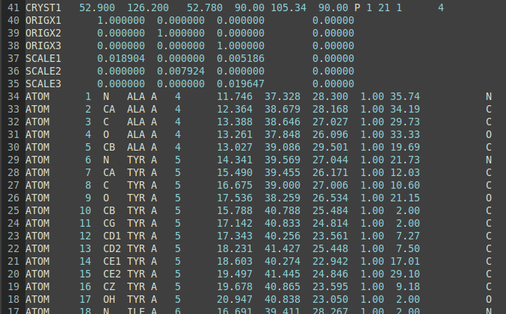

How do I make a contact map? (2)
1. Download structure data and 2. filter

Slide 13
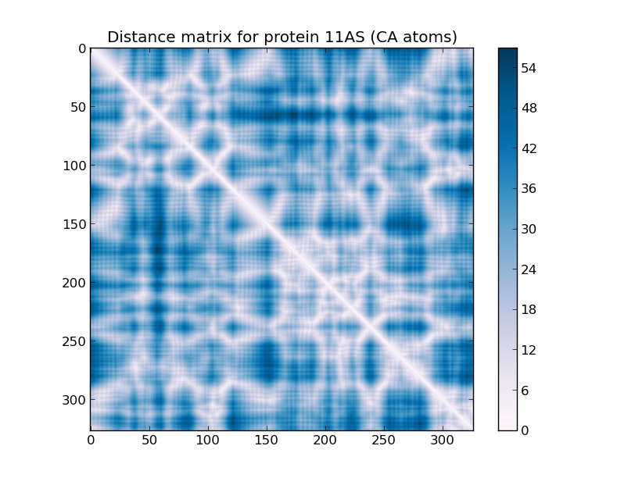
How do I make a contact map? (3)
3. Make distance matrix

Slide 14
How do I make a contact map? (4)
4. Apply threshold to distance matrix

Slide 15
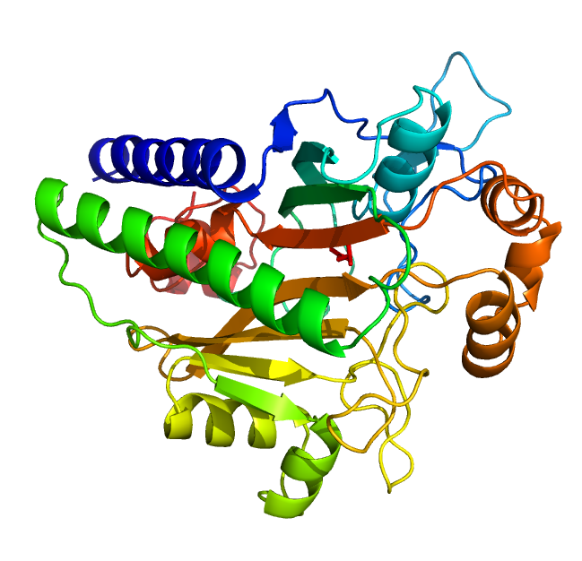
How do I unmake a contact map? (1)
?

Slide 16
How do I unmake a contact map? (2)
Lower expectations
Guess distance matrix
Fix distance matrix
Guess coordinates
Fix coordinates

Slide 17
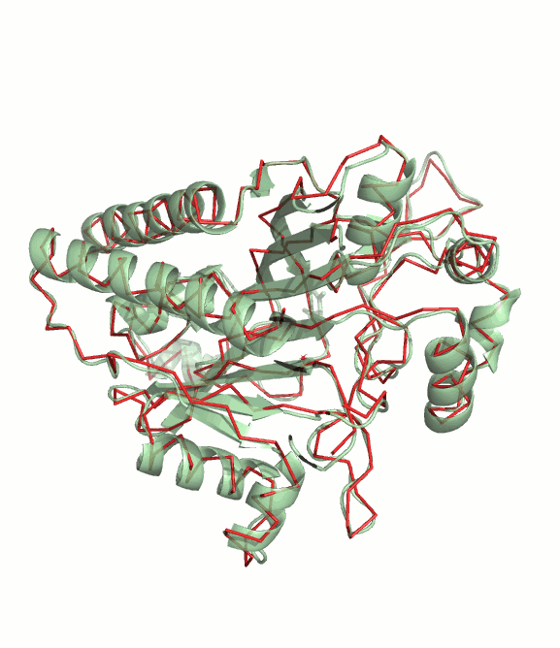
How do I unmake a contact map? (3)
1. Lower expectations
We've only got alpha carbon info in the contact map

Slide 18
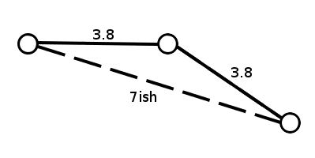
How do I unmake a contact map? (4)
2. Guess distance matrix

Slide 19
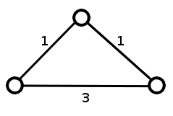
How do I unmake a contact map? (5)
3. Fix distance matrix

Slide 20
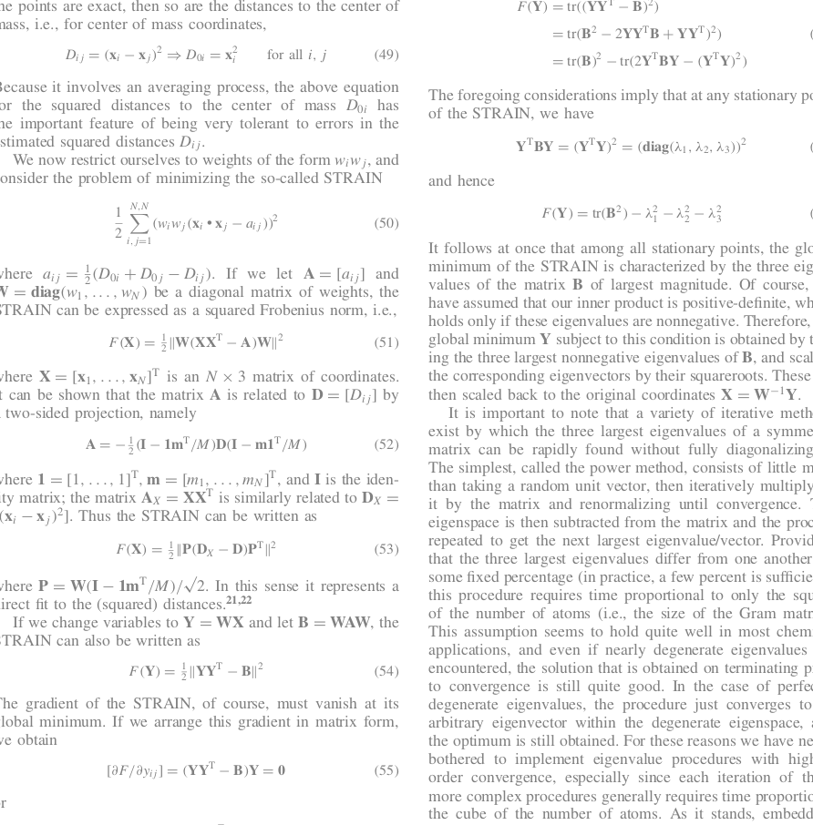
How do I unmake a contact map? (6)
Do this math
4. Guess coordinates
Distance Geometry: Theory, Algorithms and Chemical Applications –Timothy F. Havel — 1998 — In Encyclopedia of Computational Chemistry

Slide 21
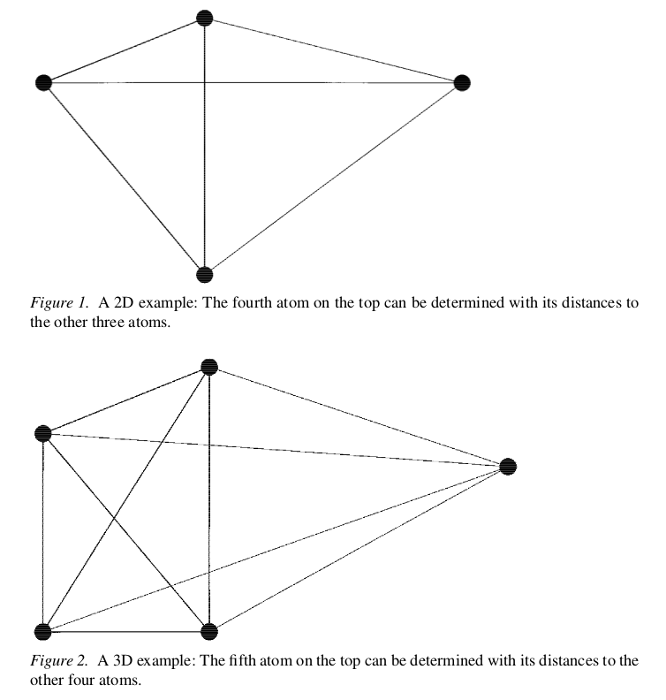
How do I unmake a contact map? (7)
4. Guess coordinates
Geometric build up method
And others
A linear-time algorithm for solving the molecular distance geometry problem with exact inter-atomic distances - QUNFENG DONG and ZHIJUN WU - Journal of Global Optimization 22: 365–375, 2002.

Slide 22
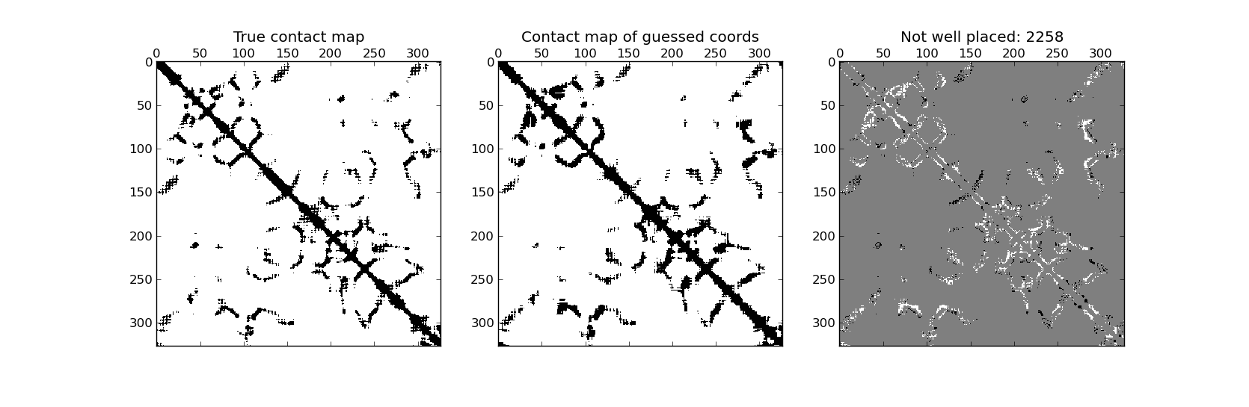
How do I unmake a contact map? (8)
5. Fix coordinates – Correct and Perturb phases

Slide 23
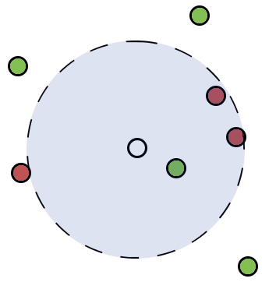
How do I unmake a contact map? (9)
5. Fix coordinates – Correct phase

Slide 24
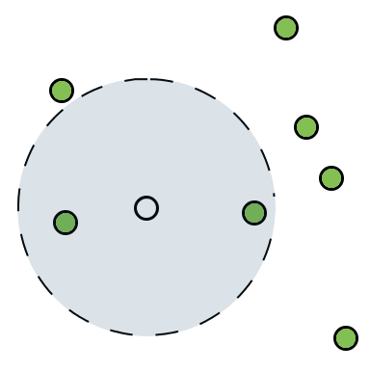
How do I unmake a contact map? (10)
5. Fix coordinates – Correct phase

Slide 25
How do I unmake a contact map? (11)
5. Fix coordinates – Perturb phase

Slide 26
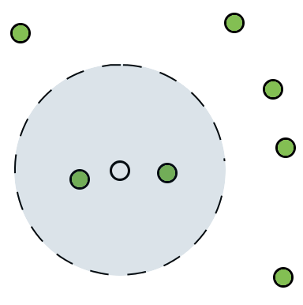
How do I unmake a contact map? (12)
5. Fix coordinates – Perturb phase

Slide 27
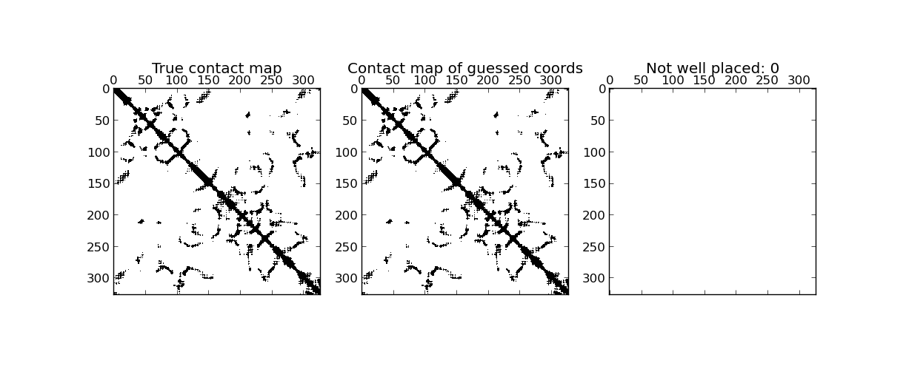
How do I unmake a contact map? (13)
5. Fix coordinates - Repeat
Repeat the correction and perturbation
Reduce the amount you perturb each step
Stop when stuff looks right

Slide 28
How do I unmake a contact map? (14)
?

Slide 29
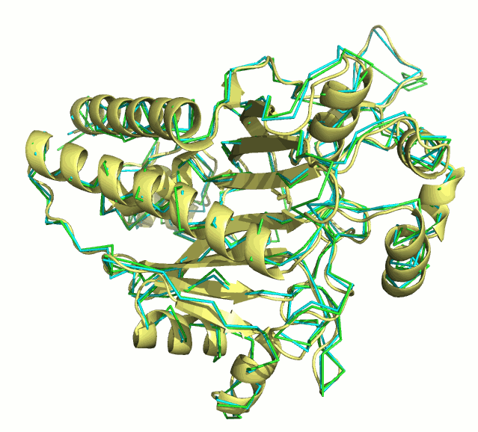
How do I unmake a contact map? (15)

Slide 30
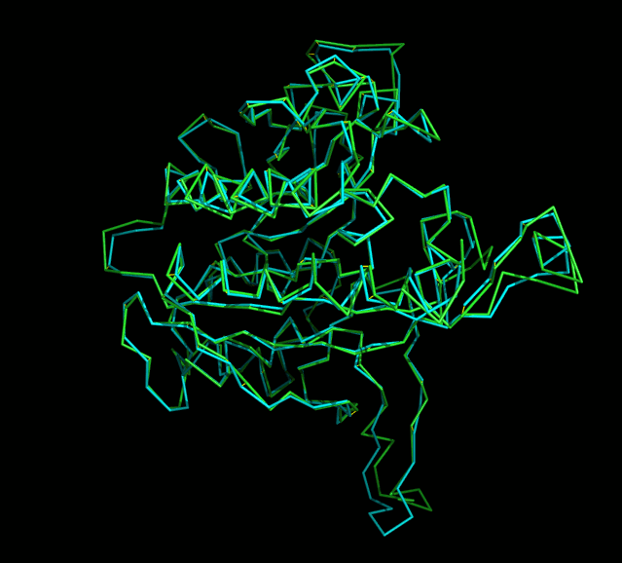
How do I unmake a contact map? (16)

Slide 31
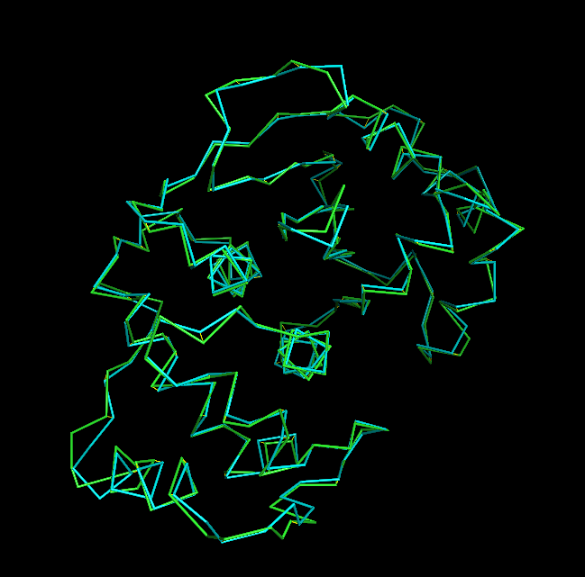
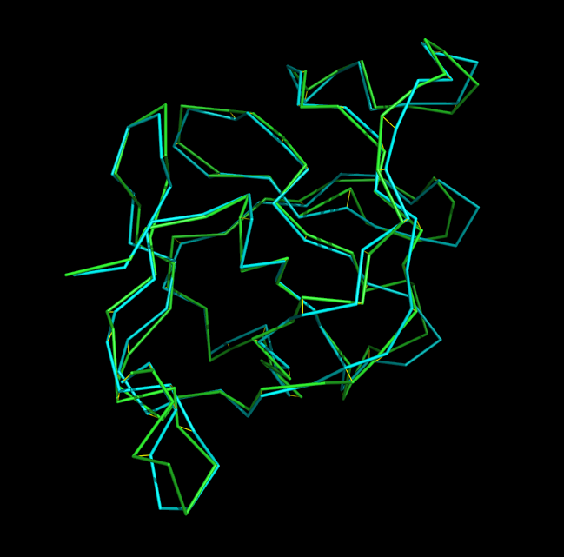
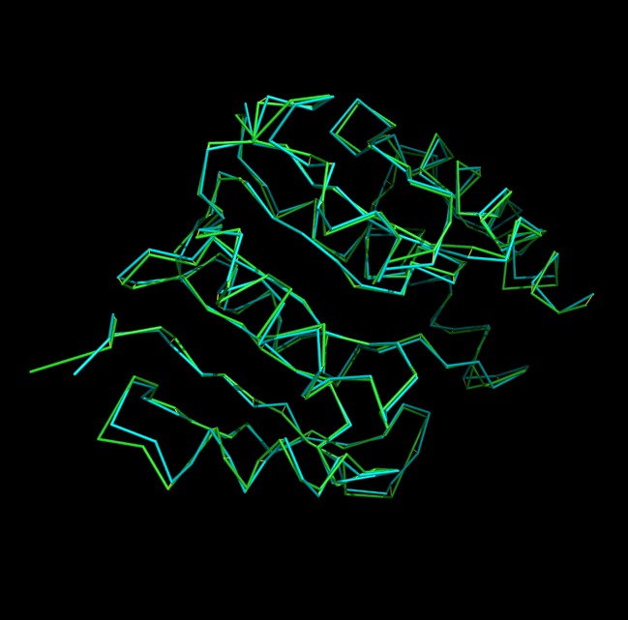
How do I unmake a contact map? (17)

Slide 32
Downsides (1)
Degenerate contact maps
Magic numbers (threshold, cooling parameter)
Just as likely to generate mirror image
Can't match exactly without further correction
Unclear benefits over distance matrix
My version is somewhat slow
Can't have missing data (FT-COMAR)

Slide 33
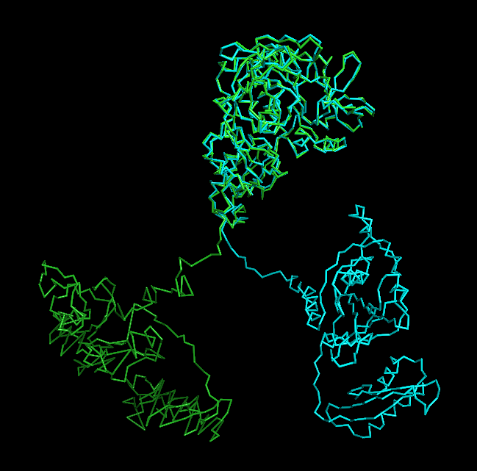
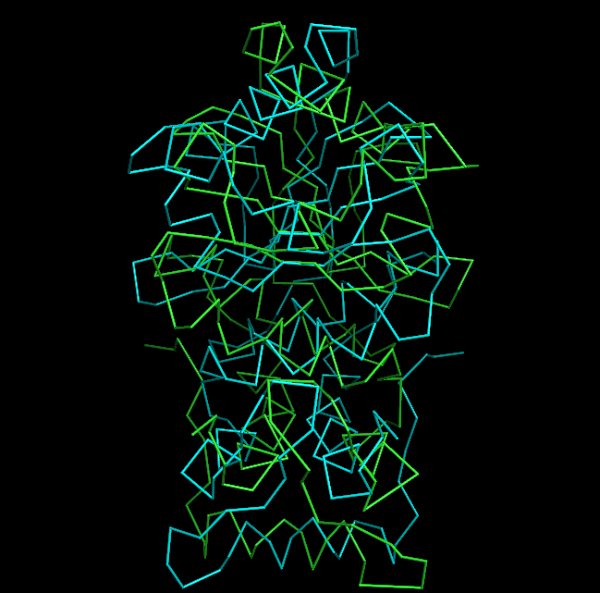
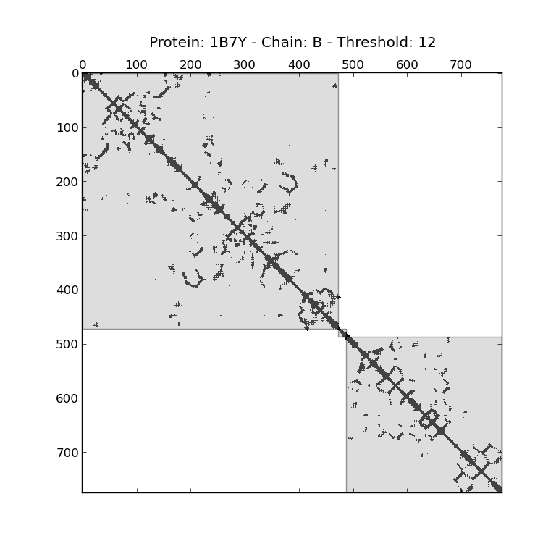

Downsides (2)

Slide 34
Recap
How are proteins structured?
What's a contact map?
Who cares?
How do I make a contact map? (Easy)
How do I unmake a contact map? (Hard)
Downsides

Slide 35
References
Aric A. Hagberg, Daniel A. Schult and Pieter J. Swart, “Exploring network structure, dynamics, and function using NetworkX”, in Proceedings of the 7th Python in Science Conference (SciPy2008), Gäel Varoquaux, Travis Vaught, and Jarrod Millman (Eds), (Pasadena, CA USA), pp. 11–15, Aug 2008
Eric Jones, Travis Oliphant, Pearu Peterson and others. “SciPy: Open Source Scientific Tools for Python.” http://www.scipy.org/ 2001
F.C.Bernstein, T.F.Koetzle, G.J.Williams, E.E.Meyer Jr., M.D.Brice, J.R.Rodgers, O.Kennard, T.Shimanouchi, M.Tasumi, "The Protein Data Bank: A Computer-based Archival File For Macromolecular Structures," J. of. Mol. Biol., 112 (1977): 535. http://www.wwpdb.org/documentation/format33/v3.3.html.
G.M. Crippen and T.F. Havel, “Distance Geometry and Molecular Conformation.” John Wiley & Sons, 1988.
Marco Vassura, Luciano Margara, Pietro Di Lena, Filippo Medri, Piero Fariselli, and Rita Casadio. 2008. FT-COMAR. Bioinformatics 24, 10 (May 2008), 1313-1315. DOI=10.1093/bioinformatics/btn115 http://dx.doi.org/10.1093/bioinformatics/btn115
Marco Vassura, Luciano Margara, Pietro Di Lena, Filippo Medri, Piero Fariselli, Rita Casadio, "Reconstruction of 3D Structures From Protein Contact Maps," IEEE/ACM Transactions on Computational Biology and Bioinformatics, vol. 5, no. 3, pp. 357-367, July-September, 2008
Qunfeng Dong and Zhijun Wu. 2002. A linear-time algorithm for solving the molecular distance geometry problem with exact inter-atomic distances. J. of Global Optimization 22, 1-4 (January 2002), 365-375. DOI=10.1023/A:1013857218127 http://dx.doi.org/10.1023/A:1013857218127
T.F. Havel, “Distance Geometry: Theory, Algorithms, and Chemical Applications in the Encyclopedia of Computational Chemistry,” 1998.
The PyMOL Molecular Graphics System, Version 1.5.0.4 Schrödinger, LLC.

Slide 36
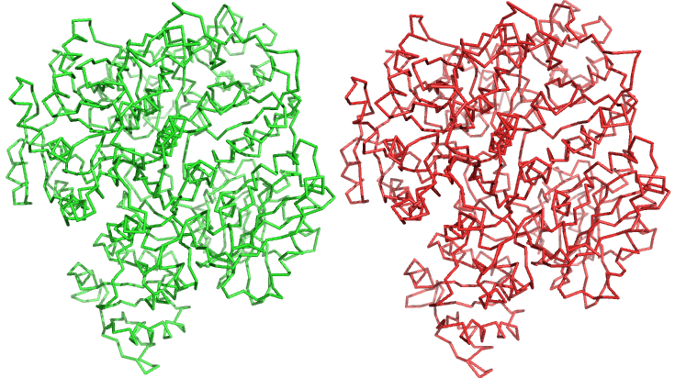
Questions?

