Slide 1

APSU MATH TRAIL
Funded by Google Community Grant and TIDES Foundation

Slide 2
Developed by:
Dr. Marylu Dalton
Dr. Jennifer Yantz
Dr. James Church
(Team of CS students)
Many thanks to:
Austin Peay State University
Google Community Grant
TIDES Foundation
2022

Slide 3
What is a Math Trail?
A math trail is a way to discover mathematics in the world around us. You can explore the trail on your own, but it’s fun to go with other people so you can share the experience - collaborating in your exploration and sharing ideas!
A Math Trail is an activity in which the participants immerse themselves in the mathematics around them, taking notice of the beauty and patterns of mathematics in everyday objects and occurrences. A math trail is a guide to observe, wonder, and engage at several stops along the way.
Some of the tasks on the Math Trail can be completed as you walk along the trail, but others you can complete once you have collected some measurements and data. The tasks on the trail vary in math knowledge and ability level, but it is meant to be fun and engaging! Choose the tasks that interest you most. Write things down or record data on your phone. Have fun!
At each stop along the way, you will be directed to notice certain items around you. You may also find mathematics in things that are not mentioned in the Trail Guide, but you are encouraged to record that information and share that with us!
Notes:
33

Slide 4
About APSU’s Math Trail
This Math Trail is about 1.25 to 1.5 miles of walking for the entire trail. It may take 1 to 2 hours if you spend time contemplating the mathematics that you see. The walk itself would take about 30 minutes at an easy pace. The Trail begins at near the Maynard Mathematics And Computer Science Building and the Technology Building (at the corner of College and Eighth Streets) and it will lead you back to the same location.
Once you have completed the APSU Math Trail, we encourage you to share the app or your booklet and receive your pin for completion.

Slide 5
Stops Menu
Stop 1: Ancient Technology on a Very Modern Technology Building
Stop 2: Fountain in the Ken and Amy Landrum Courtyard
Stop 3: Binary Numbers on Maynard Mathematics and Computer Science Building
Stop 4: Native Plant Teaching and Research Garden
Stop 5: Water Feature (A) near Library
Stop 6: Water Feature (B) in Front of Library
Stop 7: Utility Hole (Manhole) Cover
Stop 8: Is This a Euler Path?
Stop 9: How Did That Cupola Get Here?
Stop 10: If I Have Told You Once, I Have Told You a Million Times (AP Bowl)
Stop 11: The Peay Pickup
Stop 12: The Water Tower

Slide 6
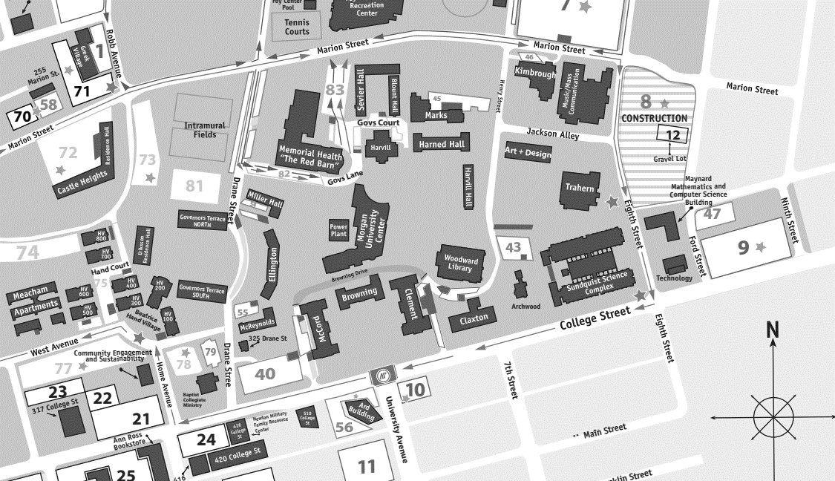
APSU Math Trail Map
10
12
9
3
5
2
8
6
11
7
1
4

Slide 7
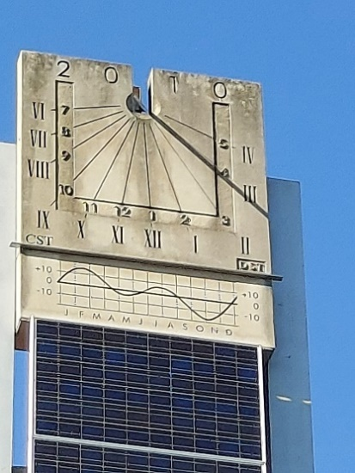
Stop 1: Ancient Technology on a Very Modern Technology Building
Information
Objective
Wrap Up
Stop 1 is a piece of ancient technology on top of the APSU Technology Building – a sundial. Notice CST in the lower left-hand corner and DST in the lower right-hand corner. CST stands for Central Standard Time and DST stands for Daylight Savings Time.
What time does the sundial currently show?
Does the time on the sundial match the time on your watch or device?
Why do you think the Roman Numerals are always one less than the corresponding Arabic numbers?
This part of Tennessee is in the Central Time Zone. How many time zones are in the US?
Enter the current time to see what time it is in other parts of the world.
Clarksville:
London:
Kyiv:
Nepal:
Tokyo:
Honolulu:
San Diego:
Did you have trouble reading the Roman Numerals? If so, go to this link for help https://roman-numerals.info/.
Did you notice the graph below the sundial?
What do you suppose the graph is showing?
It is called the Equation of Time. You can find more information here: https://en.m.wikipedia.org/wiki/Equation_of_time
Next:
Stop 2 is the fountain in front of the Maynard Mathematics and Computer Science Building. Walk along 8th street towards campus and it is on your right.
Enter Number
We do not know when the first sundial was used, but a stone fragment exists of a sundial from 1500 B.C.
Enter Time HH:MM
Home Screen
Stops Menu
Map
Notes:
Under Objective, the question “How many time zones are in the US?” should accept an integer and return feedback for correct or incorrect (showing the correct number).
Also under Objective, when someone enters the current Clarksville time, the app should return the times in the given locations. (Will DST make this more difficult?)

Slide 8
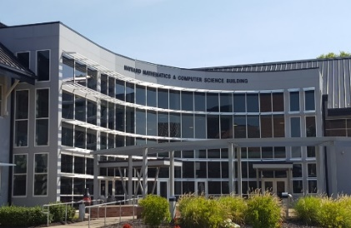
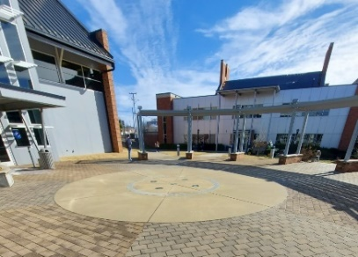
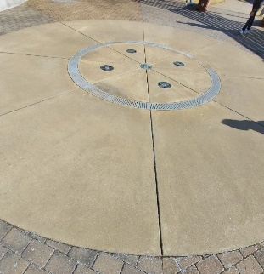

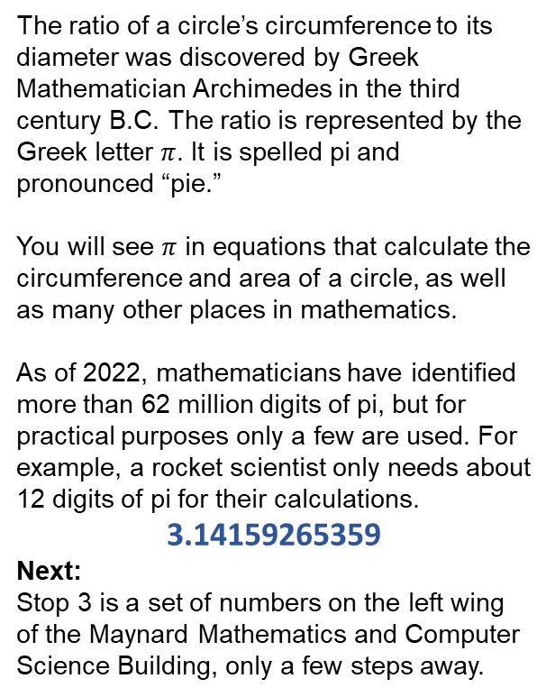
Stop 2: Fountain in the Ken and Amy Landrum Courtyard
Information
Objective
Wrap Up
There are many circles in the fountain. For each one, use the same units to measure the distance across the center of the circle (diameter) and measure the distance around the circle (circumference) on its edge. Enter the values (whole numbers or decimals) in this table. What do you notice? Are the ratios close to a famous number?
The ratio of a circle’s circumference to its diameter was discovered by Greek Mathematician Archimedes in the third century B.C. The ratio is represented by the Greek letter $π$. It is spelled pi and pronounced “pie.”
You will see $π$ in equations that calculate the circumference and area of a circle, as well as many other places in mathematics.
As of 2022, mathematicians have identified more than 62 million digits of pi, but for practical purposes only a few are used. For example, a rocket scientist only needs about 12 digits of pi for their calculations.
3.14159265359
Next:
Stop 3 is a set of numbers on the left wing of the Maynard Mathematics and Computer Science Building, only a few steps away.
Stop 2 is the fountain in the Ken and Amy Landrum Courtyard located between the Technology Building (TB) and Maynard Mathematics and Computer Science (MMCS) Building.
Notice the circle in the middle of the courtyard and prepare to take some measurements. If you do not have a measurement tool, you can improvise and use your own two feet! Have a friend help you to count your footsteps across the circle and then around the circle. Use the same feet for both measurements.
Circle | Circumference | Diameter | Ratio C/d
1
2
3
4
Home Screen
Stops Menu
Map
Notes:
Under objective, the table should accept real number measurements > 0 and then compute and return the ratio in the last column.

Slide 9
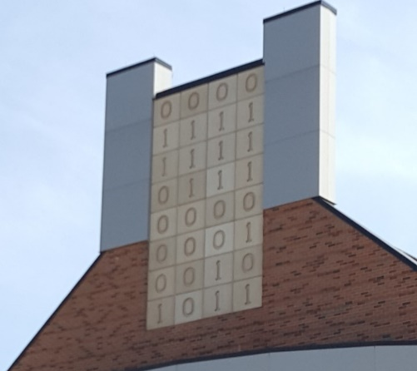
Stop 3: Binary Numbers on Maynard Mathematics and Computer Science Building
Information
Objective
Wrap Up
In computing, the most basic unit of information is a single circuit that can be either on or off, like a light switch. We call this a bit. The numbers 0 and 1 represent off and on for a bit. Eight bits together make a byte.
Computer Bit
Off On
Computer Byte
0 1 1 0 0 0 0 1
The byte above is from the first column of 0’s and 1’s and represents the binary number 01100001 in base 2. This corresponds to a lowercase “a” in ASCII code. Can you guess what the last three bytes represent?
If you couldn’t guess the last three bytes, use this converter to change binary numbers to their ASCII characters. https://www.rapidtables.com/convert/number/binary-to-ascii.html
Other fun facts about bits and bytes:
John W. Tukey shortened “binary information digit” to “bit” in a memo written in 1947.
A string of four bits is a nibble.
One megabyte is equivalent to 1,000,000 bytes.
How many megabytes of information can be stored on your phone, tablet, or computer? That is a lot of zeros and ones!
Next:
Stop 4 is the greenhouse at the end of the Sundquist Science Building. Take 8th street to College Street. Make a right at the corner and the greenhouse is at the end of the building.
Stop 3 is at the top of the left wing of the Maynard Mathematics and Computer Science Building.
Surely, they use more than just those two digits inside that building to learn mathematics! So, what could this be?
(Hint: look at the columns of numbers. There are four columns with eight numbers in each one.)
Home Screen
Stops Menu
Map
Notes:
James – please check me on this!! The information in the objective column is just my memory from a long time ago. The facts in the “wrap up” column are random things I found on the internet. Please make any corrections!!

Slide 10
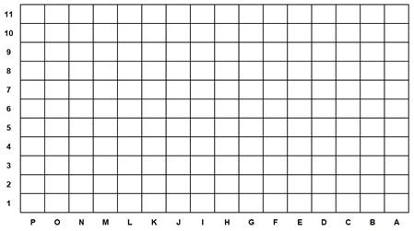
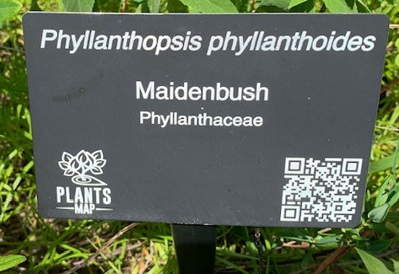
Stop 4: Native Plant Teaching and Research Garden
Information
Objective
Wrap Up
Stop 4 is the Native Plant Teaching and Research Garden behind the Sundquist Science Complex.
(insert picture)
Use the grid to find a marker for a plant in location L9.
The Native Plant Teaching and Research Garden contains over 350 species of native plants from grasslands, savannahs, rock outcrops, and woodlands of the Interior Plateau Ecoregion.
Enter Name of Plant
You will notice a grid is outlined on the walkway around the garden.
Ans: White Bear Sedge
Give the coordinates for:
Next: Stop 5 is near the Woodward Library at the Gazebo and the Certified Wildlife Habitat.
Enter Coordinates
(Answer: D4)
Home Screen
Stops Menu
Map

Slide 11
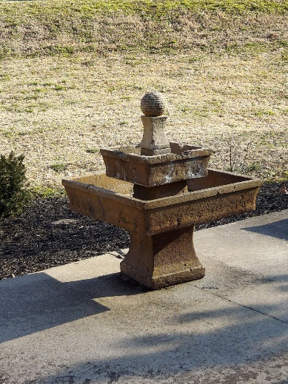
Stop 5: Water Feature (A) at the Gazebo and the Certified Wildlife Habitat
Information
Objective
Wrap Up
Consider the areas of these two squares. The ratio of the side lengths is 1:2. Is the ratio of the areas equal to this quantity?
What is the ratio of the areas?
Suppose each basin has a depth of 5 inches. What is the ratio of the volumes?
If the yellow square is twice as long as the red square, the ratio of the side lengths is 1:2. However, you will notice that it takes 4 red squares to fill in the area of the yellow square. The ratio of the areas of the two triangle is 1:4.
Look for the relationship of the volumes of two cubes using these same side lengths.
Enter Ratio
This sculpture consists of two square basins. The top one has a side length of 15 inches and the bottom one has a side length of 30 inches. This means the ratio of the side lengths is 15:30, or 1:2 in lowest terms.
Enter Ratio
Next:
Turn toward the Woodward Library. You should be able to see the next Water Feature from where you are standing.
Home Screen
Stops Menu
Map

Slide 12
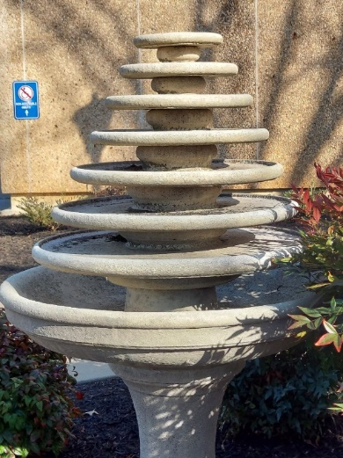
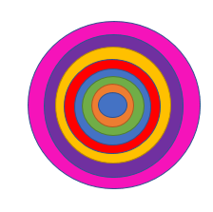
Stop 6: Water Feature (B) in Front of Library
Information
Objective
Wrap Up
It looks like concentric circles – two or more circles with the same center but different radii. Test your knowledge of concentric circles with these questions.
Concentric circles have the same radii.
How many common points are shared by concentric circles?
What do we call the area bounded by two concentric circles? (The blue area below.)
The word annulus is used in many different contexts.
Earthworms are made up of ring-like segments called annuli.
Solar eclipses may be classified as either total, in which the Moon completely covers the Sun, or annular, in which the Moon obscures all but an outer ring of the Sun.
Your “ring finger” is known more formally as digitus anularis.
An annular lake is a ring-shaped lake caused by a meteor impact.
Next:
Stop 7 is on the sidewalk next to Browning Drive near the corner of the University Center, just a few steps away.
This water feature is near the Woodward Library entrance. If you could look down on the fountain, it would look like this.
True
False
All
Some
None
What do you notice when viewing it from above?
Annulus
Intersection
Ring
Home Screen
Stops Menu
Map
Notes:
Under objective, first question correct answer is false. After the user chooses an option, turn the False “button” green and the True “button” a light red.
Under objective, second question correct answer is “None”. After user chooses an option, turn “None” green and the other two options a light red.
Under objective, third question correct answer is “Annulus”. After user chooses an option, turn “Annulus” green and the other two options a light red.
Note to Marylu: Depending on how much room we have…..some pictures under “wrap up” would be nice.

Slide 13
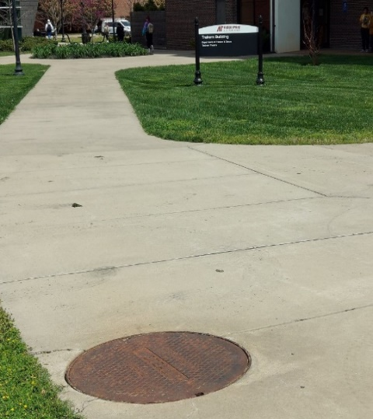
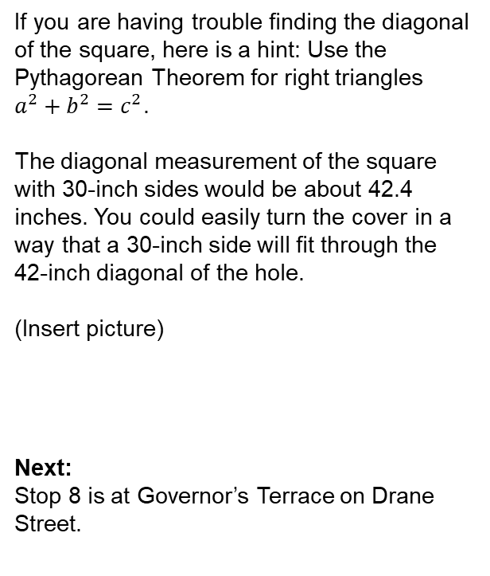
Stop 7: Utility Hole (Manhole) Cover
Information
Objective
Wrap Up
Stop 7 is a utility Hole cover near Browning Drive and the corner of the University Center. The APSU Physical Plant maintains the utilities on campus that keep our buildings warm in the winter and cool in the summer.
A very important safety reason why manhole covers are round, however, is that round covers will not accidentally fall into the manhole itself. With a round cover, no matter how you hold it, it will not fall in the hole. If it were square, someone could hold the cover diagonally over the hole and drop it in. This is hazardous to the workers below as well as people who travel over the manhole.
Can you show that this is true?
Let’s use a square which measures 30 inches on each side. How long is the diagonal of the square hole? Could the cover be positioned in a way that it would fall through the opening?
If you are having trouble finding the diagonal of the square, here is a hint: Use the Pythagorean Theorem for right triangles $a^{2}+b^{2}=c^{2}$.
The diagonal measurement of the square with 30-inch sides would be about 42.4 inches. You could easily turn the cover in a way that a 30-inch side will fit through the 42-inch diagonal of the hole.
(Insert picture)
Next:
Stop 8 is at Governor’s Terrace on Drane Street.
You will see many of these utility holes across campus where the maintenance workers access the maze of underground pipes and wiring.
Why are utility hole (manhole) covers round?
The round shape makes it easier to put the covers back in place after the workers have used them to access passageways below the cover since they don’t need to be rotated to find the right fit. Round covers are also easier to manufacture since there are no angles to match up.
30 in
30 in
Home Screen
Stops Menu
Map

Slide 14
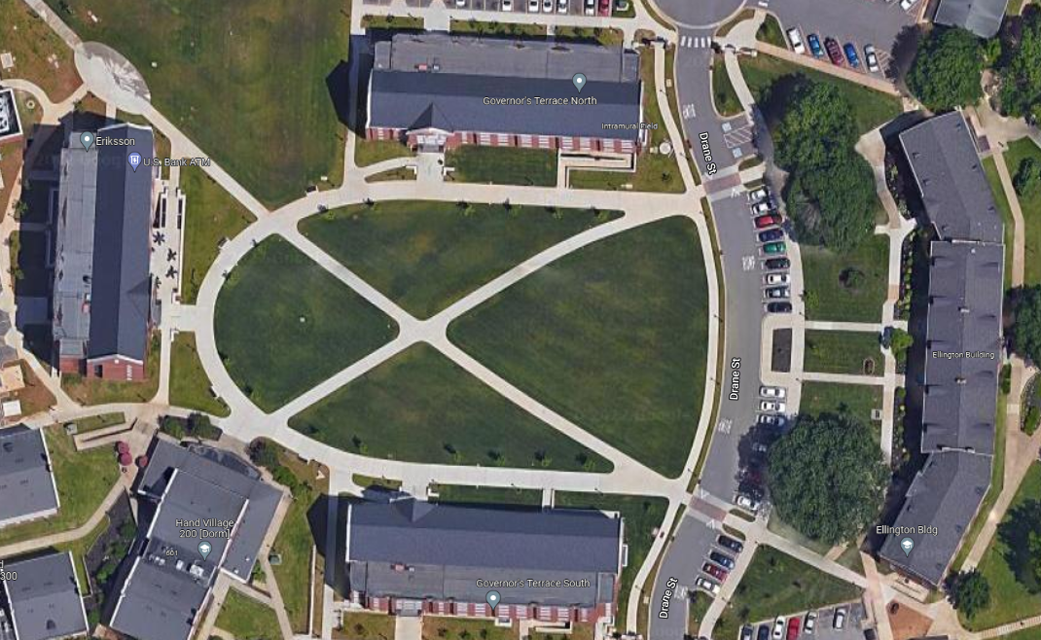
Stop 8: Is this a Euler Path?
Information
Objective
Wrap Up
Stop 9 is at the Quad between the two Governor’s Terrace residential buildings for students. (Also known as “dorm” rooms.)
Notice the shape formed by the intersecting sidewalks. Here is a picture from above that might help.
Can you walk a path along the sidewalks so that you only walk along each sidewalk exactly one time? You may cross a path that you have already traveled, but you may not walk along the same sidewalk twice.
In graph theory, a path is a connected sequence of edges (like the sidewalks) that starts at one point and ends at another. If a path returns you to the starting point, then it is called a circuit.
A path or circuit is a Euler path or circuit if it covers every edge only once.
Is the sidewalk structure in the courtyard a Euler path?
(Euler is pronounced “oil-er”.)
Were you successful? Draw the path that you walked if you were able to complete this task.
If you were unable to complete the task, is there a way to add just one sidewalk path to make it work?
Euler paths and circuits are named for Leonhard Euler (1707 - 1783). You can read more about this mathematician here: https://en.wikipedia.org/wiki/Leonhard_Euler
Next:
The next stop is between the University Center and the Library, so walk behind the Ellington Bldg. down Browning Drive towards the main courtyard.
Home Screen
Stops Menu
Map
Notes:
We may want to remove some external links.

Slide 15
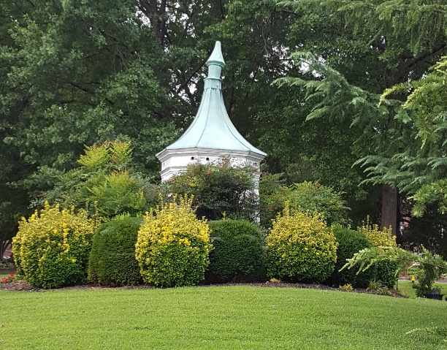
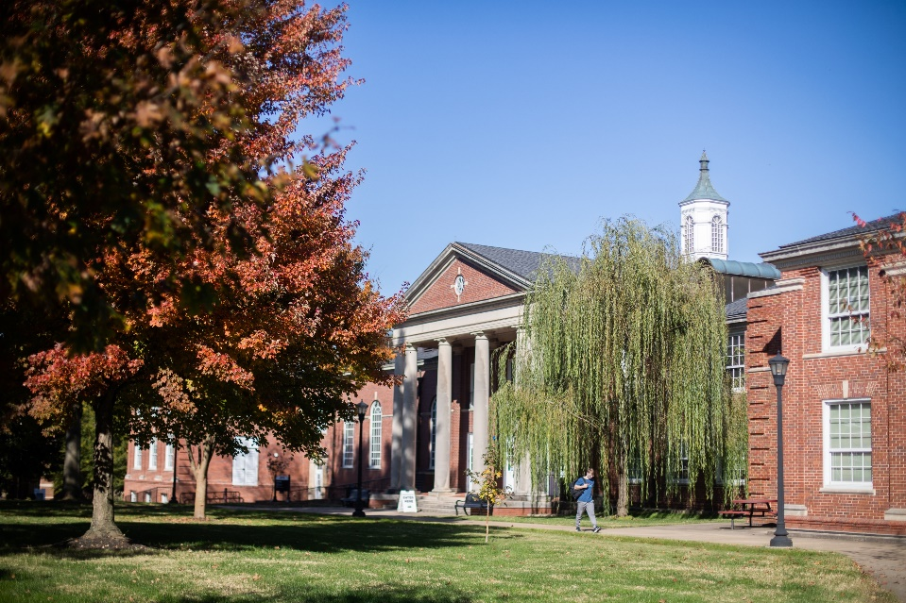
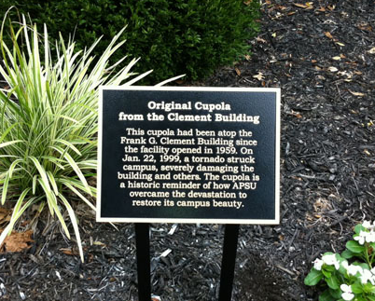
Stop 9: How Did That Cupola Get Here?
Information
Objective
Wrap Up
Stop 9 is at the Cupola located between the University Center and Woodward Library.
After reading the plaque, watch this short video clip to learn more.
1999 Tornado at APSU
In what year did this cupola appear here?
Where did the Cupola come from? Can you find that location?
What is your estimate of how far this is from its original location?
How do you think we might be able to find the exact distance? What information would you need?
This is an odd sight! Doesn’t it look like it belongs somewhere else, like on the top of one of the buildings? And why is the top crooked?
Find the plaque nearby and read about why this is here.
Check Answer
Check Answer
This is the Clement Building topped with a replica of the original Cupola. The tornado caused $17 million in damages at APSU which was the largest property loss in Tennessee up to that time.
Fortunately, everyone on campus survived the F3 tornado with no serious injuries. The Austin Peay spirit was strong and together with the Clarksville community the university was able to reopen after just six days.
Next:
Stop 10 is at the AP Bowl just a few steps away.
Actual Distance
Check Answer
Home Screen
Stops Menu
Map
Notes:
Picture and video clip came from https://www.apsu.edu/news/january-2019-tornado-anniversary.php
Need permission for the picture of the plaque from Sterling Signs (found on their website).
Under Objective, when user chooses “Check Answer” or “Actual Distance”, the app should return the answers which are “1999”, “Top of Clement Building”, “About 394 feet”, “Route, Walking or Driving, Etc…”

Slide 16
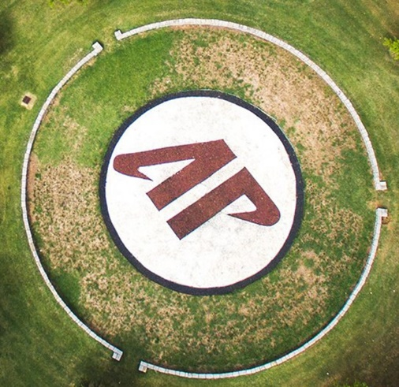



Stop 10: If I Have Told You Once, I Have Told You a Million Times (AP Bowl)
Information
Objective
Wrap Up
Do you think that there is any place on the APSU Math Trail where you may have seen a million of something?
Do you think there might be 1,000,000 stones in the AP Bowl?
What would be a good way to estimate the number of stones in the AP Bowl?
Stop 10 is at the AP Bowl between Harned and Harvill Halls.
(Choose picture from following slide)
Exactly how much is a million?
One million days is more than 2,737 years.
One million seconds is more than 11 ½ days.
If we want to count a million items and we could count one per second it would take us 11 ½ days if we didn’t stop at all, even to eat or sleep!
If I could fit 6,000 zeros on one 8.5 in by 11 in. page, how many whole pages would it take to hold one million (1,000,000) zeroes?
Here’s a local legend about the AP Bowl: If a student steps on the red stones, it is said to be bad luck. If you stand on the red stones, you will not graduate this year. Seniors, beware!
What else do you recognize in this arial photo? Does it remind you of something from Stop 6?
Next:
Stop 11 is in front of the Sundquist Science Center on 8th Street, the Peay Pickup canopy.
10
100
Check Answer
1,000
Home Screen
Stops Menu
Map
Notes:
Under objective, when the user selects the check answer box, the app should return “167 pages”.

Slide 17
Stop 11: The Peay Pickup
Information
Objective
Wrap Up
The Peay Pickup is a bus that provides transportation around the APSU campus on two different routes, north and south. Marion Street is the dividing line between the north and south sides of campus.
According to the APSU website, each bus takes approximately 5 to 6 minutes to complete a route circuit.
Write a method or draw a picture that can show how to find out how many handshakes there would be if there were 20 people in the group.
If you see a bus go by, you can time it to see when it passes by the same location again. Write the number of minutes it took for the bus to complete its circuit. _______
Is your time close to the estimate provided on the website? (5 to 6 minutes)
Using the time that you wrote down, how many times could the Peay pickup make the circuit in one hour? ____________
Next: Stop 11 is the APSU Water Tower. Walk back to the Technology building where you started at Stop 1.
Let’s say that 5 friends decided to meet at the Peay Pickup stop so that they can travel to the other side of campus together. Each time someone arrives for the meetup, that person shakes hands with everyone else at the stop. By the time the bus arrives, all 5 friends have arrived, and each of them has shaken hands once (and only once) with each of their friends. How many handshakes would happen in total?
Now think about this: if there were 10 people in the group, how many handshakes would there be?
Home Screen
Stops Menu
Map

Slide 18
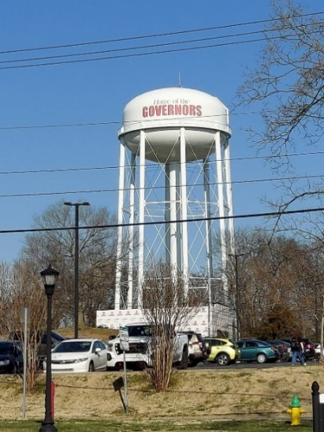
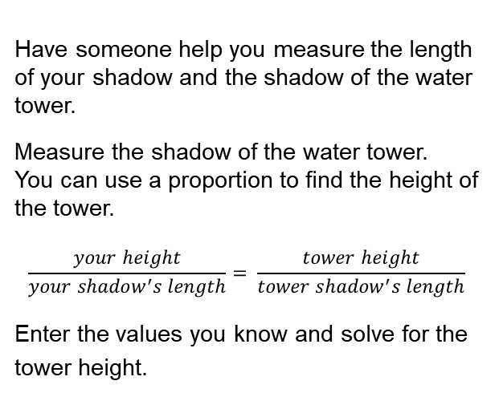
Stop 12: The Water Tower
Information
Objective
Wrap Up
Stop 12 is at the APSU Governors Water Tower. It is located behind the parking lot next to the Technology Building.
Now that you are here, right next to it, can you estimate the height of the water tower?
Another way to estimate the Water Tower height is to take a selfie in front of the tower. Later, you can look at the picture and compare your height to the height of the tower.
You can use the length of shadows. This is a good method to use if it is a sunny day and it is not too close to noontime.
If you have ever traveled to Austin Peay State University along Wilma Rudolph Boulevard to College Street, you may have noticed this water tower off in the distance and thought about how far away it looked and how tall it seemed.
Have someone help you measure the length of your shadow and the shadow of the water tower.
Measure the shadow of the water tower.
You can use a proportion to find the height of the tower.
$$\frac{your height}{your shadow^{′}s length}= \frac{tower height}{tower shadow^{′}s length}$$
Enter the values you know and solve for the tower height.
Home Screen
Stops Menu
Map

Slide 19
Additional Information
STOPS | TN Math Content Standards Addressed |  |  | More information
Stop 1: Ancient Technology on a Very Modern Technology Building |  |  |  | https://roman-numerals.info/.
 |  |  |  | https://en.m.wikipedia.org/wiki/Equation_of_time
Stop 2: Fountain in the Landrum Courtyard | 7.G.A.2 | 7.G.B.3
Stop 3: Binary Numbers on Maynard Mathematics and Computer Science Building
Stop 4: Wildflower Garden | 6.NS.C.8
Stop 5: Water Feature (A) near Library | 6.G.A.1 | 6.G.A.2 | 7.RP.A
Stop 6: Water Feature (B) in Front of Library
Stop 7: Utility Hole (Manhole) Cover | 8.G.B.5
Stop 8: The Peay Pickup | 6.RP.A.1, 2 | 7.RP.A.1
Stop 9: Is This a Euler Path? |  |  |  | https://en.wikipedia.org/wiki/Leonhard_Euler
Stop 10: How Did That Cupola Get Here? | 8.G.B.5
Stop 11: If I Have Told You Once, I Have Told You a Million Times (AP Bowl) | 8.EE.A.3
Stop 12: The Water Tower | 6.EE.B.6 | 7.EE.B.3 | 8.G.B.5

Slide 20
Standards for Mathematical Practice
Make sense of problems and persevere in solving them.
Reason abstractly and quantitatively.
Construct viable arguments and critique the reasoning of others.
Model with mathematics.
Use appropriate tools strategically.
Attend to precision.
Look for and make use of structure.
Look for and express regularity in repeated reasoning.

Slide 21
References
Cahyono, A. M. (2018). Mobile technology in a mathematics trail: how does it works? Unnes Journal of Mathematics Education, 7(1), 24-30.
COMAP: The Consortium of Mathematics and its Applications. (2003). For all practical purposes: Mathematical literacy in today's world. W.H. Freeman and Company.
Equation of time. (2022, April 19). Retrieved June 9 2022, from Wikipedia: https://en.wikipedia.org/wiki/Equation_of_time
Fong, H. K. (2013). A math trail experience: connecting mathematics and history. Learning Science and Mathematics(8), 47-56.
Leonhard Euler. (2022, June 4). Retrieved June 9, 2022, from Wikipedia: https://en.wikipedia.org/wiki/Leonhard_Euler
Math for America. (n.d.). A Math Trail at the Bronx Zoo. New York.
Richardson, K. (2004). Designing math trails for the elementary school. Teaching Children Mathematics, 11(1), 8-14.
Rosenthal, M. M., & Ampadu, C. K. (1999). Making mathematics real: The Boston math trail. Mathematics Teaching in the Middle School, 5(3), 140-147.
Shoaf, M. M., Pollak, H., & Schneider, J. (2004). Math Trails. Lexington, MA: COMAP (The Consortium for Mathematics and Its Applications).
Tennessee Mathematics Standards. https://www.tn.gov › instruction › mathematics-standards
Waugh, A. (2012). Sundials: Their Theory and Construction. United States: Dover Publications.

