Slide 1





Froogal: Reaching v1.0.0
By Chris Adamson, Dylan Commean, & Johnathan Dickson
Notes:
Speaker - Johnny
Attention-Grabber: “Is anyone going anywhere over break?”

Slide 2
Today’s Agenda
Cracking Personal Finance
Underlying Technologies
Froogal’s System Design
Getting Started w/ Froogal
Features, Not Bugs
Froogal’s Future
Live Demo
Notes:
Speaker - Johnny

Slide 3
Froogal:
Cracking personal finance

Slide 4
Froogal: Cracking Personal Finance
The Problem…
Froogal is…
A financial web app designed to provide powerful insights about a user’s spending habits.
Budgeting doesn’t show the psychology of the user
Budgeting lacks visual insights
Notes:
Speaker - Johnny
# Notes
“It’s not about how much money you make, but how much money you keep, how hard it works for you, and how many generations you keep it for.”
## Problem:
Financial literacy is the key to wealth-generation
Budget: powerful tool used
Flawed that it doesn’t reveal personal spending habits, only arbitrary values.
## Solution:
Froogal
Data visualization
Tracking spending & spending categories
Aims to make user aware of their own spending habits so they can make adjustments to better safeguard their wealth

Slide 5
Tech Stack:
Technology that powers Froogal

Slide 6
Frontend: React
React is…
React’s Pillars:
Declarative
Component-based
Unidirectional data flow
A JavaScript library designed to craft beautiful, interactive user interfaces (UI)
Notes:
Speaker - Johnny
# Notes
## Why React?
Needed to alleviate the complexity of developing reactive based UI
Add interactivity to the app, providing a better UX
Rapid development
Easier to maintain & debug

Slide 7
Frontend: Chakra UI
Chakra UI is…
Chakra’s Pillars:
Accessibility compliant
Easy to use and customize
Component-driven
A styling library which provides predefined, and customizable, atomic building-blocks for creating React apps.
Notes:
Speaker - Johnny
# Notes
## Why Chakra?
Needed to reduce the complexity of creating a beautiful UI from scratch
Predefined complex & simple components
Common components:
Dropdowns
Modals
Form controls
Layout like Box, Flex, Grid
Buttons
Icons
Much more

Slide 8
Backend: Firebase Platform
Google platform with many services our application can utilize.
Services Froogal accesses:
Authentication
Firestore
Cloud Storage
Hosting
Notes:
Speaker - Dylan
# Notes

Slide 9
Backend: Authentication
Allows us to streamline login and registration to the site.
Provides encryption and decryption on password passing over the network to Firebase.
Takes away the heavy lifting of generating emails and recovery of passwords.
Notes:
Speaker - Dylan
# Notes

Slide 10
Backend: Firestore
Database for our application
Allows storing of user data and various other functions to store, manipulate, and query information.
Stores data as Documents
No Structured Query Language (No-SQL)
Firestore responses return JavaScript Object Notation (JSON) for easier translation on the Front End.
Notes:
Speaker - Dylan
# Notes

Slide 11
External Package: Bcryptjs
Bcryptjs is…
The Why:
Security of user information is a top priority.
Firebase provides authentication, but information in the documents is in plain text.
An encryption package for JavaScript. Provides salting and hashing for encrypting and comparison functions to decrypt user’s sensitive information.
Notes:
Speaker - Dylan
# Notes

Slide 12
External Package: Recharts
Recharts is…
The Why:
Easy implementation
Exposes a wide variety of graphs and charts
A component-based charting library used render complex data visuals
Notes:
Speaker - Chris
# Notes

Slide 13
System Design:
A Bird’s-Eye View of Froogal
Notes:
Speaker - Chris

Slide 14
Major Component: Receipt HUB
Receipt HUB is…
Purpose
Allows users to create, delete, and find receipts.
Important to have as this is the main point of inputting data through our application.
A central hub for the users to be able to create, delete, and find receipts.
Notes:
Speaker - Dylan
# Notes

Slide 15
Major Component: Watchers
Watchers are…
Purpose
Visual indication of spending habits
Encourage better spending habits
Visual aids for the users to keep tabs on important information on their spending habits
Notes:
Speaker - Dylan
# Notes

Slide 16
Major Component: Lists
Lists are…
Purpose
High level overview of all expenses & receipts
Better monitoring of expenses & receipts
Serve as collections for individual’s receipts and expenses.
Notes:
Speaker - Chris
# Notes

Slide 17
Major Component: Sidebar & Drawers
Sidebar is…
Purpose
Adjust financial settings & user information in the drawers
Enable login & logout for users
Main navigation component of the dashboard. Contains important links to drawers that display user info.
Notes:
Speaker - Dylan
# Notes

Slide 18

Features, Not Bugs:
Known System Anomalies
Notes:
Speaker - Dylan
# Notes
<insert some note>

Slide 19
Bugs: Visual
Rendering issues that can be seen on our Front End.
Visual bugs include:
Strings that trail off screen
Containers trailing off screen
Chart visualizations anomalies
User Input can exacerbate these issues.
Notes:
Speaker - Chris
# Notes:
<insert Notes>

Slide 20
Bugs: Internal
Issues that happen due to validation errors or that are products of packages
Internal bugs include:
Catches in place bad data but not every aspect covered.
NaN in data visualizations
Creating a receipt with no items.
Notes:
Speaker - Dylan
# Notes

Slide 21
Future Work:
Considering v2.0.0
Notes:
Speaker - Johnny
# Notes

Slide 22
Next Steps: Improving UX & UI
UI…
UX…
Accessibility
Tab navigation
Keyboard shortcuts
Save on Enter
Refined design system
Responsiveness for mobile + tablet
Subtle animations
Notes:
Speaker - Johnny
# Notes

Slide 23
Next Steps: Collecting User Feedback
Methods
Beta testing
Github repo section
Requested features
Data validation
Regex
Notes:
Speaker - Johnny
# Notes

Slide 24

Thanks!
Any questions?
Contact the team at:
IG: @froogalapp
Email: froogalsupport@froogal.io
Notes:
Speaker - Johnny

Slide 25

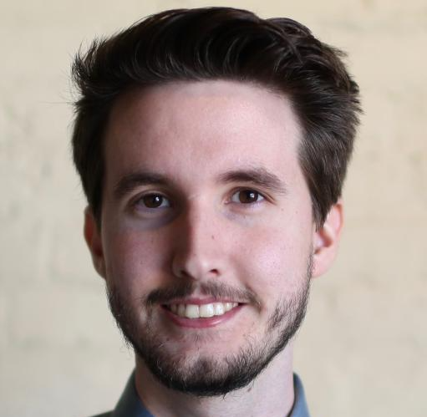

The Froogal Team.
Chris Adamson
Dylan Commean
Jonathan Dickson
Product Designer & Developer
Product Designer & Developer
Product Designer & Developer
Notes:
Speaker - Johnny

