Slide 1





Froogal: App Architecture
By Chris Adamson, Dylan Commean, & Johnathan Dickson
Notes:
Johnny

Slide 2
Today’s Agenda
Bird’s-eye View
System in Depth
Capturing Data
UI Mockups
Sample User Stories
Notes:
Johnny

Slide 3



Bird’s-eye View:
Froogal in blocks
Notes:
Johnny

Slide 4
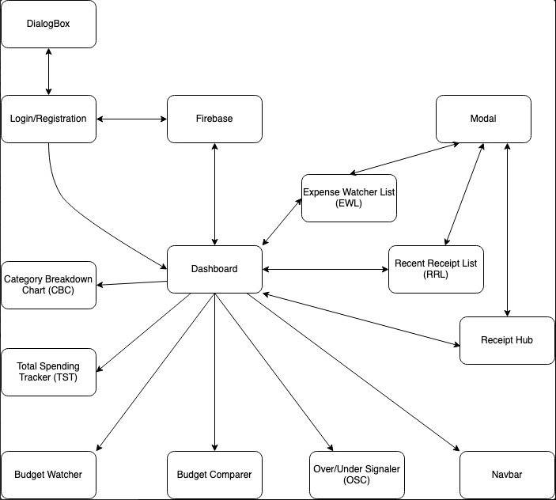
Bird’s-eye: Block Diagram
Notes:
Johnny

Slide 5
System in Depth:
Froogal in components
Notes:
Johnny

Slide 6
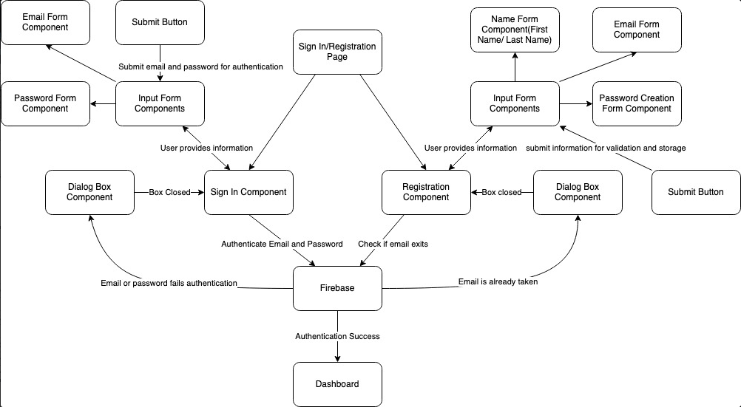
Component: Login & Registration
Notes:
Johnny

Slide 7
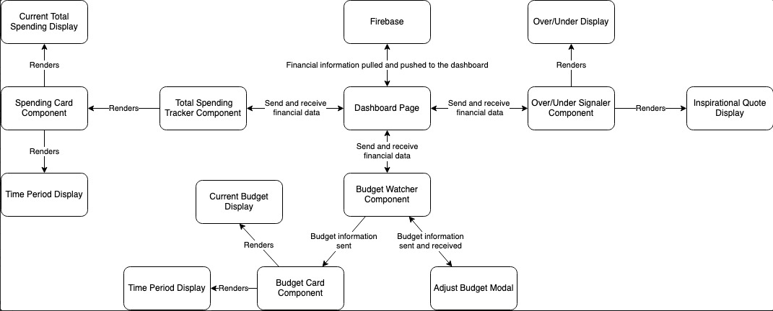
Component: Dashboard
Notes:
Dylan

Slide 8
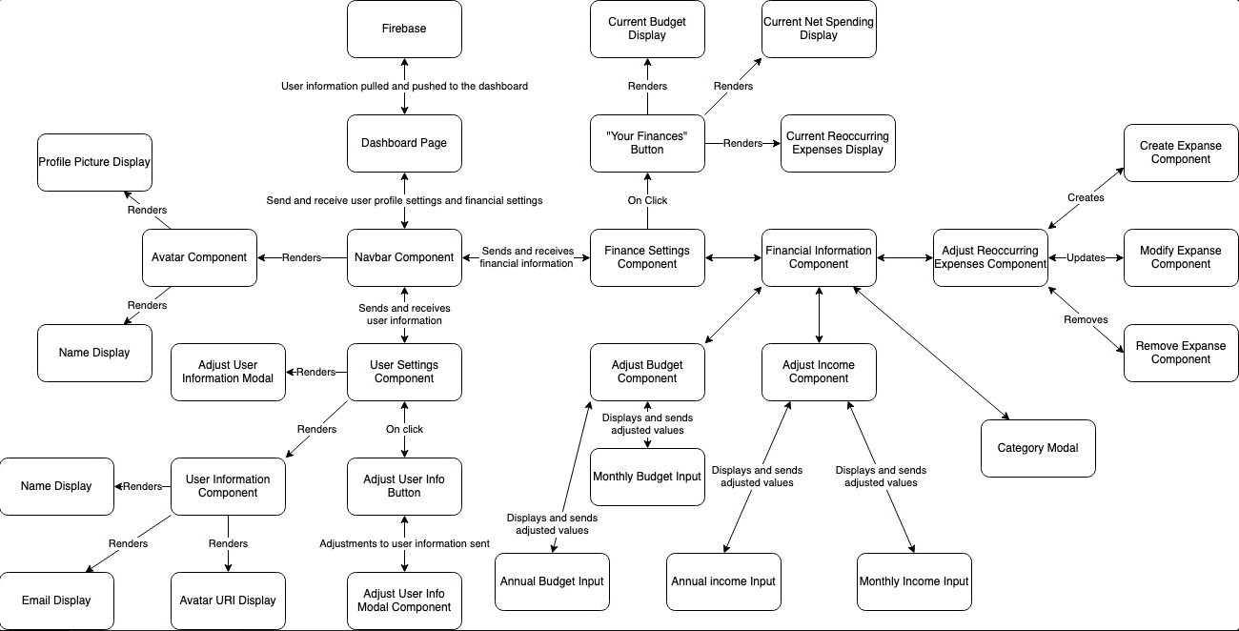
Component: Navbar
Notes:
Dylan

Slide 9


Capturing Data:
Data needed to drive Froogal
Notes:
Dylan

Slide 10
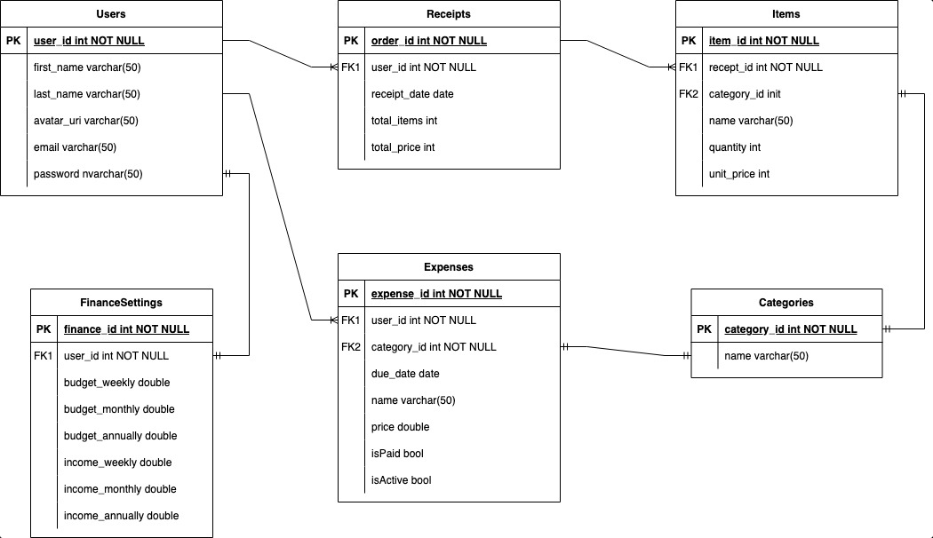
Capturing Data: Froogal’s Data Model
Notes:
Dylan

Slide 11
UI Mockups:
Visualizing Froogal
Notes:
Johnny

Slide 12
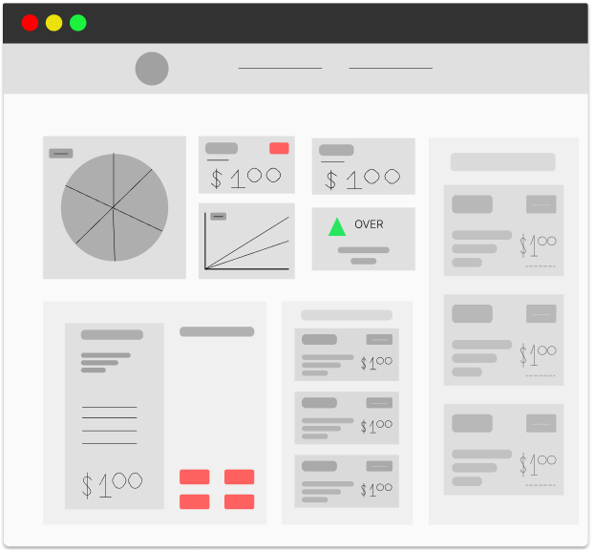
Visualizing: Froogal’s Dashboard
Notes:
Johnny

Slide 13
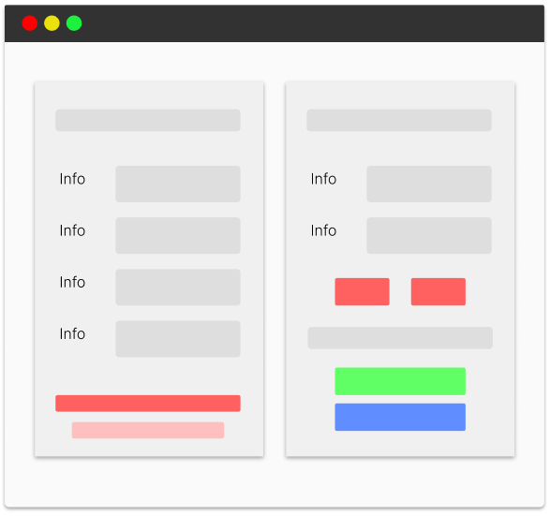
Visualizing: Froogal’s Login
Notes:
Johnny

Slide 14
User Stories:
Bringing Froogal to life
Notes:
Chris

Slide 15
Story: Failed Login
Components Used:
Steps:
Login Form
Cloud Firestore
Dialog Box Component
User enters user and password, then clicks “submit” button
Data sent to firebase for authentication
On failed attempt, presented with dialog box showing “account doesn’t exist”
User is not logged in & must try again
Notes:
Chris

Slide 16
Story: User Already Exists
Components Used:
Steps:
Registration Form
Cloud Firestore
Dialog Box Component
User fills out the registration form (name, email, & password)
User clicks “submit” button; data sent to firestore for authentication.
If email already taken, display dialog box to notify user
User is not routed to dashboard & sent back to login page
Notes:
Chris

Slide 17
Story: Utilizing the Receipt Hub
Components Used:
Steps:
Receipt Hub
Receipt Creation Modal
Total spending component
User navigates to Receipt Hub
On hub, user clicks “Add Receipt” button; receipt creation modal appears
User fills out the receipt (able to add items in modal)
Upon completion, receipt object is added to a user’s receipt collection.
Total spending component is updated
Notes:
Chris

Slide 18
Story: Closer Look at Receipts
Components Used:
Steps:
Receipt Card
Recent Receipts List
Receipt View Modal
User is curious about receipt details
User goes to recent receipt list & clicks on receipt card
Card renders a receipt view modal
Modal includes detailed information about: total price, items in receipt (quantity + total price), total price of whole receipt, and transaction date
Notes:
Chris

Slide 19
Story: Motivation, Motivation
Components Used:
Steps:
Over Under Signaler
User logins to dashboard
User looks at the total spending tracker & budget watcher
User then sees they are under their monthly budget
User is presented w/ motivation quote
User is inspired to have a better grip on their finances
Notes:
Chris

Slide 20

Thanks!
Any questions?
Contact the team at:
IG: @froogalapp
Email: froogal_support@froogal.io
Notes:
All

Slide 21
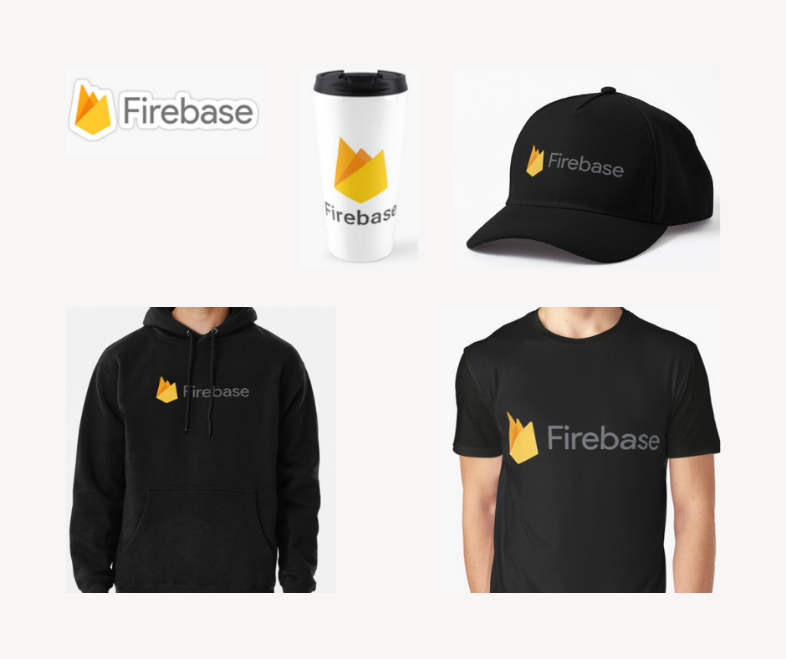
Bonus: Froogal Investor Starter Pack
Notes:
Johnny

Slide 22
I love Firebase. ~ Dr. Nicholson
Notes:
Johnny

Slide 23



The Froogal Team.
Chris Adamson
Dylan Commean
Jonathan Dickson
Product Designer & Developer
Product Designer & Developer
Product Designer & Developer
Notes:
All

