Slide 1
Solar Panel Marketing
MAR 653 FINAL PROJECT -- TEAM S
Jessica Kwon, Editt Gonen-Friedman, Matthew Kruse, Justin Pate

Slide 2
Executive Summary
With the growing attention to global warming, the widespread transition to renewable energy, and increased entry of electric cars, you might think that solar panel installation is a no-brainer. It seems the right time to grow our solar energy business. As it turns out, the solar panels market is very complex, and the business is tough to crack. Solar panels are expensive and not economical in every location and are just not easy to sell. What do we do?

Slide 3
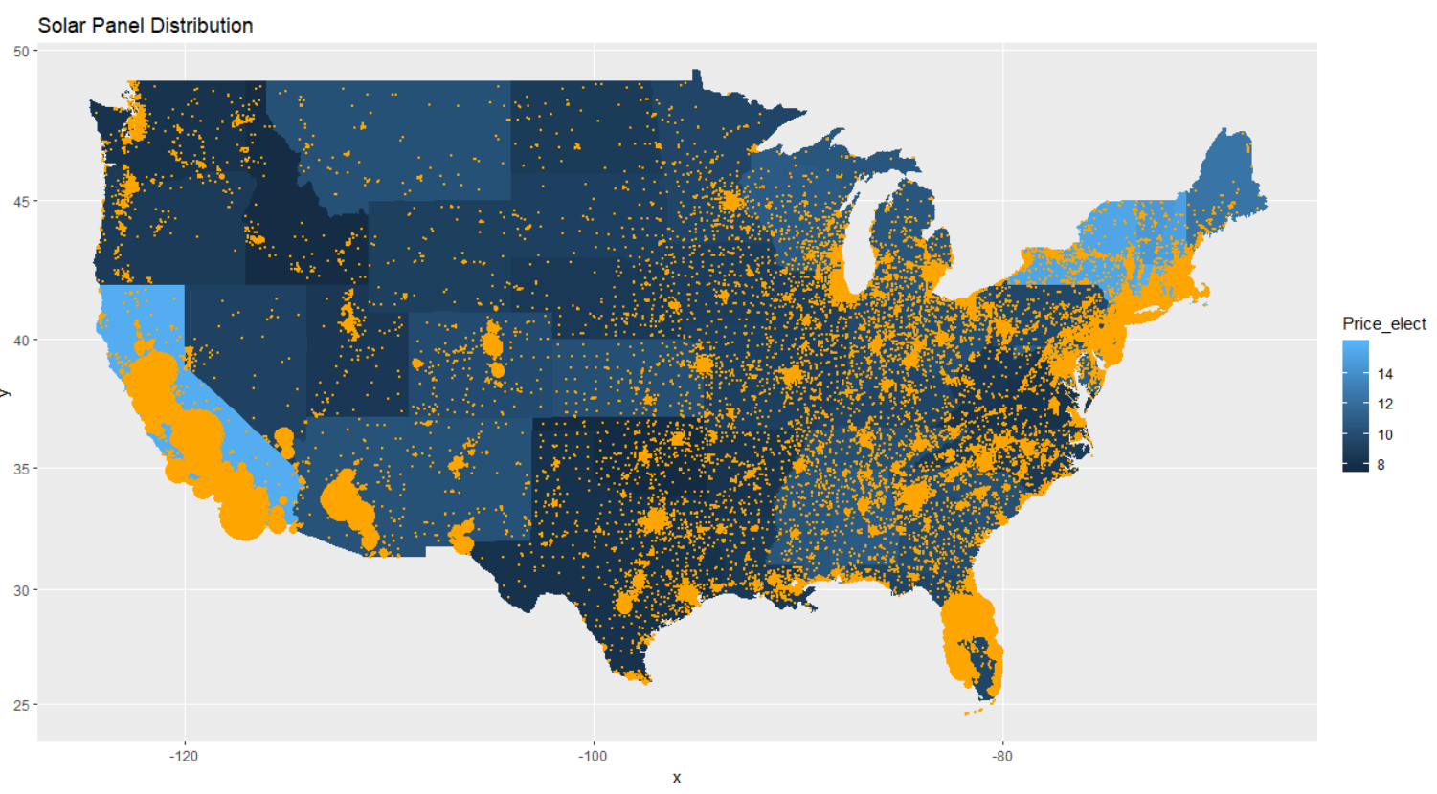
Research Objective
Optimize strategic marketing for energy conservation through U.S. solar panel sales
The goal of this analysis is to identify regions and populous that would have high propensity to invest in solar energy.
The figure to the left represents the current solar panel distribution in the United States.
As is evident, some states with higher energy costs show a larger solar panel distribution and some do not. So what affects adoption? This is a complex problem to solve.

Slide 4
Research Plan
To meet our objective of identifying target areas and customers we need to answer the following questions:
What drives the sales of solar panels?
What are the significant variables?
Who are current consumers?
Who are our target customers?
Answering the fourth question takes analysis of everything we do for the first three.

Slide 5
Research Process
We aim to find potential customers with high propensity for solar panel installation.
Steps to identify them:
Identify variables with significant correlation to having solar panels
Narrow down to attributes of existing solar panel consumers
Run clustering analysis, find the segment with highest propensity
Run prediction against this cluster
Arrive at a dataset containing customer concentration where
Solar panels probability is high but currently the customer base is smaller than average (false positives in our prediction model)
Solar panels probability is high in an existing market (true positives in our prediction model)
Craft our recommendation based on research results

Slide 6
Research Data
Our dataset is found on Kaggle: https://www.kaggle.com/tunguz/deep-solar-dataset
Deep Solar is an AI that Stanford scientists built that can identify and count Solar Panels in images taken from space. This data is joined with energy statistics, NASA data, election data, demographics and community surveys to create a massive informative dataset.
The resultant dataset contains the solar panel data analyzed by GPS imagery, combined with demographics data based on county/state (23 states were included in the data).
The dataset has 72k observations and 169 columns for which the metadata can be found here: https://github.com/sammykol83/UdacityDataScienceNanoDegree/blob/master/Project%20-%20Write%20A%20Data-Science%20Blog/features.txt

Slide 7
Data Findings
Exploratory Data Analysis
&
Predictive Data Modeling

Slide 8
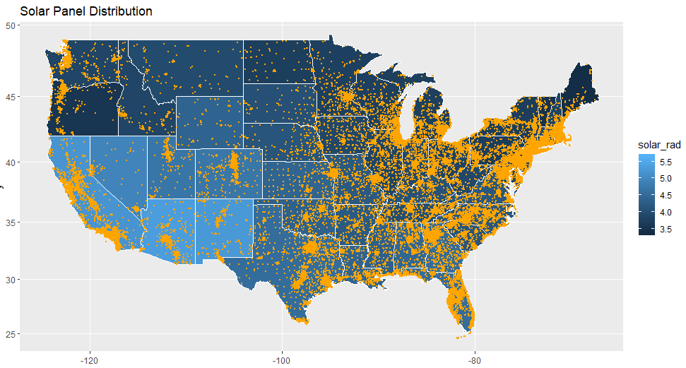
Initial Data Insights
We’ve seen solar installation data over electricity pricing.
Here we see solar panel distribution over areas measured by solar radiation. It’s a logical sell in areas with high sun exposure. Yet the map doesn’t show concentration of solar panels exactly where expected.
The dynamics at play are not clear. An analysis is needed to point out areas where conditions are optimal.

Slide 9
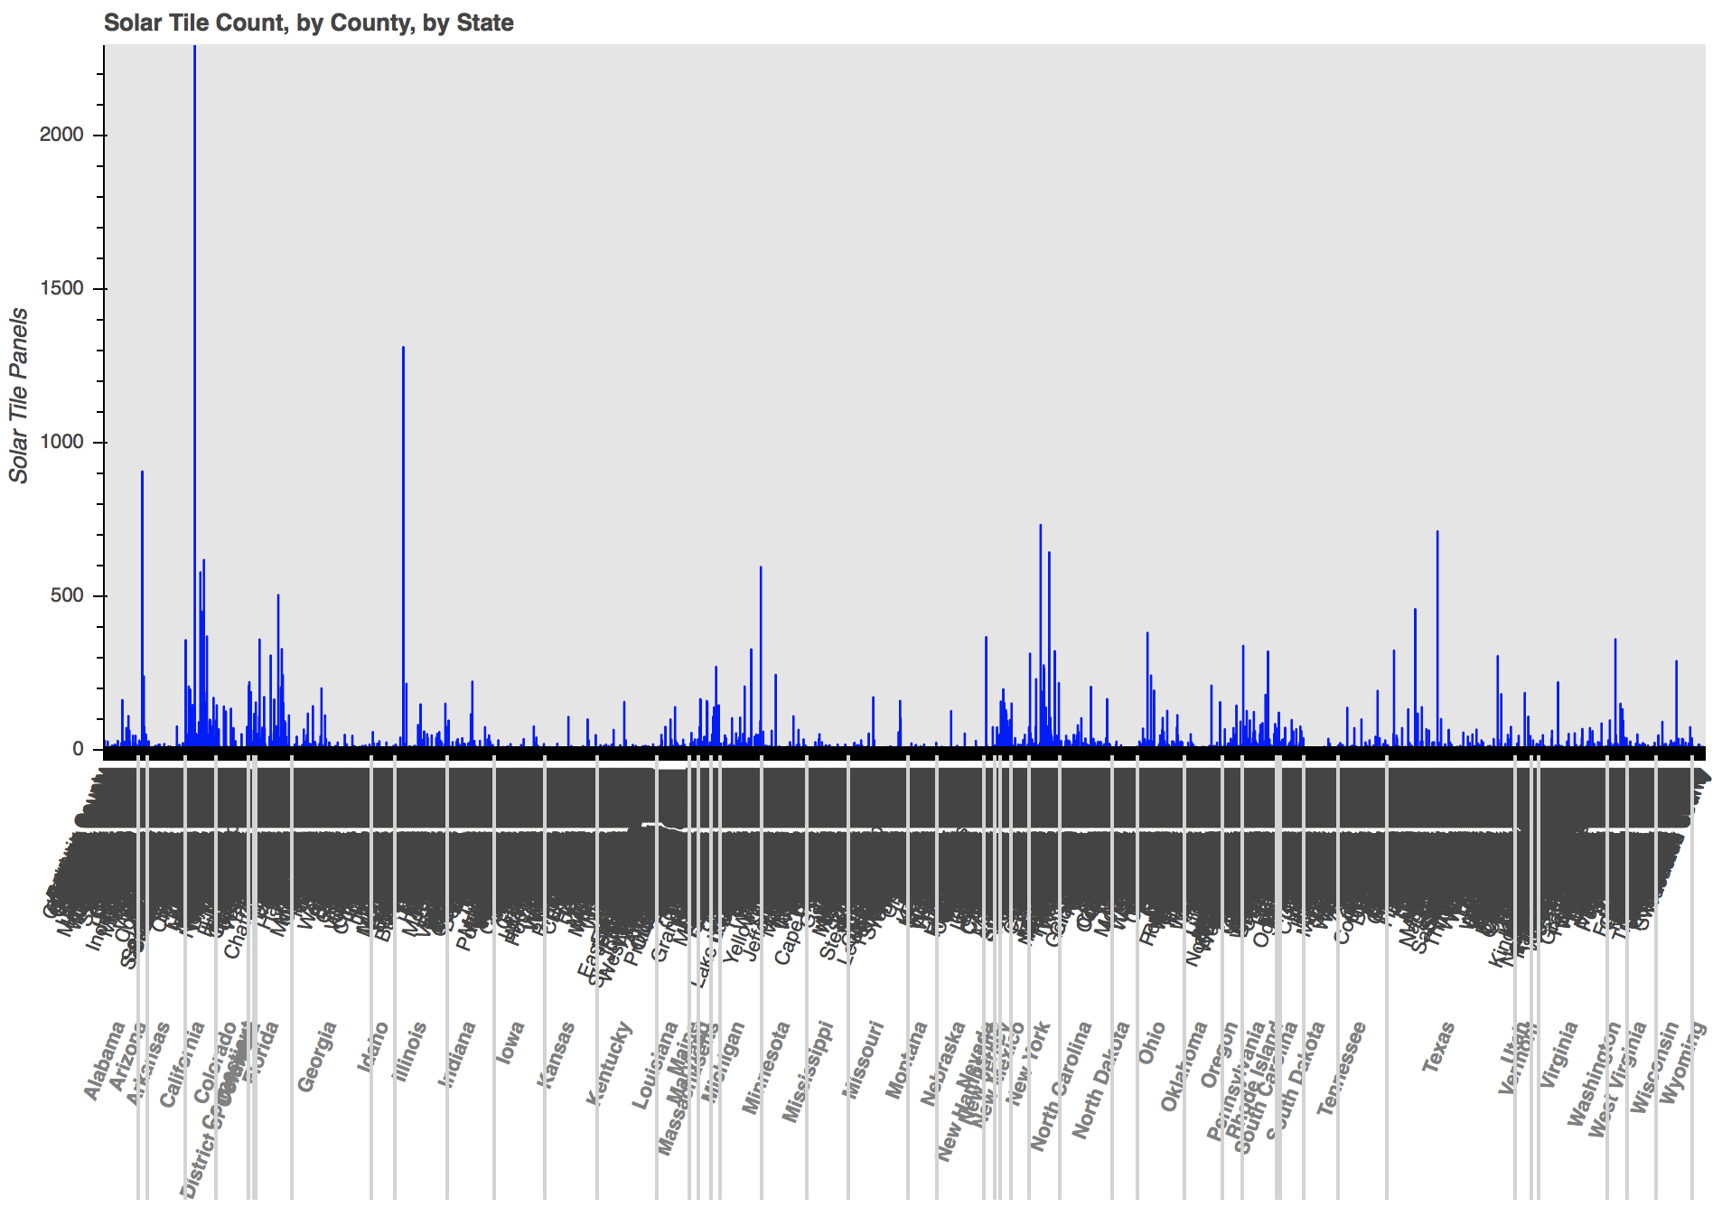
What Drives Sales?
We expected location to be a main driver. We found there is correlation with longitude: more installations as you go south, but it’s not a clear cut, it’s not a top driver.
Notes:
How does location affect sales of solar panels? The lower longitude, the closer to the equator, the larger install base of solar panels.
Some correlation with frost days explains why we see in the map solar install in the north: has to do with high reflection on snow.

Slide 10
What Drives Sales?
High Electricity Consumption
People who prefer alternate means of transportation
Sales
Large populations with an education
Areas with an equal economic standing
High Income Areas
Higher Overall Earth Temperature
High Population older than 45

Slide 11
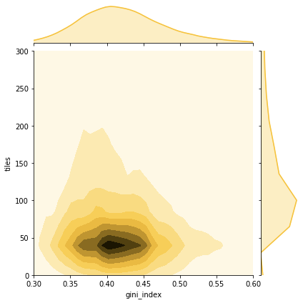
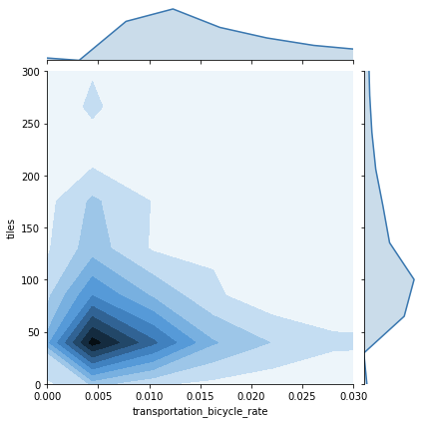
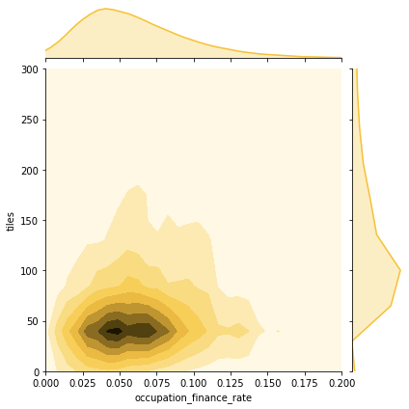
What are the Significant Variables?
Top variables that have the largest correlation and coefficient

Slide 12
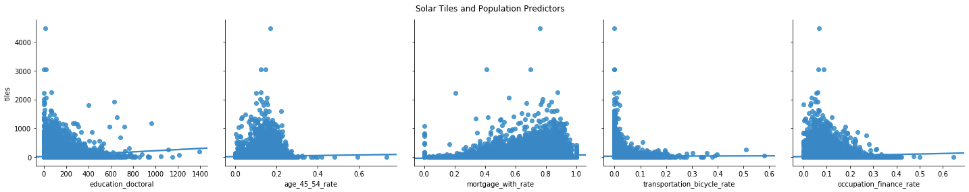
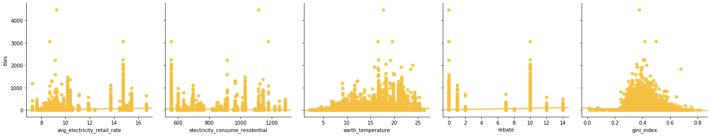
What are the Significant Variables?
Top variables that have the largest correlation and coefficient

Slide 13
Clustering -> Segmentation
Using unsupervised learning, we were able to group the population into 4 segments. Of the 4 segments, consumers in one cluster ware almost split 50/50 on owning solar panels vs not. This cluster was used for psychographics and demographics in determining customers we could potentially acquire.
Another cluster had a population with 92% solar panel customers. This cluster was used for determining what our current customer segmentation looks like.

Slide 14
Who are the current consumers?
High average household income
Many consumers who installed solar panel tend to have high household income
Education
Almost double the amount of bachelor’s degrees when compared to other segments.
High gini index
Current consumers tend to live in areas where wealth is equally distributed
Eco Friendly
These consumers are more likely to take public transportation and are into cycling
Have mortgage
Current consumers tends to have their mortgage, which means they own their property
Warm Weather
Current consumer lives where the temperature is generally high and hardly falls below 18 degrees celsius
Age of 45-54
Major current consumer’s age is between 45-54
Expensive electricity price
Existing consumers live in the area where electricity price is high
High Rate of Employment
Our customers are high in total employment.
Love Rebates
Current consumers live in areas with a seasoned rebate program (6 years compared to 1 for the other clusters)
High sales tax area
Current consumer lives in the area where sales tax is high
Democrats
Our customers that featured a very high probability of owning solar panels had a higher than average democrat percentage
Notes:
General Description:
High average household income; highly educated, prevailing doctorates; counties with wealth, and even distribution of money based on gini-index, with an indication of large middle class; low population density; home ownership with age over 45.
Average_household_income : high
Education_doctoral
gini_index (even distribution of wealth): high
Population_density: less
Electricity_price_residential (*)
Electricity_price_transportation
electricity_price_overall
electricity_consume_residential
electricity_consume_commercial
Electricity_consume_industrial
lon: longitude
Earth_temperature: high
Heating_degree_days: negative
Age_45_54_rate (*)
Occupancy_vacant_rate: less vacant, more likely to install
Mortgage_with_rate: positive with owners
corperate_tax
Sales_tax: high
Rebate: higher rebate
avg_electricity_retail_rate

Slide 15
Conclusions: Who do we market to?
Areas open to incentives
The current customers receive tons of incentives for purchasing solar panels. We need to market to counties/states that are open minded about adding solar incentives.
Lower Income
Our segmentation that is split on solar panels has a lower than average income. Would be beneficial to understand the savings associated with Solar Panels.
People with more land
Our potential customer segment owns more land than the average segments.
Industrial Heavy
The segment was dominated by electricity consumed by industrial residences.
Gimme Fuel!
Customers with fuel (gas/oil) based heating are in our potential segment. Can these people be persuaded to switch to electric?
Driving Alone
This segment features a population that prefers to drive alone as opposed to taking public transport or carpooling
Frost Days
People with higher frost days may not realize the benefits of solar panels in an area with a colder climate. Snow actually helps the absorption of solar energy.
Low Sales Tax
People in this segment live in areas where sales tax is incredibly low

Slide 16
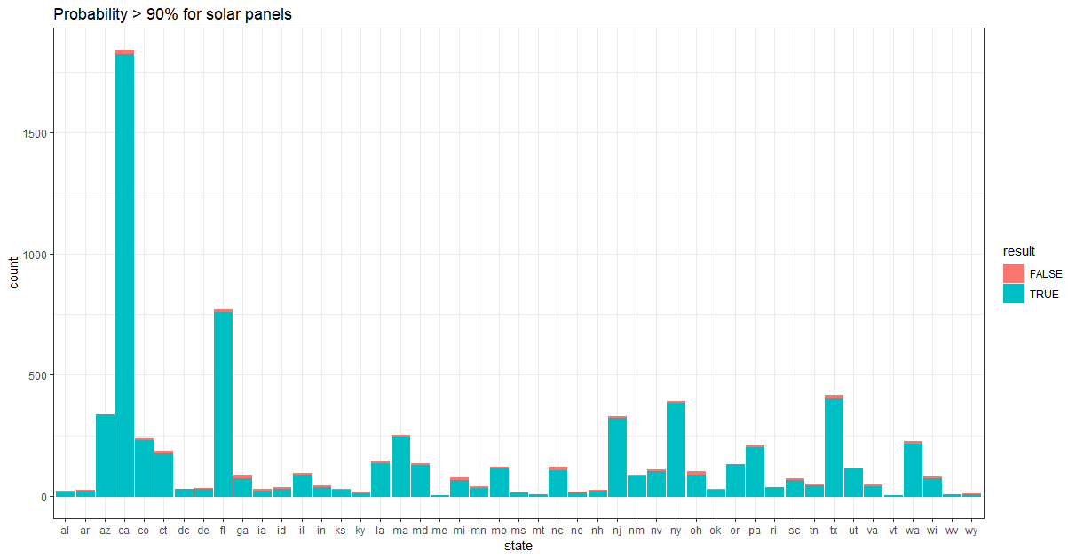
Recommendations
Our deliverable to the solar panel company is a comprehensive data set of regions where the probability of solar panel purchase is most likely, based on customer segmentation.
Target our chosen segment: customers who are older, and choose environmentally friendly options for transportation
Cater towards areas with large industries that would generate more solar power from ‘frost days’
Work with local authorities on residential rebates

Slide 17
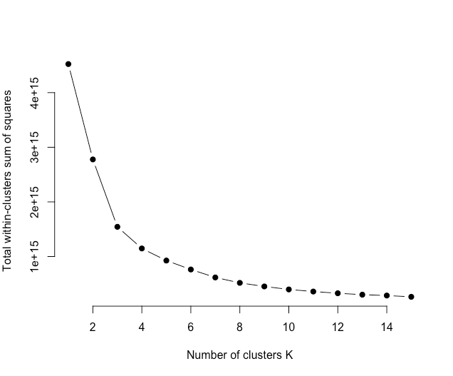
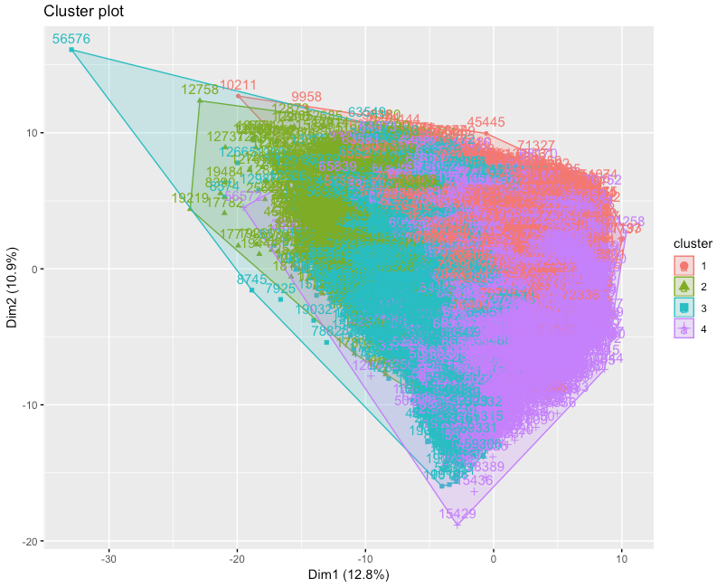

Appendix
Elbow Plot
Cluster Plot
Cluster Breakout

Slide 18
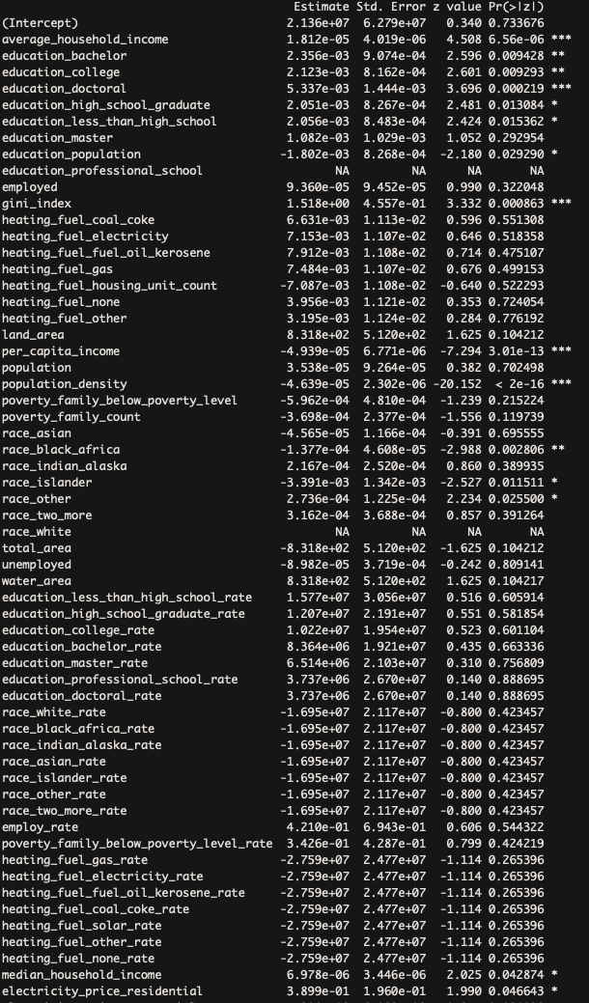
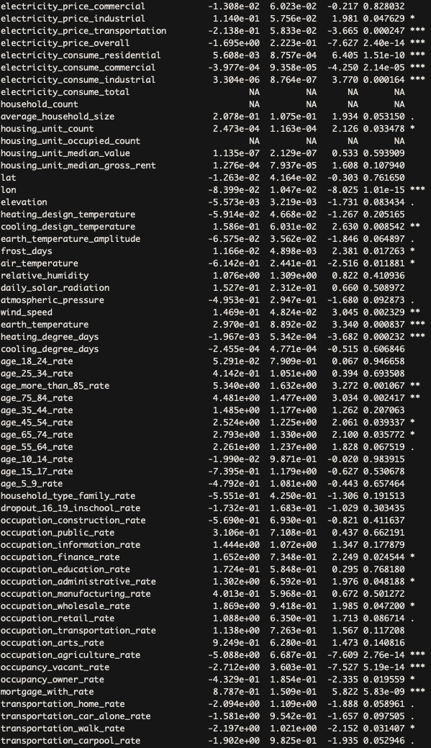
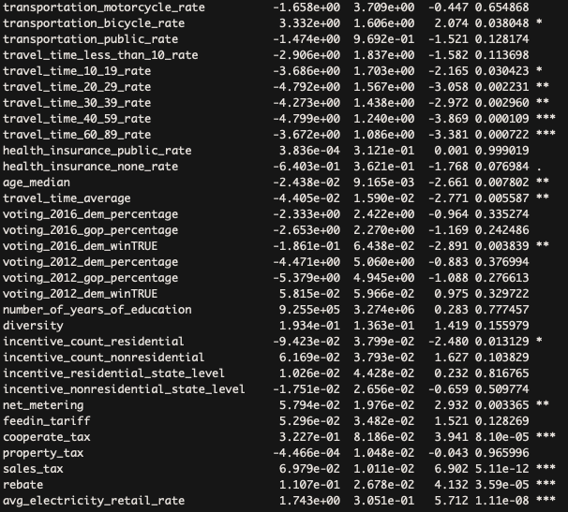
Regression Summary

Slide 19
Thanks!
Any questions ?

